Slide 1
Bacterial Blight of Rice

Slide 2
History and Importance:
1870s Epidemic in Africa
1884 in Japan
1977 in Pakistan
Severe attack results in 50% yield reduction

Slide 3
Etiology
Xanthomonas oryzae pv oryzae

Slide 4
Symptoms
Water soaked yellowish stripes on leaf blades with wavy margin.
Bacterial ooze like a milky drop on young lesions early in the morning.
Yellow lesion turn to white as the disease advances.
Panicles unfilled.

Slide 5
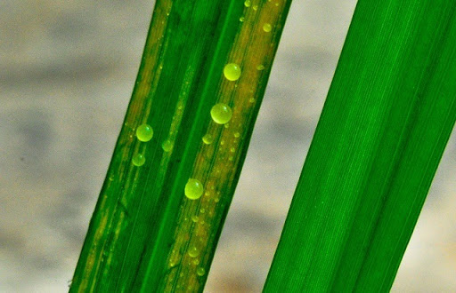
Symptoms
Yellow stripes with ooze coming out

Slide 6
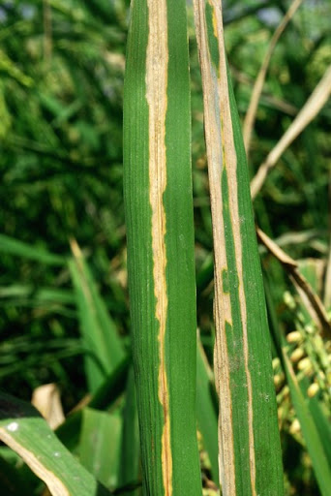
Symptoms
Turning of yellow stripes into white

Slide 7
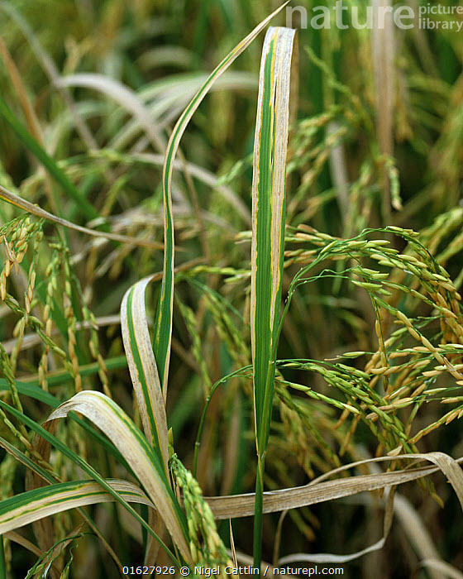
Symptoms
Field view

Slide 8
Disease cycle
Primary source: Weeds, stubbles and ratoons (cutting most of the above-ground portion but leaving the roots and the growing shoot apices intact so as to allow the plants to recover and produce a fresh crop in the next season.) of infected plants.
Secondary source: Water, rain
Enter through hydathodes and wounds.

Slide 9
Epidemiology
Temperature 25-30°C

Slide 10
Management:
Seed treatment with bleaching powder @ 100ug/L
Zinc sulphate 2%.

