Slide 1
Web Systems & Technologies
Chapter 7 - File Handling

Slide 2
File Handling
Quick and direct access to files
File names are system dependent (stick to case-sensitive and lower-case file names)
Checking Whether a File Exists
file_exists function returns TRUE if file already exists and FALSE otherwise.
if (file_exists("testfile.txt")) echo "File exists";

Slide 3
File Handling Sequence
Always start by opening the file through a call to fopen.
fopen() function is used to create or open a file in a selected mode.
Usually takes two parameters, first is the name of the file and second specifies the mode in which file should be opened.
A variable is set to the value returned (file handle) by fopen function.
Then call other functions; e.g. write to the file (fwrite) or read from an existing file (fread or fgets).
Finish by closing the file (fclose).
The fclose() function closes an open file pointed by a file handle.

Slide 4
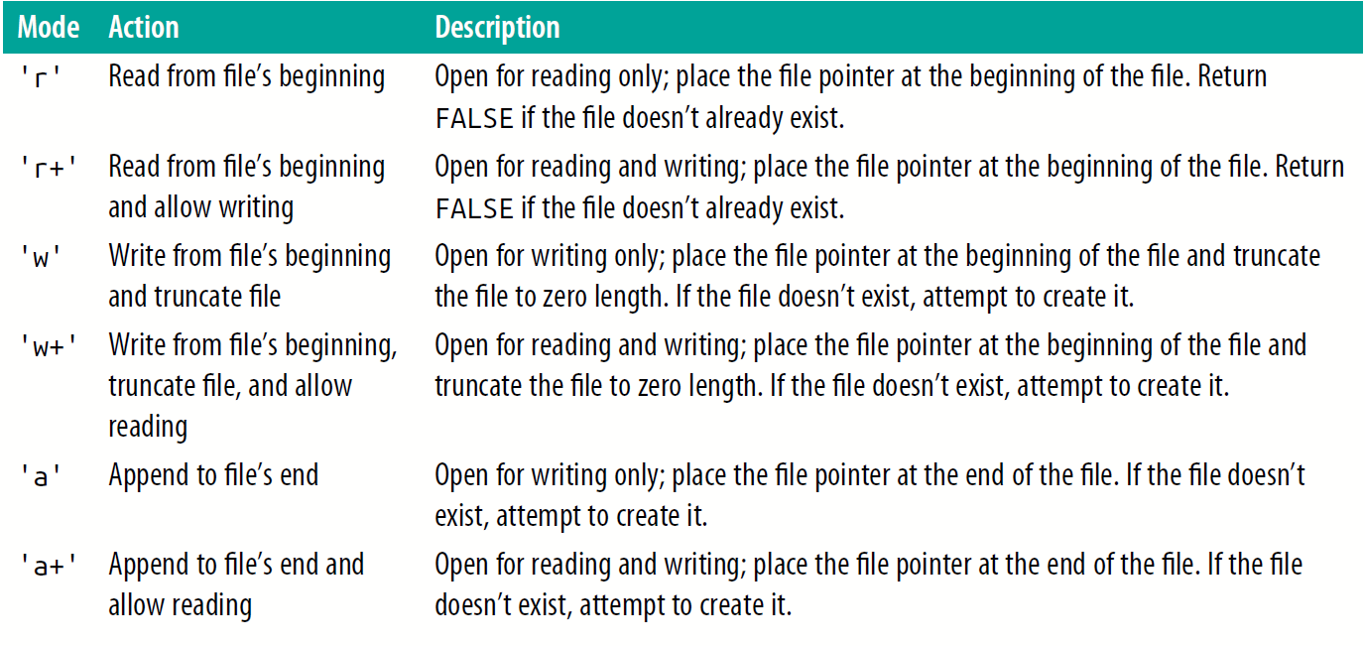
The supported fopen modes

Slide 5
Creating a File
Example 7-4. Creating a simple text file
<?php // testfile.php
$fh = fopen("testfile.txt", 'w') or die("Failed to create file");
$text = “
Line 1
Line 2
Line 3”;
fwrite($fh, $text) or die("Could not write to file");
fclose($fh);
echo "File 'testfile.txt' written successfully";
?>

Slide 6
Reading from Files
fgets() function is used to return a line from a file pointer and it stops returning at a specified length (optional length parameter), on end of file(EOF) or on a new line, whichever comes first.
It returns False on failure.
Example 7-5. Reading a file with fgets
<?php
$fh = fopen("testfile.txt", 'r') or die("File does not exist");
$line = fgets($fh);
fclose($fh);
echo $line;
?> // Output: Line 1

Slide 7
Reading from Files
Example 7-6. Reading a file with fread
<?php
$fh = fopen("testfile.txt", 'r') or
die("File does not exist"); // print a message & terminate script
$text = fread($fh, 3); // read first three characters
fclose($fh);
echo $text;
?> // Output: Lin
The fread function is commonly used with binary data. If you use it on text data that spans more than one line, remember to count newline characters.

Slide 8
Copying Files
copy() function is used to make a copy of a specified file name to the destination file name (or directory)
If the destination file already exists, it gets overwritten.
copy() function returns true on success and false on failure.
Example 7-7. Copying a file
<?php // copyfile2.php
if (!copy('testfile.txt', 'testfile2.txt')) echo "Could not copy file";
else echo "File successfully copied to 'testfile2.txt'";
?>

Slide 9
Moving a File
To move a file, rename file name or directory path with the rename function.
Example 7-9. Moving a file
<?php // movefile.php
if (!rename('testfile2.txt', 'testfolder/testfile2.txt'))
echo “File could not be moved";
else echo "File successfully moved to into 'testfolder'";
?>

Slide 10
Deleting a File
Use the unlink function to remove a file specified by a given file name.
Example 7-10. Deleting a file
<?php // deletefile.php
if (!unlink('testfile.txt')) echo "Could not delete file";
else echo "File 'testfile.txt' successfully deleted";
?>

Slide 11
Updating Files
Example 7-11. Updating a file
<?php // update.php
$fh = fopen("testfile.txt", 'r+') or die("Failed to open file");
$text = fgets($fh);
fseek($fh, 0, SEEK_END);
fwrite($fh, "$text") or die("Could not write to file");
fclose($fh);
echo "File 'testfile.txt' successfully updated";
?>

Slide 12
Updating Files
fgets function to read in a single line from the file.
fseek function moves the file pointer right to the file end.
The file pointer is the position within a file at which the next file access will take place.
SEEK_END tells the function to move the file pointer to the end of the file, and 0 tells it how many positions it should then be moved from that point.
Text that was extracted from the start of the file (stored in $text) is then appended to the file’s end.
Updated file now looks like this:
Line 1
Line 2
Line 3
Line 1

Slide 13
Locking Files for Multiple Accesses
Simultaneous access to a file can corrupt it.
Use the file-locking flock function to block to access a file until your program releases the lock.
Lock a file before writing and unlock immediately afterwards to increase responsiveness.
Example 7-12. Updating a file with file locking
<?php
$fh = fopen("testfile.txt", 'r+') or die("Failed to open file");
$text = fgets($fh);
if (flock($fh, LOCK_EX)) {
fseek($fh, 0, SEEK_END);
fwrite($fh, "$text") or die("Could not write to file");
flock($fh, LOCK_UN); }
fclose($fh); echo "File 'testfile.txt' successfully updated";
?>

Slide 14
Reading an Entire File
Use file_get_contents function to read an entire file without file handles.
Can also use it to fetch a file from a server across the internet.
Example 7-13. Using file_get_contents
<?php echo "<pre>"; // Enables display of line feeds
echo file_get_contents("testfile.txt");
echo "</pre>"; ?>
Example 7-14. Grabbing the O’Reilly home page
<?php
echo file_get_contents("http://oreilly.com");
?>

Slide 15
Uploading Files
To upload a file from a form, choose a special type of encoding called multipart/form-data.
All uploaded files are placed into the associative system array $_FILES.
To determine whether the user has uploaded a file, check if $_FILES array contains anything.
if ($_FILES)
Once a file is uploaded, use move_uploaded_file() function to moves the file from temporary location to a permanent location.

Slide 16
Example 7-15. Image uploader upload.php
<?php // upload.php
echo “<html><head><title>PHP Form pload</title></head><body>
<form method='post' action='upload.php' enctype='multipart/form-data'>
Select File: <input type='file' name='filename' size='10'>
<input type='submit' value='Upload'>
</form>”;
if ($_FILES) {
$name = $_FILES['filename']['name'];
move_uploaded_file($_FILES['filename']['tmp_name'], $name);
echo "Uploaded image '$name'<br><img src='$name’>”; }
echo "</body></html>"; ?>

Slide 17
Using $_FILES - The contents of the $_FILES array
Array element | Contents
$_FILES['file']['name'] | The name of the uploaded file (e.g., smiley.jpg)
$_FILES['file']['type'] | The content type of the file (e.g., image/jpeg)
$_FILES['file']['size'] | The file’s size in bytes
$_FILES['file']['tmp_name'] | The name of the temporary file stored on the server
$_FILES['file']['error'] | The error code resulting from the file upload

Slide 18
Table 7-7. Some common internet media content types
application/pdf
image/gif
multipart/form-data
text/xml
application/zip
image/jpeg
text/css
video/mpeg
audio/mpeg
image/png
text/html
video/mp4
audio/x-wav
image/tiff
text/plain
video/quicktime

Slide 19
Validation
Check are whether a file was actually received ?
Was the right type of data was sent?
as the right size of file was sent?
Does program have the control over the file name?
It is strongly advised to have prechosen names and locations for uploaded files.

Slide 20
Example 7-16. A more secure version of upload.php
<?php // upload2.php
echo “<html><head><title>PHP Form Upload
</title></head><body>
<form method='post' action='upload2.php’ enctype='multipart/form-data’>
Select a JPG, GIF, PNG or TIF File:
<input type='file' name='filename' size='10’>
<input type='submit' value='Upload'></form>”;

Slide 21
Example 7-16. A more secure version of upload.php
if ($_FILES)
{
$name = $_FILES['filename']['name’];
switch($_FILES['filename']['type’])
{
case 'image/jpeg': $ext = 'jpg'; break;
case 'image/gif': $ext = 'gif'; break;
case 'image/png': $ext = 'png'; break;
case 'image/tiff': $ext = 'tif'; break;
default: $ext = NULL; break;
}

Slide 22
Example 7-16. A more secure version of upload.php
if ($ext)
{
$n = "image.$ext";
move_uploaded_file($_FILES['filename']['tmp_name'], $n);
echo "Uploaded image '$name' as '$n':<br>";
echo "<img src='$n'>";
}
else echo "'$name' is not an accepted image file";
}
else echo "No image has been uploaded";
echo "</body></html>";
?>

