Slide 1
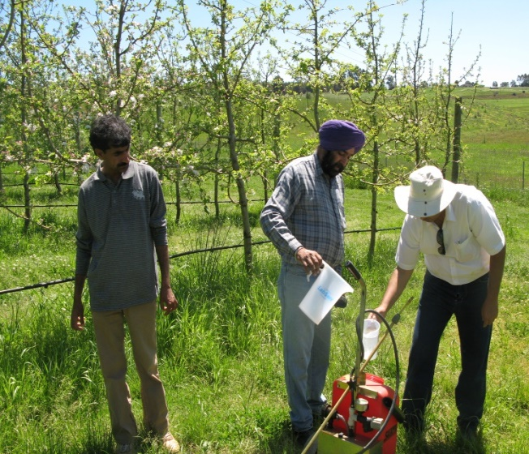
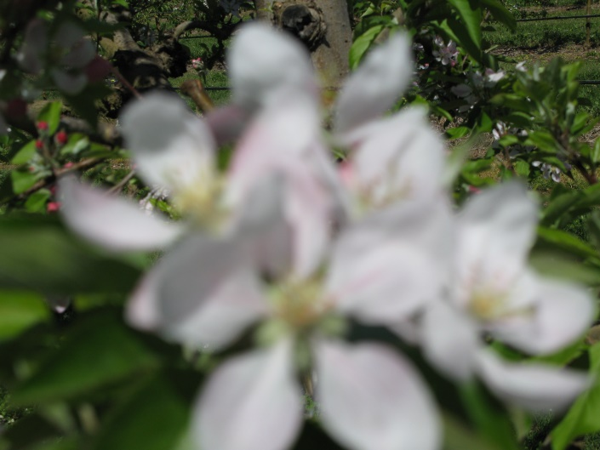
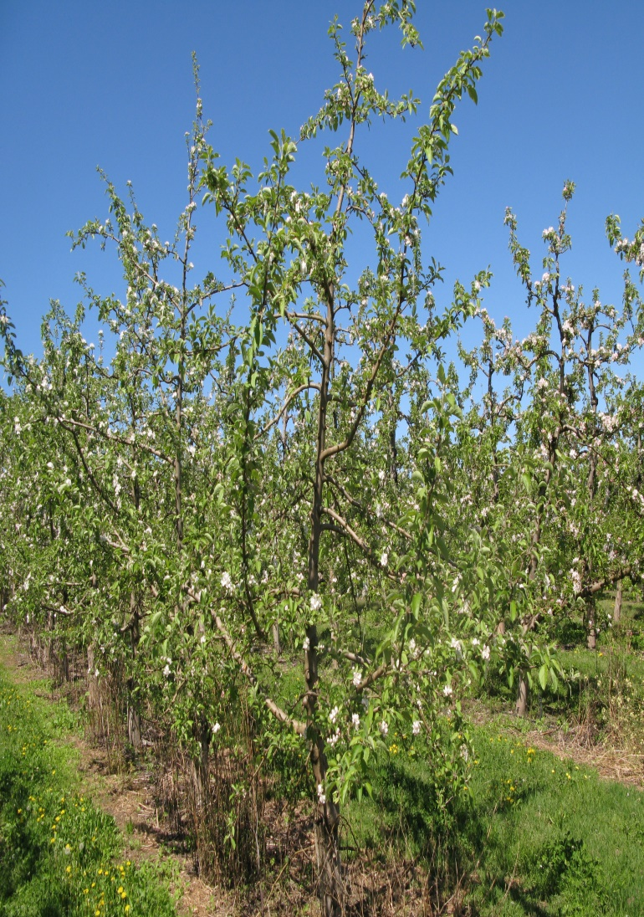
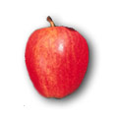
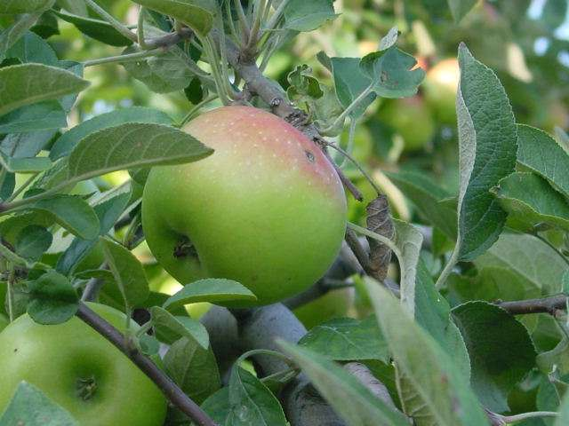
Apple

Slide 2
Apple
Family : Rosaceae
Sub-family: Pomoideae (other member pear and quince)
Botanical Name :
Pyrus : malus
Malus sylvestris
Malus malus

Slide 3
Family: Rosaceae
Sub-family: pomoideae
Pear and quince
The genus pyrus subdivided into
Malus and pyrophorum
Flower is perfect
5 sepal, petals and 5 carpels with 2 ovule
15-20 stamens
Tree is spreading , deciduous carries mixed buds which produced flowers and mostly spur-bearing leaves

Slide 4
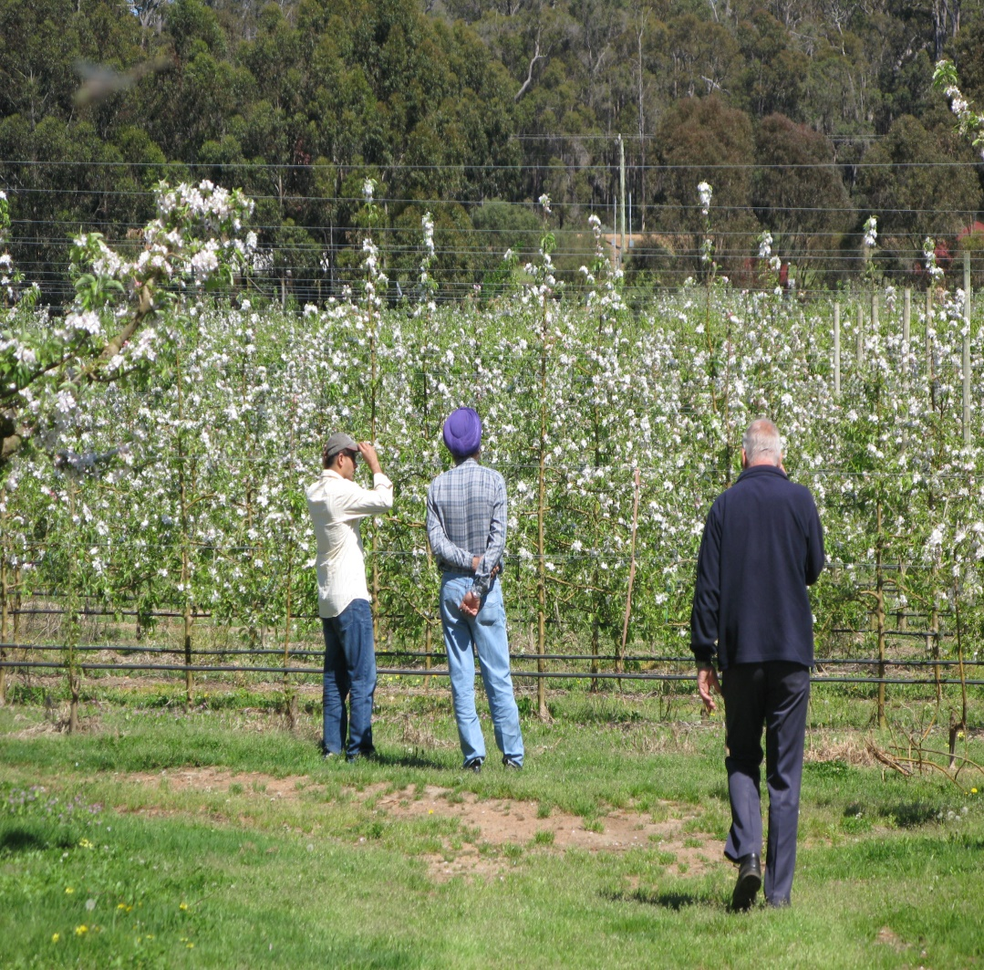
Apple trees
Apple trees can range in size from 6 to 30 feet in height, depending on the variety and type of rootstock (dwarf, semi-dwarf, etc.).

Slide 5
CLIMATE
1.TEMPERATURE
Apple is temperate fruit and generally grown in temperate region.
Apple tree require cool climate for their proper growth and development.
Apple are grown at climate which usually prevails at altitudes of 1700-2500 m
Less altitudes produced less and poor quality fruits

Slide 6
A certain minimum chilling period is needed for fruiting, in its absence the buds may not open or blossoming may be uneven. This chilling process takes place at temperature below 7ºc.
Most of the apple cultivars need to experience such temperature for about 1200 hours in order to achieve and complete and adequate rest while some varieties can manage with as little as 250 hours.

Slide 7
2. MOISTURE AND RAINFALL
Apple can grow in a wide range of rainfall from evenly spread rains of 25 to 37 cm (10-15//) per year to heavy seasonal rain fall of 125 to 175 cm (50-70//).
Where the rain fall is heavy, extensive drainage is required to prevent water logging. A certain minimum soil moisture is necessary for the proper growth and the development of the tree
Growing apples in arid climate will subject to continuous water stress and leads to low cropping capacity.

Slide 8
3. ALTITUDE
In Pakistan the apples can be grown at altitude ranging from 1350 to 2600 m.
The major advantage of planting an apple orchard at relatively lower altitude and in warmer areas is that the fruit is ready for market before the season and hence fetch a better price.
disadvantage is that the orchard will be prone to more insect and disease attacks, because insect and fungi multiply much faster in a warm climate.

Slide 9
5. FROST POCKETS
Site which is prone to frost must be avoided.
Spring frost, can cause very heavy damage to the apple crop.
It can kill or damage the blossoms or prevent the proper fertilization of the blossoms.

Slide 10
6. HAIL ZONES
Certain regions and areas are know to be hail zones which must be avoided while selecting a site for the orchards.
Hail can cause immense damage and there is no insurance against hail in Pakistan.
One heavy hail storm can reduce the value of crop up to 80% and render the entire crop fit only for processing.

Slide 11
WATER RESOURCE
Under normal circumstances, if the apple orchard is located on a site above 1800 m altitude, it requires a little irrigation. However, trees, which are planted at lower elevations or in areas which are prone to draught conditions or planted on sandy soils, may require irrigation.
Similarly dwarfing root stocks like M.9, M. 106,M.4 also prefer adequate moisture.

Slide 12
VARIETAL DEVELOPMENT
5000 to 6000 varieties
1. Golden Delicious 8. Kasmiri
2. Skyspur 9. Kandhari
3. Starking Delicious 10. Amri
4. Anna 11. Kala Kulu
5. Nugget 12. Red delicious
Double Red
7. Banki.

Slide 13
PLANTING GEOMETRY
Contour/Terrace system
^{Square system}
Distance 6-7 m
Wide spacing

Slide 14
PLANTING SEASONS
Spring
February-March
Autumn
September-October

Slide 15
PROPAGATION OF ROOT STOCK
Sexual Propagation
Crap apple (Pyrus baccata) is propagated through seeds and stooling in( May-June. Seeds are extracted and stored in cool dry place until December)
Seed are sown directly or indirectly
Started germinate in march
Other root stocks are M.1, M.7 & M.9

Slide 16
M.1 :
Outstanding root stock for
nursery performance
Vigorous on dry soil
M7:
Rapidly growing
Semi-dwarf
M9:
Heavy soil and
Dwarfing nature

Slide 17
Raising of Rootstock
Seed
Crab apple:
May and June
December
March
transplanted
Budded there by the next summer

Slide 18
Stooling
Mound layering
2 year old plant cut back to ground during spring
Shoot 10-15 cm hilled up the half the shoot
Process repeated 2 to 3 times until July
When shoots length are 45 cm or more
Many of shoots will produced roots by the following spring
Rooted shoot can be removed from the parent stool in early spring

Slide 20
Propagation of scion cvs
Cleft grafting
Whip or tongue grafting
Ring budding
Shield or “T” Budding
In Murree hills cleft grafting is used

Slide 21
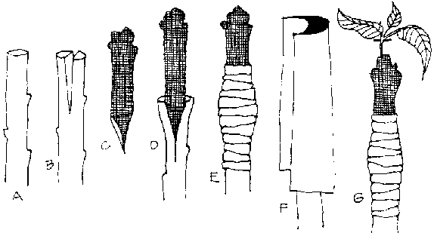
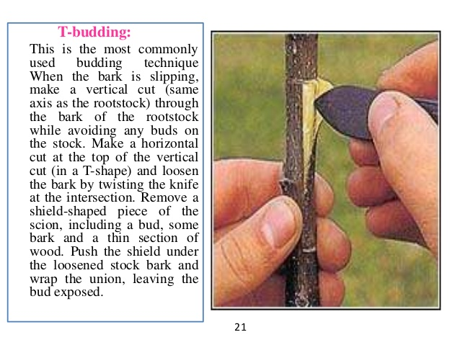
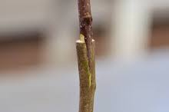

Slide 22
A Fertilizer REQUIREMENTS
Age | F.Y.M. Kg | Urea Kg | SSP Kg | SOP Kg
Pits formation | 20 | - | 2.5 | -
1 years | - | - | - | -
2 years | 10 | 0.25 | - | -
3 years | 10 | 0.33 | - | -
4 years | 15 | 0.50 | 1.50 | -
5 years | 20 | 0.75 | 1.50 | -
6-9 years | 20 | 2.00 | 2.00 | 1.0
10 year | 30 | 2.00 | 3.00 | 1.50
11&above | 40 | 2.50 | 2.5.00 | 2.00

Slide 23
P PRUNING OF APPLES
Enhances establishment of a strong, well-balanced framework
Mechanically strong, well-balanced framework of branches helps to constitute better management practices.
To insure a balance between vegetative vigor and the fruit fullness.
Improves light penetration and increases the set of interior fruit.
Increases soluble solids contents and improves rind color.

Slide 24
Forces the tree to produce new and productive fruitwood.
To treat of orchards suffering from neglect or injury.
Helpful in the treatment of diseases and recovery of trees.
Benefits spray operations by greater coverage.
Limiting tree height may make picking easier and less expensive.

Slide 25
PROBLEMS

Slide 26
Unfruitful fullness SELECTION OF POLLINIZER
Most apple varieties can not set fruit unless their flowers are cross pollinated with pollen of other compatible varieties. Such varieties are called self unfruitful
The lay out and number of pollinizer is an important part of orchard planning. Without adequate pollinizers the orchards remains unproductive and crop will be poor.
11, 15, 20, 25, 33 % pollinizers are being used in different parts of the world.
In India 25 % pollinizers are being used.

Slide 27
Quality of Pollinizers
The bloom time of the pollinizers and the variety must be the same.
The variety should be diploid.
The age and size of the pollinizers must be the same.
The pollinizers must be regular annual bearer.
The flowers of the pollinizers must be attractive for the bees.

Slide 28
Cross pollination by insect: Agent is honey bee
Suny day, 5000 flowers
rain, Temp lower than 8 ⁰C, Winds
Self pollinated cvs.
Baldwin, Grimes Golden, Rome beauty, cox’s orange and Pippen
Partially self-unfruitful:
Golden delicious, Jonathan, Gravenstein, Red delicious and stayman
Completely self unfruitful:
McIntosh, Gravenstein, red delicious and stayman winesap

Slide 29
HAIL STORMS
In Murree hills late spring frost hail storms are a serious threat for apple which are very common from flowering to harvesting damaging 95% of crop.
By the use of Nylon nets the hail storms affects can be minimized.

Slide 31
Damage by Hail Storms

Slide 32
INSECTS AND PESTS OF APPLE
Apple Lace Bug (Stephanities pyrioides).
Apple woody aphid, (Eriosoma Lanigerum).
Aphids, Aphis (spiraeecola).
San Jose Scale (Quadraspidiotus perniciosus).
Apple codling moth (Cydia Pomonella).
Tent catterpillar ( Malacosoma indicum)
Mite (Cenopalpus pulcher)

Slide 33
Codling moth
Destructive insect
Murree and Quetta
Damage the fruit with no sing on the fruit surface
Larvae burrow through the skin or calyx tube

Slide 34
DISEASES OF APPLE
Ripe rot (Rhizopus arrhizus)
Powdery mildew (Podocphaera leucotricha)
Sooty blotch ( Gloeodes pomigena ).
Apple scab (Venturia inaequalis)
Fire blight (Erwinia amylovora)
Root rot (Phytophothora cactorum)
White root rot (Rosellinia necatrix)

Slide 35
CAUSES OF LOW PRODUCTION
1. Low Organic Matter
2. Saline Soils
3. Uncertain weather conditions during flowering ( Fog, frost, Rains etc.)

Slide 36
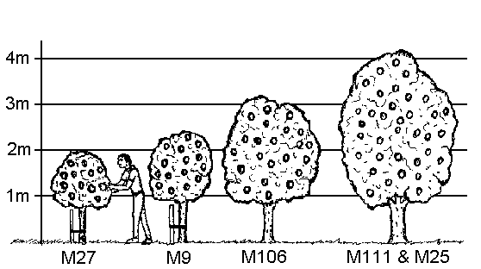
Comparative apple tree sizes using different rootstocks

Slide 37
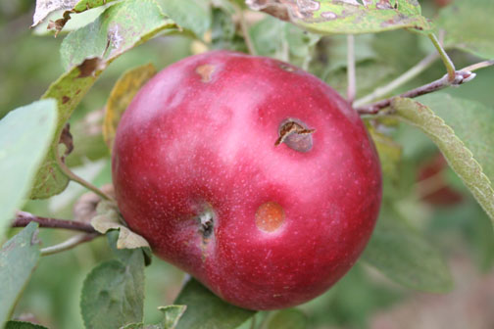
Hail Damage

Slide 38
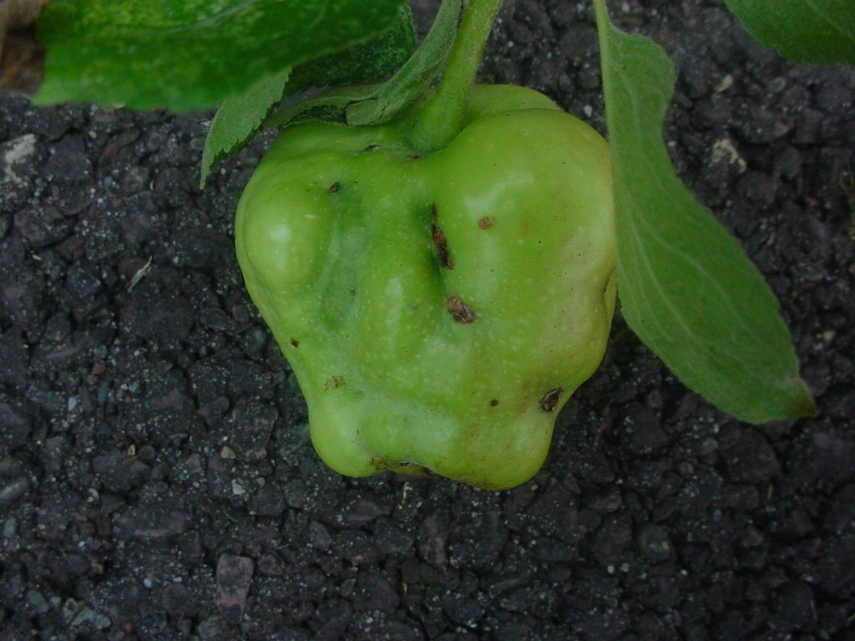
Hail Damage

Slide 39
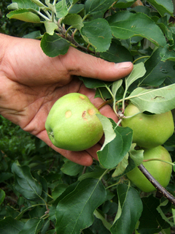

Slide 40
Cultivars 5000 to 6000 varieties
In Quetta Region
Kashmiri, kandhari, Amri, Kulu, Qalat special
In Murree hills
Delicious, Kashmir Amri, Banki, Golden Delicious, Red delicious, Sky Spur
Low chilling varieties
Tropical beauty, Enna, Ein Sheimer

Slide 41
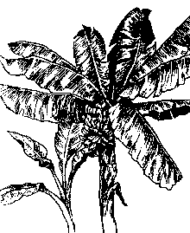
Botany

Slide 42
Botany
Common name: Banana
Musa cavendishii (Dwarf banana)
Musa sapientum (Tall banana)
Musa paradisiaca (Cooking)
Family: Musaceae
Origin: Edible bananas originated in the Indo-Malaysian region reaching to northern Australia.

Slide 43
Area: 34,800 hectares
Production: 154,800 tons.

Slide 44
Adaptation
Bananas can be grown in every humid tropical region
The plant needs 10 months of frost-free conditions to produce a flower stalk.
All but the hardiest varieties stop growing when the temperature drops below 53° F.
Growth of the plant begins to slow down at about 80° F and stop entirely when the temperature reaches 100° F.

Slide 45
Adaptation
High temperatures and bright sunlight will also scorch leaves and fruit, although bananas grow best in full sun.
Freezing temperatures will kill the foliage.

Slide 46
Growth Habit
Bananas are fast-growing herbaceous perennials arising from underground rhizomes.
The fleshy stalks or pseudostems formed by upright concentric layers of leaf sheaths constitute the functional trunks.

Slide 47
Growth Habit
The true stem begins as an underground corm which grows upwards, pushing its way out through the center of the stalk 10-15 months after planting, eventually producing the terminal inflorescence which will later bear the fruit.
Each stalk produces one huge flower cluster and then dies.

Slide 48
Fruits: The ovaries contained in the first (female) flowers grow rapidly, developing parthenocarpically (without pollination) into clusters of fruits, called hands.
All hands on an inflorescence are collectively called a bunch.
Each hand consists of 12-20 fruits called fingers.
The number of hands varies with the species and variety.
The fruit (technically a berry) turns from deep green to yellow or red, and may range from 2-1/2 to 12 inches in length and 3/4 to 2 inches in width.

Slide 49
Soil
Bananas will grow in most soils, but to thrive, they should be planted in a rich, well-drained soil.
The best possible location would be above an abandoned compost heap.
They prefer an acid soil with a pH between 5.5 and 6.5.
The banana is not tolerant of salty soils.

Slide 50
Irrigation:
The large leaves of bananas use a great deal of water.
Regular deep watering is an absolute necessity during warm weather.
Do not let plants dry out, but do not overwater.
Standing water, especially in cool weather, will cause root rot.

Slide 51
Fertilization:
Their rapid growth rate make bananas heavy feeders.
During warm weather, apply a balanced fertilizer once a month
A mature plant may require as much as 1-1/2 to 2 pounds of the NKP fertilizer each month.
In general NPK three fertilizers are important for good growth and yield

Slide 52
Fertilization:
250 kg N 26 kg P and 500kg K are removed by the growth cycle of banana to produce 72 tones of fruit /ha.
(N vegetative growth, P helps in fruit formation, K helps in increasing the yield and quality of Fruit)

Slide 53
Frost Protection
Bananas flourish best under uniformly warm conditions but can survive 28° F for short periods.
If the temperature does not fall below 22° F and the cold period is short, the underground rhizome will usually survive.
To keep the plants that are above ground producing, protection against low temperatures is very important.

Slide 54
Frost Protection
Wrap trunk or cover with blanket if the plants are small and low temperatures are predicted.

Slide 55
Pruning
Only one primary stem of each rhizome should be allowed to fruit.
All excess shoots should be removed as soon as they are noticed.
This helps channel all of the plant's energy into fruit production.
Once the main stalk is 6 - 8 months old, permit one sucker to develop as a replacement stalk for the following season.
When the fruit is harvested, cut the fruiting stalk back to 30 inches above the ground.

Slide 56
Pruning
Remove the stub several weeks later.
The stalk can be cut into small pieces and used as mulch

Slide 57
Propagation
Cultivated commercial varieties are seedless.
Vegetative propagation
The crops grown after the first year of plantation are called Ratoons.
One meter tall, narrow-leaved suckers known as sword suckers are preferred for propagation.
Broad leaved or water suckers should not used for propagation as they produced late and inferior quality fruit.

Slide 58
Propagation
New plantation should be done in FEBRUARY–MARCH or July-August
Planting distance 2-3 m

Slide 59
Varieties
Basrai
Mirpuri
Sonkel
Safri
Chini champa

