Slide 1
Histology of Hypophysis
Dr Muhammad Aaqib Riaz
Anatomy Department
Sargodha Medical College

Slide 2
Hypophysis
The hypophysis lies in the cranial cavity and is attached to the base of the brain by salk called infundibulum.
Is the master endocrine gland that produces several hormones.
The hypophysis has two major divisions;
Adenohypophysis
Neurohypophysis

Slide 3
Hypophysis
Adenohypophysis:
There are three subdivisions of adenohypophysis;
Pars distalis
Pars intermedia
Pars tuberalis

Slide 4
Pars distalis
It constitues the 70% of the hypophysis.
It is surrounded by a dense fibrous capsule.
The parenchyma of pars distalis consist of cords and clusters of cells which are supported by stroma composed of fibroblasts and reticular fibers.
Sinusidal capillaries are present between the cords of cells.

Slide 5
Pars distalis
The cells of pars distalis were classified into two major groups;
Chromophobes
Chromophils
Chromophobes Cells:
These cells stain poorly and the cytoplasm contain no granules.
These cells were interpreted as resting secretory cells.

Slide 6
Pars distalis
Chromophils:
These cells stain deeply and their cytoplasm contain secretory granules.
The chromophils were further divided into two types
Acidophils
Basophils

Slide 7
Pars distalis
The cells of pars distalis are classified into five types depending upon the basis of hormonal secretory activity.
Somatotropes
Mammotropes
Corticotropes
Gonadotropes
Thyrotropes

Slide 8
Somatotropes
These cells constitue about 50% of pars distalis
They are oval cells having centrally placed spherical nucleus.
The cytoplasm contains various cell organelles and secretory granules.
The somatotropes secrete growth hormone.

Slide 9
Mammotropes
They constitute 15 to 20% of total cells of pars distalis.
These are polygonal cells with oval nuclei
Their cytoplasm contains numerous large acidophilic granules.
The mammotropes secrete prolactin

Slide 10
Corticotropes
They constitute 15 to 20% of total cells of pars distalis.
These are also polygonal cells with round nucleus located in eccentric position
These cells secrete ACTH

Slide 11
Gonadotropes
They constitute 10% of total cells of pars distalis.
These are oval cells with round nuclei.
Cytoplasm contain sceretory granules that stain basophilic.
The gonadotropes produce LH and FSH.

Slide 12
Thyrotropes
They constitute 5% of parencymal cells of pars distalis.
These are relatively large ,oval cells with round nucleus.
They contain small cytoplasmic granules which show affinity for basic dye.
The thyrotrpes secrete TSH

Slide 13
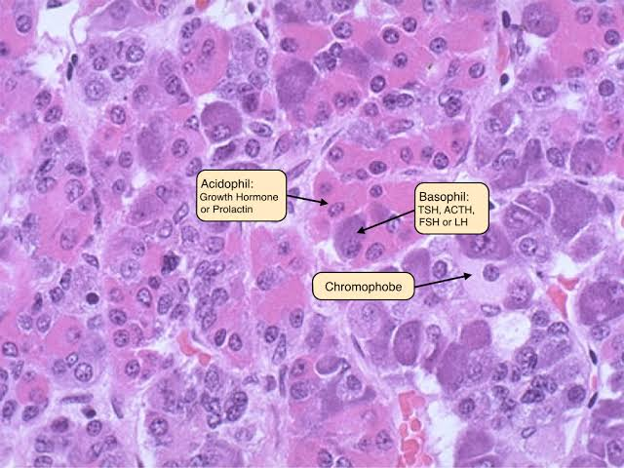

Slide 14
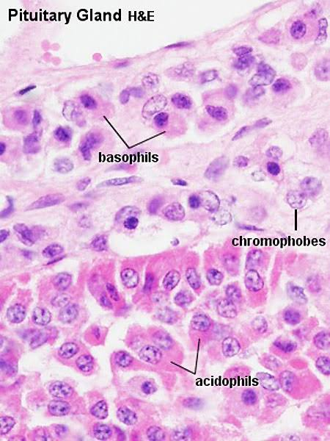

Slide 15
Pars Intermedia
In humans the pars intermedia is rudimentary and is composed of basophilic polygonal cells.
In between the cords some follicles are also present are lined by cuboidal cells and contain colloid material.

Slide 16
Pars Tuberalis
Also called pars infundibularis surrounds the infundibulum.
It is composed of cords of basophilic cuboidal cells associated with blood vessels.

Slide 17
Neurohypophysis
The neurohypophysis consist of pars nervosa and the infundibulum which connects the hypophysis to the hypothalamus.
This part contains unmyelinated nerve fibers, fenestrated capillaries and specialized glial cells called pituicytes.
Two hormones are stored and released from the neurohypophysis
Oxytocin
Vasopressin

Slide 18
Neurohypophysis
In H&E preparation the structural features cannot be easily distinguished.
By Special staining , large accumulation of neurosecretory material seen as basophilic masses called Herring bodies.
The pituicytes are glial cells that support the axon of neurohypophysis.

Slide 19
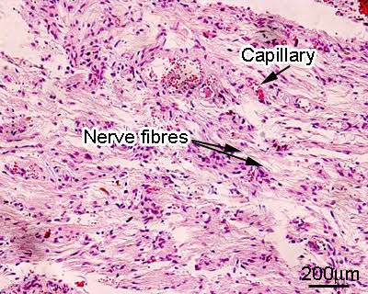

Slide 20
Adrenal Gland
The adrenal gland are paired organs lie at superior poles of kidneys.
Each gland is covered by thick connective tissue capsule from which septa penetrate into the substance of gland.
On gross inspection gland has two region
Cortex yellowish outer region constitute about 90% of gland
Medulla smaller inner region appears reddish to naked eye.

Slide 21
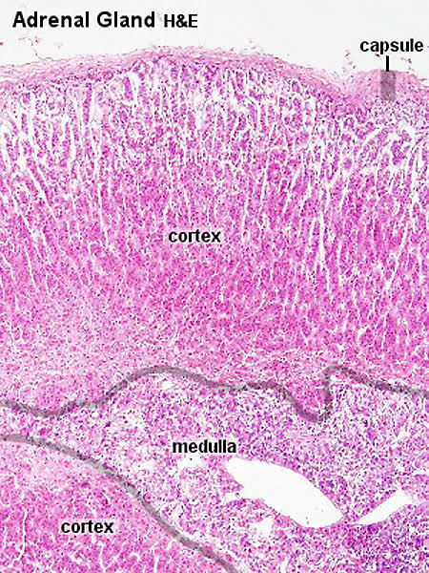

Slide 22
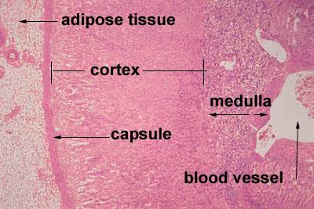
Adrenal Gland

Slide 23
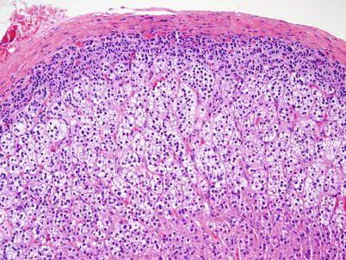
Adrenal Gland

Slide 24
Adrenal Cortex
The suprarenal cortex is divided into three zones
Outer zone , Zona Glomerulosa
Middle zone, Zona Fasciculata
Inner zone, Zona Reticularis

Slide 25
Zona Glomerulosa
Just beneath the capsule and is composed of columnar or pyramidal cells are arranged in rounded clusters.
The zona glomerulosa cells contain darkly staining nuclei.
The acidophlic cytoplasm contain SER, well develop golgi apparatus, large mitochondria, some RER and few lipid droplets.
It secretes mineralocorticoids, mainly aldosterone.

Slide 26
Zona Fasciculata
Is the thickest zone and accounts for 80% of cortical volume.
Has large polyhedral cells arranged in cords that are one or two cell thick.
Sinusoidal capillaries are present in between the cells.
The cells stain acidophilic and contain single, spherical nucleus.
The cytoplasm contain SER, golgi bodies , mitochondria and large number of fat droplets.
The cells appear vacuolated and known as spongiocytes.
Zona fasciculata secrete glucocorticoids mainly cortisol and corticosterone.

Slide 27
Zona Reticularis
It contains polyhedral or rounded cells arranged in branching.
Sinusoidal capillaries are present in between the cells.
Cytoplasm is acidophilic and contain small amount of fat droplets.
The cells secrete weak androgens and small amount of cortisol.

Slide 28
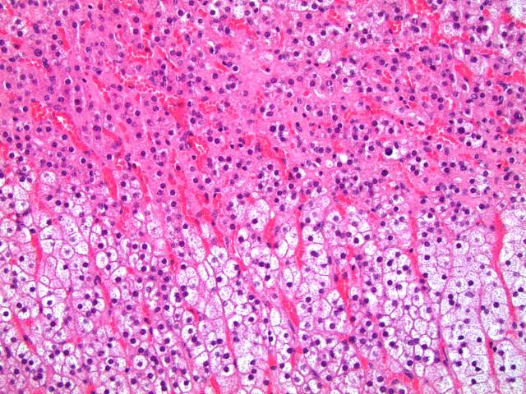
Adrenal Cortex

Slide 29
Medulla
Is composed of chromaffin cells
These cells are arranged in irregular rounded groups isolated by fine septa.
The cytoplasm of cells is basophilic.
The chromaffin cells are seen to be filled with fine brown granules.
These granules are precursors of epinephrine and norepinephrine.
Norepinephrine producing cells are relatively more densely granulated.

