Slide 1
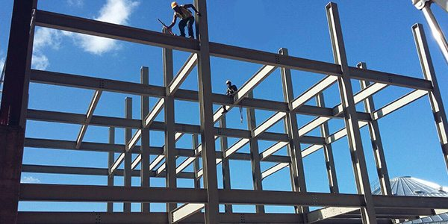
COLLEGE OF ENGINEERING AND TECHNOLOGY UNIVERSITY OF SARGODHA Theory Of Structures (CT-226) (B.S TECHNOLOGY)
23-April-2020
ONLINE LECTURE-6
Influence Line Diagram
Engr. Aqeel Ahmed
Lecturer, CET, UOS, Sargodha

Slide 6
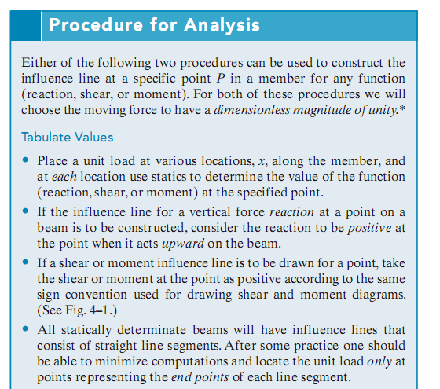

Slide 7
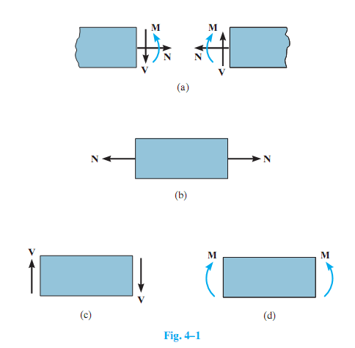

Slide 8
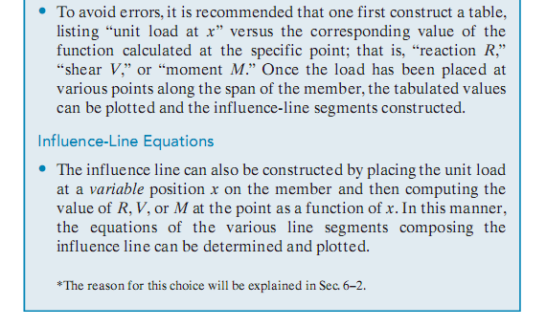

Slide 10
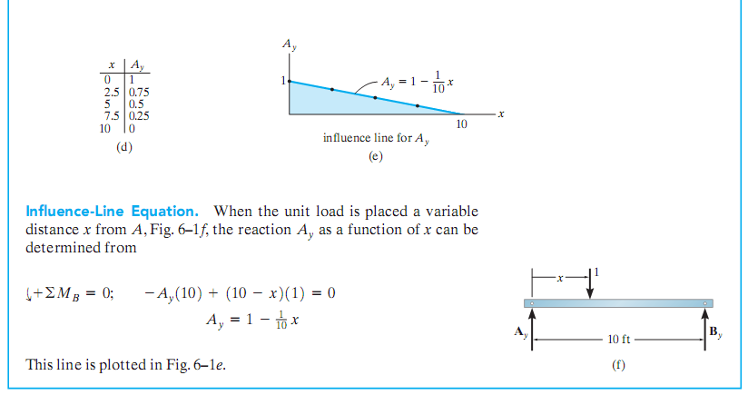

Slide 11
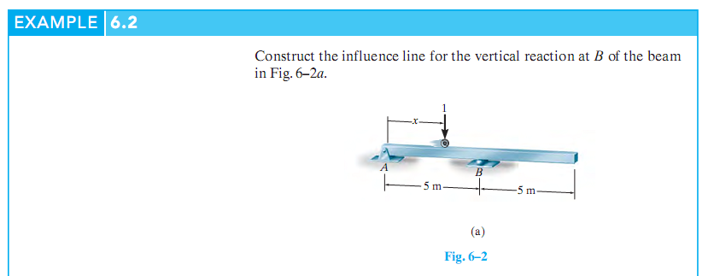

Slide 12
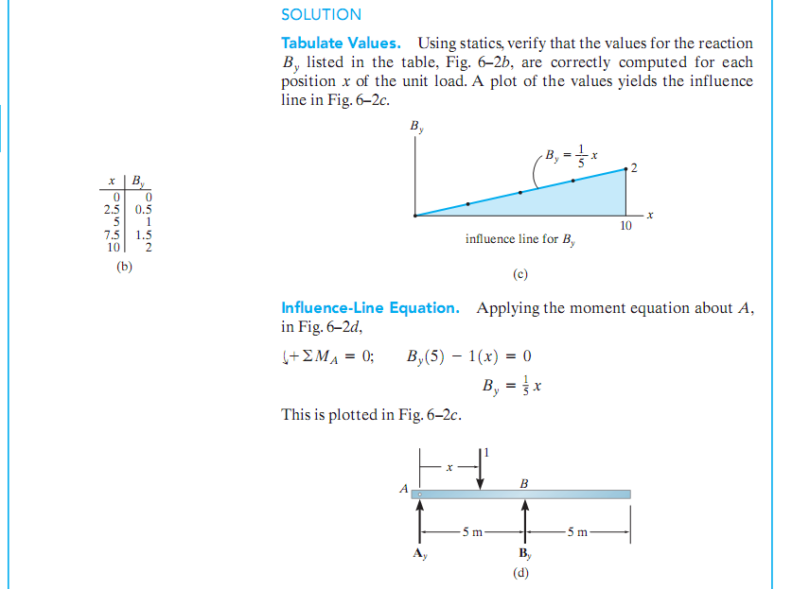

Slide 13
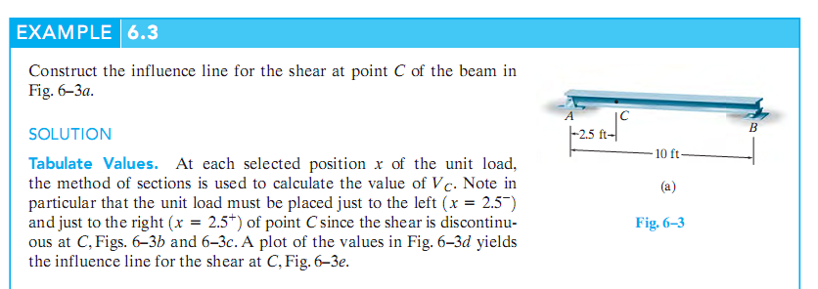

Slide 16
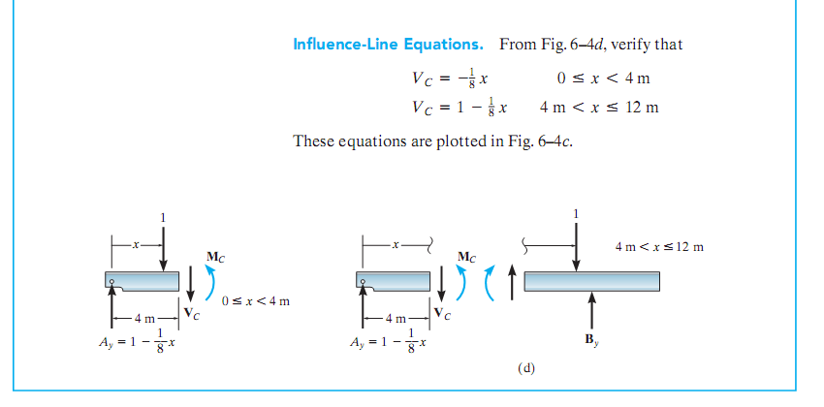

Slide 18
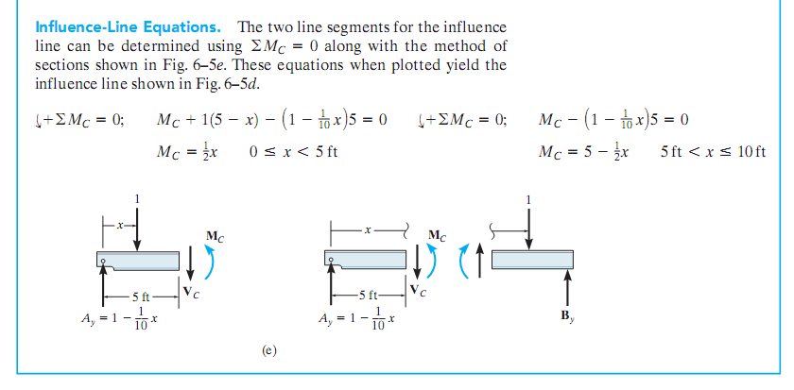

Slide 19
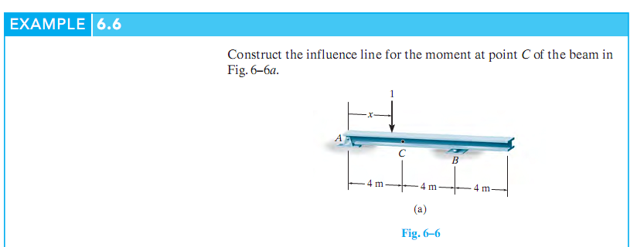

Slide 20
