Slide 2
Chambers of the Heart
2 atria – receiving chambers
Auricles increase capacity
2 ventricles – pumping chambers
Sulci – grooves
Contain coronary blood vessels
Coronary sulcus
Anterior interventricular sulcus
Posterior interventricular sulcus
Notes:
Sulcus,,a groove or furrow, especially one on the surface of the brain and also heart

Slide 3
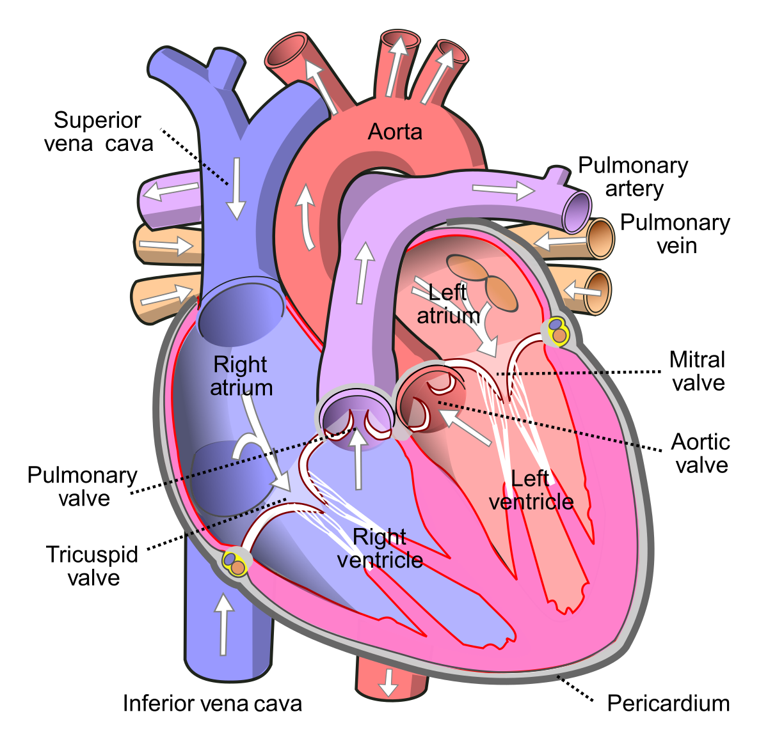
Structure of the Heart

Slide 4
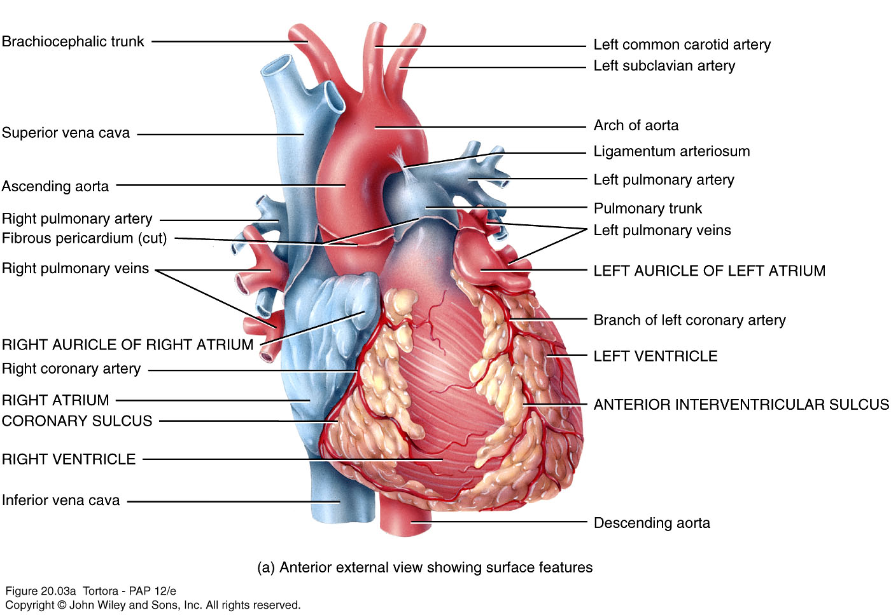
Structure of the Heart
Notes:
The ligamentum arteriosum (Latin: arterial ligament) is a small ligament that is the remnant of the ductus arteriosus formed within three weeks after birth. At the superior end, the ligamentum attaches to the aorta—at the final part of the aortic arch (the isthmus of aorta) or the first part of the descending aorta.
In anatomy, isthmus refers to a constriction between organs.

Slide 5
Right Atrium
Forms right border of heart
Pectinate Muscle (Inside of anterior wall)
Receives blood from
Superior vena cava
Inferior vena cava
Coronary sinus
Interatrial septum has fossa ovalis
Remnant of foramen ovale
Blood passes through tricuspid valve (right atrioventricular valve) into right ventricle
Notes:
The fossa ovalis is a depression in the right atrium of the heart, at the level of the interatrial septum: the wall between right and left atrium
The foramen ovale is a normal opening between the upper two chambers of an unborn baby's heart. Before a baby is born, it does not use its lungs to get blood rich in oxygen. It usually closes soon after the baby's birth. In biology, a septum is a wall, dividing a cavity or structure into smaller ones.

Slide 6
Right Ventricle
Forms most of anterior surface of heart
Trabeculae carneae – ridges formed by raised bundles of cardiac muscle fiber
Some are part of conduction system of the heart
Tricuspid valve connected to chordae tendinae connected to papillary muscles
Interventricular septum
Blood leaves through pulmonary valve (pulmonary semilunar valve) into pulmonary trunk and then right and left pulmonary arteries
Notes:
The chordae tendineae (tendinous cords), colloquially (informal conversation) known as the heart strings, are tendon-resembling fibrous cords of connective tissue that connect the papillary muscles to the tricuspid valve and the bicuspid valve in the heart.
The papillary muscles are muscles located in the ventricles of the heart. They attach to the cusps of the atrioventricular valves (also known as the mitral and tricuspid valves) via the chordae tendineae and contract to prevent inversion or prolapse of these valves on systole (or ventricular contraction).

Slide 7
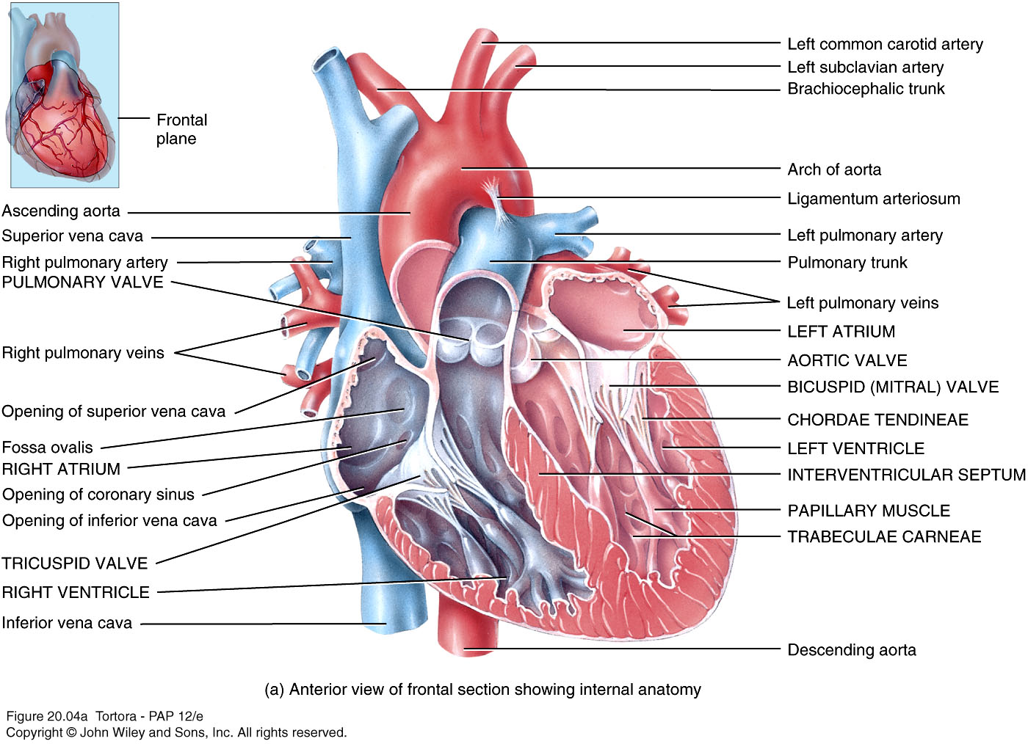
Internal Anatomy of the Heart
Notes:
The trabeculae carneae (columnae carneae, or meaty ridges), are rounded or irregular muscular columns which project from the inner surface of the right and left ventricle of the heart. These are different from the pectinate muscles, which are present in the atria of the heart.

