Slide 1
THE NEARCTIC REGION

Slide 2
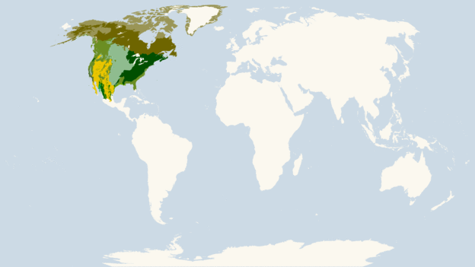

Slide 3
The Nearctic is one of the nine terrestrial ecozones dividing the Earth's land surface .
The ecozone is further divided into following ecoregions:
Canadian Shield
Eastern North America
Western North America
Northern Mexico and Southwestern North America

Slide 5
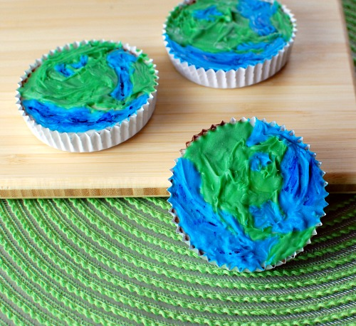
THE CANADIAN SHIELD

Slide 6
The Canadian Shield, also called the Laurentian Plateau, or Bouclier Canadien in French.
Area is 8 000 000 km
It is an area mostly composed of igneous rock which relates to its long volcanic history.

Slide 7
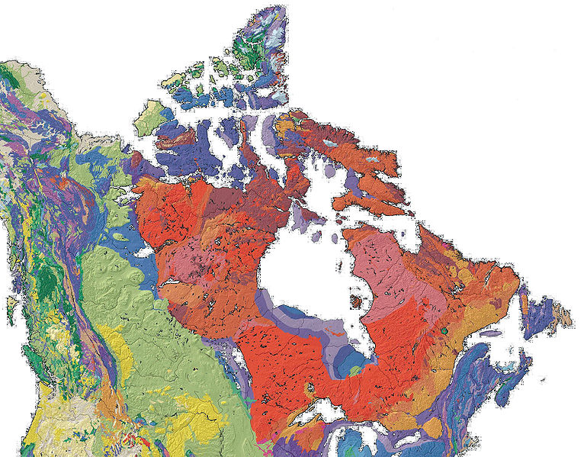

Slide 8
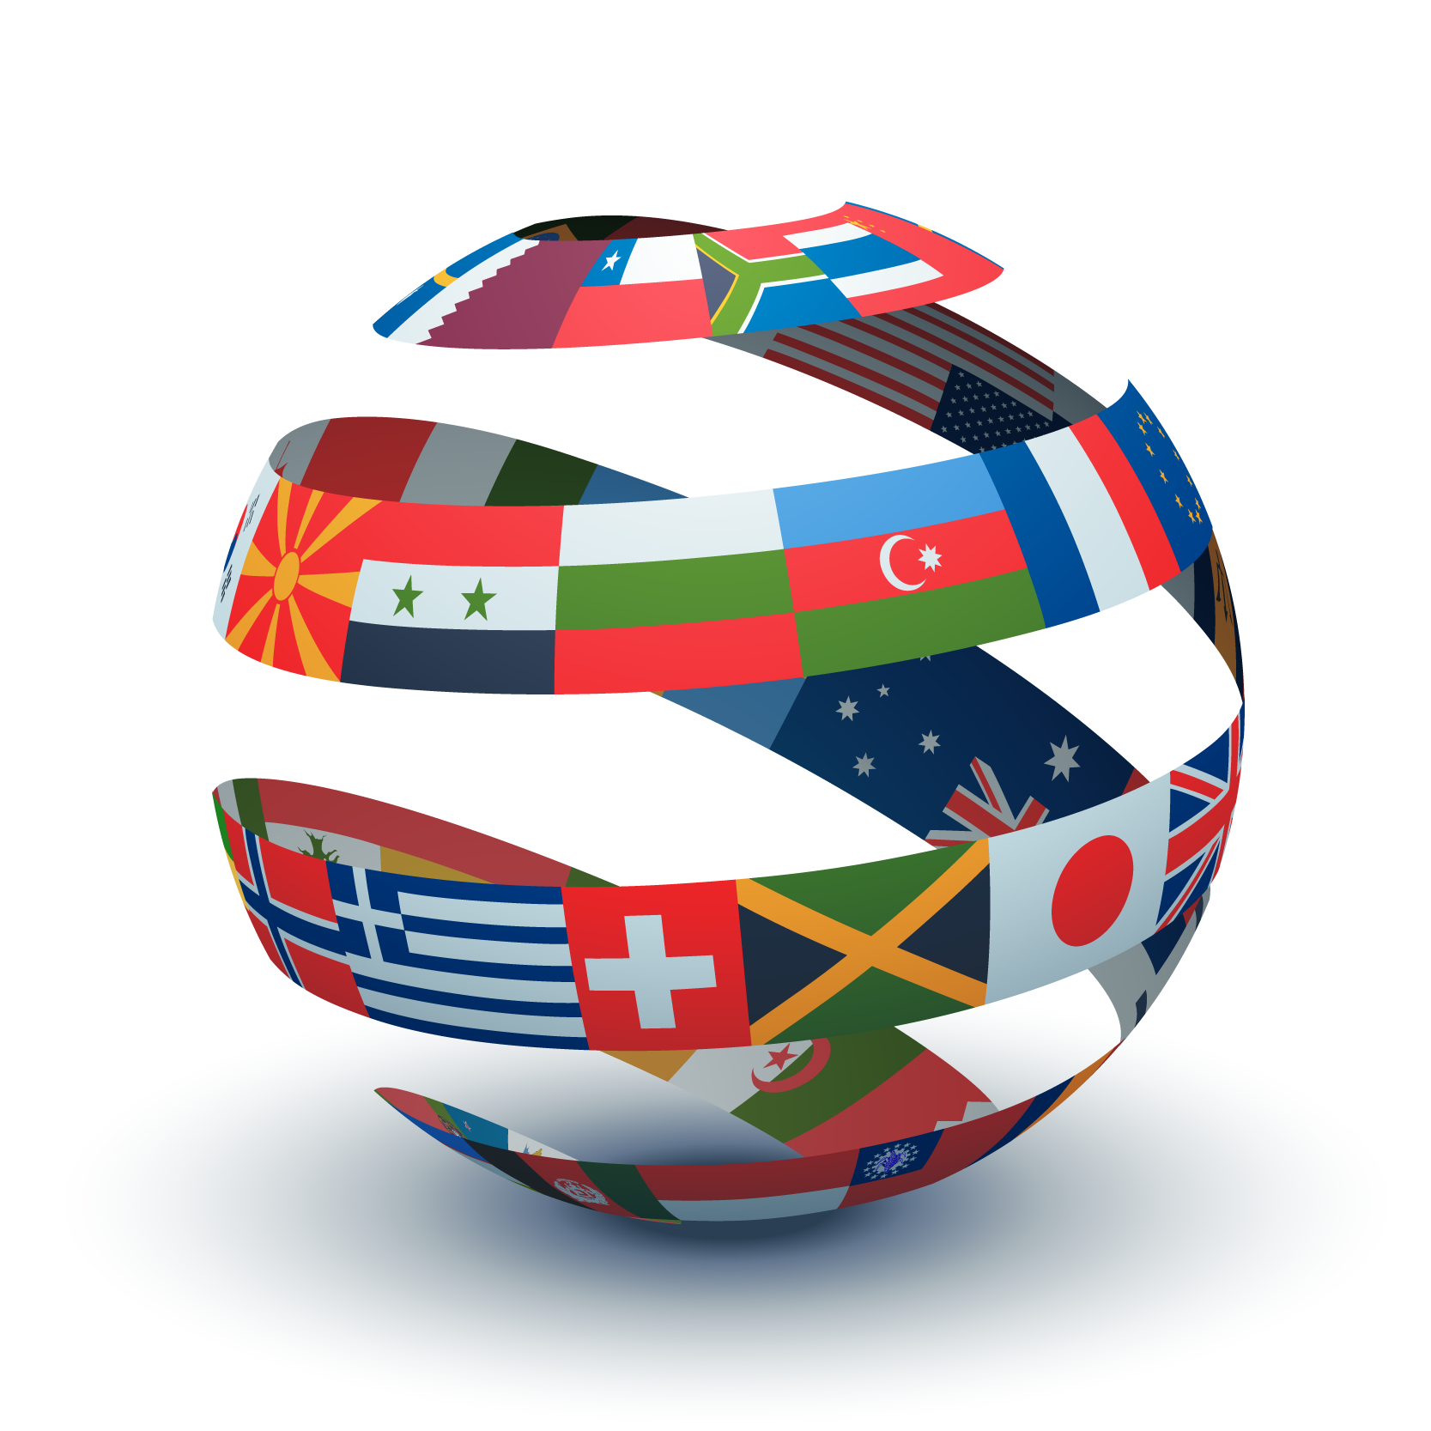
COUNTRIES INCLUDED IN CANADIAN SHIELD

Slide 9
CANADA
UNITED STATES

Slide 10
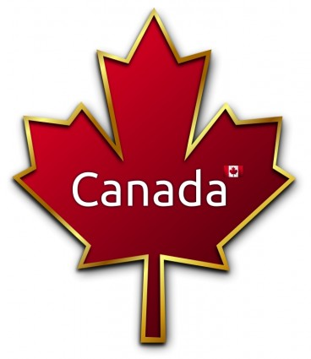

Slide 12
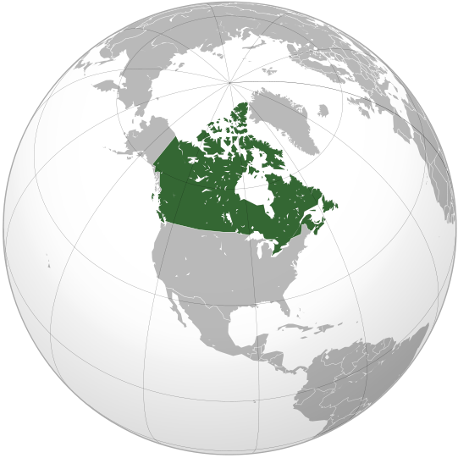
LOCATION ON GLOBE

Slide 13
The name Canada comes from the word Kanata, meaning "village" or "settlement“.
Capital: Ottawa
Area: 9,984,670 km²
Canada is the world's second largest country according to total area.
Official language: English and French
Canada has the longest coastline in the world, about 243,000 kilometers in length.

Slide 14
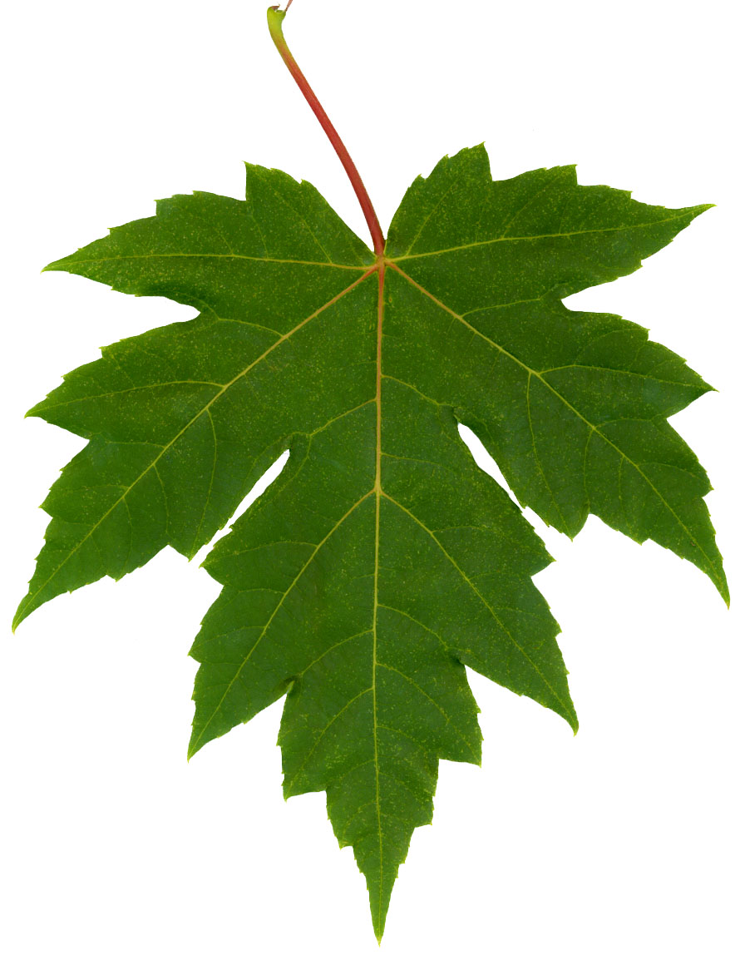
The national symbol of Canada is the maple leaf

Slide 15
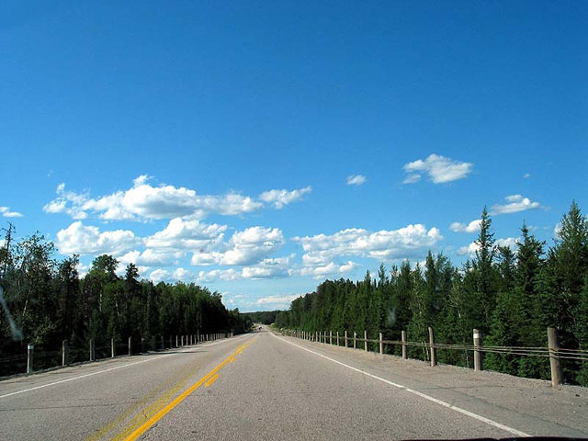
The longest highway in the world is the Trans-Canada Highway which is over 7604 kilometers in length.

Slide 16
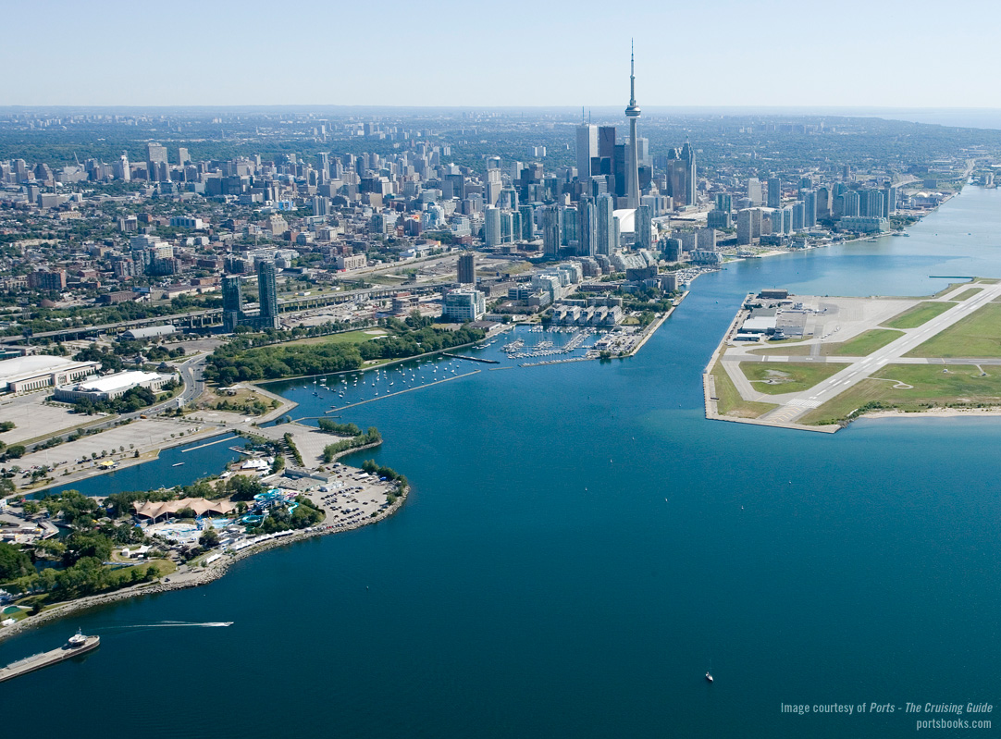
Toronto is the largest city of Canada, with a population of more than 5 million people.

Slide 17
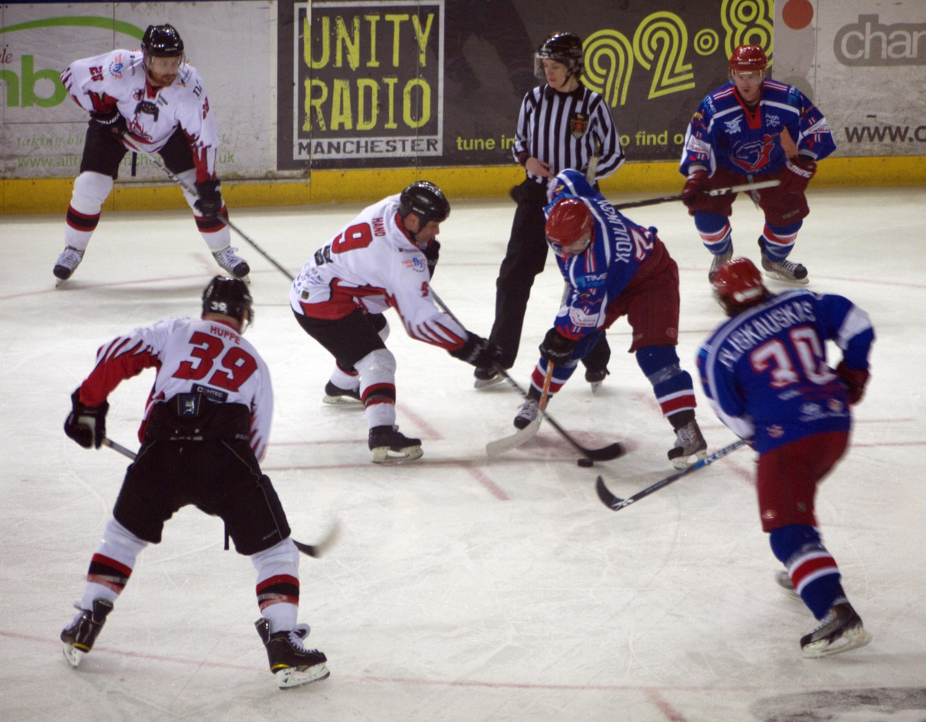
National game of Canada is ice hockey.

Slide 18
The Canadian men's ice hockey team celebrates winning the gold medal during the 2010 Winter Olympics

Slide 19
SOME INTERESTING SOCIAL CUSTOMS:
The most common greeting is the handshake.
It should be firm and accompanied by direct eye contact and a sincere smile.
Gifts are given to honorable guests which are usually flowers and sweets and interesting thing is this the guest have to open it on the spot.
Do not give white lilies as they are used at funerals. Do not give cash or money as a present.

Slide 20
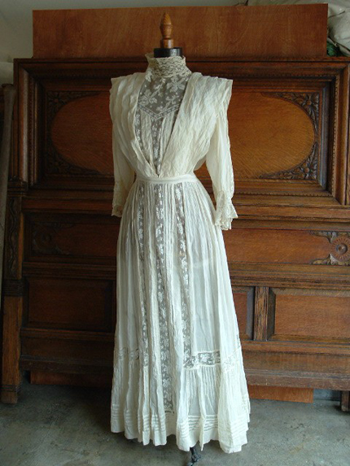
A TYPICAL WEDDING DRESS

Slide 21
CANADIAN BRIDE

Slide 22
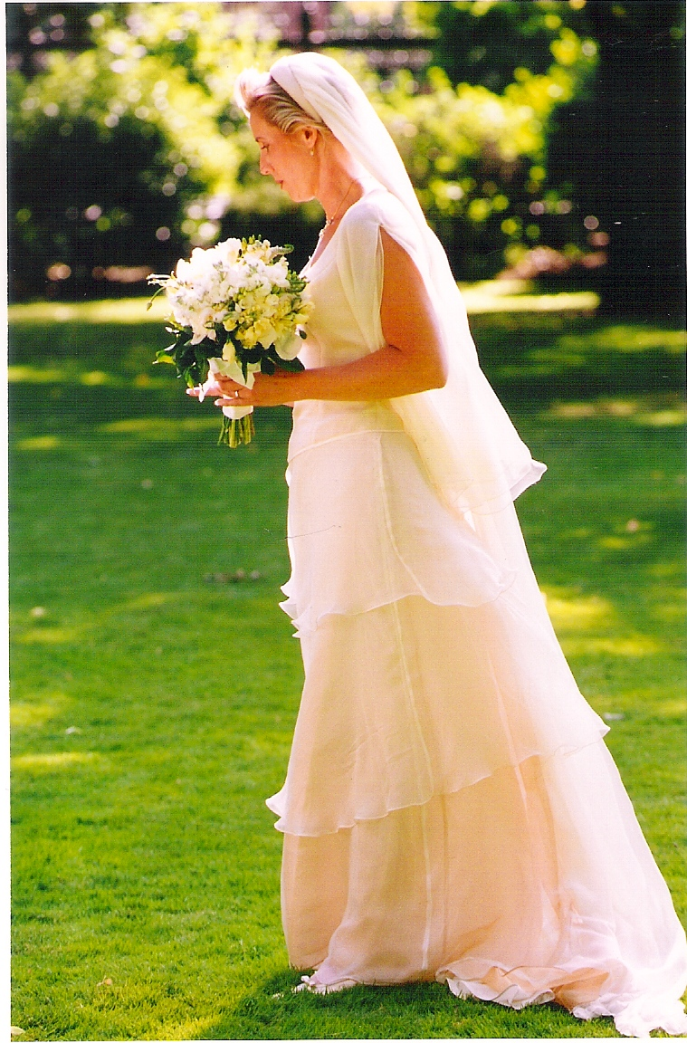

Slide 23
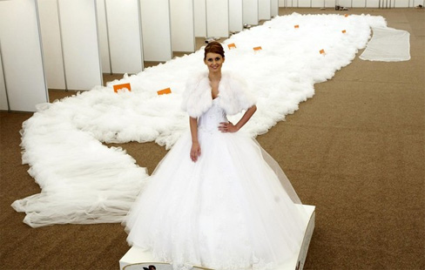

Slide 24
WEDDING JEWLERY

Slide 25
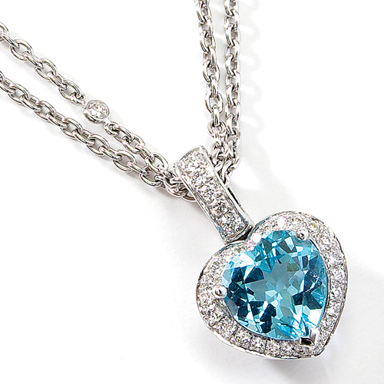

Slide 27
SOME IMPORTANT PLACES OF

Slide 28
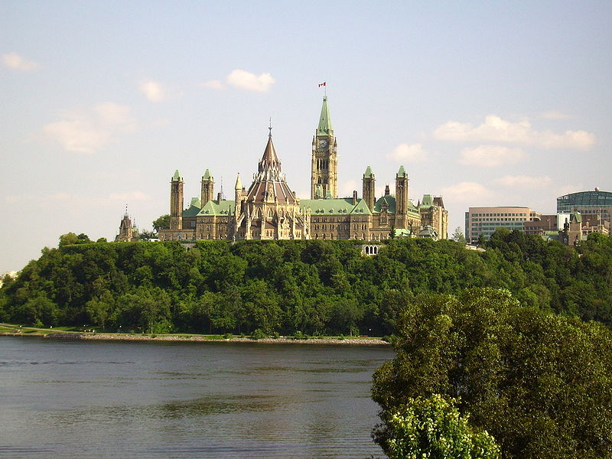
THE CANADIAN PARLIMENT

Slide 29
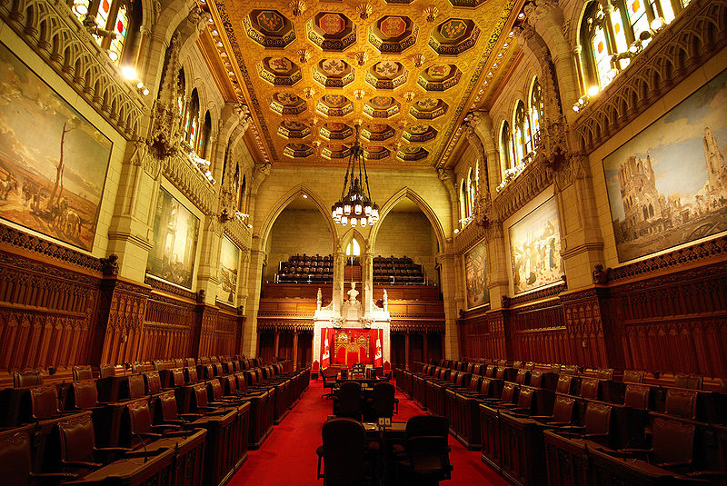
SENATE CHAMBER

Slide 30
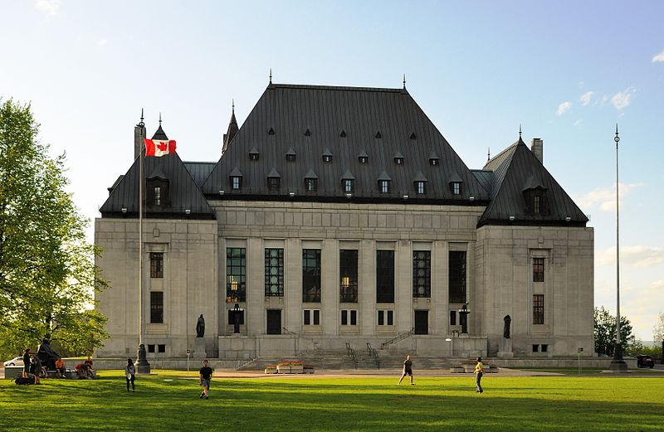
SUPREME COURT OF CANADA

Slide 31
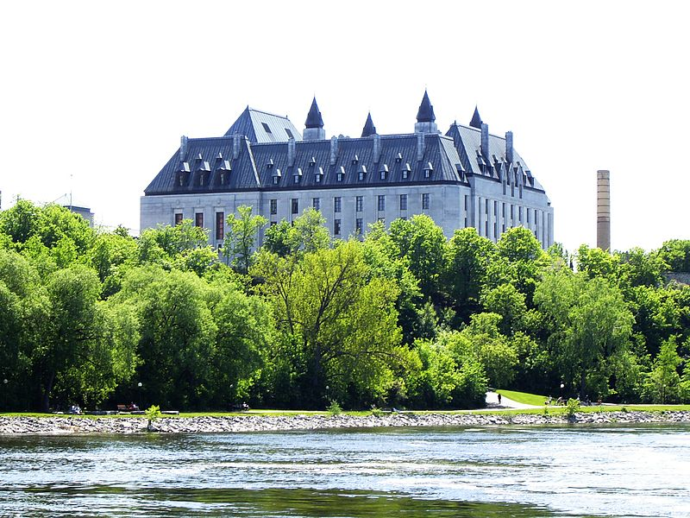
VIEW OF SUPREME COURT AT OTAWA RIVER

Slide 32
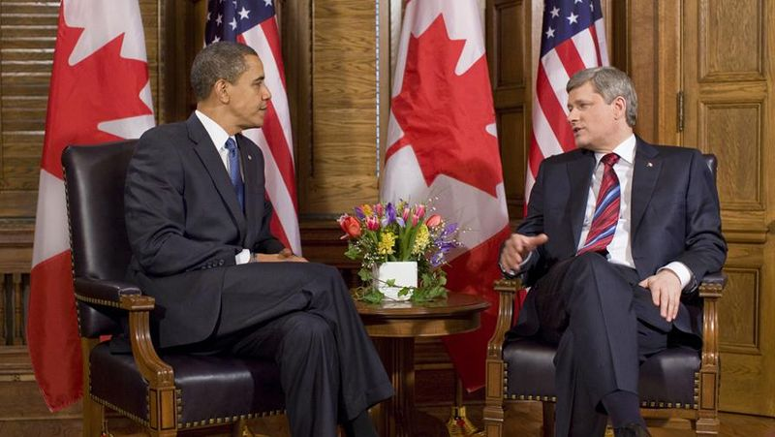
P.M STEPHEN HERPER MEETING U.S PRESIDENT OBAMA

Slide 33
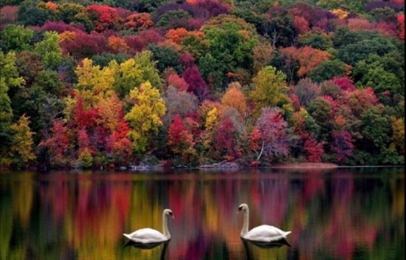
SOME BEAUTIFUL PLACES TO VISIT IN CANADA

Slide 34
NIAGARA WATERFALL: The Niagara falls are one of the most beautiful waterfalls in the world. Among the top ten places to visit in Canada, this waterfall is probably the most beautiful one.

Slide 35
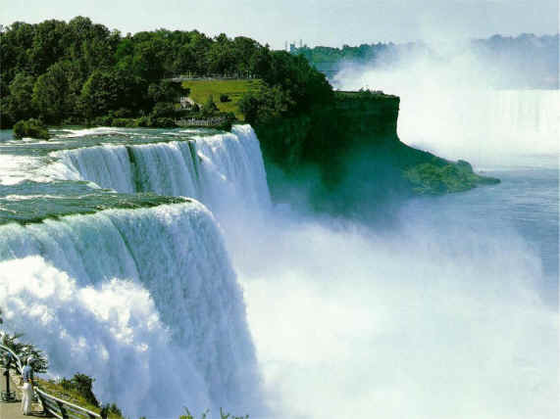

Slide 36
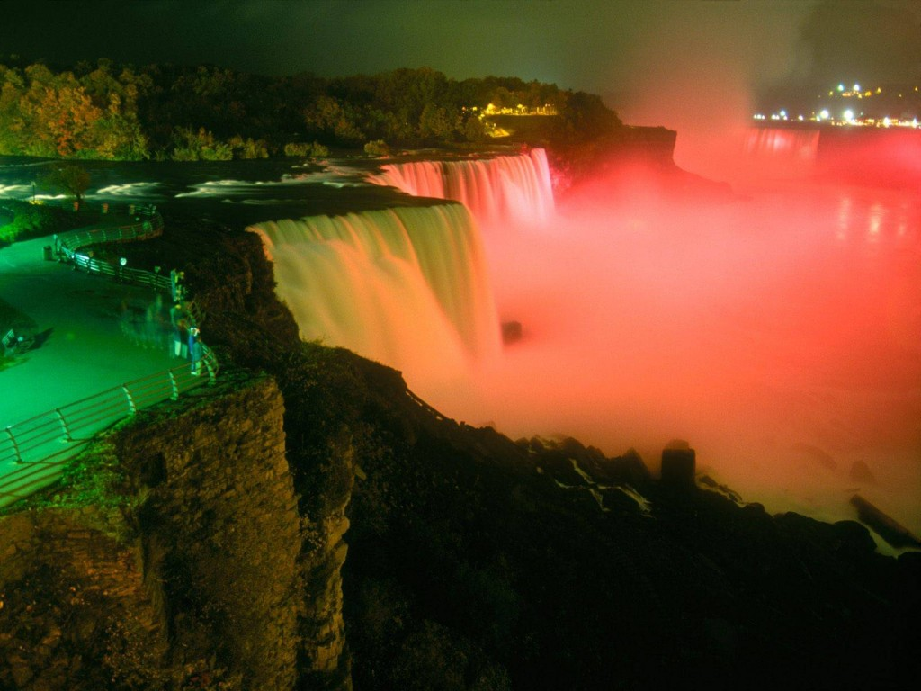
NIAGRA FALLS AT NIGHT

Slide 37
Vancouver: Vancouver is one of the largest multi-cultural cities in the Canadian province. It is another beautiful attraction of Canada.

Slide 38
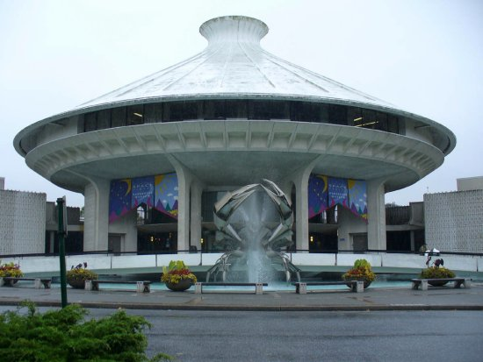
VANCOUVER MUSEUM

Slide 40
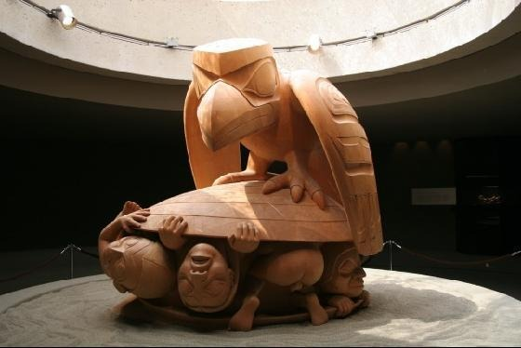

Slide 41
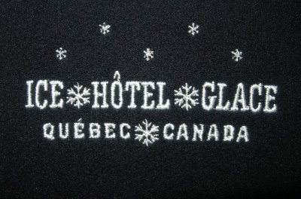
The Ice Hotel in Quebec, known as Hotel de Glace is created every year using 400 tons of ice and 12,000 tons of snow. It melts away every summer and is recreated every winter.

Slide 42
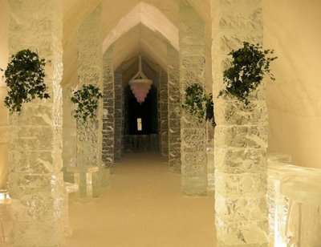

Slide 43
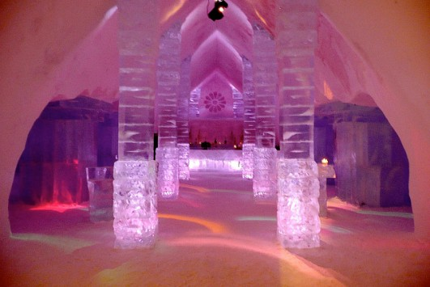

Slide 44
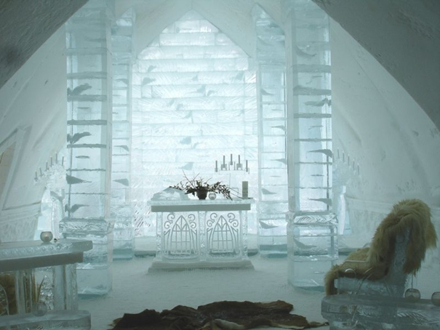

Slide 45
LAKE LOUISE a large turquoise lake trickles from the thousands year old glacier in the distance. It is one of most beautiful place to visit and feel nature.

Slide 46
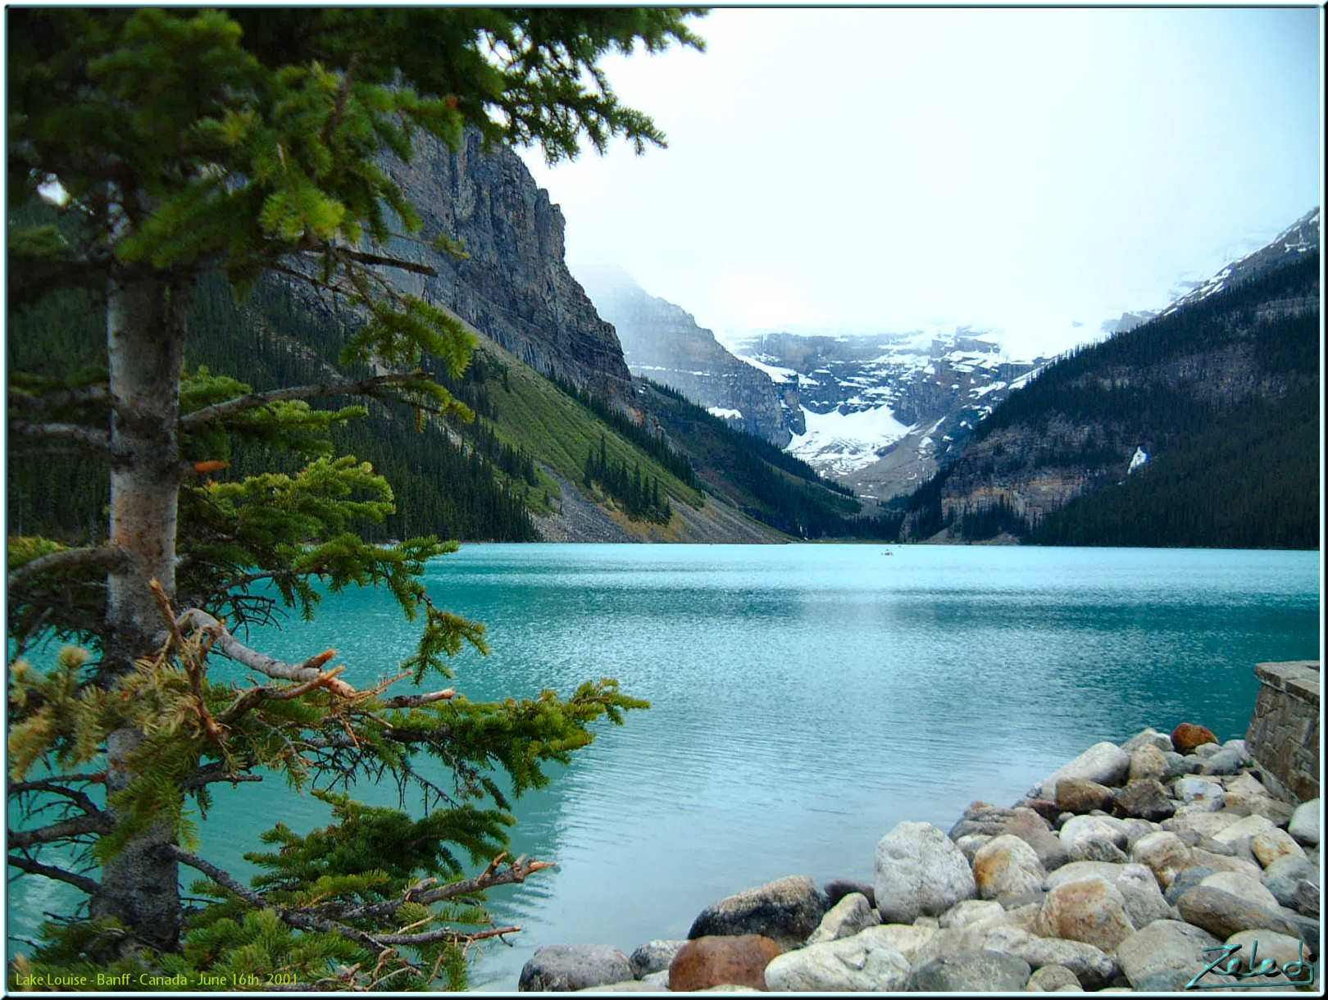
LAKE LOUISE

Slide 47
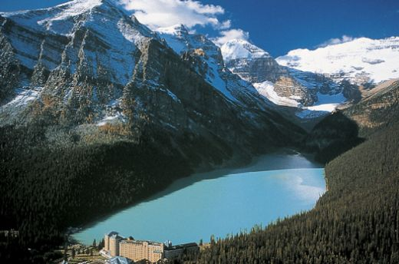

Slide 48
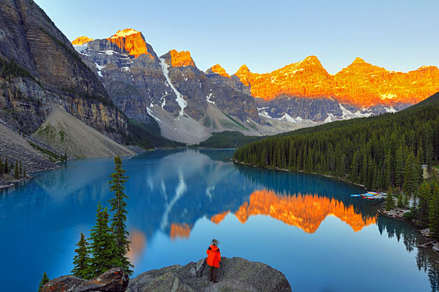

Slide 49
Kelowna, British Columbia:
Kelowna, BC is in the heart of the Canadian Rockies. It is a beautiful river-valley that has some of Canada's best weather. Warm in the summer and mild in the winter. The valley produces Canada's world famous apples.

Slide 50
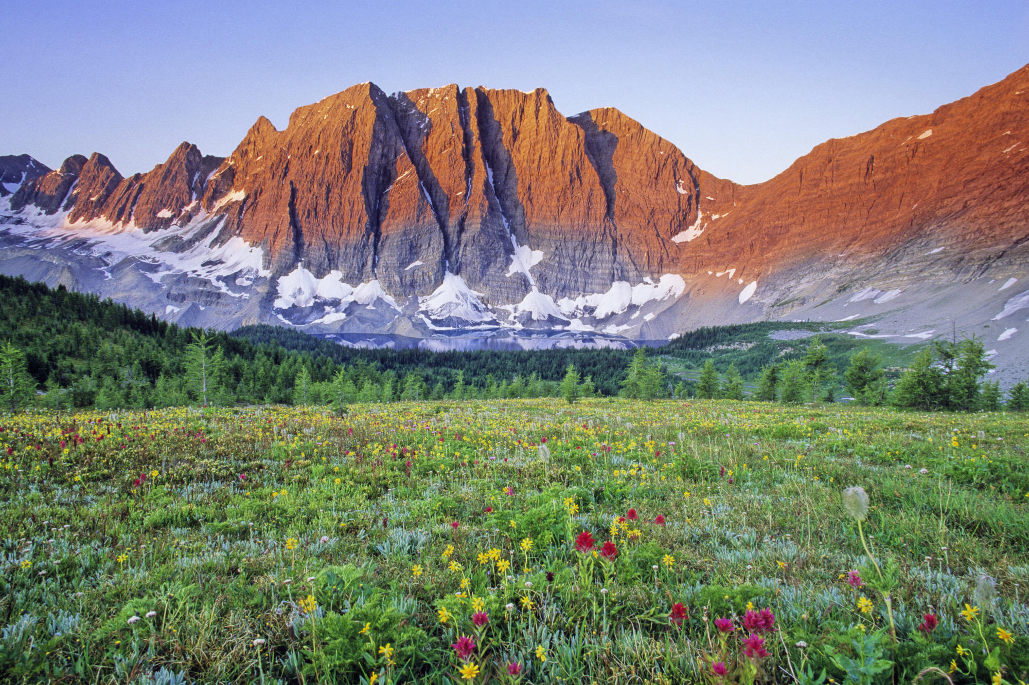

Slide 51
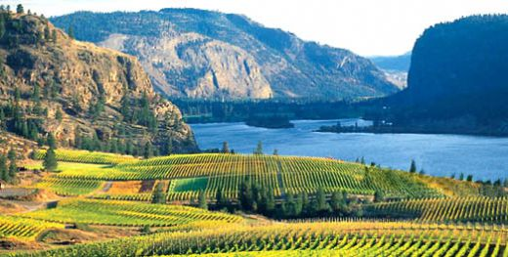

Slide 52
