Slide 1
Data and Computer Communications

Slide 2
Channel Capacity
Max possible data rate on communication channel
Function of
Data rate - in bits per second
Bandwidth - in cycles per second or Hertz
Noise - on communication link
Error rate - of corrupted bits
Limitations due to physical properties
Want most efficient use of capacity
Main constraint on achieving the efficiency is noise
Notes:
The maximum rate at which data can be transmitted over a given communication channel, under given conditions, is referred to as the channel capacity. There are four concepts here that we are trying to relate to one another.
• Data rate, in bits per second (bps), at which data can be communicated
• Bandwidth, as constrained by the transmitter and the nature of the transmission medium, expressed in cycles per second, or Hertz
• Noise, average level of noise over the communications path
• Error rate, at which errors occur, where an error is the reception of a 1 when a 0 was transmitted or the reception of a 0 when a 1 was transmitted
All transmission channels of any practical interest are of limited bandwidth, which arise from the physical properties of the transmission medium or from deliberate limitations at the transmitter on the bandwidth to prevent interference from other sources. Want to make as efficient use as possible of a given bandwidth. For digital data, this means that we would like to get as high a data rate as possible at a particular limit of error rate for a given bandwidth. The main constraint on achieving this efficiency is noise.

Slide 3
Nyquist Bandwidth
Consider noise free channels
If rate of signal transmission is 2B then can carry signal with frequencies no greater than B
i.e. given bandwidth B, highest signal rate is 2B
For binary signals, 2B bps needs bandwidth B Hz
Notes:
Consider a noise free channel where the limitation on data rate is simply the bandwidth of the signal. Nyquist states that if the rate of signal transmission is 2B, then a signal with frequencies no greater than B is sufficient to carry the signal rate. Conversely given a bandwidth of B, the highest signal rate that can be carried is 2B. This limitation is due to the effect of intersymbol interference, such as is produced by delay distortion.
If the signals to be transmitted are binary (two voltage levels), then the data rate that can be supported by B Hz is 2B bps. However signals with more than two levels can be used; that is, each signal element can represent more than one bit. For example, if four possible voltage levels are used as signals, then each signal element can represent two bits. With multilevel signaling, the Nyquist formulation becomes: C = 2B log₂ M, where M is the number of discrete signal or voltage levels.
So, for a given bandwidth, the data rate can be increased by increasing the number of different signal elements. However, this places an increased burden on the receiver, as it must distinguish one of M possible signal elements. Noise and other impairments on the transmission line will limit the practical value of M.

Slide 4
Nyquist Bandwidth
Can increase rate by using M signal levels
Nyquist Formula is:
C = 2B log₂M
So increase rate by increasing signals
At cost of receiver complexity
Limited by noise & other impairments

Slide 5
Nyquist Bandwidth
EXAMPLE: Consider a voice channel being used, via modem, to transmit digital data. Assume a bandwidth of 3100 Hz and M = 8.
As we know,
C = 2B log₂M
C = 2*3100*log₂(8)
C = 18600 bps

Slide 6
Shannon Capacity Formula
Considers relation of data rate, noise & error rate
Faster data rate shortens each bit so bursts of noise affects more bits
Given noise level, higher rates means higher errors
Shannon developed formula relating these to signal to noise ratio (in decibels)
Notes:
Consider the relationship among data rate, noise, and error rate. The presence of noise can corrupt one or more bits. If the data rate is increased, then the bits become "shorter" so that more bits are affected by a given pattern of noise. Mathematician Claude Shannon developed a formula relating these. For a given level of noise, expect that a greater signal strength would improve the ability to receive data correctly in the presence of noise. The key parameter involved is the signal-to-noise ratio (SNR, or S/N), which is the ratio of the power in a signal to the power contained in the noise that is present at a particular point in the transmission. Typically, this ratio is measured at a receiver, because it is at this point that an attempt is made to process the signal and recover the data. For convenience, this ratio is often reported in decibels. This expresses the amount, in decibels, that the intended signal exceeds the noise level. A high SNR will mean a high-quality signal and a low number of required intermediate repeaters.
The signal-to-noise ratio is important in the transmission of digital data because it sets the upper bound on the achievable data rate. Shannon's result is that the maximum channel capacity, in bits per second, obeys the equation shown. C is the capacity of the channel in bits per second and B is the bandwidth of the channel in Hertz. The Shannon formula represents the theoretical maximum that can be achieved. In practice, however, only much lower rates are achieved, in part because formula only assumes white noise (thermal noise).

Slide 7
Shannon Capacity Formula
Signal to noise ratio(some time written as S/N)
$\text{SNR}\text{db}=\text{10 }\text{log}\text{10}\frac{\text{Signal}}{\text{Noise}}$
High SNR will mean a high-quality signal
Low number of required intermediate repeaters
Notes:
Consider the relationship among data rate, noise, and error rate. The presence of noise can corrupt one or more bits. If the data rate is increased, then the bits become "shorter" so that more bits are affected by a given pattern of noise. Mathematician Claude Shannondeveloped a formula relating these. For a given level of noise, expect that a greater signal strength would improve the ability to receive data correctly in the presence of noise. The key parameter involved is the signal-to-noise ratio (SNR, or S/N), which is the ratio of the power in a signal to the power contained in the noise that is present at a particular point in the transmission. Typically, this ratio is measured at a receiver, because it is at this point that an attempt is made to process the signal and recover the data. For convenience, this ratio is often reported in decibels. This expresses the amount, in decibels, that the intended signal exceeds the noise level. A high SNR will mean a high-quality signal and a low number of required intermediate repeaters.
The signal-to-noise ratio is important in the transmission of digital data because it sets the upper bound on the achievable data rate. Shannon's result is that the maximum channel capacity, in bits per second, obeys the equation shown. C is the capacity of the channel in bits per second and B is the bandwidth of the channel in Hertz. The Shannon formula represents the theoretical maximum that can be achieved. In practice, however, only much lower rates are achieved, in part because formula only assumes white noise (thermal noise).

Slide 8
Shannon Capacity Formula
Maximum channel capacity, in bits per second
Capacity C=B log₂(1+SNR)
Represents the theoretical maximum achievable capacity
Get lower data rates in practice
Because white noise is accounted only
Impulse noise is not accounted for, nor are attenuation distortions

Slide 9
Shannon Capacity Formula

Slide 10
E_{b} / N₀
SNR is used for analog signals
E_{b} / N₀ is the equivalent for digital signals
Signal Energy per bit
E_{b} / N₀ =$\frac{\text{Signal} \text{Energy} \text{per} \text{bit} }{\text{Noise} \text{Power} \text{Density} \text{per} \text{Hertz} }$

Slide 11
Summary
looked at data transmission issues
frequency, spectrum & bandwidth
Analogue Vs. digital signals
Transmission impairments
Notes:
Stallings DCC8e Chapter 3 summary.

Slide 12
Signal Encoding Techniques

Slide 13
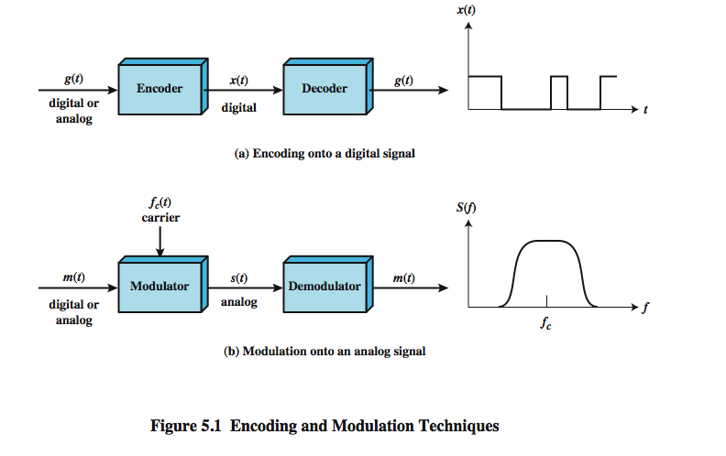
Signal Encoding Techniques
Notes:
Have already noted in Ch 3 that both analog and digital information can be encoded as either analog or digital signals:
Digital data, digital signals: simplest form of digital encoding of digital data
Digital data, analog signal: A modem converts digital data to an analog signal so that it can be transmitted over an analog
Analog data, digital signals: Analog data, such as voice and video, are often digitized to be able to use digital transmission facilities
Analog data, analog signals: Analog data are modulated by a carrier frequency to produce an analog signal in a different frequency band, which can be utilized on an analog transmission system
Stallings DCC8e Fig 5.1 emphasizes the process involved in this. For digital signaling, a data source g(t), which may be either digital or analog, is encoded into a digital signal x(t). The basis for analog signaling is a continuous constant-frequency f_{c} signal known as the carrier signal. Data may be transmitted using a carrier signal by modulation, which is the process of encoding source data onto the carrier signal. All modulation techniques involve operation on one or more of the three fundamental frequency domain parameters: amplitude, frequency, and phase. The input signal m(t) may be analog or digital and is called the modulating signal, and the result of modulating the carrier signal is called the modulated signal s(t).

Slide 14
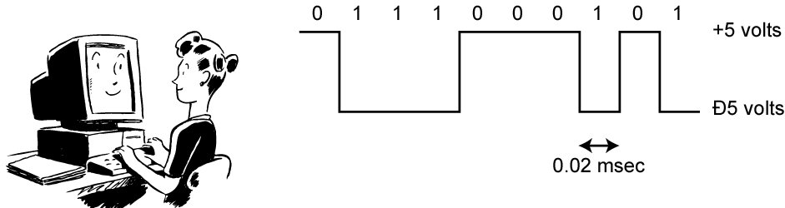
Digital Data, Digital Signal
Digital signal
discrete, discontinuous voltage pulses
each pulse is a signal element
binary data encoded into signal elements
Notes:
Encoding - Digital data to digital signals: A digital signal is a sequence of discrete, discontinuous voltage pulses, as illustrated in Stallings DCC8e Figure 3.13. Each pulse is a signal element. Binary data are transmitted by encoding each data bit into signal elements. In the simplest case, there is a one-to-one correspondence between bits and signal elements. More complex encoding schemes are used to improve performance, by altering the spectrum of the signal and providing synchronization capability. In general, the equipment for encoding digital data into a digital signal is less complex and less expensive than digital-to-analog modulation equipment

Slide 15
Some Terms
Unipolar
All signal elements have the same sign
Polar
One logic state represented by positive voltage the other by negative voltage
Data rate
Bits per second
Duration or length of a bit
Time taken for transmitter to emit the bit

Slide 16
Some Terms
Modulation rate
Rate at which the signal level changes
measured in Baud
Baud Rate = signal elements per second
Depends on type of digital encoding used
Mark and space
Binary 1 and Binary 0 respectively
Notes:
The bit rate is the number of bits transmitted per second, whereas, the baud rate is the number of signal units transmitted per second and one signal unit is able to represent one or more bits. Therefore,baud rate is always less than or equal to the bit ratebut never greater.

Slide 17
Interpreting Signals
Need to know
timing of bits - when they start and end
signal levels
Factors affecting signal interpretation
signal to noise ratio
data rate
bandwidth
encoding scheme
Notes:
The tasks involved in interpreting digital signals at the receiver can be summarized as follows. First, the receiver must know the timing of each bit, knowing with some accuracy when a bit begins and ends. Second, the receiver must determine whether the signal level for each bit position is high (0) or low (1). These tasks can be performed by sampling each bit position in the middle of the interval and comparing the value to a threshold. Because of noise and other impairments, there will be errors. As was shown in Chapter 3, three factors are important: the signal-to-noise ratio, the data rate, and the bandwidth. With other factors held constant, the following statements are true:
• An increase in data rate increases bit error rate (BER).
• An increase in SNR decreases bit error rate.
• An increase in bandwidth allows an increase in data rate.
There is another factor that can be used to improve performance, and that is the encoding scheme. The encoding scheme is simply the mapping from data bits to signal elements. A variety of approaches have been tried. In what follows, we describe some of the more common ones.

Slide 18
Comparison of Encoding Schemes
signal spectrum
clocking
error detection
signal interference and noise immunity
cost and complexity
Notes:
Before describing the various encoding techniques, consider the following ways of evaluating or comparing them:
Signal Spectrum - Lack of high frequencies reduces required bandwidth, lack of dc component allows ac coupling via transformer, providing isolation, should concentrate power in the middle of the bandwidth
Clocking - need for synchronizing transmitter and receiver either with an external clock or with a sync mechanism based on signal
Error detection - useful if can be built in to signal encoding
Signal interference and noise immunity - some codes are better than others
Cost and complexity - Higher signal rate (& thus data rate) lead to higher costs, some codes require signal rate greater than data rate

Slide 19
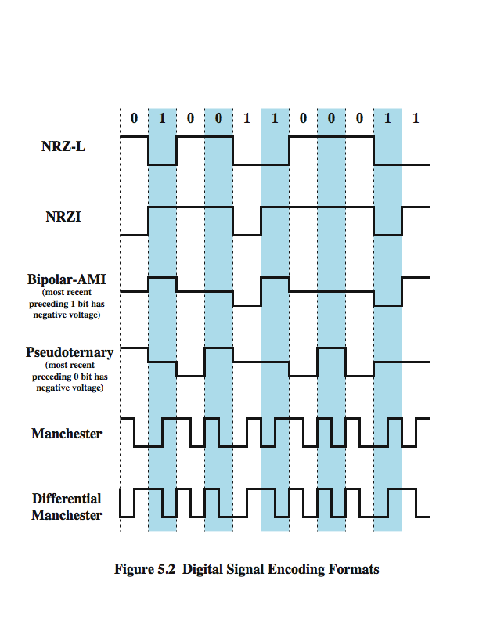
Encoding Schemes
Notes:
We now turn to a discussion of various techniques, which are defined in Stallings DCC8e Table 5.2 and depicted in Figure 5.2 as shown above. They include:
Nonreturn to Zero-Level (NRZ-L)
Nonreturn to Zero Inverted (NRZI)
Bipolar -AMI
Pseudoternary
Manchester
Differential Manchester
B8ZS
HDB3

Slide 20
Non return to Zero-Level (NRZ-L)
Two different voltages for 0 and 1 bits
Voltage constant during bit interval
no transition I.e. no return to zero voltage
such as absence of voltage for zero, constant positive voltage for one
more often, negative voltage for one value and positive for the other
Notes:
The most common, and easiest, way to transmit digital signals is to use two different voltage levels for the two binary digits. Codes that follow this strategy share the property that the voltage level is constant during a bit interval; there is no transition (no return to a zero voltage level). Can have absence of voltage used to represent binary 0, with a constant positive voltage used to represent binary 1. More commonly a negative voltage represents one binary value and a positive voltage represents the other. This is known as Nonreturn to Zero-Level (NRZ-L). NRZ-L is typically the code used to generate or interpret digital data by terminals and other devices.

Slide 21
Nonreturn to Zero Inverted
Non return to zero inverted on ones
constant voltage pulse for duration of bit
data encoded as presence or absence of signal transition at beginning of bit time
transition (low to high or high to low) denotes binary 1
no transition denotes binary 0
example of differential encoding since have
data represented by changes rather than levels
more reliable detection of transition in the presence of noise
Notes:
A variation of NRZ is known as NRZI (Nonreturn to Zero, invert on ones). As with NRZ-L, NRZI maintains a constant voltage pulse for the duration of a bit time. The data bits are encoded as the presence or absence of a signal transition at the beginning of the bit time. A transition (low to high or high to low) at the beginning of a bit time denotes a binary 1 for that bit time; no transition indicates a binary 0.
NRZI is an example of differential encoding. In differential encoding, the information to be transmitted is represented in terms of the changes between successive signal elements rather than the signal elements themselves. The encoding of the current bit is determined as follows: if the current bit is a binary 0, then the current bit is encoded with the same signal as the preceding bit; if the current bit is a binary 1, then the current bit is encoded with a different signal than the preceding bit. One benefit of differential encoding is that it may be more reliable to detect a transition in the presence of noise than to compare a value to a threshold. Another benefit is that with a complex transmission layout, it is easy to lose the sense of the polarity of the signal.

Slide 22
NRZ Pros & Cons
Pros
easy to engineer
make good use of bandwidth
Cons
dc component
lack of synchronization capability
used for magnetic recording
not often used for signal transmission
Notes:
The NRZ codes are the easiest to engineer and, in addition, make efficient use of bandwidth. Most of the energy in NRZ and NRZI signals is between dc and half the bit rate. The main limitations of NRZ signals are the presence of a dc component and the lack of synchronization capability. Consider that with a long string of 1s or 0s for NRZ-L or a long string of 0s for NRZI, the output is a constant voltage over a long period of time. Under these circumstances, any drift between the clocks of transmitter and receiver will result in loss of synchronization between the two.
Because of their simplicity and relatively low frequency response characteristics, NRZ codes are commonly used for digital magnetic recording. However, their limitations make these codes unattractive for signal transmission applications.

Slide 23
Multilevel Binary Bipolar-AMI
Use more than two levels
Bipolar-AMI
zero represented by no line signal
one represented by positive or negative pulse
one pulses alternate in polarity
no loss of sync if a long string of ones
long runs of zeros still a problem
no net dc component
lower bandwidth
easy error detection
Notes:
A category of encoding techniques known as multilevel binary addresses some of the deficiencies of the NRZ codes. These codes use more than two signal levels. Two examples of this scheme was illustrated in Figure 5.2.
In the bipolar-AMI scheme, a binary 0 is represented by no line signal, and a binary 1 is represented by a positive or negative pulse. The binary 1 pulses must alternate in polarity. There are several advantages to this approach. First, there will be no loss of synchronization if a long string of 1s occurs. Each 1 introduces a transition, and the receiver can resynchronize on that transition. A long string of 0s would still be a problem. Second, because the 1 signals alternate in voltage from positive to negative, there is no net dc component. Also, the bandwidth of the resulting signal is considerably less than the bandwidth for NRZ. Finally, the pulse alternation property provides a simple means of error detection. Any isolated error, whether it deletes a pulse or adds a pulse, causes a violation of this property.

Slide 24
Multilevel Binary Pseudoternary
one represented by absence of line signal
zero represented by alternating positive and negative
no advantage or disadvantage over bipolar-AMI
each used in some applications
Notes:
The comments on bipolar-AMI also apply to pseudoternary. In this case, it is the binary 1 that is represented by the absence of a line signal, and the binary 0 by alternating positive and negative pulses. There is no particular advantage of one technique versus the other, and each is the basis of some applications.

Slide 25
Multilevel Binary Issues
synchronization with long runs of 0’s or 1’s
can insert additional bits, cf ISDN
scramble data (later)
not as efficient as NRZ
each signal element only represents one bit
receiver distinguishes between three levels: +A, -A, 0
a 3 level system could represent log₂3 = 1.58 bits
requires approx. 3dB more signal power for same probability of bit error
Notes:
Although a degree of synchronization is provided with these codes, a long string of 0s in the case of AMI or 1s in the case of pseudoternary still presents a problem. Several techniques have been used to address this deficiency. One approach is to insert additional bits that force transitions. This technique is used in ISDN (integrated services digital network) for relatively low data rate transmission. Of course, at a high data rate, this scheme is expensive, because it results in an increase in an already high signal transmission rate. To deal with this problem at high data rates, a technique that involves scrambling the data is used.
Thus, with suitable modification, multilevel binary schemes overcome the problems of NRZ codes. Of course, as with any engineering design decision, there is a tradeoff. With multilevel binary coding, the line signal may take on one of three levels, but each signal element, which could represent log₂ 3 = 1.58 bits of information, bears only one bit of information, since the receiver of multilevel binary signals has to distinguish between three levels (+A, –A, 0) instead of just two levels in the signaling formats previously discussed. Because of this, the multilevel binary signal requires approximately 3 dB more signal power than a two-valued signal for the same probability of bit error. Put another way, the bit error rate for NRZ codes, at a given signal-to-noise ratio, is significantly less than that for multilevel binary.

Slide 26
Manchester Encoding
has transition in middle of each bit period
transition serves as clock and data
low to high represents one
high to low represents zero
used by IEEE 802.
Notes:
There is another set of coding techniques, grouped under the term biphase, that overcomes the limitations of NRZ codes. Two of these techniques, Manchester and differential Manchester, are in common use.
In the Manchester code, there is a transition at the middle of each bit period. The midbit transition serves as a clocking mechanism and also as data: a low-to-high transition represents a 1, and a high-to-low transition represents a 0. Biphase codes are popular techniques for data transmission. The more common Manchester code has been specified for the IEEE 802.3 (Ethernet) standard for baseband coaxial cable and twisted-pair bus LANs.

Slide 27
Differential Manchester Encoding
midbit transition is clocking only
transition at start of bit period representing 0
no transition at start of bit period representing 1
this is a differential encoding scheme
used by IEEE 802.5
Notes:
In differential Manchester, the midbit transition is used only to provide clocking. The encoding of a 0 is represented by the presence of a transition at the beginning of a bit period, and a 1 is represented by the absence of a transition at the beginning of a bit period. Differential Manchester has the added advantage of employing differential encoding.
Differential Manchester has been specified for the IEEE 802.5 token ring LAN, using shielded twisted pair.

Slide 28
Biphase Pros and Cons
Con
at least one transition per bit time and possibly two
maximum modulation rate is twice NRZ
requires more bandwidth
Pros
synchronization on mid bit transition (self clocking)
has no dc component
has error detection
Notes:
All of the biphase techniques require at least one transition per bit time and may have as many as two transitions. Thus, the maximum modulation rate is twice that for NRZ; this means that the bandwidth required is correspondingly greater. The bandwidth for biphase codes is reasonably narrow and contains no dc component. However, it is wider than the bandwidth for the multilevel binary codes.
On the other hand, the biphase schemes have several advantages:
• Synchronization: Because there is a predictable transition during each bit time, the receiver can synchronize on that transition, known as self-clocking codes.
• No dc component: Biphase codes have no dc component
• Error detection: The absence of an expected transition can be used to detect errors. Noise on the line would have to invert both the signal before and after the expected transition to cause an undetected error.

Slide 29
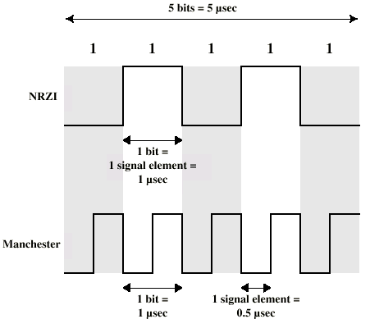
Modulation Rate
Notes:
When signal-encoding techniques are used, a distinction needs to be made between data rate (expressed in bits per second) and modulation rate (expressed in baud). The data rate, or bit rate, is 1/T_{b}, where T_{b} = bit duration. The modulation rate is the rate at which signal elements are generated. Consider, for example, Manchester encoding. The minimum size signal element is a pulse of one-half the duration of a bit interval. For a string of all binary zeroes or all binary ones, a continuous stream of such pulses is generated. Hence the maximum modulation rate for Manchester is 2/T_{b}. This situation is illustrated in Stallings DCC8e Figure 5.5, which shows the transmission of a stream of binary 1s at a data rate of 1 Mbps using NRZI and Manchester.
One way of characterizing the modulation rate is to determine the average number of transitions that occur per bit time. In general, this will depend on the exact sequence of bits being transmitted. Stallings DCC8e Table 5.3 compares transition rates for various techniques.

Slide 30
Scrambling
Use scrambling to replace sequences that would produce constant voltage
These filling sequences must
produce enough transitions to sync
be recognized by receiver & replaced with original
be same length as original
Design goals
have no dc component
have no long sequences of zero level line signal
have no reduction in data rate
give error detection capability
Notes:
Although the biphase techniques have achieved widespread use in local area network applications at relatively high data rates (up to 10 Mbps), they have not been widely used in long-distance applications. The principal reason for this is that they require a high signaling rate relative to the data rate. This sort of inefficiency is more costly in a long-distance application.
Another approach is to make use of some sort of scrambling scheme. The idea behind this approach is simple: sequences that would result in a constant voltage level on the line are replaced by filling sequences that will provide sufficient transitions for the receiver's clock to maintain synchronization. The filling sequence must be recognized by the receiver and replaced with the original data sequence. The filling sequence is the same length as the original sequence, so there is no data rate penalty. The design goals for this approach can be summarized as follows:
• No dc component
• No long sequences of zero-level line signals
• No reduction in data rate
• Error-detection capability

Slide 31
REVIEW

