Slide 1
Calligraphers
Hassan Massoudy
Born: 1944 Najaf, Iraq
Known for: Painter, calligrapher, illustrator
Movement: Hurufiyya movement
Massoudy is an Iraqi artist renowned for his use of traditional Arabic calligraphy in his works. Traditionally Arabic calligraphy is done with black ink. His work is a mixture of traditional Arabic style and Western tradition, drawing inspiration from the work of Modern masters, including Henri Matisse, Pierre Soulages, and Pablo Picasso. he was doing headlines in calligraphy for Arabic magazines.
He has become an important influence on a generation of calligraffiti artists. He traveled through Europe with Arabesque, a work incorporating performance, music, poetry, and calligraphy.
Massoudy as a major source of inspiration.He completely revolutionized the art of calligraphy."

Slide 2
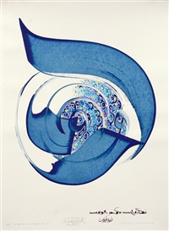
Art Work
Hassan Massoudy
Untitled ("Dawn is the age of roses" -..., 2005
Sundaram Tagore Gallery
Ecstasy" (Al-Wajd) by Hassan Massoudy, 2001

Slide 3
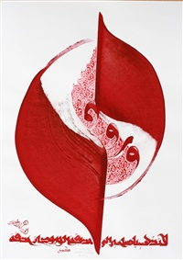
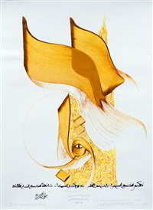
Hassan Massoudy
Untitled ("O Friend! Do not go to the garden , 2012
Sundaram Tagore Gallery
Hassan Massoudy
Untitled ("You fled to the desert on the..., 2014
Sundaram Tagore Gallery

Slide 4
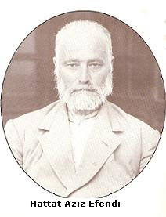
Hattat Aziz Efendi
Born: 1871 Maçka, Ottoman Empire
Known for: Calligraphy
He learn calligraphy from Ahmed Arif Effendi.Two of his calligraphic panels are hanging in the Grand Mosque of Bursa, Turkey. learned the writings of sulus and naskh as Nazari 1896. He started to write the Holy Quran that was requested by Fuad I. The beauty in the calligraphy and illumination of the Quran was admired in Fuad I and offered Aziz Efendi to open the Hat School in Cairo.

Slide 5
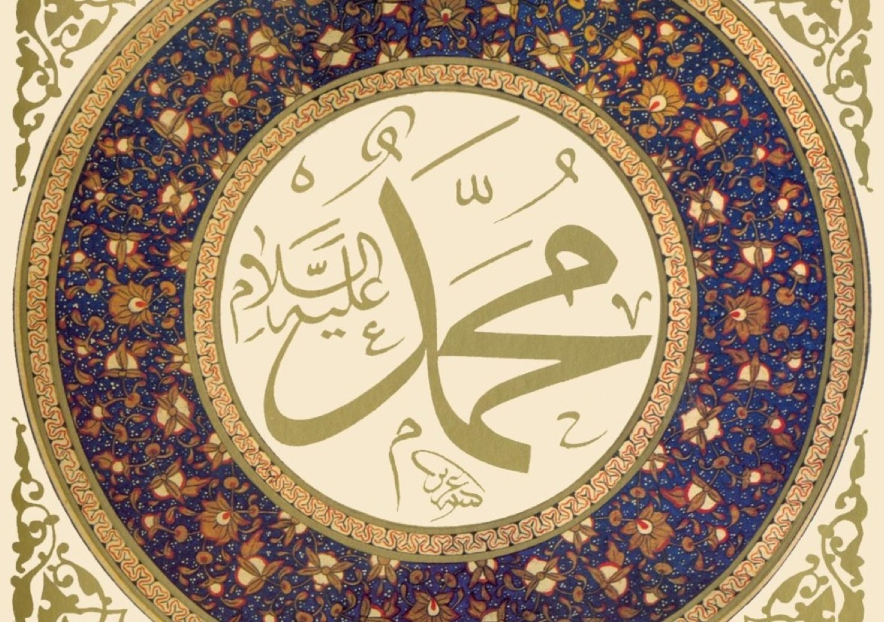
Art Work
The name "Muhammad" in traditional Thuluth calligraphy, possibly inspired by a 19th-century disk in the Hagia Sophia
The first sura of the Qur'an, al-Fatihah, in the hand of Hattat Aziz Efendi

Slide 6
Aslam Kiratpuri
Born : 25 July 1951 Kiratpur, Uttar Pradesh, India
Known for: Lahori Nastalique calligrapher
Is an Urdu journalist, artist and a professional Lahori Nastalique calligrapher. Kiratpuri creates his calligraphic Toghras, intricate works of calligraphy in different styles using verses from the Quran along with various geometric and floral designs. He is the only Lahori Nastalique style calligrapher in India. He specialises in different styles of Quranic calligraphy. In 1979, he was elected as a Founder President of the Urdu Calligraphers Association India, He published his first book on calligraphy " Muraqqa - e - Faiz".

Slide 7
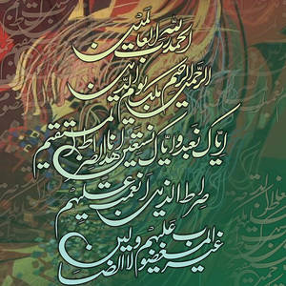
Art Work
Al Hamed Qurani Aayaat is a painting by Aslam Kiratpuri which was uploaded on August 17th, 2012.
Islamic Calligraphy is a painting by Aslam Kiratpuri which was uploaded on August 17th, 2012.

