Slide 1
Rural and urban pollution

Slide 2
Pollution
Pollution can be defined as any undesirable change in physical, chemical, or biological characteristics of any component of the environment i.e. air, water, soil which can cause harmful effects on various forms of life or property.
The term pollution can be defined as influence of any substance causing nuisance, harmful effects, and uneasiness to the organisms.

Slide 3
Pollutants:
Any substance causing Nuisance or harmful effects or uneasiness to the organisms, then that particular substance may be called as the pollutant.
For example: different metals, chlorides, sulphates, oxides of iron, cadmium, acids and alkalis.

Slide 4
Types of Pollution
Air
Water
Land
Noise

Slide 5
Rural Pollution
WATER POLLUTION:
Water is a vital commodity and is essential to the natural environment.
We not only rely on it for drinking but also for its use in industrial processes, cooking, cleaning and the growing of our food. There are many sources of water pollution.

Slide 6
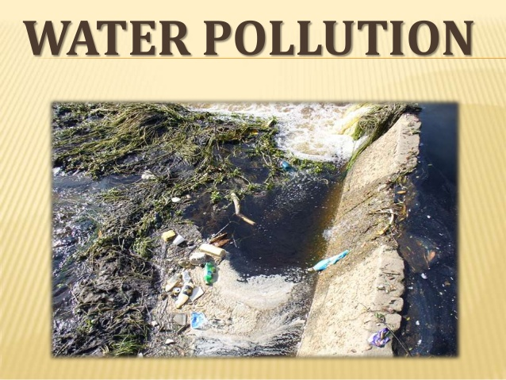
WATER POLLUTION:

Slide 7
Continue:
The major sources of water pollution being; runoff, agricultural pollution, organic matter, toxic waste, and thermal pollution.
One example of this is eutrophication

Slide 8
Eutrophication:
Eutrophication is a situation when foreign bodies such as fertilizers of sewage enter a river or stream and act as a nutrient for algae causing rapid growth and algal blooms.
These algae grow out of control and thus the water becomes depleted in oxygen. The water becomes depleted in oxygen because dead algae sink to the river bed the retrieve the oxygen so it can decompose.

Slide 10
Effects:
This can then lead to further problems if too much algae decomposes it may use all the oxygen.
This will mean all the oxygen has gone and because the water near the surface of the water is warmer its oxygen doesn’t mix with water from the bottom as it’s colder and has a higher density

Slide 11
Runoff Problem:
Runoff is a major cause for concern in more rural areas and areas of intense agriculture.
These pollutants are both organic and inorganic and can also be perversely complex, this leads to little knowledge of how these pollutants will interact once they combine and enter a water body.

Slide 12
Continue:
One of the mains sources of which is agriculture as previously mentioned, the main pollutants involved in diffuse water pollution in agriculture are nitrogen and phosphorus.
Animal waste as found in areas of agriculture, also the use of phosphorus and nitrogen in fertilizers contributes to water pollution.

Slide 14
Phosphorous:
The adding of fertilizers to crops also returns the essential phosphorus back to the soil, which gets taken from the soil to help grow the crops to start with.
Phosphorus can also be found in soils in both the organic and inorganic form. In terms of organic phosphorus it exists in plant residues, organic soil and microbes.
Phosphorus can also be in an insoluble form within soil meaning that plants cannot take in this phosphorus.

Slide 15
Nitrogen:
Nitrogen is essential nutrient for plant growth and part of a natural cycle that occurs which if perturbed can have serious effects on organisms that rely on the cycle.
The addition of extra nitrogen from farming practices and the use of fertilizers will lead to the potential eutrophication of water bodies.

Slide 16
Continue:
This is due to the when the balance of the nitrogen cycle is interrupted with the addition of nitrogen from fertilizers.
As a result of this the natural nitrogen cycle expels the surplus nitrogen which can be washed away into a water body.

Slide 17
LAND POLLUTION:
Land pollution is the demolition of Earth's land surfaces often caused by human activities and their misuse of land resources.
It occurs when waste is not disposed properly.
Urbanization and industrialization are major causes of land pollution

Slide 18
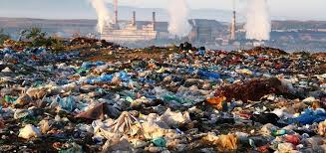
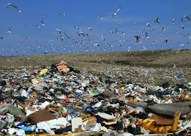

Slide 19
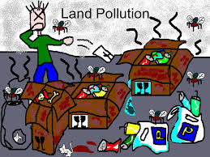
Causes:
Agriculture
Domestic wastes.
These are the two main causes of land pollution in rural areas.

Slide 20
Agriculture:
As there are more and more people inhabiting the earth, food is in higher demand and so forests are chopped down and turned into farmland.
In addition, herbicides, pesticides, artificial fertilizers, animal manure are washed into the soil and pollute it.

Slide 21
DOMESTIC WASTE
Tons of domestic waste is dumped every day. Some waste from homes, offices and industries can be recycled or burnt in incinerators.
There is still a lot of garbage, such as refrigerators and washing machines that are dumped in landfills simply because they cannot be reused in anyway, nor recycled.

Slide 22
Solutions:
More and more land should be brought under farming. Trees should be planted everywhere.
Waste matter should be disposed immediately. Avoid drilling the Land for more underground water.
Avoid using more fertilizers and Pesticides.

Slide 23
Urban Pollution:
AIR POLLUTION:
Air pollution is the introduction of chemicals, particulate matter, or biological materials that cause harm or discomfort to humans or other living organisms, or cause damage to the natural environment or built environment, into the atmosphere.
A substance in the air that can cause harm to humans and the environment is known as an air pollutant.

Slide 24
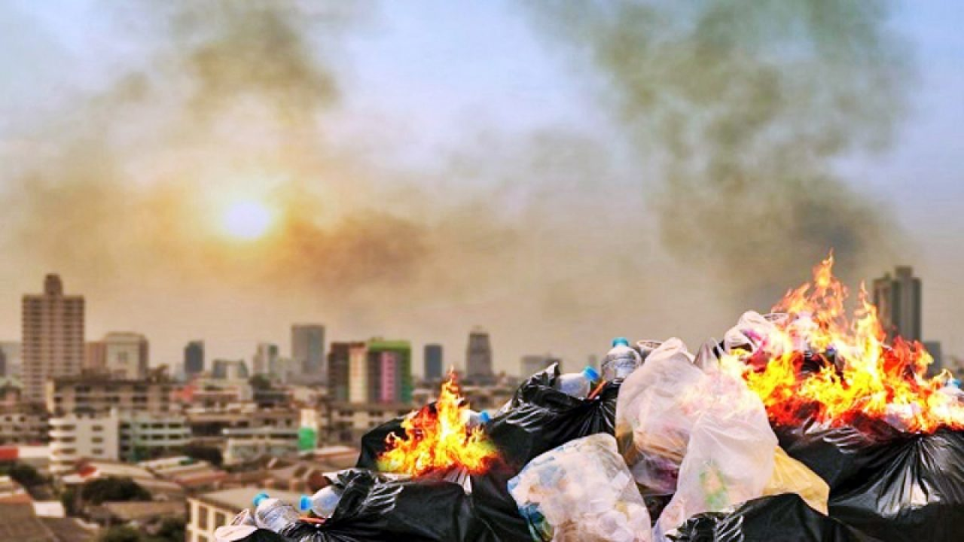

Slide 25
Causes:
Carbon dioxide-this happens because of Deforestation and fossil fuel burning.
Sulfur dioxide –Due to the burning of sulfur containing compounds of fossil fuels.
Sulfur oxides- very dangerous to humans at a high concentration. Sulfur in the atmosphere is responsible for acid rain.

Slide 26
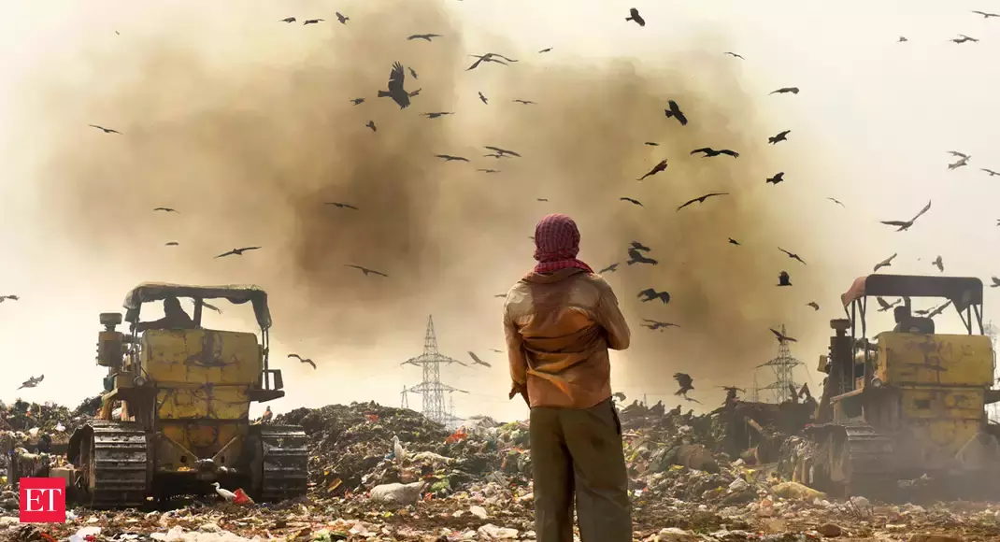
Effects:
CO2 is a good transmitter of sunlight, but it also partially restricts infrared radiation going back from the earth into space, which produces the so called greenhouse effect that prevents a drastic cooling of the Earth during the night.

Slide 27
WATER POLLUTION:
Water Pollution can be defined as alteration in physical, chemical, or biological characteristics of water through natural or human activities and making it unsuitable for its designated use.
The used water becomes contaminated and is called waste water.

Slide 28
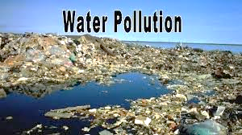

Slide 29
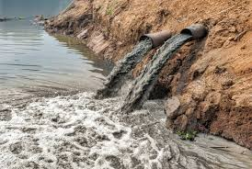
Sources:
The sources of water pollution can be classified as:
Municipal Waste Water
Industrial Waste Inorganic Pollutants
Organic Pollutants
Thermal pollution

Slide 30
INDUSTRIAL WASTE
The major source of water pollution is the waste water discharged from industries and commercial bodies, these industries are chemical, metallurgical, food processing industries, textile, paper industries.
They discharge several organic and inorganic pollutants that prove highly toxic to living beings.

Slide 31
THERMAL POLLUTION
Thermal Pollution of water is caused by the rise in temperature of water. The main source of thermal pollution are the thermal and nuclear power plants.
The power generating plants use water as coolants and release hot water into the original source. Sudden rise in temperature kills fish and other aquatic animals.

Slide 32
Effects:
On human health:
Waterborne pathogens, in the form of disease-causing bacteria and viruses from human and animal waste, are a major cause of illness from drinking contaminated water.
Diseases spread by unsafe water include cholera, giardia, and typhoid. Even in wealthy nations, accidental or illegal releases from sewage treatment facilities, as well as runoff from farms and urban areas, contribute harmful pathogens to waterways.

Slide 33
On the environment
In order to thrive, healthy ecosystems rely on a complex web of animals, plants, bacteria, and fungi—all of which interact, directly or indirectly, with each other.
Harm to any of these organisms can create a chain effect, imperiling entire aquatic environments.

Slide 34
Solutions:
Rivers should not be used for washing clothes or bathing animals in. Harvesting of Rainwater to meet water requirements.
Dams and embankments must be created. The rivers must not be contaminated.
Reduce your plastic consumption and reuse or recycle plastic when you can.

Slide 35
NOISE POLLUTION
Noise pollution is excessive, displeasing human, animal, or machine-created environmental noise that disrupts the activity or balance of human or animal life.
Sound becomes undesirable when it disturbs the normal activities such as working, sleeping, and during conversations.

Slide 36
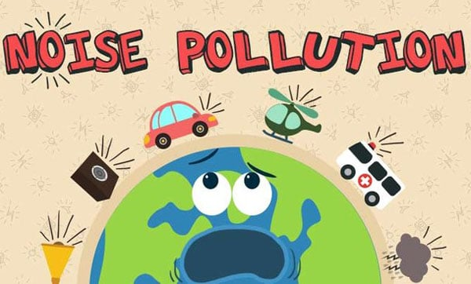

Slide 37
SOURCES
Transportation systems are the main source of noise pollution in urban areas.
Construction of buildings, highways, and streets cause a lot of noise, due to the usage of air compressors, bulldozers, loaders, dump trucks, and pavement breakers.
Industrial noise also adds to the already unfavorable state of noise pollution.

Slide 38
EFFECTS:
Noise pollution can damage physiological and psychological health.
High blood pressure, stress related illness, sleep disruption, hearing loss, and productivity loss are the problems related to noise pollution.
It can also cause memory loss, severe depression, and panic attacks.

Slide 39
Solutions:
Planting bushes and trees in and around sound generating sources is an effective solution for noise pollution.
Regular servicing and tuning of automobiles can effectively reduce the noise pollution.
Social awareness programs should be taken up to educate the public about the causes and effects of noise pollution.
Workers should be provided with equipment such as ear plugs and earmuffs for hearing protection.

