Slide 1
Micro WATERSHED MANAGMENT
UNDER RAINFED CONDITION

Slide 2
WATERSHED and MICRO-WATERSHED
The watershed is a natural hydrological entity that covers a specific aerial expanse of land surface from which the rainfall runoff flows to a defined drain, channel, stream or river at any particular point,The smallest hydrologic unit in the hierarchal system is termed as Micro watershed having size of 100-1000 ha.
Or
Micro watersheds: The size of the watershed range from few hectares to hundreds of hectares. These can be designed within the crop fields.

Slide 3
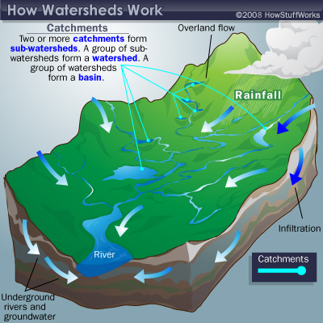
How to work

Slide 4
TYPES OF WATERSHED
Watersheds is classified depending upon drainage, shape and land use pattern.
Macro watershed (> 50,000 Ha)
Sub-watershed (10,000 to 50,000 Ha)
Milli-watershed (1000 to10000 Ha)
Micro watershed (100 to 1000 Ha)
Mini watershed (1-100 Ha)

Slide 5
Micro Watershed Management
Micro Watershed management implies the wise use of soil and water resources within a given geographical area.
Micro watershed management is a term used to describe the process of implementing land use practices and water management practices to protect and improve the quality of the water and other natural resources within a watershed by managing the use of those land and water resources in a comprehensive manner.

Slide 6
Principles of Micro watershed Management
Utilizing the land based on its capability Protecting the fertile top soil
Minimizing the silting up of the reservoirs
In situ conservation of rain water
Safe diversion of surface runoff to storage structures through grassed water ways.
Water harvesting for supplemental irrigation
Ensuring sustainability of the ecosystem
Improving socio-economic status of farmers.

Slide 7
Objectives of Micro Watershed Management
The term watershed management is synonymous with soil and water conservation with the difference that emphasis is on flood protection and sediment control besides maximizing crop production.
The watershed aims ultimately at improving standards of living of common people in the basin by increasing their earning capacity.

Slide 8
Components of Micro Watershed Management
The main components of micro watershed programme are:
Soil and water conservation
Water harvesting
Crop management
Alternate land use systems

Slide 9
Factors affecting watershed management
a) Watershed characters
i) Size and shape
ii) Topography
iii) Soils
b) Climatic characteristic
i. Precipitation
ii. Amount and intensity of rainfall

Slide 10
Factors affecting watershed management
C) Watershed operation
d) Land use pattern

Slide 11
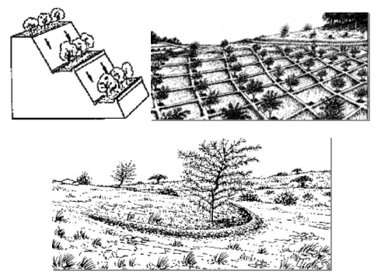
MICROCATCHMENTS
It is useful for in situ moisture conservation and erosion control for tree crops.

Slide 12
MICRO WATERSHED MANAGMENT

Slide 13
MICROCATCHMENTS

Slide 14
MICROCATCHMENTS
Slope ranges from 2 –8%
Soil type – Light to moderate texture
In situ moisture conservation with staggered planting
Suitable for dry land Horticulture & Agroforestry
Bund height – 30 to 45 cm.

Slide 15
Check Dam
A low weir normally constructed across the gullies
Constructed on small streams and long gullies formed by erosive activity of flood water.
It cuts the velocity and reduces erosive activity
The stored water improves soil moisture.
Spacing between the check dams water spread of one should be beyond the water spread of the other Height depends on the bank height, varies from a metre to 3 metre and length varies from less than 3m to 10m.

Slide 16
Check dam

Slide 17
Percolation pond
Shallow depression created at lower portions in a natural or diverted stream course.
Preferable under gentle sloping stream where narrow valley exists Located in soils of permeable nature.
Adaptable where 20-30 ground water wells for irrigation exist with in the zone of influence about 800 – 900m.

Slide 18
Percolation pond

Slide 19
Stone Barriers

Slide 20
Contour Trench

Slide 21
Gully plugs

Slide 22
Gully plugs
Gully plug is one of the simple method of soil and water conservation. It plays an important role in soil and water conservation.
Gullies are formed due to erosion of top soil by the flow of rain water.

Slide 23
Vegetative barriers
Vegetative barriers are also an effective inter-terrace land treatment in place of earthen barriers.

Slide 24
Farm ponds
Rain water is harvested and stored
Used for storing water for longer duration.
Covered with polythene sheet to prevent evaporation.

