Slide 1
Spinal Cord Injury Management 2

Slide 2
Outline
Level of spinal segment
Etiology
Mechanism and types
Hamstring

Slide 4
SPINAL CORD INJURY
Low incidence
High cost disability
Age 16-30yr
Male to female 4:1
Average length of hospital
Acute condition 15days
In rehabilitation 44days

Slide 5
The typical person with spinal cord injury is male, aged between 15 and 25 years;
only about 15% of spinal cord injuries affect females and only 18% affect people over 45 years
For example, in the Pakistan earthquakes of 2005 the majority of spinal cord injuries (estimated to be over 1500) were in young women and children.

Slide 6
Over 55% of all spinal cord injuries are cervical; the remainder are approximately equally divided between thoracic, lumbar and sacral levels.
The most common level of injury is C5, followed by C4, C6 and T12, in that order.10

Slide 7
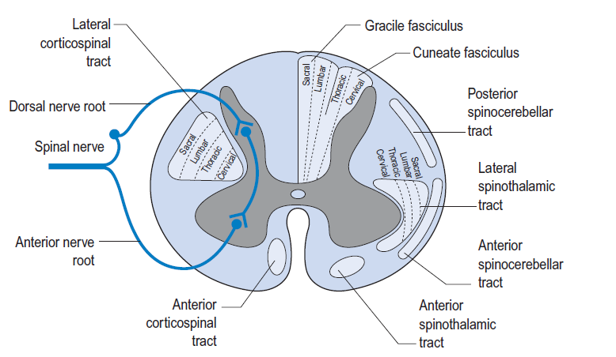

Slide 8
Etiology
Traumatic
Non-Traumatic

Slide 9
Mechanism

Slide 10
Mechanism

Slide 11
Traumatic
Most common
Motor vehicle accident
Fall
Gun shot
Earthquake

Slide 12
Non-Traumatic
Pathological condition
AVM (Arteriovenous malformation)
Vertebral subluxation
R.A
DJD
Spinal neoplasm
Infections
MS
ALS

Slide 13
Classification
Tetraplegia
Complete
Partial
Paraplegia
Complete
Partial

Slide 14
Designation of lesion level
Most distal uninvolved nerve root segment with normal function together with skeletal level.
C7 intact
Below C7 no sensory no motor so it will called
C7 Complete Tetraplegia
If some sensation and some muscle function below C7
C7 incomplete or partial Tetraplegia

Slide 15
Types of Lesion
Complete Lesion
No Sensory sensation below lesion
No Motor function below lesion

Slide 16
Types of Lesion
Incomplete Lesion
Some Sensory function below lesion
Some Motor function below lesion

Slide 17
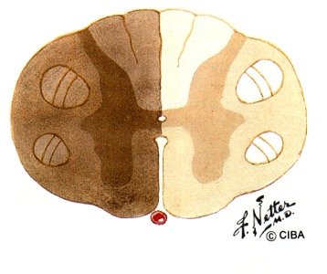
Types of Lesion
Brown Squared Syndrome
Hemi-section
Stab wounds
Ipsilateral Loss of motor function
Loss of proprioception,light
touch,kinesthesia,two point discrimination
Contralateral Pain and temperature
Superficial lack of reflexes
Clonus Present
Bibinski’sign Positive

Slide 18
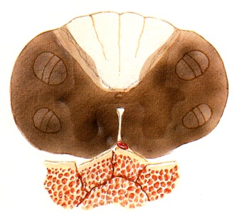
Types of Lesion
Anterior cord syndrome
Flexion injuries
Anterior damage
Fracture ,dislocation, disc protrusion
Loss of motor function
Loss of pain and temperature
Kinesthetic and Proprioception preserved

Slide 19
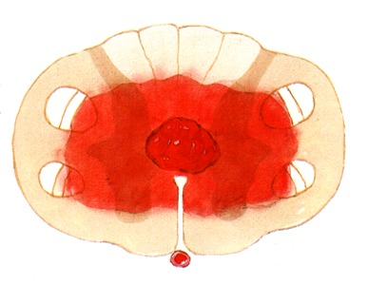
Types of Lesion
Central cord syndrome
Hyperextension injuries
Congenital
Degenerative
More upper extremity (cervical tracts are more centrally)
Normal bowl and bladder control

Slide 20
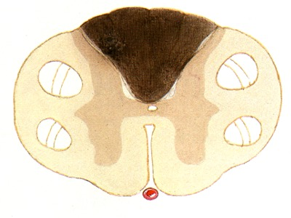
Types of Lesion
Posterior cord syndrome
Loss of proprioception,kinesthesia and touch
Motor function,pain and temperature are preserved
Loss of stereognosis
Wide based gait

Slide 21
Types of Lesion
Sacral sparing
Intact bowl and bladder
Perianal sensation
Toe flexors active

Slide 22
Types of Lesion
Cauda equina injuries
Spinal cord ends???
What is cauda equina???
Upper motor and lower motor neuron lesion????
Mostly incomplete
Lower motor lesion
Regeneration power

Slide 23
Motor Exam
10 “key” muscles (5 upper & 5 lower ext)
C5-Elbow flexion L2-hip flexion
C6-wrist extension L3-knee extension
C7-elbow extension L4-ankle dorsiflexion
C8-finger flexion L5-toe extension
T1-finger abduction S1-ankle plantarflexion
Sacral exam: voluntary anal contraction (present/absent)

Slide 24
ASIA Impairment Scale
A = Complete - no S/M sacral function
B = Sensory incomplete -sacral sensory sparing
C = Motor incomplete -motor sparing below (strength < 3/5 in most m’s)
D = Motor incomplete - “ ”(>3/5)
E = Normal - Normal S/M exam

Slide 25
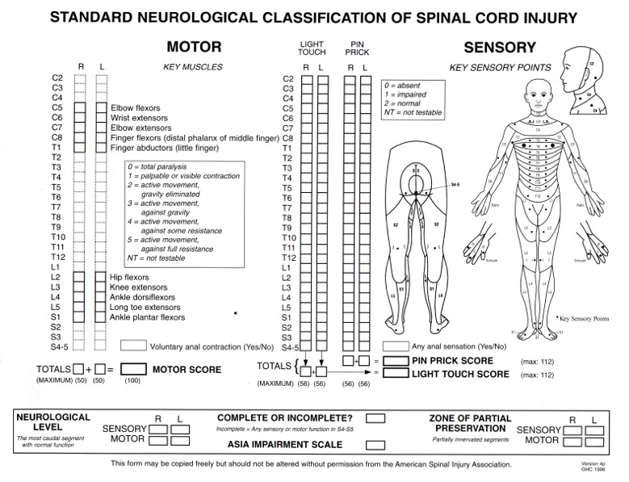

Slide 26
Stretching
Hold Relax
Both ends
Self stretching
Positional stretching
Active stretching
Passive stretching
Geriatrics population stretching

Slide 28
Questions
What is the significance of length of spinal cord
What are different types of covering of SC and their function
What is the difference between function of brain and spinal cord
What is the role of cortico bulbar tract
What is the function of tectospinal tract
What is the significance of reticulo spinal tract
In neuro rehab what is the importance of muscles and movement and what is the role of strengthening exercise in brain and SC injury
Which area of nervous system belongs to ANS
Which tracts decussate at spinal and medulla level
What are dermatomes and myotomes of body

