Slide 1
Legumes

Slide 2
Legumes rank next in importance to cereals as human food sources.
They contain more protein than any other vegetable and thus are addition to animal meat in food value.
Fats and carbohydrates are also present.
The proteins occur as small granules in the same cells with the starch grains.
The high protein content is related to the presence on the roots of many legumes tubercles that hold nitrogen-fixing bacteria.
The legumes belong to the family Leguminosae (Fabaceae), which is noted for having a special kind of fruit, a legume, which is a pod that opens along two sutures when the seeds are ripe.
Over 11,000 species of legumes are known, and many are of importance as industrial, medicinal or food plants.
The immature fruits also serve as food as demonstrated by garden beans and peas.
Because all parts of the plant are rich in protein, legumes are valuable as field and forage crops.

Slide 3
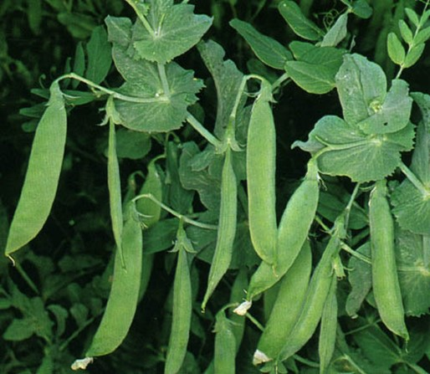
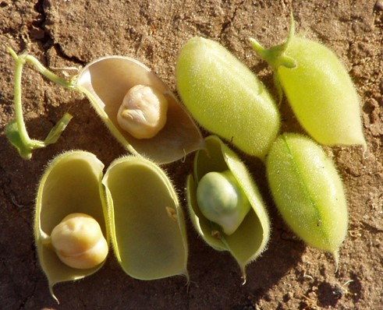
Peas
The common pea, Pisum sativum, is native to Southern Europe and has been cultivated since before the Christian era.
Chickpeas (Garbanzo Beans), Cicer arietinum, are native to southern Europe where they are still extensively grown.
Chickpeas are the best legumes for human consumption as the seeds are very nutritious.

Slide 4
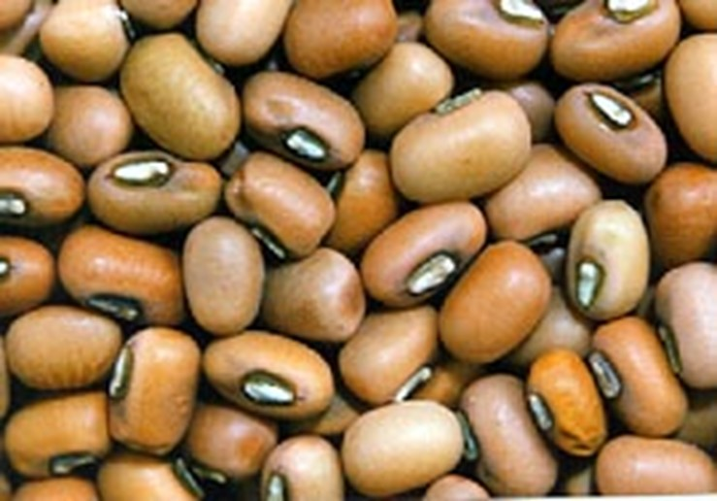
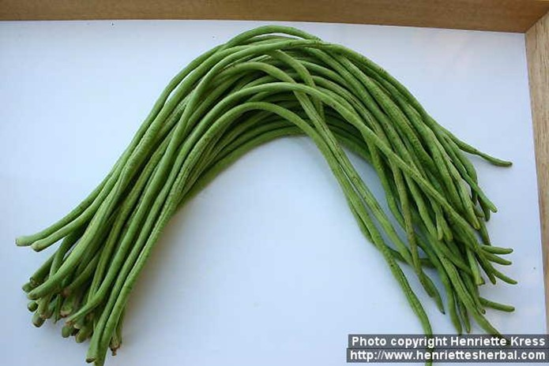
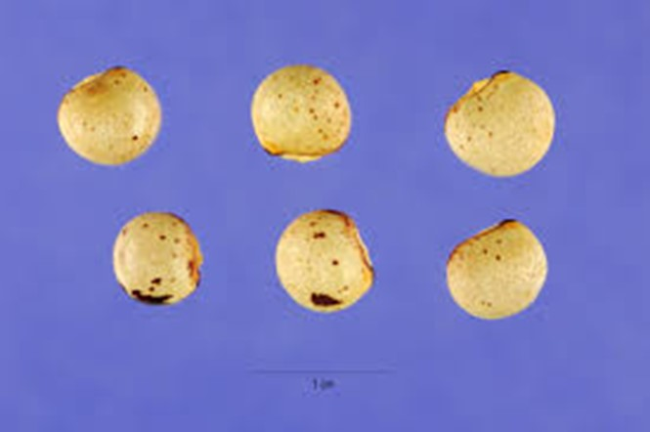
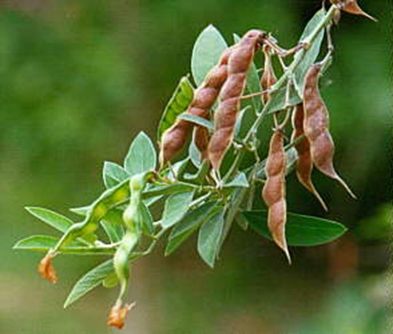
Cowpeas, Vigna sinensis, are more closely related to beans than to peas.
The cowpea is a very old crop, probably originating in Central Asia, although it has been grown in Southeastern Asia for over 2,000 years.
The seeds are used as feed for poultry and cattle, and they may serve as a coffee substitute.
Cajan Pea is a pigeon pea, Cajanus cajan, that was first domesticated in Asia or Africa and is now widely cultivated in the tropics and subtropics, especially in the East Indies, the West Indies and India.
Both the immature and mature seeds have been used for human and animal food for thousands of years.

Slide 5
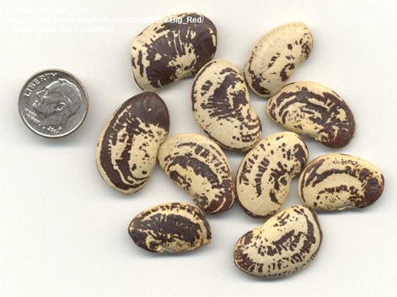
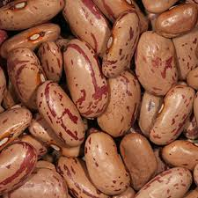
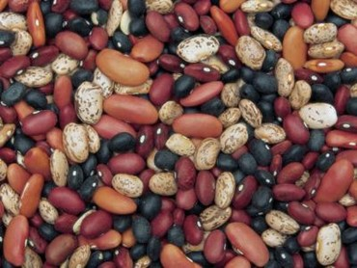
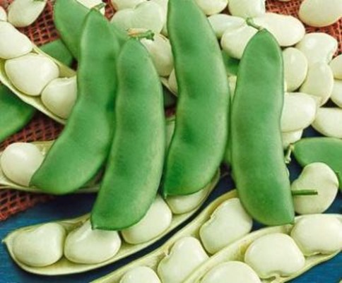
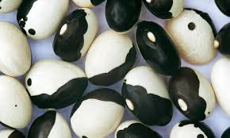
Beans
Lima beans, Phaseolus limensis, are native to Peru and Brazil and have been grown in South America for centuries.
Either green or dried beans are consumed and a large quantity is processed.
the Sieva Bean (Phaseolus lunatus), also native to tropical America.
Garden or kidney beans (Sem Phalli), Phaseolus vulgaris, are indigenous to America.
The whole plant is used for forage.

Slide 6
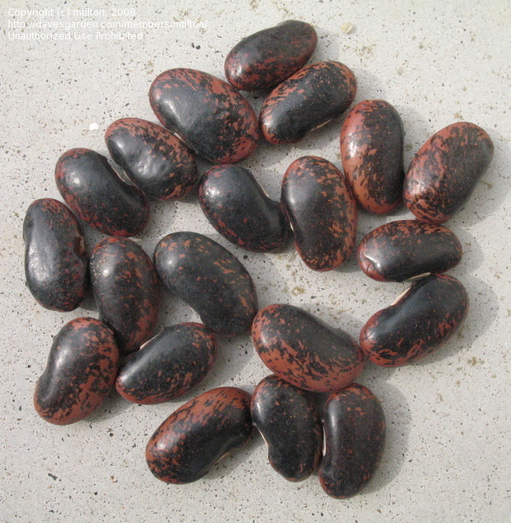
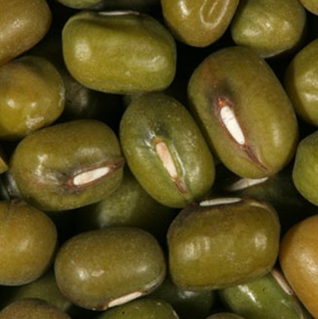
Other species of Phaseolus that are often cultivated include the Scarlet Runner Beans, P. coccineus that have a thickened root and ornamental flowers and the
Mung Bean, Vigna radiata. Mung beans were grown in India in ancient times and are still an important crop.
The small oval seeds are highly nutritious and the green pods are also consumed.

Slide 7
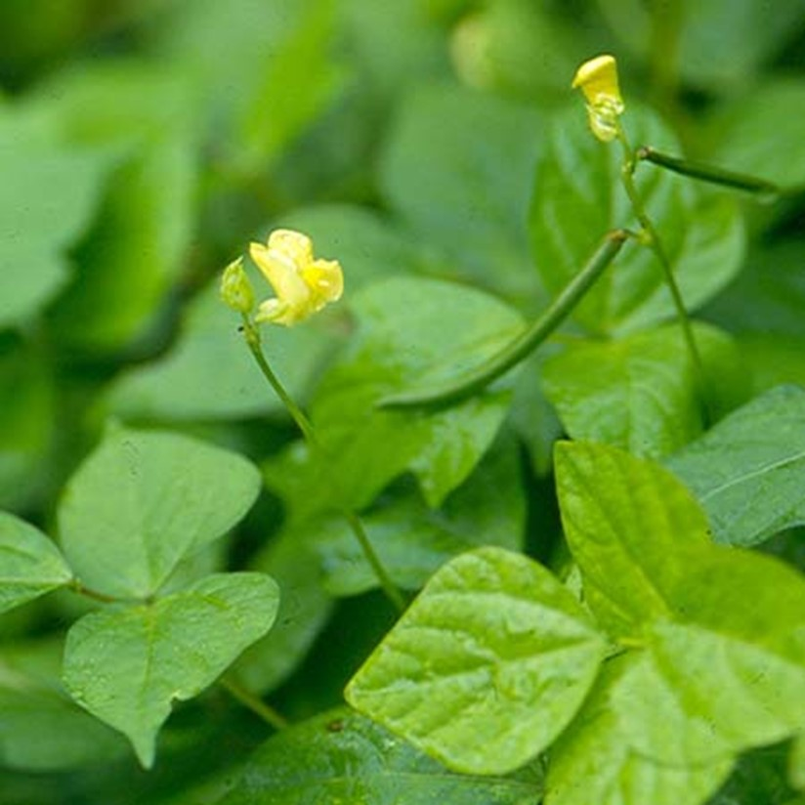
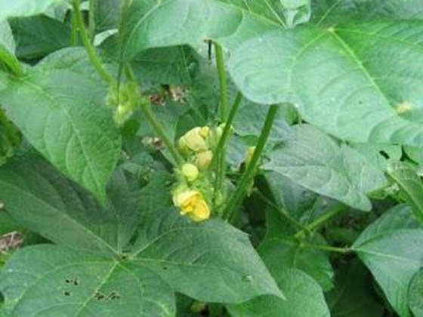
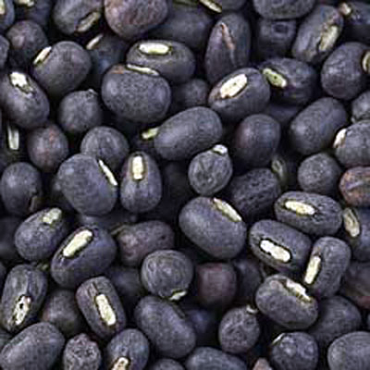
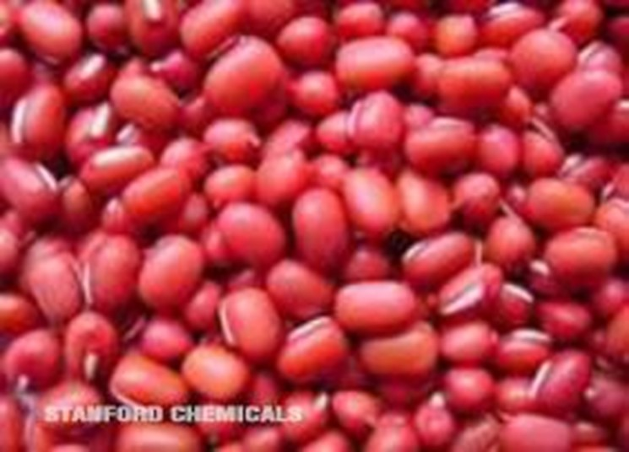
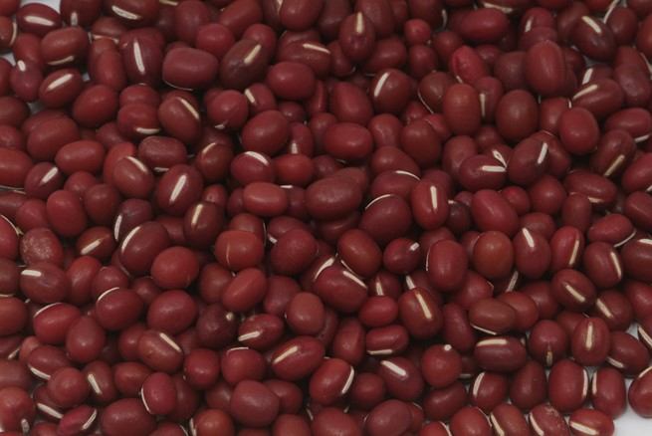
Mash Bean (Black gram), Vigna mungo, originated in India, where it has been in cultivation from ancient times and is one of the most highly prized pulses of India and Pakistan.
The Adsuki Bean, Phaseolus angularis, is next to the Mung Bean in importance in Manchuria and China.
The Rice Bean, Phaseolus calcaratus, is widely cultivated in Southern Asia.

Slide 8
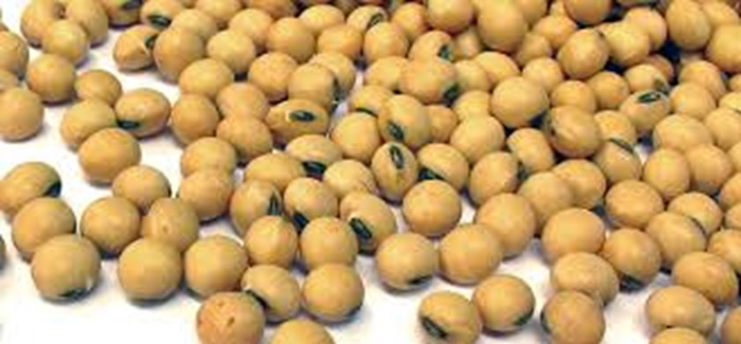
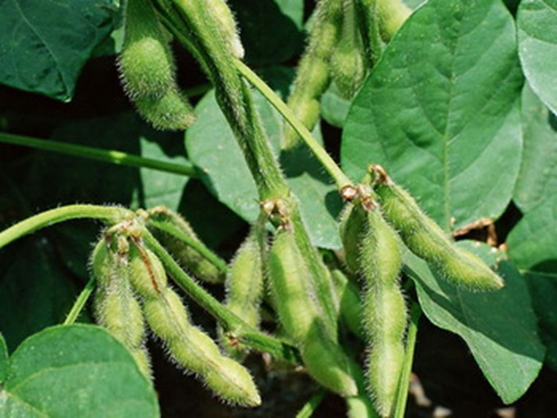
Soybeans, Glycine max, is one of the oldest cultivated crops. It was grown in China centuries before the first written records in 2,838 B.C. It is indigenous to Southeastern Asia, where over 1,000 varieties are grown.
Soybean is the most important legume in Asia there it is consumed fresh, fermented or dried and is used everywhere in the daily diet to supplement rice.
The seed is the richest natural vegetable food known.
In tropical areas, especially Indonesia, soybeans are boiled and then fermented by addition of a mold to yield a food known as Tempe.
Soybean sauce, made from cooked beans, roasted wheat flour, salt and ferment, is widely used.
The flour, with a low carbohydrate and high protein content, is an excellent food for diabetics.
Soybean milk, extracted from the seed, is used in cooking and is used as a substitute for cow’s milk.
Soybean oil is an important drying oil.

Slide 9
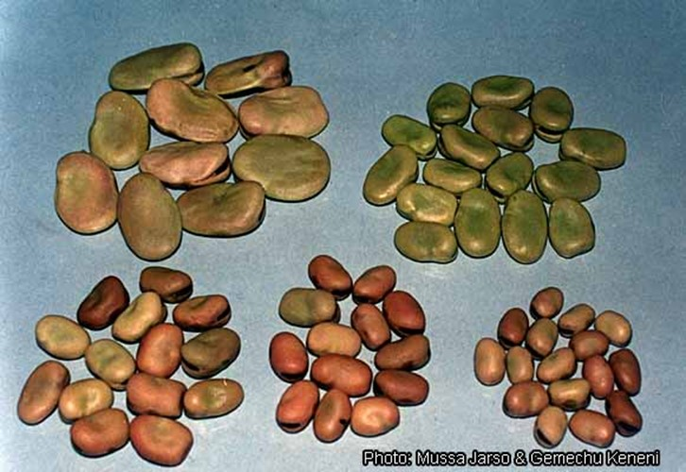
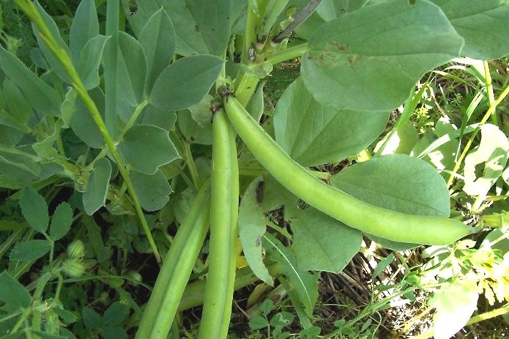
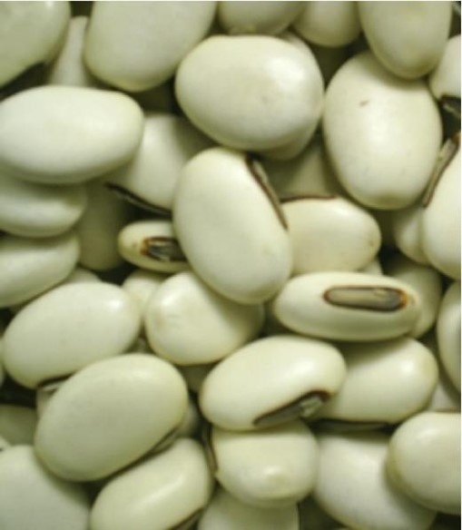
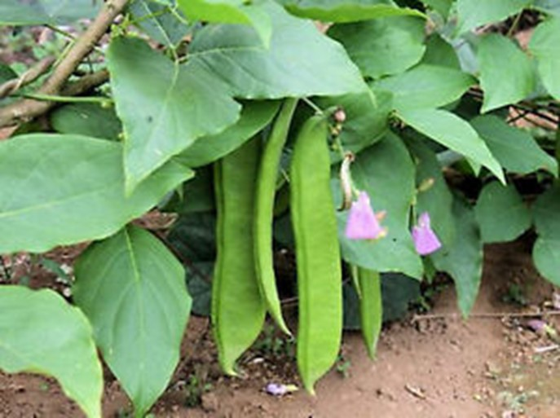
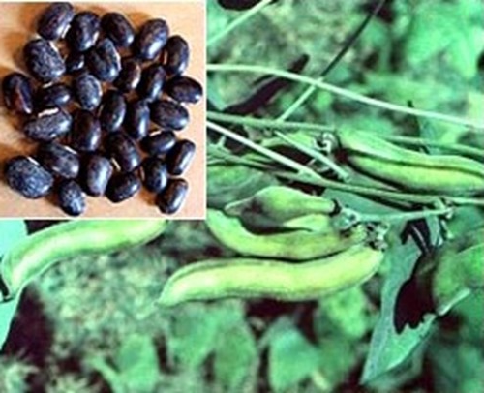
Broad Bean, Vicia faba, is also called the Windsor Bean, Horse Bean or Scotch Bean. It was cultivated in prehistoric times and most likely is indigenous to Southwestern Asia or Algeria.
Horse or Jack Beans, Canavalia ensiformis, are indigenous in the West Indies and are now grown in almost all tropical countries for their seeds.
The unripe seeds and pods are used for human food and the whole plant serves for green forage.
Velvet beans, Stizolobium deeringianum, are widely cultivated in the tropics for their edible seeds and for fodder.

Slide 10
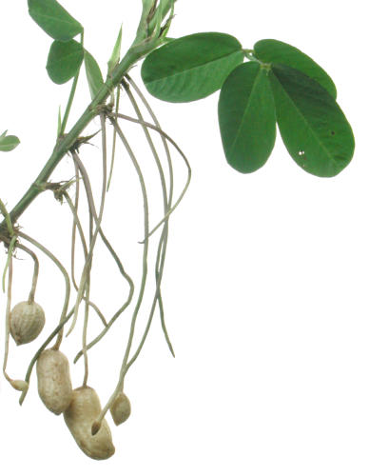
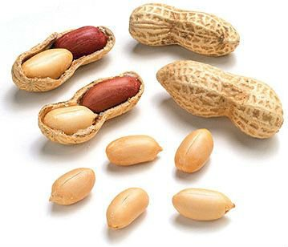
Peanuts
The peanut is indigenous in South America but was early carried to the Old World tropics by the Portuguese explorers and is now grown extensively in most tropical countries.
The plants may be used for forage, livestock feed or as soil renovators.
The nuts or seeds are used for roasting or salting. In candy and for the preparation of peanut butter.
Peanut oil is important food oil.

Slide 11
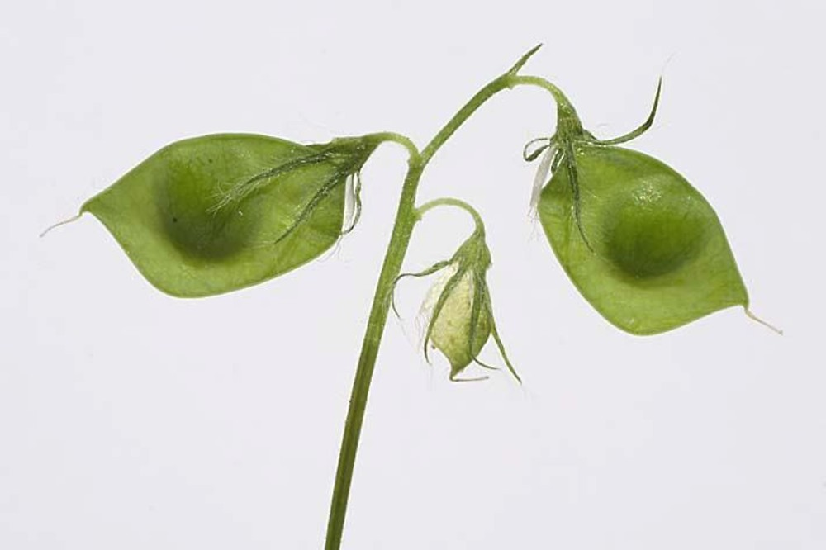
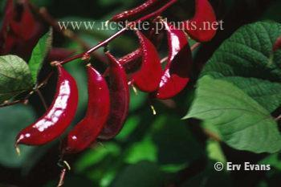
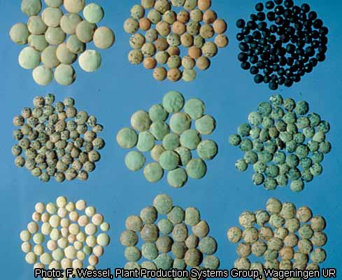
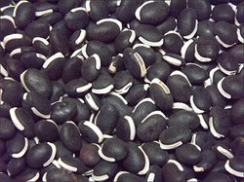
Lentils, Lens culinaris, are some of the most ancient of foods and also one of the most nutritious.
The ancestral home is Southwestern Asia, but they were introduced into ancient Egypt and Greece.
The seeds are used principally in soups and in East Indian cuisine mixed with rice and herbs.
They are easy to digest, more so than meat.
Lablab, Dolichos lablab, is a bean-like legume that is grown in many tropical areas.
Both the pods and the seeds are consumed, and the entire plant is used for hay and forage for horses and cattle.

