Slide 2
Topic:- Binomial Distribution

Slide 3
Introduction
The Binomial probability distribution is the most widely used distribution in two-outcome situations. It was discovered by the Swiss mathematician “Jakob Bernoulli”(1654-1704).Binomial distribution published in 1713, posthumously of Jakob Bernoulli.

Slide 4
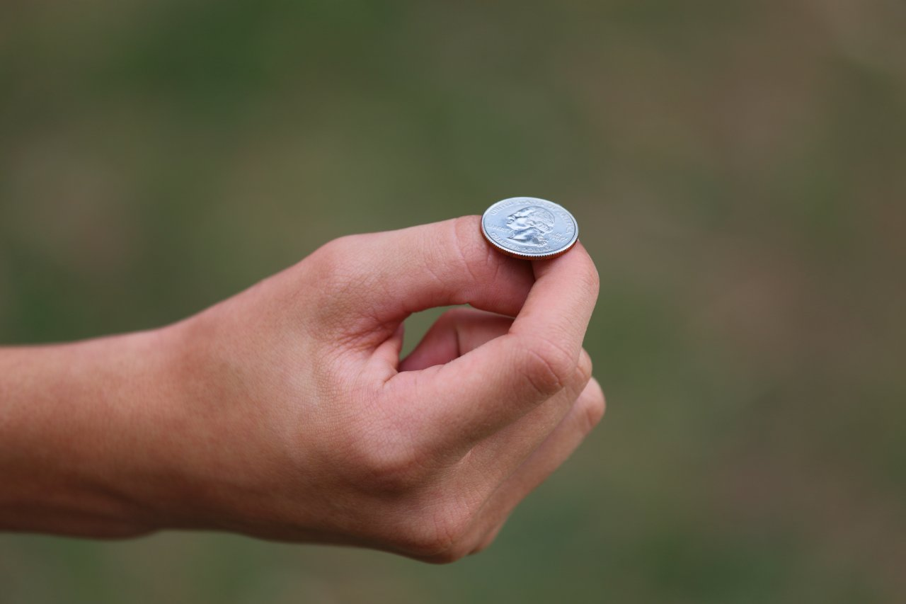
Trial
A single performance of an experiment is called a trial.
Bernoulli Trial
A Bernoulli trial is an experiment which result in one of two mutually exclusive outcomes usually called success or failure and occurrence or non-occurrence on each trial.
Binomial Experiment
The experiment having “n” Bernoulli trials is called a binomial experiment.

Slide 5
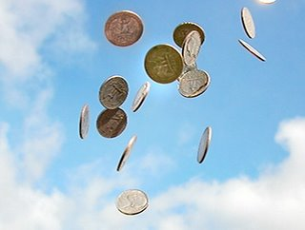
Assumptions of Binomial Distribution
An experiment which fulfil the following conditions is called binomial experiment.
Each experiment has two outcomes which may be classified as success or failure.
The probability of success “p” remains constant from trial to trial. The probability of failure “q” is equal to 1-p. And p+q=1.
The successive trials are independent.
The experiment is repeated for fixed number of time say “n”

Slide 6
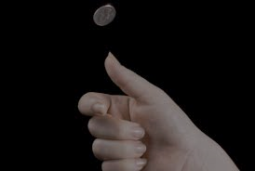
Binomial Random Variable
When the discrete random variable “x” denotes the number of success in “n” independent Bernoulli trials with probability of success “p” remains constant in each trial, then “x” is called binomial random variable.
Binomial Probability Distribution
When the binomial random variable “X” assumes a value “x” then the probability distribution of the number of successes:
P(X=x), f(x), b(x; n, p)=$\left(\begin{aligned}n \\ x\end{aligned}\right)p^{x}q^{n−x}$ where x=0,1,2,……,n
And
p = probability of success.
q = probability of failure.
n = number of trials.
x = number of successes.
n-x = number of failure.

Slide 7
It is called Binomial or Bernoulli probability distribution.
This probability distribution is basically called Bernoulli probability distribution for which number of trials is equal to one (n = 1).

Slide 8
Real life Examples of Binomial Distribution
A certain surgical procedure has an 85% chance of success. A doctor performs the procedure on eight patients. The random variable represents the numbers of successful surgeries.
Explanation:-
The experiment is a binomial experiment because it satisfies the four conditions of a binomial experiment. In the experiment, each surgery represents one trial. There are eight surgeries, and each surgery is independent of the others. Also, there are only two possible outcomes for each surgery either the surgery is a success or it is a failure. Finally, the probability of success for each surgery is 0.85.

Slide 9
A test has an 50% chance of pass the test. 10 tests are conducted during a semester . The random variable represents the numbers of passing tests.
Explanation:-
The experiment is a binomial experiment because it satisfies the four conditions of a binomial experiment. In the experiment, each test represents one trial. There are 10 tests, and each test is independent of the others. Also, there are only two possible outcomes for each test either pass or fail. Finally, the probability of success for each test is 0.5.

Slide 10
A fair coin is tossed 5 times. The random variable represents the numbers of heads.
Explanation:-
The experiment is a binomial experiment because it satisfies the four conditions of a binomial experiment.
Each toss of a coin (each trial) has two possible outcomes heads (success) and tails (failure).
The probability of a head (success) is p = ½ and remains the same for successive tosses.
The successive tosses of the coin are independent.
The coin is tossed 5 times.

Slide 11
Graph of Binomial distribution
b(x; n, p) = b(x; 5,1/2)
P(x=0) = $\left(\begin{aligned}5 \\ 0\end{aligned}\right){\left(\frac{1}{2}\right)}^{0}{\left(\frac{1}{2}\right)}^{5−0}$= 0.031
P(x=1) = $\left(\begin{aligned}5 \\ 1\end{aligned}\right){\left(\frac{1}{2}\right)}^{1}{\left(\frac{1}{2}\right)}^{5−1}$ = 0.156
P(x=2) = $\left(\begin{aligned}5 \\ 2\end{aligned}\right){\left(\frac{1}{2}\right)}^{2}{\left(\frac{1}{2}\right)}^{5−2}$= 0.313
P(x=3) = $\left(\begin{aligned}5 \\ 3\end{aligned}\right){\left(\frac{1}{2}\right)}^{3}{\left(\frac{1}{2}\right)}^{5−3}$= 0.313
P(x=4) = $\left(\begin{aligned}5 \\ 4\end{aligned}\right){\left(\frac{1}{2}\right)}^{4}{\left(\frac{1}{2}\right)}^{5−4}$= 0.156
P(x=5) = $\left(\begin{aligned}5 \\ 5\end{aligned}\right){\left(\frac{1}{2}\right)}^{5}{\left(\frac{1}{2}\right)}^{5−5}$ = 0.031

Slide 12
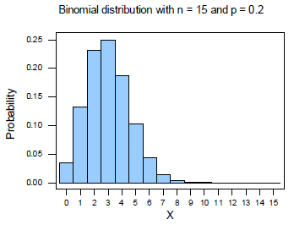
In above example we see that if p=0.5, then distribution is symmetric.
If p < 0.5, then distribution is positively skewed. For example:

Slide 13
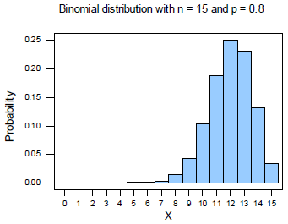
If p > 0.5, then distribution is negatively skewed. For example:

Slide 14
Properties of binomial distribution
Probability Mass function of Binomial distribution:-
P(X=x), f(x), b(x; n ,p)=$\left(\begin{aligned}n \\ x\end{aligned}\right)p^{x}q^{n−x}$
Range of Binomial distribution:-
x = 0,1,2,……..,n
Parameters of Binomial distribution:-
A probability distribution is define in terms of its parameters which are numerical values use to specify the distribution. Binomial probability distribution has two parameters “n” and “p”. The probability for any value of x can be determined when “n” and “p” are known.

Slide 15
Mean of Binomial distribution:-
Mean = np
Variance of Binomial distribution:-
Var = npq
Standard deviation of Binomial distribution:-
S.D = $\sqrt{npq}$
Coefficient of variation of Binomial distribution:-
C.V = $\frac{\sqrt{npq}}{np}×100$
Variance < Mean
Coefficient of Skewness:-
$$\sqrt{β_{1}}=\frac{q−p}{\sqrt{npq}}$$

Slide 16
Coefficient of Kurtosis:-
$$β_{2}=3+\frac{1−6pq}{npq}$$
If p=q=0.5, then the distribution is symmetric.
If p<0.5, then the distribution is positively skewed
If p>0.5, then the distribution is negatively skewed.

Slide 17
If $\sqrt{β_{1}}$ > 0, then distribution is positively skewed

Slide 18
If $\sqrt{β_{1}}$ < 0, then distribution is negatively skewed

Slide 19
If $\sqrt{β_{1}}$ = 0, then distribution is symmetric

Slide 20
If $β_{2}$ = 3, then distribution is Meso-kurtic.
If $β_{2}$ > 3, then distribution is Lepto-kurtic.
If $β_{2}$ < 3, then distribution is platy-kurtic.

