Slide 1
IN THE NAME OF ALLAH THE MOST MERCIFUL, THE BENEFICENT….

Slide 2
ACUTE CORONARY SYNDROMES
DR. SHEHZAD ASLAM MBBS, MCPS (Medicine), FCPS (Cardiology)
Assistant professor of cardiology,
Sargodha medical college,
DHQ teaching hospital sargodha

Slide 3
History
Cardiac ischemia was first identified in the early 1900’s
First EKG introduced 1909
Despite the recognition little treatment available till 1960’s
First CCU (cardiac care unit) in 1962
Reduced acute MI mortality by 50%

Slide 4
History
1980’s – pathology of acute MI was recognized to be > 90% thrombus formation
Management Revolution
Thrombolytic therapy
Percutaneous transluminal coronary angioplasty (PTCA)
Coronary Stent Placement

Slide 5
ACUTE CORONARY SYNDROMES
Acute coronary syndrome encompasses the clinical syndromes of unstable angina, non-ST segment elevation myocardial infarction (NSTEMI), and ST segment myocardial infarction (STEMI).

Slide 7
DEFINITION OF MI
The detection of a rise and/or fall in cardiac biomarkers with at least one value above the 99th percentile of the upper reference limit (URL) ,together with evidence of ischemia.

Slide 8
ISCHEMIA IS DEFINED AS
Any symptoms of ischemia.
ECG changes suggestive of new ischemia.
Development of pathologic Q waves on ECG.
Imaging evidence of infarction.
Sudden cardiac death with evidence of myocardial ischemia (new ST elevation, LBBB, or coronary thrombus).
Biomarkers elevation > 3 URL for post PCI pts.
> 5 URL for post CABG pts.

Slide 9
CLINICAL CLASSIFICATION OF DIFFERENT TYPES OF MYOCARDIAL INFARCTION
TYPE 1.
Spontaneous MI related to ischemia from a coronary plaque rupture or dissection.
TYPE 2.
MI due to ischemia resulting from increased oxygen or decreased supply.
TYPE 3.
Sudden cardiac death with symptoms of ischemia, new ST elevation, or LBBB or coronary thrombus.
TYPE 4a.
MI associated with PCI.
TYPE 4B.
MI associated with stent thrombosis.
TYPE 5.
MI associated with CABG

Slide 10
PATHOPHYSIOLOGY ABRUPT OCCLUSION OF CORONARY VESSEL
Vascular injury to coronary vessel
Further platelet activation and potential
Resistance to thrombolysis
Plaque fissures, ruptures or
ulcerates
Conformational change in glycoprotein
IIb/IIIa receptors
Platelet activation by various
Agonist such as
Collagen,ADP,Epinephrine
Serotonin
Receptors develop a high affinity for
Von Willebrand and fibrinogen
Resulting in platelet cross-linking and
Aggregation.
Production and release of
Thromboxane A2 causing
vasoconstriction

Slide 11
COAGULATION CASCADE
Activation of tissue factor on exposure
To damaged endothelial cells.
Activation of factors VII and X
Conversion of prothrombin
to thrombin
Conversion of fibrinogen
to fibrin

Slide 12
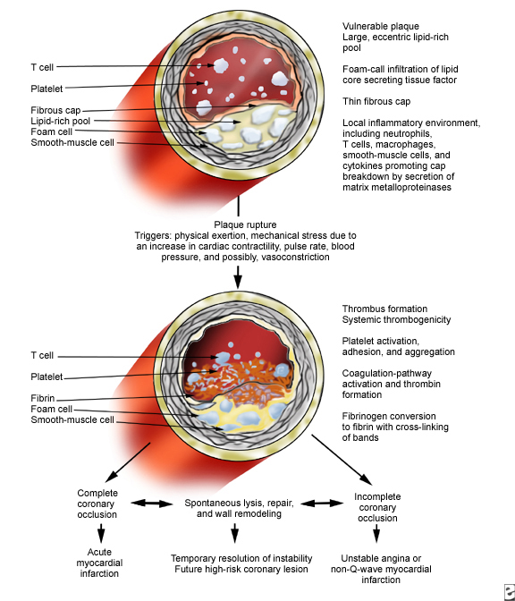

Slide 13
THROMBOTIC PROCESS – PATHOPHYSIOLOGY PLATELET ACTIVATION
TxA₂
Thrombin
ADP
Epinephrine
Platelet
Collagen
Tissue Factor
Ruptured
Plaque

Slide 14
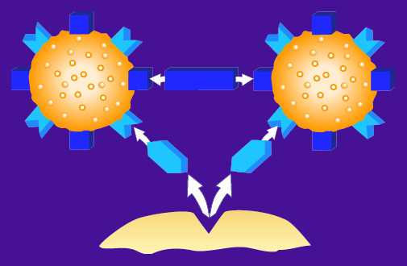
THROMBOTIC PROCESS – PATHOPHYSIOLOGY PLATELET AGGREGATION
Fibrinogen
GP IIb/IIIa
Receptor
VWF
VWF
GP Ib
Receptor
Ruptured Plaque

Slide 15
CLINICAL PRESENTATION HISTORY
Pain, usually involving central portion of the chest and/or the epigastrium with or without radiation to arms,sholders,back,lower jaw or neck.
Pain is deep and visceral commonly described as heavy,squeezing,and crushing.
Often associated with weakness,sweating,nausea,vomiting, anxiety and a sense of impending doom.

Slide 16
PHYSICAL FINDINGS
Anxiety, restlessness.
Pallor associated with perspiration and coolness of extremities.
1.
B.P.and pulse rate may be normal within 1st hr of STEMI.
About 1/4th of patients with anterior infarction have manifestations of tachycardia and/or hypertension.
Whereas ½ with inferior MI show evidence of bradycardia and/or hypotension.
Other signs of ventricular dysfunction include S4 and S3(heart sounds),decreased intensity of 1st heart sound and paradoxical splitting of 2nd heart sound.
A transient midsystolic or late systolic and apical systolic murmur due to dysfunction of the mitral valve apparatus may be present.
A pericardial friction rub may be present.

Slide 17
INDICATION FOR E.C.G.
A 12-lead ECG should be performed and shown to an experienced emergency physician within 10 minutes of ED arrival for all patients with chest discomfort (or anginal equivalent) or other symptoms suggestive of STEMI
If the initial ECG is not diagnostic of STEMI but the patient remains symptomatic, and there is a high clinical suspicion for STEMI, serial ECGs at 5- to 10-minute intervals or continuous 12-lead ST-segment monitoring should be performed to detect the potential development of ST elevation. C)
In patients with inferior STEMI, right-sided ECG leads should be obtained to screen for ST elevation suggestive of right ventricular (RV) infarction

Slide 18
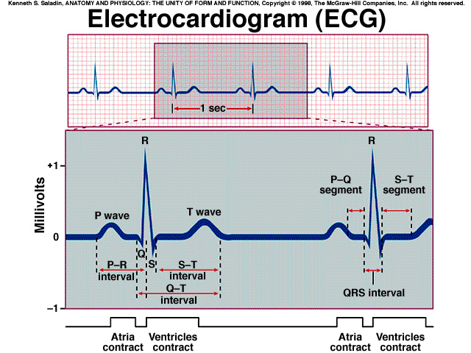

Slide 19
CORONARY ANATOMY
Anterior wall MI
V₁ through V₄
ST Elevation
Lateral wall MI
I, aV_{L} , V_{5,} and V₆
ST Elevation
Inferior wall MI
II, III, and aV_{F}
ST Elevation
RV wall MI
V_{4R}
ST Elevation
Posterior wall MI
V₈ and V₉
ST Elevation
V₁ through V₃
ST depression

Slide 20
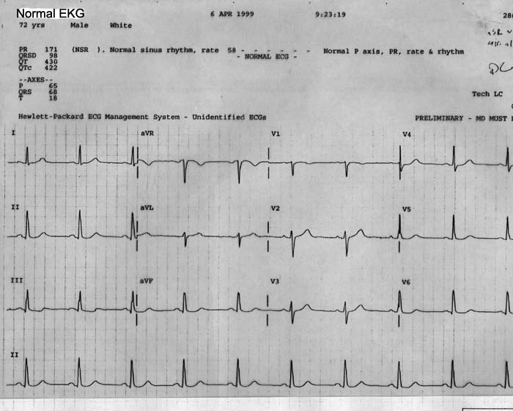
ANATOMICAL LEADS

Slide 21
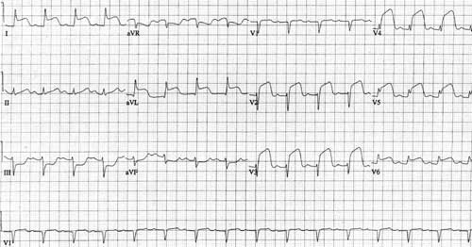
ANTERIOR ST ELEVATION MI

Slide 22
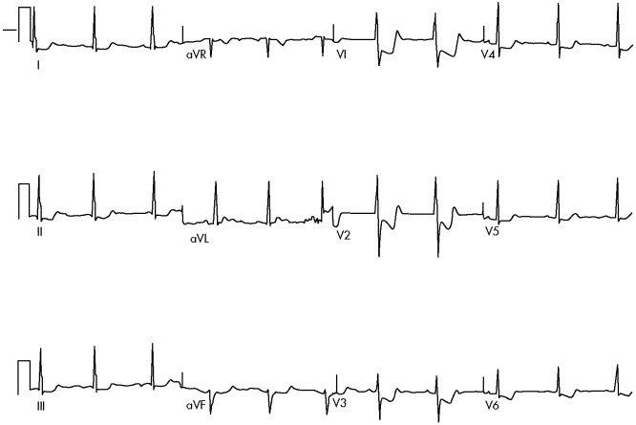

Slide 23
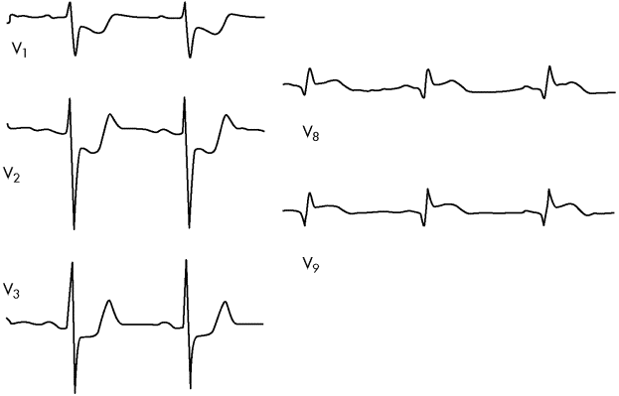
POSTERIOR MI WITH POSTERIOR LEADS

Slide 24
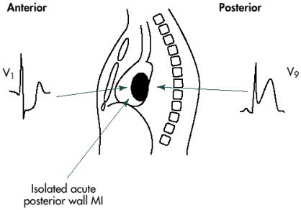
POSTERIOR MI

Slide 25
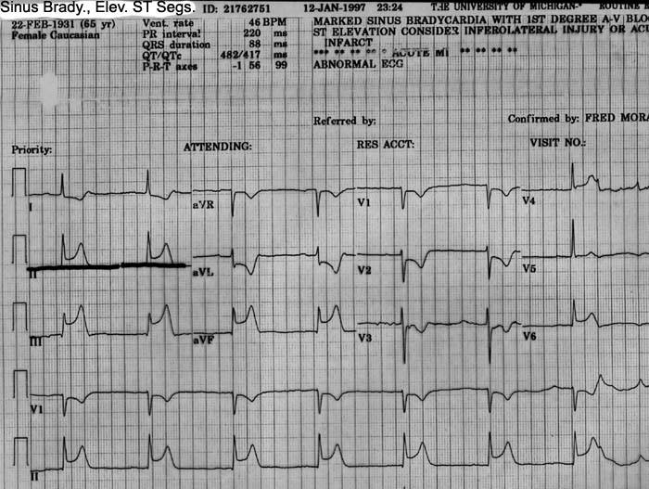

Slide 26
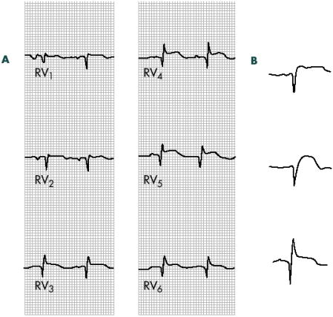
RV INFARCTION

Slide 27
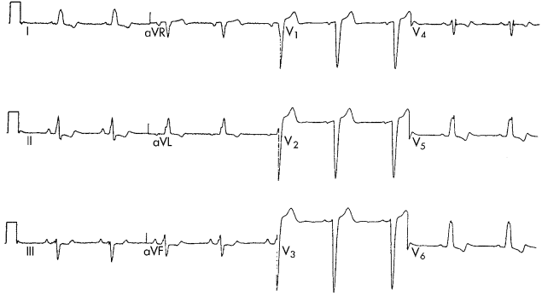
LEFT BUNDLE BRANCH BLOCK

Slide 28
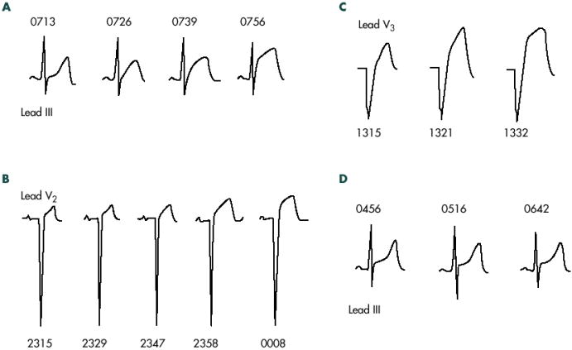
DIAGNOSIS - ACS
Serial Electrocardiograms increase accuracy
Initial EKG only 50% accurate for AMI

Slide 29
DIAGNOSIS - ACS
Electrocardiogram – Acute MI
ST Depression
Noninfarct ischemia or Non-STEMI
Digoxin toxicity, hypokalemia, LVH
Down sloping or flat ST segments

Slide 30
IMAGING
Portable echocardiography is reasonable to clarify the diagnosis of STEMI and allow risk stratification of patients with chest pain on arrival at the ED, especially if the diagnosis of STEMI is confounded by left bundle-branch block (LBBB) or pacing, or there is suspicion of posterior STEMI with anterior ST depressions.

Slide 31
DIAGNOSIS - ACS
Echocardiogram
Wall motion abnormalities
Hypokinesis -> akinesis
Ejection fraction reduced
Limitations
Quality of the study
Machine, Patient habitus
Sensitivity – 88% - 94%
Specificity – 50% to 75%

Slide 32
WALL MOTION ABNORMALITIES ON 2D ECHOCARDIOGRAPHY

Slide 33
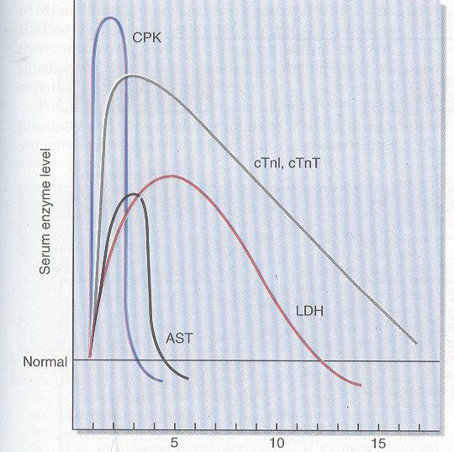

Slide 34
FALSE POSITIVE TROPONINS T.
Renal failure.
POSITIVE TROPONIN I.
Presence of heterophilic antibodies.
Fibrin.
Marked tachycardia.
Elevated BP.
Pulmonary embolism.
Hypoxemia.

Slide 35
DIFFERENTIAL DIAGNOSIS OF STEMI
COMBORBID ISCHEMIA | ST ELEVATION BUT NO ISCHEMIA | CHEST PAIN BUT NO ISCHEMIA
Aortic dissection | Early repolarization | Myopericarditis
Systemic arterial embolism | Left ventricular hypertrophy | Pleuritis
Hypertensive crisis | Left bundle-branch block | Pulmonary embolism
Aortic stenosis | Hyperkalemia | costochondritis
Cocaine use | Brugada syndrome | GI disorder
Arteritis

Slide 36
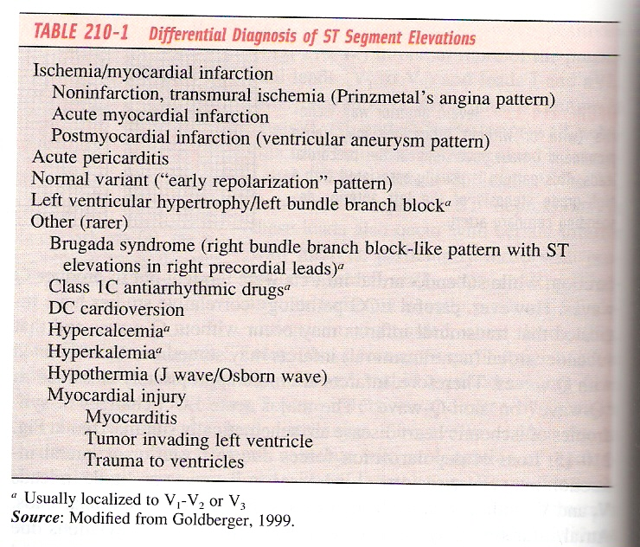
DIFFERENTIAL DIAGNOSIS OF ST-SEGMENT ELEVATION

Slide 37
DIFFERENTIAL DIAGNOSIS OF ST-SEGMENT ELEVATION
LVH
LBBB
Hyper K
M.I
Brugada
Pericarditis
RBBB+M.I

Slide 38
DIFFERENTIAL DIAGNOSIS OF ST-SEGMENT ELEVATION
Early Repolarization

Slide 39
INITIAL RECOGNITION AND MANAGEMENT IN EMERGENCY
OPTIMAL STRATEGIES OF
ED -TRIAGE.
INITIAL PATIENT EVALUATION
History
Physical examination
Electrocardiogram
Laboratory examinations
Measurement of biomarkers
of cardiac damage
Imaging
MANAGEMENT
Oxygen
Nitroglycerin
Analgesia
Aspirin
Clopidogrel
Beta-blockers
Reperfusion
Ancillary
reperfusion therapy
Other pharmacological
measures

Slide 41
MANAGEMENT - ACS
Goals of Management
Restore oxygen flow to the myocardium
Supplemental oxygen
Nitroglycerin and morphine
Thrombolysis or PTCA
Beta blockade to reduce contractility and oxygen demand
Block platelet function – asprin, IIb / IIIa

Slide 42
MANAGEMENT - ACS
Asprin
Irreversibly acetylates platelet cyclooxygenase
Inhibiting platelet aggregation for duration of platelet life 8 – 10 days
ISIS-2 trial – strongest evidence
Asprin alone – reduced mortality 23%
Asprin with thrombolysis – reduced mortality 42%

Slide 43
MANAGEMENT - ACS
Beta Blockers
Reduce the catecholamine driven tachycardia, contractility, oxygen demand
Reduce mortality in Acute MI and unstable angina
Contraindications include: bradycardia, COPD, hypotension, CHF, pulmonary edema

Slide 44
MANAGEMENT - ACS
Nitroglycerin
Decreases cardiac preload through venous pooling
Coronary Vasodilation -> increased perfusion
Treat with sublingual or IV nitroglycerin
Contraindications: hypotension, Right ventricle infarct

Slide 45
MANAGEMENT - ACS
Morphine
Used regularly, however no significant medical trials or research have been done
Properties: analgesic and anxiolytic
Dosage: 2 – 5 mg IV every 30 minutes as needed

Slide 46
MANAGEMENT - ACS
Heparin
Inhibits clot propagation and platelets
Together with Asprin, thrombolytics in STEMI it reduces mortality significantly
Low Molecular Weigh Heparin
Fractionated heparin, lower side effects
Studies suggest it is as effective as heparin

Slide 47
MANAGEMENT - ACS
Glycoprotein IIb – IIIa Receptor Inhibitors
Activated Platelets bind together through the activation of IIb – IIIa receptors
IIb – IIIa blockers inhibit platelet aggregation
Usage is clear in ST elevation MI when patients go to the Cath lab
NO clear benefit for NSTEMI or no Cath

Slide 48
MANAGEMENT - ACS
Thrombolytic Therapy
Lysis of fibrin based clots to open clotted artery and return coronary blood flow
Analysis of 9 large studies show a 20% reduction in mortality when treating an ST Elevation MI

Slide 49
MANAGEMENT - ACS
Thrombolytic Therapy
No benefit for unstable angina or in non-ST elevation MI
Time is clearly important
Rapid administration of thrombolytic improves survivability
Side effect – 1 - 2% intracranial bleed

Slide 50
MANAGEMENT - ACS
Thrombolytic Therapy Guidelines
Timing
Within 12 hours of onset of symptoms
LATE trial - 26% reduction in mortality when treated within 12 hours with t-PA, Heparin, Asprin
No improved survivability when given after 12 hours

Slide 51
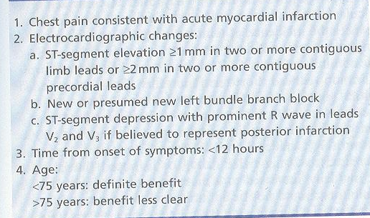
SELECTION CRITERIA FOR THROMBOLYTIC THERAPY IN ACUTE MYOCARDIAL INFARCTION

Slide 53
ABSOLUTE AND RELATIVE CONTRAINDICATIONS FOR THROMBOLYTIC THERAPY IN PATIENTS WITH ST-SEGMENT ELEVATION MYOCARDIAL INFARCTION
ABSOLUTE CONTRAINDICATIONS.
Any prior intracranial hemorrhage.
Known structural cerebral vascular lesion.
Known intracranial neoplasm.
Ischemic stroke within the past 3 months. (except for acute stroke within 3 hours)
Suspected aortic dissection.
Active bleeding or bleeding diathesis (excluding menses).
Significant closed-head or facial trauma within 3 months.

Slide 54
Relative contraindications.
History of chronic, sever, poorly controlled hypertension, Systolic pressure >180 mm Hg or diastolic >110 mm Hg
History of prior ischemic stroke >3 months
Previously, dementia, or known intracranial pathology not covered in absolute contraindications
Recent (within 2–4 weeks) internal bleeding
Noncompressible vascular punctures
Pregnancy
Active peptic ulcer
Current use of anticoagulants: the higher the INR, the higher the risk of bleeding.For streptokinase/anistreplase: if there is prior exposure or prior allergic reaction to these agents.

Slide 55
PERCUTANEOUS TRANSLUMENAL CORONARY ANGIOPLASTY (PTCA)
Stent placement
Direct visualization of involved coronary vessels
Decreased complications
Coronary Revisualization

Slide 56
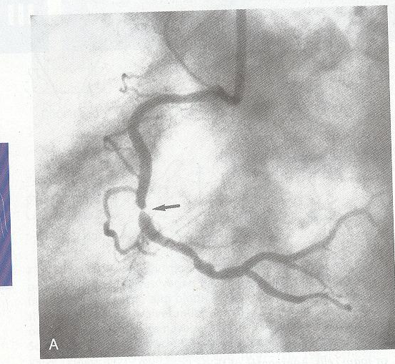
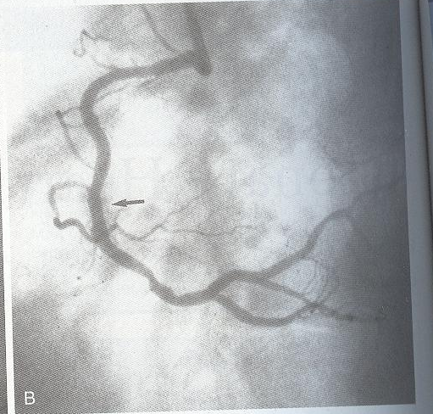

Slide 57
SPECIFIC CONSIDERATIONS
Primary PCI should be performed as quickly as possible, with a goal of a medical contact-to-balloon or door-to-balloon time of within 90 minutes.
If the symptom duration is within 3 hours and the expected door-to-balloon time minus the expected door-to-needle time is:
within 1 hour, primary PCI is generally preferred.
Greater than 1 hour, fibrinolytic therapy (fibrin-specific agents) is generally preferred.
If symptom duration is greater than 3 hours, primary PCI is generally preferred and should be performed with a medical contact–to-balloon or door-to-balloon time as brief as possible, with a goal of within 90 minutes.

Slide 58
SPECIFIC CONSIDERATIONS
Primary PCI should be performed for patients younger than 75 years old with ST elevation or LBBB who develop shock within 36 hours of MI and are suitable for revascularization that can be performed within 18 hours of shock, unless further support is futile because of the patient's wishes or contraindications/unsuitability for further invasive care.
Primary PCI should be performed in patients with severe CHF and/or pulmonary edema (Killip class 3) and onset of symptoms within 12 hours. The medical contact-to-balloon or door-to-balloon time should be as short as possible (i.e., goal within 90 minutes).

Slide 59
SPECIFIC CONSIDERATIONS
Primary PCI is reasonable for selected patients 75 years or older with ST elevation or LBBB or who develop shock within 36 hours of MI and are suitable for revascularization that can be performed within 18 hours of shock. Patients with good prior functional status who are suitable for revascularization and agree to invasive care may be selected for such an invasive strategy.
It is reasonable to perform primary PCI for patients with onset of symptoms within the prior 12 to 24 hours and 1 or more of the following:
Severe CHF
Hemodynamic or electrical instability
Persistent ischemic symptoms.

Slide 60
ACUTE SURGICAL REPERFUSION
Emergency or urgent CABG in patients with STEMI should be undertaken in the following circumstances:
Failed PCI with persistent pain or hemodynamic instability in patients with coronary anatomy suitable for surgery.
Persistent or recurrent ischemia refractory to medical therapy in patients who have coronary anatomy suitable for surgery, have a significant area of myocardium at risk, and are not candidates for PCI or fibrinolytic therapy.
At the time of surgical repair of postinfarction ventricular septal rupture (VSR) or mitral valve insufficiency.

Slide 61
ACUTE SURGICAL REPERFUSION
Cardiogenic shock in patients less than 75 years old with ST elevation, LBBB, or posterior MI who develop shock within 36 hours of STEMI, have severe multivessel or left main disease, and are suitable for revascularization that can be performed within 18 hours of shock, unless further support is futile because of the patient's wishes or contraindications/unsuitability for further invasive care.
Life-threatening ventricular arrhythmias in the presence of greater than or equal to 50% left main stenosis and/or triple-vessel disease.

Slide 62
ASSESSMENT OF REPERFUSION
It is reasonable to monitor the pattern of ST elevation, cardiac rhythm, and clinical symptoms over the 60 to 180 minutes after initiation of fibrinolytic therapy. Noninvasive findings suggestive of reperfusion include relief of symptoms, maintenance or restoration of hemodynamic and or electrical stability, and a reduction of at least 50% of the initial ST-segment elevation injury pattern on a follow-up ECG 60 to 90 minutes after initiation of therapy.

