Slide 1
APOPTOSIS AND GAP JUNCTION

Slide 2
Apoptosis:
(Programmed cell death)

Slide 3
Life cannot exist without cellular death:

Slide 4
Introduction:
Apoptosis, or programmed cell death, is a highly regulated process that allows a cell to self-degrade in order for the body to eliminate unwanted or dysfunctional cells. During apoptosis, the genome of cell with disintegrate into smaller apoptotic bodies.
Between 50 and 70 billion cells die each day due to apoptosis in the average human adult. For an average child between the ages of 8 and 14, approximately 20 billion to 30 billion die each day

Slide 6
History:
German scientist Carl Vogt was first to described the principle of apoptosis in 1842. In 1845, anatomist Walther Flemming delivered a more precise description of the process of programmed cell death.
Kerr received the Paul Ehrlich and Lud wig Darmstaedter prize on March 14, 2000, for this description of apoptosis. He shared the prize with Boston biologist Robert Horvitz.

Slide 8
History:
Apoptosis has since been recognized and accepted as a distinctive and important mode of “programmed” cell death, which involves the genetically determined elimination of cells.
Apoptosis is essential to embryonic development and the maintenance of homeostasis in multicellular organisms. In humans, for example, the rate of cell growth and cell death is balanced to maintain the weight of the body. During fetal development, cell death helps sculpt body shape and making the right neuronal connections.

Slide 9
Tissue homeostasis mainly depends on the balance between cell proliferation and cell death. Programmed cell death or apoptosis is an intrinsic death program that occurs in various physiological and pathological situations.
Apoptosis or self destruction is necessary for normal development and homeostasis of multicellular organisms.
Apoptosis play a major role in many diseases like cancer,
AIDS and
Neurodegenerative disorders.

Slide 12
Cell death:
Cell die by one of two mechanisms-
- Necrosis - Death By Injury
- Apoptosis - Death By Suicide
Apoptosis and necrosis have different characteristics.

Slide 15
Need of apoptosis:
Apoptosis is needed for proper development
Examples:
The reabsorption of tadpole tail.
The formation of the fingers and toes of the cells.
The formation of proper connections between neurons in the
brain.

Slide 16
Apoptosis is needed to destroy cells
Examples;
Cell infected with viruses
Cell with DNA damage
Cancer cells

Slide 19
Reasons of apoptosis:
Withdrawal of positive signals
Examples:
__ growth factors for neurons
__ Interleukit-2 (IL-2)
Receipt of negative signals

Slide 20
Examples:
- increased levels of oxidants within the cell
- damage to DNA within the cell
- death activators :
Tumor necrosis in factor alpha (TNF-alpha)
Lymphotoxin (TNF-beta)
Fas ligand (FasL)

Slide 23
Inducers of Apoptosis:
TNF family
Growth factor withdrawl
Calcium
Oncogenes
Nutrient deprivation
Toxins
UV radiation
Gamma radiation

Slide 25
Important in normal physiology
Development: Immune system maturation, Morphogenesis, Neural development.
Adult: Immune privilege, DNA damage and wound repair,
Excess apoptosis
Neurodegenerative diseases
Deficient apoptosis
Cancer
Autoimmunity

Slide 26
Caspases:
Caspases stands for CYSTEINE ASPARTATE-SPECIFIC PROTEASE.
Caspases have the characteristics of high specificity for substrates containing Asp, and use a Cys for catalyzing peptide bond cleavage.
Synthesized in the cell as precursors named procaspase.
Caspases are the major executioners in apoptosis.

Slide 29
Caspase Role in Apoptosis:
Cut of contact with surrounding cells.
Reorganize cytoskeleton.
Shut don DNA replication and repair.
Interrupt splicing.
Destroy nuclear structure.
Induce cell to display signals making it for phagocytosis.
Disintegrate cells into apoptotic bodies.

Slide 30
Types:

Slide 36
Intrinsic Pathway:
Initiated from within the cell.
Activated in response to signals such as DNA damage, loss of cell survival factors, cell stress.
Hinges on balance between pro and anti apoptotic signals of Bcl-2 family.
Apaf-1, cytochrome-c, ATP(apoptosome) activate procaspase-9 complex.
Pro apoptotic proteins released which activate caspase proteases.

Slide 37
Extrinsic Pathway
Begins out side the cell.
Activation of death receptors (Fas-R, TNF-R, DR-3, DRY/DR5) by death ligands (Fas-L, TNF-alpha, Apo3L, Apo2L) play major role.
Death induced signaling complex (DISC) activated.
On DISC activation same effector pathway on intrinsic pathway is adopted.

Slide 40
Disorders where apoptosis is inhibited (decreased apoptosis, increase in cell survival)
Cancer
Colorectal cancer
Glioma
Lymphoid malignancies
Liver
Neuroblastoma
Prostate cancer
Autoimmune disorders
Mysthenia gravis
systemic lupus eryrhematous

Slide 41
3. Inflammatory disease:
Bronchial asthma
Inflammatory bowel disease
Pulmonary inflammation
4. Viral infections
Herpesviruses
Poxviruses
Adenoviruses
Baculovirus
Cowpox

Slide 42
Disorders where apoptosis is excessive increased in cell death (Means hyperactive apoptosis)
AIDS
CD4+ cells
T-lymphocytes
2. Neurodegenerative disorders
Alzheimer’s disease
Epilepsy
Parkinson’s disease
Amyotrophic lateral sclerosis
Cerebellar degenration

Slide 45
Apoptosis: Role in Disease Cancer.
Apoptosis eliminates damaged cells (damage => mutations =>) cancer.
Tumor suppressor p53 controls senescence and apoptosis responses to damage.
Most cancer cells are defective in apoptotic response (damaged, mutant cells survive)
High levels of anti apoptotic proteins
OR
Low levels of pro-apoptotic protein ➔ Cancer

Slide 46
Gap Junction
Also called “ communicating” junctions.
2 opposing connexons join across intercellular space.
Connexons: assembly of six proteins that creat gap between two plasama members.

Slide 47
The function of Gap Junctions
The created gap…
Provides cytoplasm channels from one cell to an adjacent cell.
Allows for communication through exchange of materials and transmission of electrical impulses.

Slide 48
Gap Junctions
Allow direct diffusion of ions and small molecules between adjacent cells.
Hollow cylinders of proteins (connexons) function like tunnels to send messages.
Molecules can travel directly from one cell to the next through these channels.

Slide 49
Gap Junction
Membrane proteins form a tunnel between cells (called connexons)
Allows cell to communicate with each other, share nutrients, and transfer chemical/electrical signals.

Slide 50
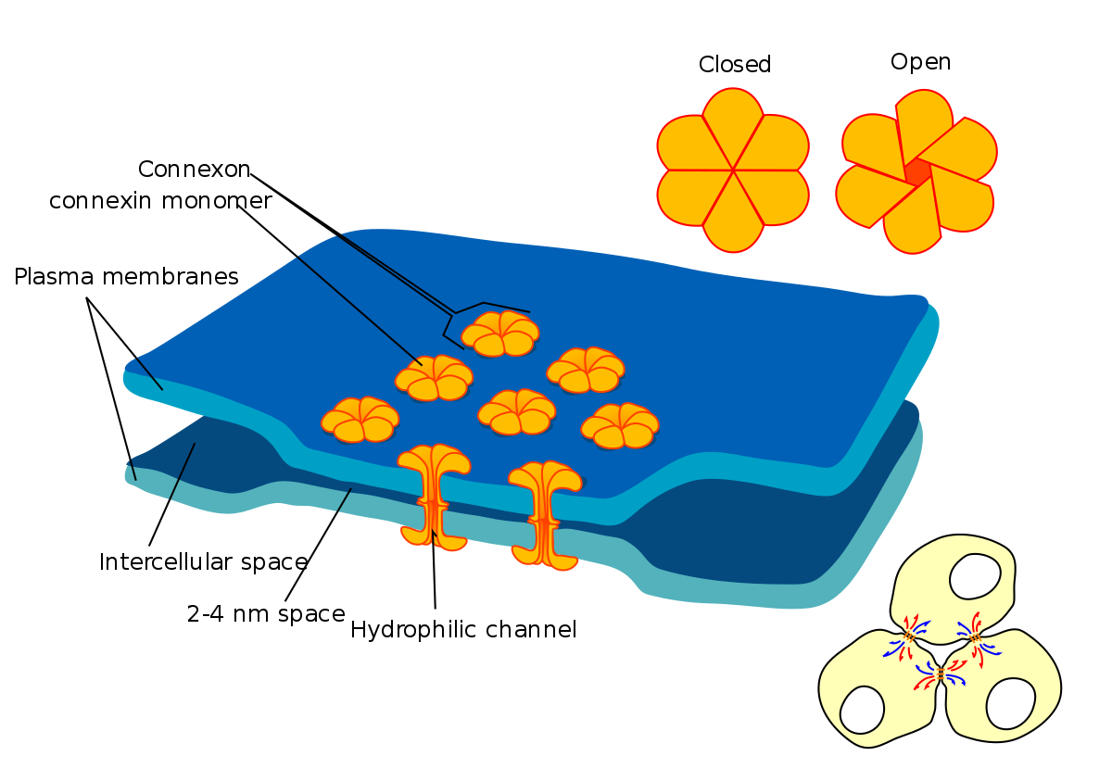

Slide 51
Gap Junctions
Permit small molecules to shuttle from one cell to another and thus directly link the interior of adjacent cells.

Slide 52
Gap Junctions and plasmodesmata

Slide 53
Gap Junction
Communicating junctions allow ions and small molecules to pass from one cell to the next for intercellular communication.

Slide 54
Gap Junctions
Gap junctions are communicating junctions. It is a gap which exists between adjacent cells, which are linked by small, connecting tunnels formed by connexons.
Abundant in cardiac muscle and smooth muscle where they transmit electrical activity.
In non-muscle tissues they permit small nutrient molecules e.g. glucose, aa,.
Serve as roads for transfer of small signaling molecules from one cell to next.

Slide 55
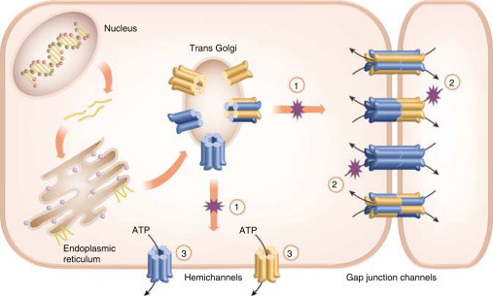

Slide 56
Composition of Gap Junction
Composed of two connexons (hemichannels) which connect across intercellular space.
Each connexon is composed of six copies of connexins (transmembrane proteins).

Slide 57
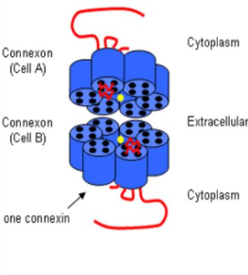

Slide 58
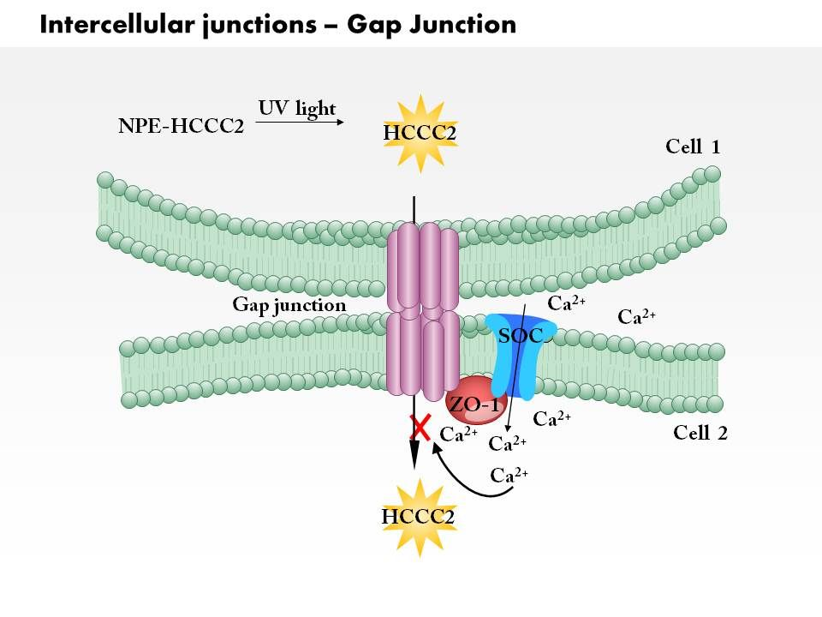

Slide 59
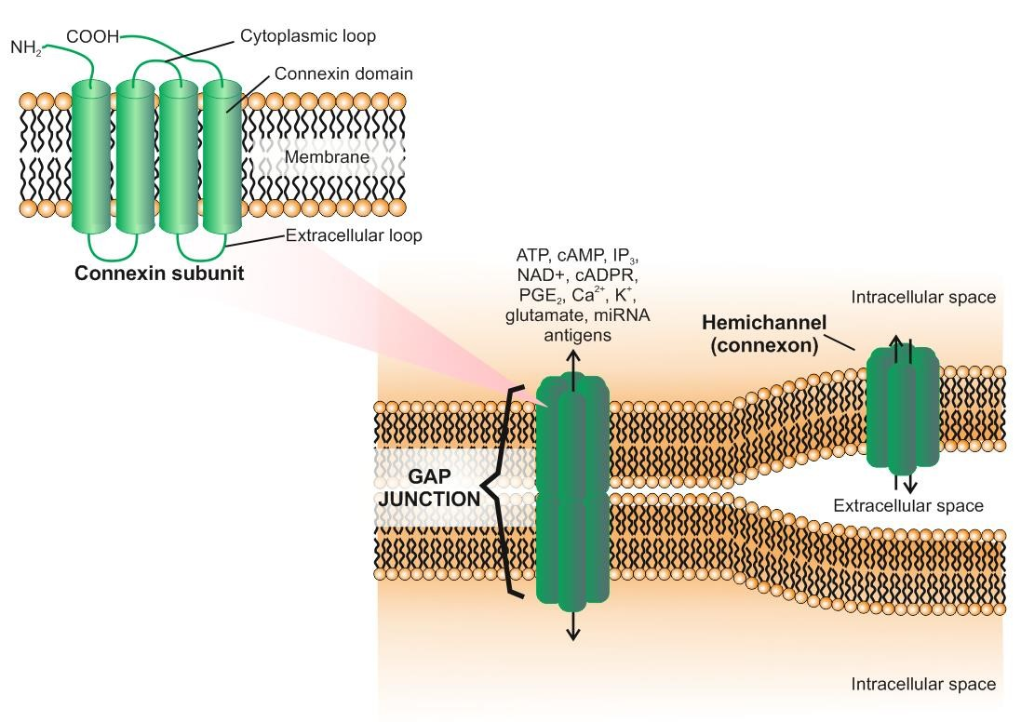
Gap Junctions in the immune system

Slide 60
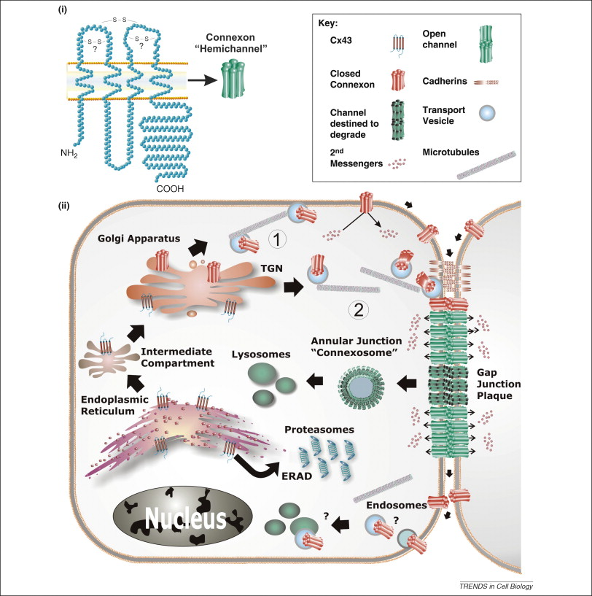
The Gap Junction proteome and its relationship to disease

