Slide 1
ENTO-306
Agricultural pests and their management
Identification of important agricultural pests
Their mode of damages
Control measures
By: Dr. Muhammad Zeeshan Majeed

Slide 2
Insect Pests of Maize and Sorghum

Slide 3
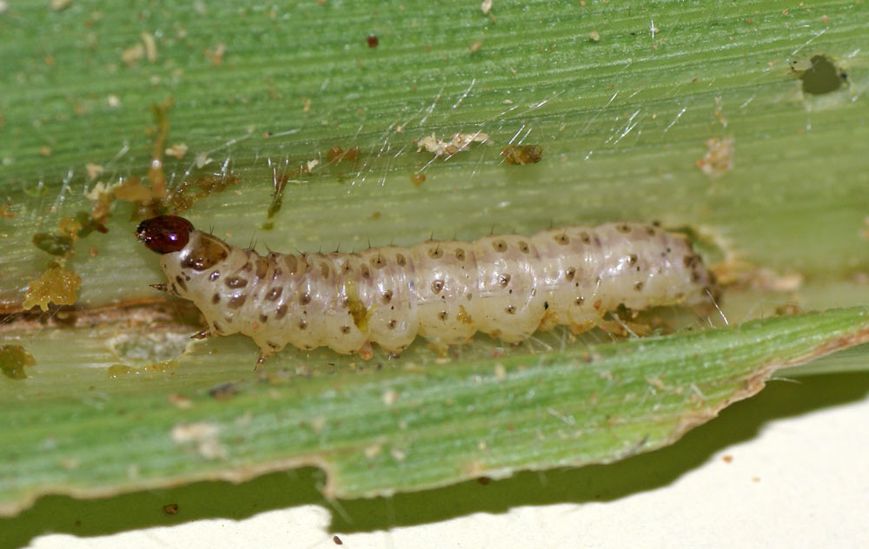
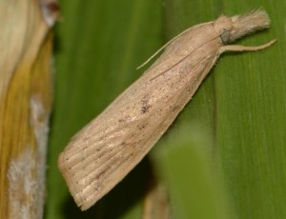
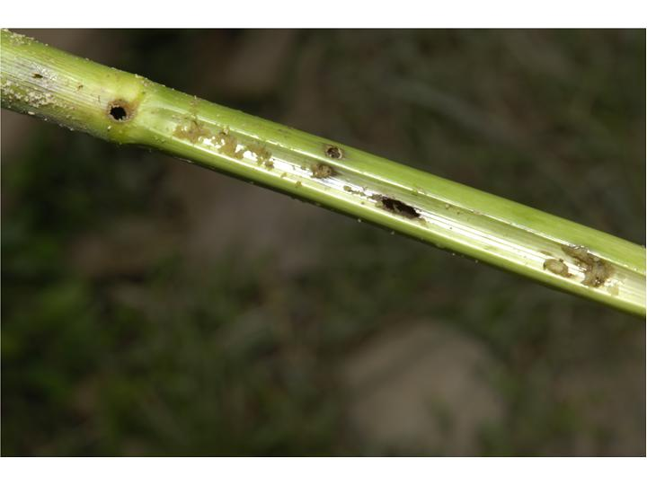
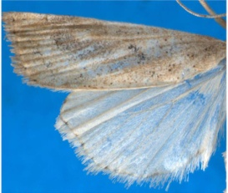
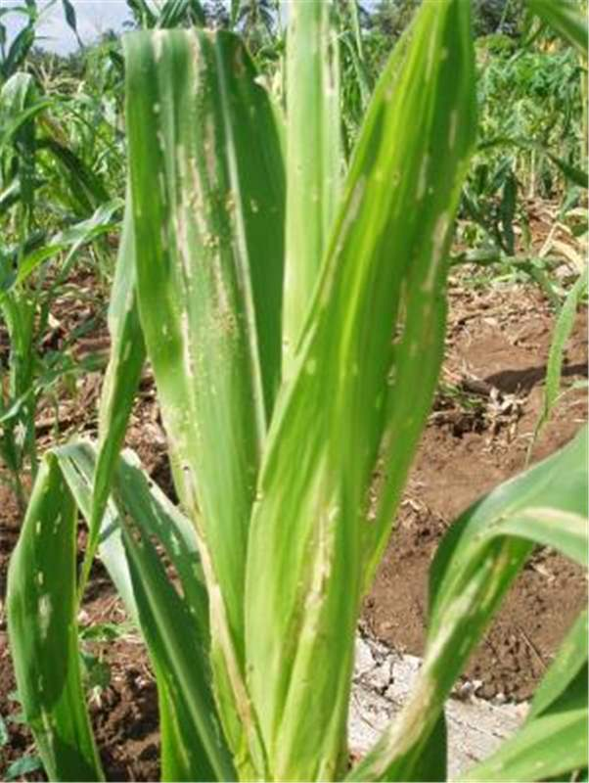
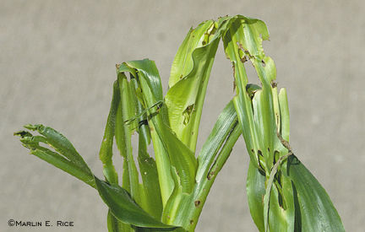
ENTO-306 Agricultural pests and their management 4(3-1)
Insect pests of Maize & Sorghum Stem borer (Chilo partellus: Pyralidae: Lepidoptera)
Host plants: wild and cultivated grass species, including maize, sorghum, millets and rice
Identification (Spotted stem borer)
Adult: Forewings are yellowish grey
Eggs: Clusters of 10-70 oval shaped eggs laid on leaves near midribs.
Larvae: Creamy-white to yellowish-brown in color
with 4 purple longitudinal strips on dorsal side
Conspicuous dark-brown spots on dorsal side
Life history:
Life cycle: 3-4 weeks
Larvae: 1-2 weeks (diapause as larva)
Pupation: 1-1.5 weeks (inside stems)
No. of generations: 5-7
Damage:
Active period: April to October
Early stage crop is more susceptible.
Young larvae feed inside the leaf whorl (leaving shot holes on leaves)
Stem boring and feeding on growing tissues
Producing ‘deadhearts’ and weakening stem with holes on them on internodal region.
Control:
Destruction of crop stubbles.
Granular/dust insecticide to plant whorls.
Biological control by Cotesia flavipes, Bracon spp.
Carbofuran / Cypermethrin / Deltamethrin

Slide 4
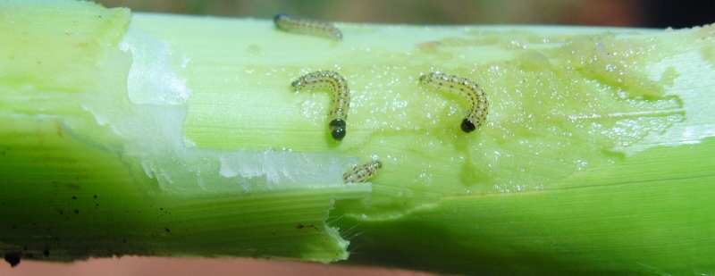

Slide 5
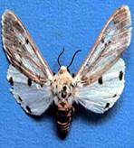
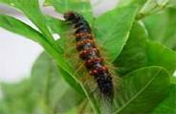
ENTO-306 Agricultural pests and their management 4(3-1)
Insect pests of Maize & Sorghum Kutra moth (Amsacta moorei: Arctiidae: Lepidoptera)
Host plants: Polyphagous insect
Sorghum, corn, millets, sesame, pulses
Identification: (also called red hairy caterpillar)
Adult: White forewings with scarlet reddish streaks on out margins and on the thorax and abdomen
Large black markings on hind wings
Eggs: yellow spherical eggs in clusters of few hundreds on leaf under sides,
Larvae: reddish brown hairy catterpillars
Life history:
Life cycle: 3 weeks
Larvae: 2 weeks
Pupation: 1 week (diapauses as pupae in soil)
No. Of generations: 2-3
Damage:
Active period is June to August.
Kutra moth catterpillars feed on gorwing shoot core
Large grown larvae eat agressively on all green matter.
Control:
Light traps for adult control
Pull-out and discard the infested plants with pest agrégations
Deep ploughting hoeing to kill pupae
10% Carbofuran

Slide 6
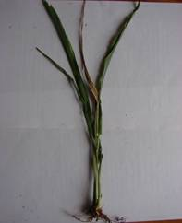
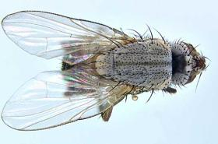
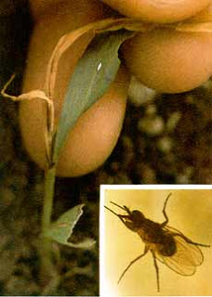
ENTO-306 Agricultural pests and their management 4(3-1)
Insect pests of Maize & Sorghum Shoot fly (Atherigona soccata: Muscidae: Diptera)
Host plants: Sorghum, maize, millets, wheat, other grasses
Identification:
Adult: small dark flies like house flies
Eggs: elongated whitish in color laid singly on leave lowersides (30-40 eggs /female)
Larvae: yellowish brown in color
Pupae: Pale white (turns brown later on)
Life history:
Life cycle:
Adult: 1 month
Larvae: 6-10 days
Pupation: 7 days (in side stems)
Damage:
Active period: Feburary to October
Maggots bore into the shoot of young plants, Central shoot dries (dead-heart).
Side tillers formation (which may be further attacked).
Control:
Pull-out and discard the infested plants
Higher seed rate
10% Carbofuran, Cypermethrin
Notes:
small dark fly; whitish eggs singly laid on leaf middle area.
Larvae yellow in color, make a clean cut at the base of the leaf inside the leaf whorls.
The maggots bore into the shoot of young plants, central shoot dries (dead-heart).
Side tillers (which may be further attacked).

Slide 7
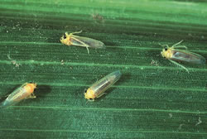
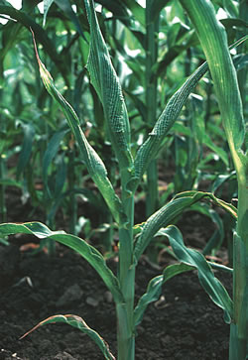
ENTO-306 Agricultural pests and their management 4(3-1)
Insect pests of Maize & Sorghum Maize jassid (Zygina spp.: Cicadellidae: Homoptera)
Maize leafhoppers
Pest of maize, sorghum and millets crops
Adult/numph: Yellow and green-bright
Desaping and deviatalizing the plants

