Slide 1
Federation, Presence, Identity and Privacy in cloud

Slide 2
Problems that led to Cloud Federation:
Decentralized cloud computing environment
Untrusted Components
Vendor lock-in
No standards for storage etc
Different delivery models
New services
3 A’s
Authentication
Auditing/Accountability
Authorization
Notes:
https://pdfs.semanticscholar.org/5d84/1fce8946ad9cbf6960827fa402b3551cc4c3.pdf
https://pdfs.semanticscholar.org/ba91/e27e10d839a9aba5b3cfe7438bba9ead3858.pdf

Slide 3
Inter-Clouds
The Inter-Cloud is an interconnected global "cloud of clouds" and an extension of the Internet "network of networks" on which it is based. Inter-Cloud computing is interconnecting multiple cloud providers’ infrastructures. The main focus is on direct interoperability between public cloud service providers. To provide cloud services as utility successfully, interconnected clouds are required and interoperability and portability are important factors in Inter-Cloud.
Notes:
A cloud model that, for the purpose of guaranteeing
service quality, such as the performance and availability
of each service, allows on-demand reassignment
of resources and transfer of workload through
a interworking of cloud systems of different cloud
providers based on coordination of each consumers
requirements for service quality with each providers
SLA and use of standard interfaces.

Slide 4
Need of inter-clouds
The limitations of cloud are that they have limited physical resources. If a cloud has exhausted all the computational and storage resources, it cannot provide service to the clients. The Inter-Cloud addresses such situations where each cloud would use the computational, storage, or any kind of resource of the infrastructures of other clouds. The Inter-Cloud environment provides benefits like diverse Geographical locations, better application resilience and avoiding vendor lock-in to the cloud client. Benefits for the cloud provider are expand-on-demand and better service level agreements (SLA) to the cloud client.

Slide 5
Types of Inter clouds:
Multiple cloud organisations can be realised under a voluntary or independent model. In the voluntary model, clouds participating explicitly know they are taking part in an inter-cloud and their behaviour is ruled in terms of a contract that defines how the items so that the resources of each cloud are shared by the other clouds. E.g. Cloud Federation
In the independent model, clouds work in conjunction in an orchestrated manner provide by third part service and the participating are not aware of the orchestration or the existence of the other clouds. In this approach we can mention the hybrid clouds, service and libraries.
Notes:
Research Paper: Cloud Federation: characterization and conceptual model

Slide 6
Federation
Cloud Federation refers to the unionization of software, infrastructure and platform services from disparate networks that can be accessed by a client via the internet. The federation of cloud resources is facilitated through network gateways that connect public or external clouds, private or internal clouds (owned by a single entity) and/or community clouds (owned by several cooperating entities); creating a hybrid cloud computing environment.
Notes:
Book: Dan C. Marinescu Cloud Computing_ Theory and Practice 2013 (Topic 3.6)

Slide 7
Federation Classification
Horizontal, vertical, and hybrid. In the horizontal class, the inter-cloud expands within the same type of service. In the vertical class, the multiple cloud organisation expands along a variety of services, as IaaS and PaaS, for instance. In the hybrid class, both vertical and horizontal expansion can take place.
Notes:
Research Paper: Cloud Federation: characterization and conceptual model

Slide 8
a cloud federation must present at least three characteristics to be effectively recognised as a federation:
capacity to dynamically expand or resize resources to fulfil incoming demand;
be able to operate as a part of a market directed to resource lending; and
be able to deliver reliable services with interesting costs, complying with established quality of service requirements.

Slide 9
Reading assignment
Read 5.2.1 (Four levels of federation)
Read 5.2.2(Difference between between trusted and encrypted federation)
Book –
Rittinghouse John, Ransome James Cloud Computing_ Implementation, Management, and Security (2009)

Slide 10
Products and protocols available
Extensible Messaging and Presence Protocol (XMPP)
Jabber XCP based on XMPP
highly programmable platform, which makes it ideal for adding presence and messaging to existing applications or services and for building next-generation, presence-based solutions.
Session Initiation Protocol (SIP)
Notes:
Session Initiation Protocol, or SIP for short, is a signaling protocol used primarily for setting up communications within an IP network. The role of SIP within an IP communications network is to allow callers to easily locate their targeted recipients, and deliver session invitations effectively regardless of where the end users are located or what devices they are using. Its purpose is actually quite simple, but characteristics of the technology make SIP particularly powerful when used in conjunction with other protocols. Currently, SIP is the de facto standard protocol for establishing, manipulating and terminating VoIP communication sessions.

Slide 11
Why XMPP?
It is decentralized, meaning anyone may set up an XMPP server.
It is based on open standards.
It is mature—multiple implementations of clients and servers
exist.
Robust security is supported via Simple Authentication and Security Layer (SASL) and Transport Layer Security (TLS).
It is flexible and designed to be extended.
Notes:
The protocol enables XMPP entities to create nodes (topics) at a pubsub service and publish information at those nodes; an event notification (with or without payload) is then broadcasted to all entities that have subscribed to the node. Pubsub therefore adheres to the classic Observer design pattern and can serve as the foundation for a wide variety of applications, including news feeds, content syndication, rich presence, geolocation, workflow systems, network management systems, and any other application that requires event notifications.

Slide 12
Protecting and Controlling Federated Communication
Designers of technologies like XMPP learned from past problems with email systems and incorporated these lessons to prevent address spoofing, unlimited binary attachments, inline scripts, and other attack tactics in XMPP.
The use of point-to-point federation will avoid problem that occur with multihop federation. This includes injection attacks, data loss, and unencrypted intermediate links.
Using certificates issued by trusted root CAs ensures encrypted connections and strong authentication, both of which are currently feasible with an email network.
Notes:
A certificate authority (CA) is a trusted entity that issues electronic documents that verify a digital entity's identity on the Internet. The electronic documents, which are called digital certificates, are an essential part of secure communication and play an important part in the public key infrastructure (PKI)

Slide 13
Employing intelligent servers that have the ability to blacklist (explicitly block) and whitelist (explicitly permit) foreign services, either at the host level or the IP address level, is a significant mitigating factor.

Slide 14
Presence
It provides true-or-false answers to queries about the network availability of a person, device, or application. Presence is a core component of an entity’s real-time identity.
Signal availability for interaction over a network.
Enabling technology for peer-to-peer interaction
Design pattern – publish and subscribe
Ability to integrate presence information with existing organizational infrastructure is required
Read 5.3.3 ( Ref: Text book)
Notes:
Implementation of presence follows the software design pattern known
as publish-and-subscribe (pub-sub). This means that a user or application
publishes information about its network availability to a centralized location
and that information is broadcast to all entities that are authorized to
receive it. The authorization usually takes the form of a subscription. In IM
implementations, contacts or buddies are the authorized entities. The popularity
of these services among millions of people validated the value of the
concept of presence.
The modern, reliable method to determine another entity’s capabilities
is called service discovery,wherein applications and devices exchange information
about their capabilities directly, without human involvement.

Slide 15
Identity
Digital identity refers to the traits, attributes, and preferences on which one may receive personalized services.
Two attributes - presence and location

Slide 16
Federated identity management
Federated identity management (IdM) refers to standards-based approaches for handling authentication, single sign-on (SSO, a property of access control for multiple related but independent software systems), role-based access control, and session management across diverse organizations, security domains, and application platforms.
It is a system that allows individuals to use the same user name, password, or other personal identification to sign on to the networks of more than one entity in order to conduct transactions.
Liberty Alliance Identity Federation Framework (ID-FF), OASIS’s Security Assertion Markup Language (SAML), and WS-Federation
Notes:
The principal underlying standard for federated identity is the Security
Assertion Markup Language (SAML), which defines the exchange of security information
between online business partners. SAML conveys authentication information
in the form of assertions about subjects. Assertions are statements about the
subject issued by an authoritative entity.
OASIS:Organization for the Advancement of Structured Information Standards

Slide 17
Federated identity management (cont.)
Federated identity management enables:
Easier access to consume cloud resources
Superior end-user experience through SSO and just-in-time account provisioning
Reduced cost and time to incorporate authentication and authorization
Elimination of non-scalable proprietary SSO applications

Slide 18
Federated identity management (cont.)
The challenge with federated identity management is to integrate multiple technologies, standards, and services to provide a secure, user-friendly utility. The key, as in most areas of security and networking, is the reliance on a few mature standards widely accepted by industry. Federated identity management seems to have reached this level of maturity.

Slide 19
Federated identity management (cont.)
There are four common methods to achieve identity federation:
Proprietary solutions
Open source solutions
contract a vendor to do it
Implement a standards based federated solution
SAML

Slide 20
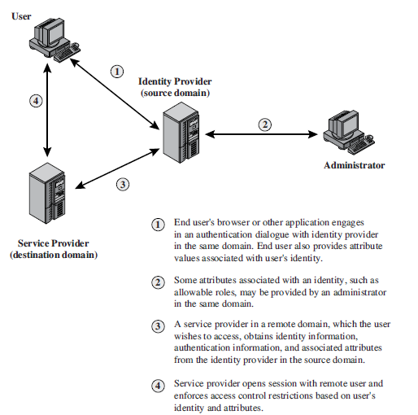
Federated Identity Operation

Slide 21
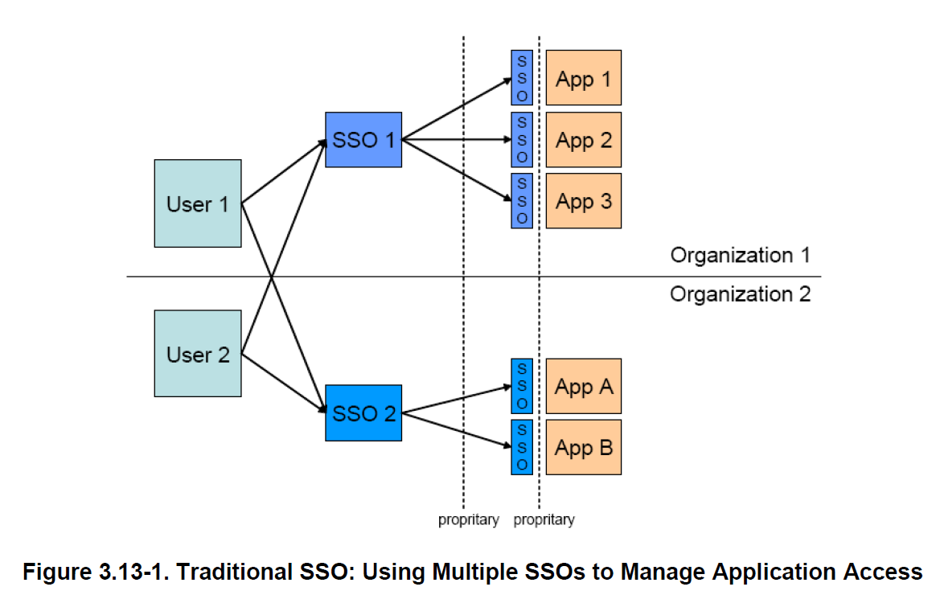
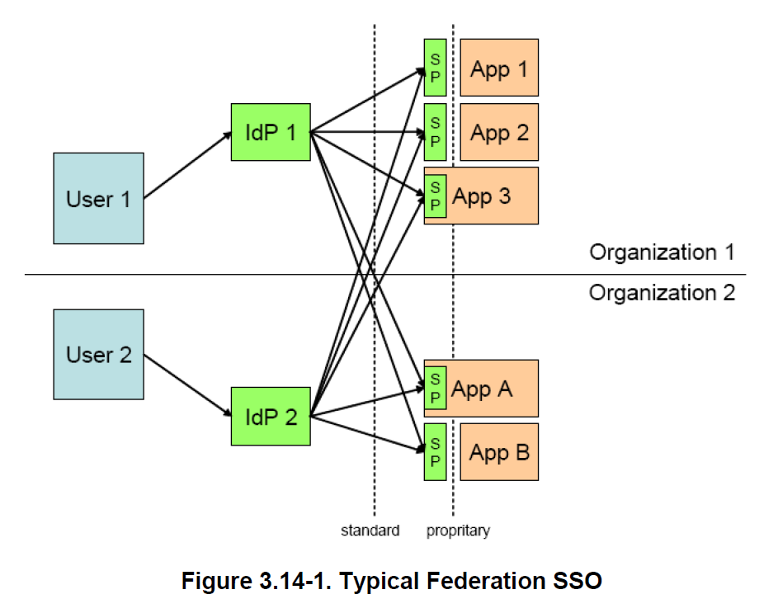
SSO (Traditional vs. Federated) ^{(*)}
(*) “CSC White Paper: “Identity Federation Concepts” http://assets1.csc.com/cybersecurity/downloads/FIM_White_Paper_Identity_Federation_Concepts.pdf

Slide 22
Benefits
Single Sign-On (SSO) – a user is prompted to authenticate once and allowed access to multiple systems for which he/she is authorized. This may be internally as well as across organization domains.
Cost Reduction
Effective use of resources
(*)S. Landau and T. Moore, “Economic tussles in federated identity management,” First Monday, vol. 17, no. 10, pp. 1–20, 2012

Slide 23
Risks
Trust (*)
trustworthiness of the user
service provider and identity provider’s inability to prevent Man in the middle attacks which lead to theft of user’s identity
trustworthiness of the IDPs and SPs
Security (*)
logic flaws from browser relayed messages (browser)
insecure channel (network)
Liability(**)
Who is responsible when something goes wrong?
(*) E. Ghazizadeh, M. Zamani, A. Pashang and J. A. Manan, “A survey on security issues of federated identity in the cloud
computing, 2012 IEEE, pp. 562–565, 2012
(**) S. Landau and T. Moore, “Economic tussles in federated identity management,” First Monday, vol. 17, no. 10, pp. 1–20, 2012

Slide 24
SAML (Security Assertion Markup Language)
The Security Assertion Markup Language (SAML) standard defines how providers can offer both authentication and authorization services.
Authentication: Determining that the users are who they claim to be
Authorization: Determining if users have the right to access certain systems or content
SAML provider (service provider, identity provider)
SAML assertion
Notes:
Systems that provide or consume SAML services are generically called service providers; the most important kind of service provider is an identity provider.
assertions (statements that service providers use to make access-control decisions)
Loosely speaking, a relying party interprets an assertion as follows:
Assertion A was issued at time t by issuer R regarding subject S provided conditions C are valid.
SAML assertions are usually transferred from identity providers to service providers. Assertions contain statements that service providers use to make access-control decisions. Three types of statements are provided by SAML:
Authentication statements
Attribute statements
Authorization decision statements:
Authentication statements assert to the service provider that the principal did indeed authenticate with the identity provider at a particular time using a particular method of authentication. Other information about the authenticated principal (called the authentication context) may be disclosed in an authentication statement.
An attribute statement asserts that a principal is associated with certain attributes. An attribute is simply a name-value pair. Relying parties use attributes to make access-control decisions.
An authorization decision statement asserts that a principal is permitted to perform action A on resource R given evidence E. The expressiveness of authorization decision statements in SAML is intentionally limited.

Slide 25
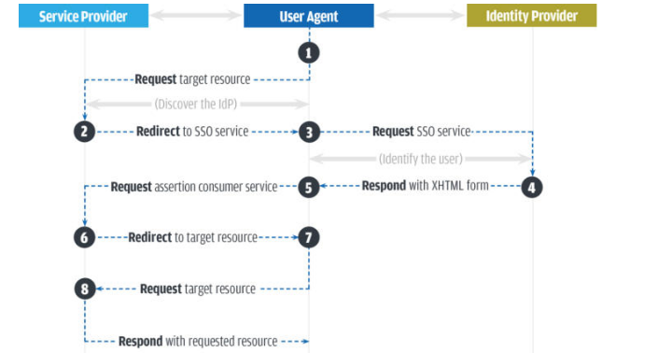
SAML authentication sequence

Slide 26
SAML examples
https://developer.salesforce.com/docs/atlas.en-us.sso.meta/sso/sso_saml_assertion_examples.htm

Slide 27
Compliance-as-a-Service (CaaS)
Managed services providers historically have faced contractual difficulties with their customers in negotiating information assurance requirements, particularly regarding regulatory compliance verification.
Cloud compliance is the general principle that cloud-delivered systems must be compliant with standards that the cloud customers face. This is a very important issue with new cloud computing services, and it is something that lots of IT professionals look at very closely.
Cost-effective multiregulation compliance verification
Read 5.3.11 from book
Notes:
Essentially, cloud customers need to look at the effective security provisions of their vendors the same way they would look at their own internal security. They will need to figure out whether their cloud vendor services match the compliance that they need. There are several ways to go about this. In some cases, companies can just look for vendors that certify compliance, and choose their services without any further input. However, sometimes clients may need to actually get involved in accessing the cloud vendor's security, to make sure that it complies with the industry standards and regulations.
In assessing cloud security, experts suggest that cloud customers ask certain kinds of questions, such as -- where is the data going to be stored? And who will be able to access it? In addition, companies are choosing between public, private and hybrid cloud computing services. This is also relevant to security, in that private cloud solutions can sometimes be more secure than public cloud solutions. In public cloud services, clients essentially share the same data platforms, and that means that in some cases, there is a concern about data crossover or unauthorized access.

Slide 28
Configurable
Automatic Updates
Continuous audit
Threat intelligence
Simplifies the Process
Notes:
General Data Protection Regulation (GDRP)

Slide 29
Privacy (5.4)
Collection
Notice
Choice and consent
Use
Security
Access
Retention
Disposal

Slide 30
Examples of U.S. Regulations
Regulation | Applies to | Regulates
Federal Information Security Management Act (FISMA) | Federal government Other organizations that process government data | Information security for government agencies
Health Insurance Portability and Accountability Act (HIPAA) | Health care providers Health plans Health care clearinghouses | Regulates privacy of protected health information

Slide 31
Examples of U.S. Regulations
Regulation | Applies to | Regulates
Gramm-Leach- Bliley Act (GLBA) | Banks Investment companies Other financial services | Customer data privacy
Sarbanes-Oxley (SOX) Act | Public corporations | Financial accuracy and public disclosure to investors

Slide 32
Topics for self reading
Rittinghouse John, Ransome James Cloud Computing_ Implementation, Management, and Security (2009)
5.4

