Slide 1
COMPRESSION
MOHSANA TARIQ
(BSPT. PP,DPT)
LECTURER
SARGODHA MEDICAL COLLEGE

Slide 2
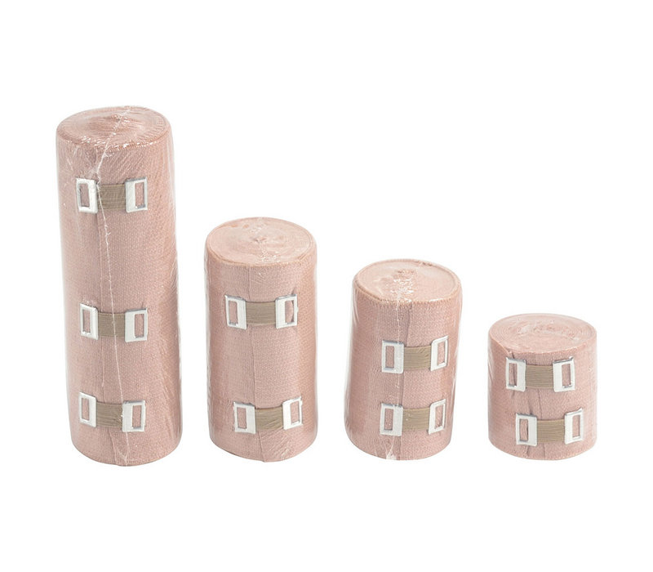

Slide 3
“Compression is the application of a mechanical force that increases external pressure on the body or a body part.”
Compression is generally used to improve fluid balance and circulation or to modify scar tissue formation.
Compression improves fluid balance by increasing the hydrostatic pressure in the interstitial space so that it becomes greater than that in the vessels.
This can limit or reverse outflow of fluid from blood vessels and lymphatic.
Keeping fluid in the vessels or returning it to the vessels allows it to circulate rather than to accumulate in the periphery

Slide 4
Compression can be
Static
exerting a constant force,
Intermittent,
with the force varying over time.
With intermittent compression the pressure may be applied to the entire limb all at one time, or it maybe applied sequentially starting distally and progressing proximally.

Slide 6
EFFECTS OF EXTERNAL COMPRESSION
Improved venous and lymphatic circulation
Limits the shape and size of tissue
Increased tissue temperature

Slide 7
IMPROVED VENOUS AND LYMPHATIC CIRCULATION
Both static and intermittent compression devices can increase circulation since both can increase the hydrostatic pressure in the interstitial space outside the blood and lymphatic vessels.
An increase in extravascular pressure can limit the outflow of fluid from the vessels into the interstitial space. where it tends to pool. Keeping it in the circulatory system, where it can circulate.
Intermittent compression may improve circulation more effectively than static compression because the varying amount of pressure is thought to push fluids from the distal to the proximal vessels.

Slide 8
It is achieved when the venous and lymphatic vessels are compressed, the fluid in them pushed proximally, and then, when compression is reduced. the vessels can open and refill with new fluid from the interstitial space. ready to be pushed proximally at the next compression
Sequential compression is thought to provide more effective drainage than single-chamber, intermittent compression because it can cause a wave of vessel constriction moving in a proximal direction to ensure that fluid is pushed along the vessels toward the heart rather than in a distal direction.
Improving circulation can benefit patients with edema, may help to prevent the formation of venous thrombosis in high-risk patients, may facilitate the healing of ulcers caused by stasis.

Slide 9
LIMITS THE SHAPE AND SIZE OF TISSUE
Static compression garments or bandaging can provide a form to limit the shape and size of new tissue formation.
This type of compression acts as a second skin, which, having an elastic compression element or being less extensible than skin, limits the shape and size of the tissue.
This effect of compression is exploited when compression bandaging or garments are used
over residual limbs after amputation,
when compression garments are applied over burn-damaged skin.
and when bandaging or garments are applied to edematous limbs.

Slide 10
INCREASED TISSUE TEMPERATURE
Most compression devices, except those with built in cooling mechanisms, increase superficial tissue temperature because the device insulates the area to which it is applied.
A heavy compression stockings or an air-filled sleeve will act as an insulator, preventing loss of body heat, thereby increasing local superficial tissue temperature.
Although the increase in temperature produced by compression garments is not a direct effect of the compressive forces, it has been proposed that the increased activity of temperature-sensitive enzymes such as collagenase, which breaks down collagen, produced by these garments may be the mechanism by which they control scar formation.

Slide 11
CLINICAL INDICATION FOR THE USE OF EXTERNAL COMPRESSION

Slide 12
Edema
Edema due to venous insufficiency
Lymphedema
2. Deep venous thrombosis
3. Venous stasis ulcers
4. Residual limb shaping after amputation
5. Control of hypertrophic scarring

Slide 13
EDEMA
“Edema is the presence of abnormal amounts of fluid in the extracellular tissue spaces of the body.”
Normal equilibrium in the tissues is maintained by the balance between the hydrostatic and osmotic pressure inside and outside the blood vessels.
THE HYDROSTATIC PRESSURE is determined by blood pressure and effects of gravity.
The higher hydrostatic pressure inside the vessels acts to push fluid out of the vessels
OSMOTIC PRESSURE is determined by the concentration of proteins inside and outside the vessels
Higher the osmotic pressure in side the vessels acts to keep the fluids inside the vessels

Slide 14
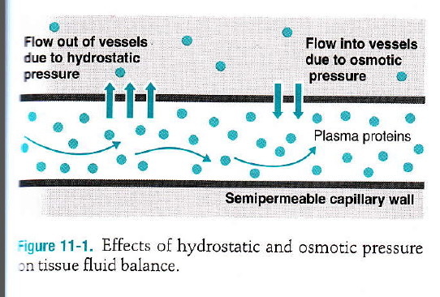

Slide 15
. Under normal circumstances, the hydrostatic pressure pushing fluid out of the veins is slightly higher than the osmotic pressure keeping fluid in, resulting in a slight loss of fluid into the interstitial space.
The fluid that is pushed out of the veins into the interstitial space is then taken up by the lymphatic capillaries, to be returned to the venous circulation at the subclavian veins.
This fluid, known as LYMPHATIC FLUID OR LYMPH, rich in protein, water, and macrophages.
Dysfunction in any of these mechanisms can result in increased extravasation of fluid from the vessels into the interstitial extravascuIar space or reduced flow of venous blood or lymph back toward the heart, and thus the formation of edema.

Slide 16
The most common reasons patients develop edema are
venous insufficiency or
dysfunction of the lymphatic system.
Edema may also occur after
exercise,
trauma,
surgery or
burns,
or in conjunction with infection
due to the increased vascular capillary permeability that occurs with the acute inflammation associated with these events.

Slide 17
EDEMA DUE TO VENOUS INSUFFICIENCY
The peripheral vein‘s function is to carry whole deoxygenated blood from the periphery back to the heart.
W hen the calf muscles contract, they extra pressure on the outside of the veins, which pushes the blood through the veins.
Then, following the contraction the pressure falls allowing the veins to refill.
A healthy amount of skeletal muscle activity, such as occurs with walking or running, or even with just rhythmic isometric muscle contraction, provides a milking action to propel the blood in the veins from the periphery back toward the heart.
Valves within the vessels prevent backflow of the fluid.
Lack of physical activity
dysfunction of the venous valves due to degeneration,
or mechanical obstruction of the veins by a tumor or inflammation
can result in venous insufficiency and accumulation of fluid in the periphery.

Slide 18
The most common cause of venous insufficiency is inflammation of the veins, known as phlebitis. which causes thickening of the vessel walls and damage to the valves.
The increased amount of fluid that enters the extravascular space and thus causes edema.
If the limbs are then placed in a dependent position, the edema will worsen because of increased hydrostatic pressure due to gravity.

Slide 19
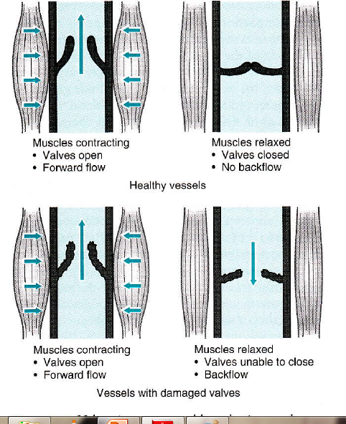

Slide 20
LYMPHADEMA
Fluid flows into the lymphatic system because concentration of proteins inside the lymphatic is generally higher than in the interstitial space.
A s with the veins, flow along the lymphatic vessels in a proximal direction depends on muscle activity.
Such as walking or running, which compresses the vessels and valves within the vessels and prevents backflow.
Decreased levels of plasma proteins particularly albumin, mechanical obstruction of the lymphatics abnormal distribution of lymphatic vessels or lymph nodes, or reduced activity can result in reduced lymphatic flow and the formation of lymphedema

Slide 21
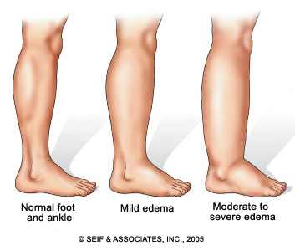
Edema

Slide 22
Adverse consequences of edema
Restrictions of range of motion (R.OM).
Limitations of function,
pain.
chronic edema particularly lymphedema that has a high level of protein, can also cause collagen to be laid down in the area, leading to subcutaneous tissue fibrosis and hard induration of the skin.
This may eventually cause disfiguring and disabling contractures and deformities
Chronic edema due to venous or lymphatic insufficiency also increases the risk of infection.
cellulitis,
Ulceration
Partial limb amputation
Chronic venous insufficiency also often causes itching, dermatitis, and brown pigmentation of the skin.

Slide 23
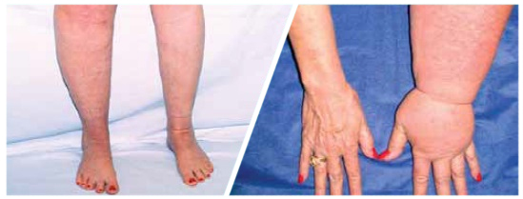
Lymphedema

Slide 24
How compression can reduce edema
Compression is effective in controlling edema due to venous insufficiency, lymphatic dysfunction, or any of the other causes because it increases extravascular hydrostatic pressure and circulation.
If the patient has other underlying causes of edema, such as infection, malnutrition inadequate physical activity, or organ dysfunction, these must also be addressed to achieve an optimal outcome and to prevent recurrence of the edema.

Slide 25
Compression of a limb with a static or intermittent device increases the pressure surrounding the extremity to counterbalance any increased osmotic or hydrostatic pressure causing fluid to flow out of the vessels into the extravascular space.
If sufficient pressure is applied, the hydrostatic pressure in the interstitial extravascular spaces becomes greater than that in the veins and lymphatic vessels, reducing outflow from the vessels and causing fluid in the interstitial spaces to return to the vessels.
Once fluid is in the vessels it can be circulated out of the periphery, preventing or reversing edema formation.
In addition, if an intermittent compression device is used, it may also to move the fluid proximally through the vessels.

Slide 26
Prevention from DVT
Deep venous thrombosis (DVTs) are blood clots in the deep veins. They can occur when circulation is poor or when there is inflammation of the veins.
If circulation is poor, the blood may move slowly to allow coagulation and the formation of a thrombus; thus, an intervention that increases the circulatory rate can reduce the risk of thrombus formation.
DVT formation is most common in immobilized patients, particularly after surgery or when recovering from cardiac failure or stroke.

Slide 27
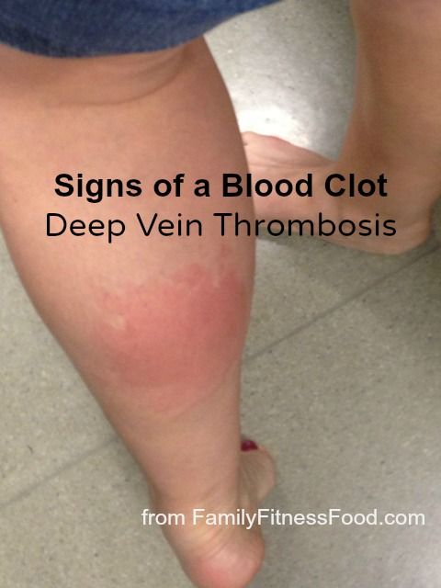

Slide 28
The prophylactic application of external compression devices to the foot and calf has been shown to reduce the incidence of DVT formation in patients who are hospitalized for a variety of reasons including postoperative and post acute stroke area and after spinal cord injury.
External compression devices may also protect against pulmonary embolism and reduce mortality.

Slide 29
Venous stasis Ulcers
Venous stasis ulcers are areas of tissue breakdown and necrosis that occur as the result of impaired venous circulation.
Impaired venous circulation, which may be the result of lack of muscle contraction, venous insufficiency, or mechanical obstruction, can result in poor tissue oxygenation and malnutrition, reduced local immunological responses, and an accumulation of waste products, all of which can contribute to cell death and tissue necrosis.
Because compression can improve venous circulation and because improving circulation may reduce these adverse effects, diminish the risk of vascular ulcer formation, and facilitate healing of previously formed ulcers.
compression is the treatment of choice for venous stasis ulcers.

Slide 30
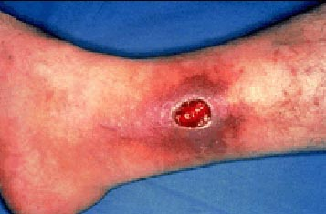

Slide 31
Residual limb shaping after amputation
Compression can be used for residual limb reduction and shaping after amputation in order to help prepare the limb for prosthetic fitting.
Both static and intermittent compression are used for this application,
although intermittent compression has been shown to reduce the residual limb in approximately half of the time required by other techniques.
For this type of application, when intermittent compression is used, it is applied in conjunction with wrapping with an elastic bandage.
Compression reduces residual limb size because it controls postsurgical edema and prevents stretching of the soft tissues by Excessive fluid accumulation.

Slide 33
Control of Hypertrophic Scarring
Hypertrophic scarring is a common complication of deep burns and other extensive skin and soft tissue injuries.
. Hypertrophic scars result in poor cosmesis and the development of contractures that may restrict ROM and function
Although many approaches, including surgery pharmaceuticals, passive stretch with positioning, massage, and silicone gel are used to control hypertrophic scar formation, compression is the most common.
Compression may directly shape the scar tissue by acting as a mold for the new tissue, decreasing local edema formation, and facilitating improved collagen orientation

Slide 34
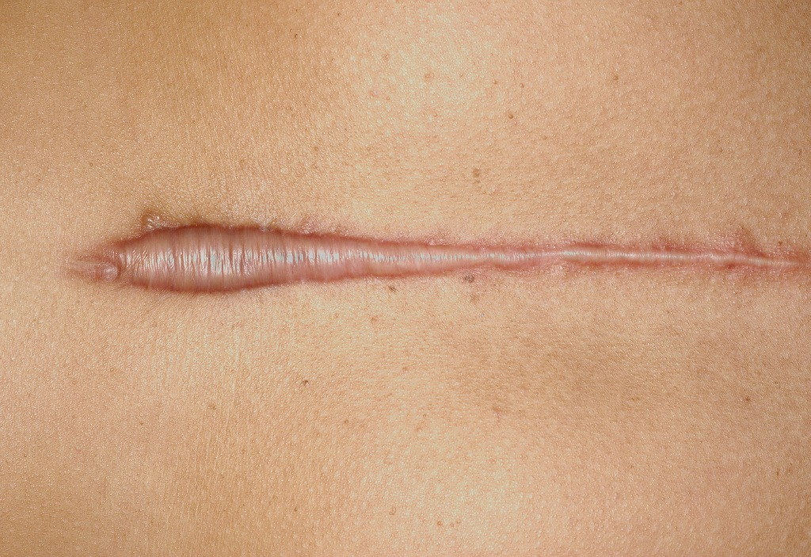

Slide 35
When applying compression to control hypertrophic scar formation, treatment is generally initiated once the new epithelium has formed, and is then continued for I to 12 months or longer until the scar is no longer growing and has reached maturity.
Compression can be applied with elastic bandages, self-adherent wraps, tubular elastic cotton supports, or elastic custom-fit garments.
With any of these approaches the compression pressure is maintained at approximately 20 mm Hg to 30 mm Hg.
It is recommended that the compression device are worn 24 hours a day, except when bathing, in order to achieve maximum benefit.
Common complications of this treatment include skin irritation constriction of circulation, and restriction of joint motion.

Slide 36
CONTRAINDICATION
Heart failure or pulmonary edema
Recent or acute DVT, thrombophlebitis, or pulmonary embolism
Obstructed lymphatic or venous return
Severe peripheral arterial disease or ulcers due to arterial insufficiency.
Acute local skin infection
Significant hypo-proteinemia -protein levels less than 2 g/dl
Acute fracture or other trauma

Slide 37
1. Heart failure or pulmonary edema
compression pumps should not be used treat edema of this etiology because the shift of fluid from the peripheral to the central circulation may increase the stress on the failing organs

Slide 38
2. Recent or acute DVT, thrombophlebitis, or pulmonary embolism
Compression, particularly intermittent compression, should not be used when the patient is known to have a DVT, thrombophlebitis, or a pulmonary embolus because thrombus may become dislodged or the embolus may travel.
This can occur because of direct mechanical agitation of the clot by the compression or because of increased circulation produced by compression.
If a thrombus or embolus becomes dislodged, it may travel in the bloodstream to a distant site and lodge in a location where it impairs blood flow to an organ sufficiently to cause organ damage, severe morbidity, or even death.

Slide 39
3. Obstructed lymphatic or venous return
Compression is contraindicated when lymphatic or venous return is totally obstructed because in such cases increasing the fluid load of the vessels cannot reduce the edema until the obstruction has been removed.
May be due to tumor, thrombus, or any damage to the lymph nodes

Slide 40
4. Severe peripheral arterial disease or ulcers due to arterial insufficiency.
Compression should not be used in patients with severe peripheral arterial disease or where there are ulcers due to arterial insufficiency because it aggravate these conditions by closing down the diseased arteries and further impairing circulation into the area.

Slide 41
5. Acute local skin infection
Local skin infection is likely to be aggravated by the application of compression because the sleeves and skin coverings used increase the moisture and temperature of the area, encouraging e growth of microorganisms.
If a chronic skin infection is present, single-use sleeves that avoid cross-contamination from one patient to another, or reinfection of the same patient, may be used for the application of intermittent compression.

Slide 42
6. Significant hypo-proteinemia -protein levels less than 2 g/dl
Although peripheral edema is a common symptom of sever hypoproteinemia, when the serum protein level is less than 2 g/dL, the resulting edema should not be treated with compression because returning fluid to the vessels will further lower the serum protein concentration, potentially resulting in severe and adverse consequences, including cardiac and immunological dysfunction.

Slide 43
7. Acute fracture or other trauma
Intermittent compression is contraindicated immediately after an acute trauma because the motion caused by this intervention may cause excessive motion at the site of trauma, increasing bleeding, aggravating the acute inflammation, or destabilizing an acute fracture.
Such effects can cause further damage at the site of injury and impair healing

Slide 44
PRECAUTIONS
impaired sensation or mentation.
Uncontrolled hypertension
Cancer
Stroke or significant vascular insufficiency
Superficial peripheral nerves

Slide 45
1. lmpaired sensation or mentation.
Compression should be applied with caution to patients with impaired sensation or mentation because such patients may be unable to recognize or communicate when pressure is excessive or painful.

Slide 46
2. Uncontrolled hypertension
Compression should be applied with caution to patients with uncontrolled hypertension because compression can further elevate blood pressure by increasing the vascular fluid load.
Blood pressure should be monitored frequently during treatment of these patients, and treatment should be stopped if their blood pressure increases above the safe level determined by their physician.

Slide 47
3. Cancer
Compression can increase circulation which may disturb or dislodge metastatic tissue, promoting metastasis,
or may improve tissue nutrition, promoting tumor growth.

Slide 48
4. Stroke or significant vascular insufficiency
Compression should be applied with caution patients who have had a stroke or have signs of significant cerebrovascular insufficiency, such as a history of transient ischemic attacks.
Caution is because the hemodynamic changes caused by compression may alter circulation to the brain.

Slide 49
5. Superficial peripheral nerves
When compression is applied over an area where there is a superficial nerve, particularly in a patient with significant weight loss, the clinician should monitor closely for symptoms of nerve compression, including changes in or loss of sensation or strength

Slide 50
APPLICATION TECHNIQUES
COMPRESSION BANDAGING
COMPRESSION GARMENTS
INTERMITTENT PNEUMATIC COMPRESSION PUMP

Slide 51
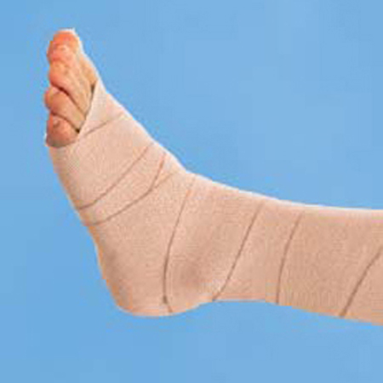
Compression bandages

Slide 52
1.COPMRESSION BANDAGES
Compression bandages are generally applied by wrapping them around the limb in a figure 8 manner, starting distally and progressing proximally.
Circular or spiral wrapping are generally not recommended because these configurations can result in the uneven application of pressure and thus the uneven control of edema.
The bandage should be applied tightly enough to apply moderate, comfortable compression without impairing circulation.
To avoid slipping of the compression bandage on the skin, cohesive gauze or foam bandages are often applied under the compression bandages directly against the patient's skin.
Soft cotton may also be used as an under wrapping to absorb sweat and to help distribute pressure more evenly. Compression bandages with different amounts of elasticity and extensibility are available.
More the extensibility of the bandage more will be the pressure exerted by the it.

Slide 53
UNNA’S BOOT
A semi rigid bandage formed of zinc oxide-impregnated gauze can also used.
This type of bandage is applied to the lower extremity it is known as an Unna's boot.
This is typically used for the treatment of venous stasis ulcers.
Zinc oxide impregnated gauze bandages become soft when wet allow molding around the involved limb, and then harden as they dry to form a semi-rigid boot.
The boot is left on the patient for as long as 1 to 2 weeks, and then removed and replaced.
An Unna's boot provide a sustained compression force of 35mm Hg to 40 mm Hg
For all types of bandages, it must be applied so that compression, be greatest distally, and gradually decrease proximally in order to achieve an appropriate pressure gradient.

Slide 54
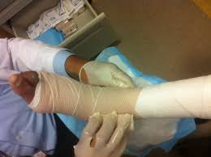
Unna boot

Slide 55
Application Technique Compression Bandages
Remove clothing and jewelry from the area to be treated.
Inspect the skin in the area.
Apply foam or cotton padding around anatomical indentations.
Dress and cover any wound according to the treatment regime
Apply a cohesive gauze, foam, or cotton under bandage to protect the skin from the compression bandage and minimize slipping of the compression bandage. Start distally and progress proximally.
Apply the compression bandage, starting distally and progressing proximally.
When applying a bandage to the lower extremity, first apply it around the ankle to fix the bandage in place then wrap the foot and then bandage the leg and thigh. Wrapping around the foot should be from medial to lateral.
When applying a bandage to the upper extremity, first apply it to the wrist to fix it in place, then wrap the hand and bandage the forearm and arm. bandage should be applied in a figure 8 manner.

Slide 56
Advantages
Inexpensive.
Quick to apply once skill is mastered.
Readily available.
Extremity can be used during treatment.
Safe for acute conditions.

Slide 57
Disadvantages
When used alone, does not reverse edema.
Effective only for controlling edema formation.
Requires moderate skill, flexibility, and level of cognition to apply.
Compression not readily quantifiable or replicable.
Bulky and unattractive.
Inelastic bandages are ineffective in controlling edema in a flaccid limb.

Slide 58
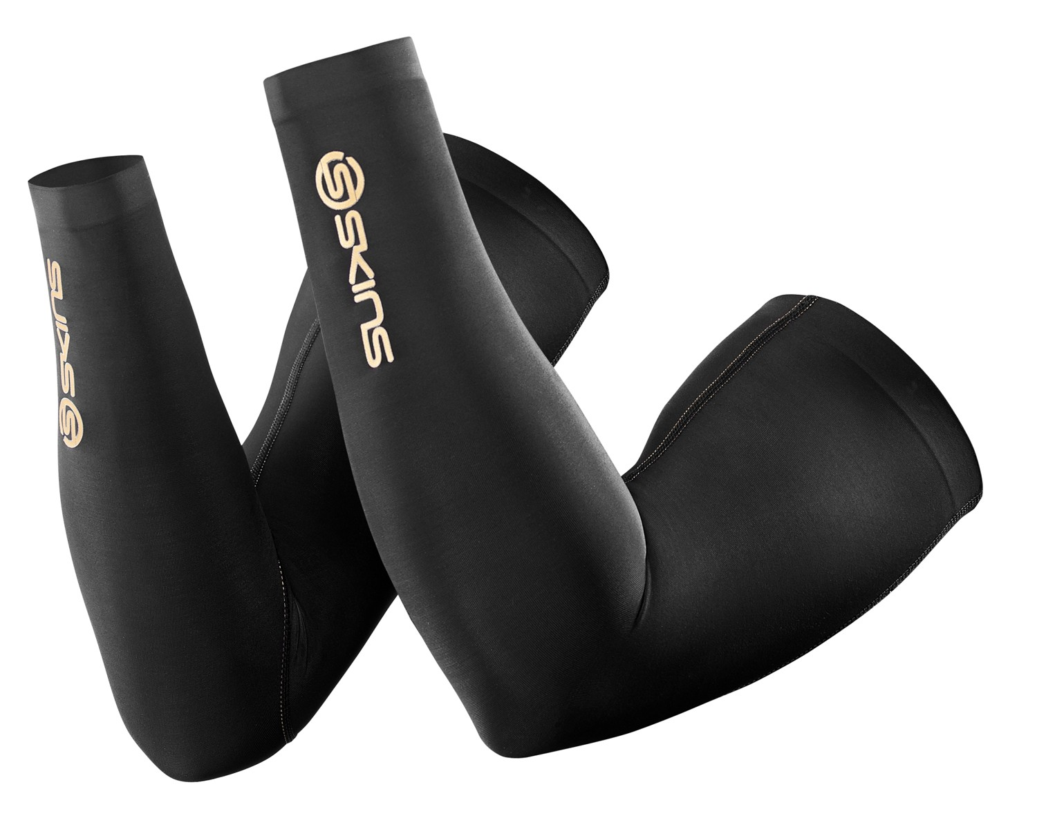
Compression garments

Slide 59
COMPRESSION GARMENTS
Compression garments can provide various degrees of compression and are available in custom-fit sizes for all areas of the body and standard off-the-shelf sizes for the limbs.
They are generally made of washable Lycra spandex and nylon and have moderate elasticity to provide a combination of moderate resting and working pressure
Off-the-shelf stockings providing a low compression force of about 16 mm Hg to 18 mm Hg, known as anti embolisms stockings, used to prevent DVT in bedridden patient

Slide 60
Application Techniques For Pressure Garments
Compression garments should be applied by gathering them up, placing them on the distal area first, and then gradually unfolding them proximally.
Since the Compression garments need to be worn every day throughout the day, except for bathing, to control edema, to improve circulation ,or control scar formation.
In general, with proper care, these garments last about 6 months, after which time they lost their elasticity and no longer exert the appropriate amount of pressure.
Garments also need to be re placed if there is a significant change in limb sizes, as may occur with changes in edema or in body weight.

Slide 61
Advantages
Compression quantifiable( unlike bandaging).
Extremity can be used during treatment (unlike a
pump).
Less expensive than intermittent compression devices for short-term use.
Thin and attractive ,available in various colors.
Safe for acute condition.
Can be used 24 hours/day, as for modification of scar formation.
Preferred by patients to compression bandages.

Slide 62
Disadvantages
When used alone, may not reverse edema that is already present.
More expensive than most bandages.
Need to be fitted appropriately.
Require strength, flexibility and dexterity to put on.
Hot, particularly in warm weather
Expensive for long-term use, as they need to be replaced at least every 6 months and the patient requires at least two identical garments so that one is available when the other is being laundered.

Slide 63
Intermittent pneumatic compression pump

Slide 64
INTEREMITTENT PNEUMATIC COMPRESSION PUMP
Intermittent pneumatic compression pumps are used to provide the force for intermittent compression.
The pump is attached, via a hose, to a chambered sleeve placed around the involved limb.
Intermittent compression is suitable for home use,
the patient should always begin the course of therapy under medical supervision.
In general since a compression pump is used for only a number of hours each day, the patient should use a static compression device between treatments, in order to maintain the reversal of edema produced by the pump.
The use of intermittent compression in conjunction with static compression also generally improves the outcomes.
For example, intermittent compression pumping twice a week in conjunction with static compression with an Unna's boot was found to approximately double the rate of venous ulcer healing compared with the use of Unna's boot alone.

Slide 65
Techniques of application IPCP
Determine that compression is not contraindicated for the patient or the condition.
Remove jewelry and clothing from the treatment area and inspect the skin. Cover any open wound with gauze or an appropriat dressing.
Place the patient in a comfortable position, with affected limb elevated. Limb elevation reduces pain and the edema caused by venous insufficiency.
Measure and record the patient's blood pressure.
Measure and record the limb circumference at a number of places with reference to bony landmarks.

Slide 66
Place a stocking over the area to be treated and smooth out all the wrinkles.
Apply the sleeve From the unit
8. Attach the hose from the pneumatic compression pump to the sleeve.
9. Set the appropriate compression parameters, including
inflation and deflation times,
inflation pressure,
and total treatment time.

Slide 67
The inflation time is the period during which the compression sleeve is being inflated or is at the maximal inflation pressure.
T he deflation time is the period during which the compression sleeve is being deflated or is fully deflated.
Inflation pressure is the maximum pressure during the inflation time and is measured in (mm Hg). Most units can deliver between mm Hg and 120 mm Hg of inflation pressure.
Total treatment time recommendations vary from 1 to 4 hours per treatment, with treatment frequency ranging from 3 times per week to 4 times per day.
For most applications treatments of 2 to 3 hours once or twice a day are recommended.

Slide 68
Provide the patient with a means to call you during the treatment. Measure and record the patient's blood pressure during the treatment, and discontinue treatment if either the systolic or diastolic pressure exceeds the limits set for the patient by the physician.
When the treatment is complete, tum off the unit disconnect the tubing, and remove the sleeve and stocking.
Re-measure and record limb volume in the same manner.
Re-inspect the patient's skin.
Re-measure and document the patient's blood pressure.
Apply a compression garment or bandage to maintain the reduction in edema between treatments.

Slide 69
Advantages
Actively moves fluids and therefore may be more effective than static devices, particularly f or a flaccid limb.
Compression quantifiable.
Can provide sequential compression.
Requires less finger and hand dexterity to apply than compression bandages or garments.
Can be used to reverse as well as control edema.
Use can be supervised in a patient who is non compliant with static compression.

Slide 70
Disadvantages
Used only for limited times during the day, and therefore not appropriate for modification of scar formation.
Generally requires a static compression device to be used between treatments.
Expensive to purchase unit or to pay for regular treatments in a clinic.
Requires moderate comfort using machinery to apply.
Requires electricity.
Extremity cannot be used during treatment.
Patient cannot move about during treatment.
Pumping motion of device may aggravate an acute condition.

Slide 71
Recommended Parameters for the Application of Intermittent Compression
Problem | Inflation/deflation time(seconds) | Inflation pressure (mmHg) | Treatment time (hours)
edema, DVT Prevention, venous stasis ulcers | 80-100/25-35 | 30-60 UE 40-80 LE | 2-3
Residual limb reduction | 40-60/10-15 | 30-60 UE 40-80 LE | 2-3

