Slide 1
Depressive Disorders

Slide 2
Depressive disorders include
disruptive mood dysregulation disorder,
major depressive disorder (including major depressive episode),
persistent depressive disorder (dysthymia),
premenstrual dysphoric disorder,
substance/medication-induced depressive disorder,
depressive disorder due to another medical condition,
other specified depressive disorder,
and unspecified depressive disorder.
Unlike in DSM-IV, in DSM-V“Depressive Disorders” has been separated from “Bipolar and Related Disorders.”
The common feature of all of these disorders is the presence of sad, empty, or irritable mood, accompanied by somatic and cognitive changes that significantly affect the individual’s capacity to function. What differs among them are issues of duration, timing, or presumed etiology.

Slide 3
DISRUPTIVE MOOD DYSREGULATION DISORDER
DMDD

Slide 4
Diagnostic Criterion
DSM V Criteria
A. Severe recurrent temper outbursts manifested verbally (e.g., verbal rages) and/or behaviorally (e.g., physical aggression toward people or property) that are grossly out of proportion in intensity or duration to the situation or provocation.
B. The temper outbursts are inconsistent with developmental level.
C. The temper outbursts occur, on average, three or more times per week.
D. The mood between temper outbursts is persistently irritable or angry most of the day, nearly every day, and is observable by others (e.g., parents, teachers, peers).

Slide 5
E. Criteria A-D have been present for 12 or more months. Throughout that time, the individual has not had a period lasting 3 or more consecutive months without all of the symptoms in Criteria A-D.
F. Criteria A and D are present in at least two of three settings (i.e., at home, at school, with peers) and are severe in at least one of these.
G. The diagnosis should not be made for the first time before age 6 years or after age 18 years.
H. By history or observation, the age at onset of Criteria A-E is before 10 years.
I. There has never been a distinct period lasting more than 1 day during which the full symptom criteria, except duration, for a manic or hypomanic episode have been met.
Note: Developmentally appropriate mood elevation, such as occurs in the context of a highly positive event or its anticipation, should not be considered as a symptom of mania or hypomania.
J. The behaviors do not occur exclusively during an episode of major depressive disorder and are not better explained by another mental disorder (e.g., autism spectrum disorder, posttraumatic stress disorder, separation anxiety disorder, persistent depressive disorder [dysthymia]).

Slide 6
Note: This diagnosis cannot coexist with oppositional defiant disorder, intermittent explosive disorder, or bipolar disorder, though it can coexist with others, including major depressive disorder, attention deficit/hyperactivity disorder, conduct disorder, and substance use disorders. Individuals whose symptoms meet criteria for both disruptive mood dysregulation disorder and oppositional defiant disorder should only be given the diagnosis of disruptive mood dysregulation disorder. If an individual has ever experienced a manic or hypomanic episode, the diagnosis of disruptive mood dysregulation disorder should not be assigned.
K. The symptoms are not attributable to the physiological effects of a substance or to an other medical or neurological condition.

Slide 7
Why the new diagnosis?
First, no DSM-IV category captures the symptomatology of children characterized primarily and fundamentally by severely impairing non-episodic irritability.
Other DSM-IV disorders do not accurately capture the phenotype exhibited by severe irritability.
Oppositional defiant disorder does have irritability but it is not required; can be diagnosed only on the basis of oppositional behavior

Slide 8
Common indications
Children with DMDD have severe and frequent temper tantrums that interfere with their ability to function at home, in school or with their friends.
Some of these children were previously diagnosed with bipolar disorder, even though they often did not have all the signs and symptoms.
Research has also demonstrated that children with DMDD usually do not go on to have bipolar disorder in adulthood. They are more likely to develop problems with depression or anxiety.

Slide 9
Prevelance
An epidemiologic study found a lifetime prevalence of 3.3% for a retrospectively assigned proxy diagnosis of DMDD in children 9 to 19 years of age (Brotman et al, 2006),
DMDD was associated with depressive and anxiety symptoms in later adulthood (Brotman et al, 2006; Stringaris et al, 2009); no further research is available so far

Slide 10
Neurobiology
participants with DMDD show an underactivation of amygdala
neural recruitment during failed motor inhibition were larger in people diagnosed with DMDD than in controls (Deveney et al, 2012b).
underlying brain mechanisms of several processes that are related to the symptomatology of DMDD are different between patients with DMDD, bipolar disorder and healthy people

Slide 11
Treatment
The only treatment trial of severe mood dysregulation is a small, negative trial of lithium
Cognitive therapies:
Psychoeducation: clinicians, teachers and parents need to work closely together to address and meet these patients’ special needs (e.g., classroom support, more time to complete school tests, etc.).
Parenting programs and Family therapy
Behavioral therapy

Slide 12
Major depressive disorder
MDD

Slide 13
Diagnostic Criteria
A. Five (or more) of the following symptoms have been present during the same 2-week period and represent a change from previous functioning: at least one of the symptoms is either (1) depressed mood or (2) loss of interest or pleasure.
Note: Do not include symptoms that are clearly attributable to another medical condition.
1. Depressed mood most of the day, nearly every day, as indicated by either subjective report (e.g., feels sad, empty, hopeless) or observation made by others (e.g., appears tearful). (Note: In children and adolescents, can be irritable mood.)
2. Markedly diminished interest or pleasure in all, or almost all, activities most of the day, nearly every day (as indicated by either subjective account or observation).

Slide 14
3. Significant weight loss when not dieting or weight gain (e.g., a change of more than 5% of body weight in a month), or decrease or increase in appetite nearly every day.
(Note: In children, consider failure to make expected weight gain.)
4. Insomnia or hypersomnia nearly every day.
5. Psychomotor agitation or retardation nearly every day (observable by others, not merely subjective feelings of restlessness or being slowed down).
6. Fatigue or loss of energy nearly every day.
7. Feelings of worthlessness or excessive or inappropriate guilt (which may be delusional) nearly every day (not merely self-reproach or guilt about being sick).
8. Diminished ability to think or concentrate, or indecisiveness, nearly every day (either by subjective account or as observed by others).
9. Recurrent thoughts of death (not just fear of dying), recurrent suicidal ideation without a specific plan, or a suicide attempt or a specific plan for committing suicide.

Slide 15
B. The symptoms cause clinically significant distress or impairment in social, occupational, or other important areas of functioning.
C. The episode is not attributable to the physiological effects of a substance or to another medical condition.
Note: Criteria A-C represent a major depressive episode.
Note: Responses to a significant loss (e.g., bereavement, financial ruin, losses from a natural disaster, a serious medical illness or disability) may include the feelings of intense sad­ness, rumination about the loss, insomnia, poor appetite, and weight loss noted in Criterion A, which may resemble a depressive episode. Although such symptoms may be understandable or considered appropriate to the loss, the presence of a major depressive episode in addition to the normal response to a significant loss should also be carefully considered. This decision inevitably requires the exercise of clinical judgment based on the individual’s history and the cultural norms for the expression of distress in the context of loss.

Slide 16
D. The occurrence of the major depressive episode is not better explained by schizoaffective disorder, schizophrenia, schizophreniform disorder, delusional disorder, or other specified and unspecified schizophrenia spectrum and other psychotic disorders.
E. There has never been a manic episode or a hypomanic episode.
Note: This exclusion does not apply if all of the manic-like or hypomanic-like episodes are substance-induced or are attributable to the physiological effects of another medical condition.

Slide 17
Persistent Depressive Disorder (Dysthymia)

Slide 18
Diagnostic Criteria
This disorder represents a consolidation of DSM-lV-defined chronic major depressive disorder and dysthymic disorder.
A. Depressed mood for most of the day, for more days than not, as indicated by either subjective account or observation by others, for at least 2 years.
Note: In children and adolescents, mood can be irritable and duration must be at least 1 year.
B. Presence, while depressed, of two (or more) of the following:
1. Poor appetite or overeating.
2. Insomnia or hypersomnia.
3. Low energy or fatigue.
4. Low self-esteem.
5. Poor concentration or difficulty making decisions.
6. Feelings of hopelessness.
C. During the 2-year period (1 year for children or adolescents) of the disturbance, the individual has never been without the symptoms in Criteria A and B for more than 2 months at a time.
D. Criteria for a major depressive disorder may be continuously present for 2 years.
E. There has never been a manic episode or a hypomanie episode, and criteria have never been met for cyclothymic disorder.

Slide 19
F. The disturbance is not better explained by a persistent schizoaffective disorder, schizophrenia, delusional disorder, or other specified or unspecified schizophrenia spectrum and other psychotic disorder.
G. The symptoms are not attributable to the physiological effects of a substance (e.g., a drug of abuse, a medication) or another medical condition (e.g. hypothyroidism).
H. The symptoms cause clinically significant distress or impairment in social, occupational, or other important areas of functioning.
Note: Because the criteria for a major depressive episode include four symptoms that are absent from the symptom list for persistent depressive disorder (dysthymia), a very limited number of individuals will have depressive symptoms that have persisted longer than 2 years but will not meet criteria for persistent depressive disorder. If full criteria for a major depressive episode have been met at some point during the current episode of illness, they should be given a diagnosis of major depressive disorder. Otherwise, a diagnosis of other specified depressive disorder or unspecified depressive disorder is warranted.

Slide 20
Causes of depressive disorders
The biological social and psychological perspectives

Slide 21
Etiology of DepressiveDisorders: Neurobiological Factors
Genetic factors
Heritability estimates
37% MDD (Sullivan, et al., 2000)
Heritability estimates higher for women than men
Much research in progress to identify specific genes involved but the results of most studies fail to replicate (Kato, 2007)
DRD4.2 gene, which influences dopamine function, appears to be related to MDD (Lopez Leon et a., 2005).

Slide 22
Etiology of Mood Disorders: Neurobiological Factors
Neurotransmitters
Low levels of norepinephrine, dopamine, and serotonin
New models focus on sensitivity of postsynaptic receptors
Dopamine receptors may lack sensitivity in MDD
Depleting tryptophan, a precursor of serotonin, causes depressive symptoms in individuals with personal or family history of depression
Individuals who are vulnerable to depression may have less sensitive serotonin receptors (Sobczak et al., 2002)

Slide 23
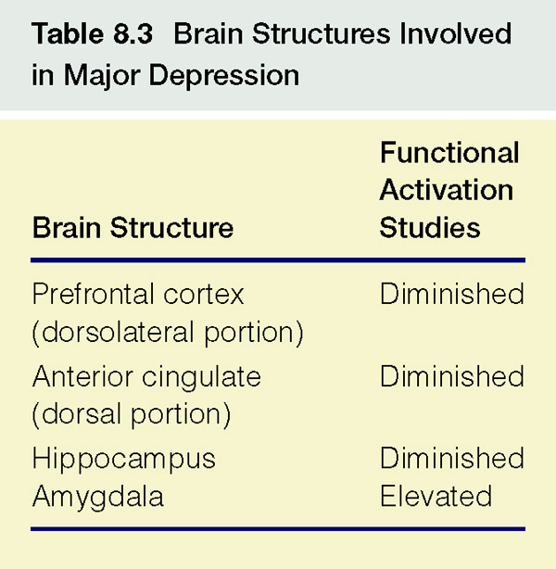
Etiology of Mood Disorders: Neurobiological Factors

Slide 24
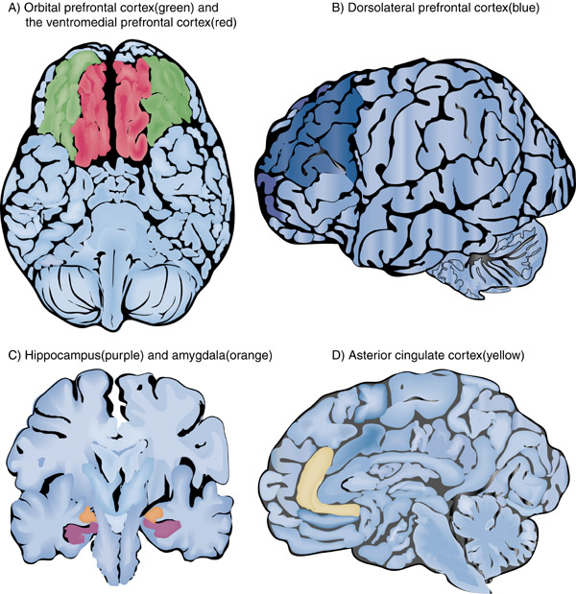
Figure 8.5 Key Brain Structures Involved in MDD

Slide 25
Etiology of Mood Disorders: Social Factors
Life events
Prospective research
42-67% report a stressful life event in year prior to depression onset
e.g., romantic breakup, loss of job, death of loved one
Lack of social support may be one reason a stressor triggers depression.
Interpersonal Difficulties
High levels of expressed emotion by family member predicts relapse
Marital conflict also predicts depression
Behavior of depressed people often leads to rejection by others
Excessive reassurance seeking
Few positive facial expressions
Negative self disclosures
Slow speech and long silences

Slide 26
Etiology of Mood Disorders: Psychological Factors
Freud’s theory
Oral fixation leads to excessive dependency
Depression
Anger towards loved ones who reject us is turned inward
Lack of empirical support for theory
Depressed individuals express more anger towards others than non-depressed people (Biglan et al., 1988)

Slide 27
Etiology of Mood Disorders: Psychological Factors
Neuroticism
Tendency to react with higher levels of negative affect
Predicts onset of depression (Jorm et al., 2000)
Extraversion
Associated with high levels of positive affect
Low extraversion does not always precede depression

Slide 28
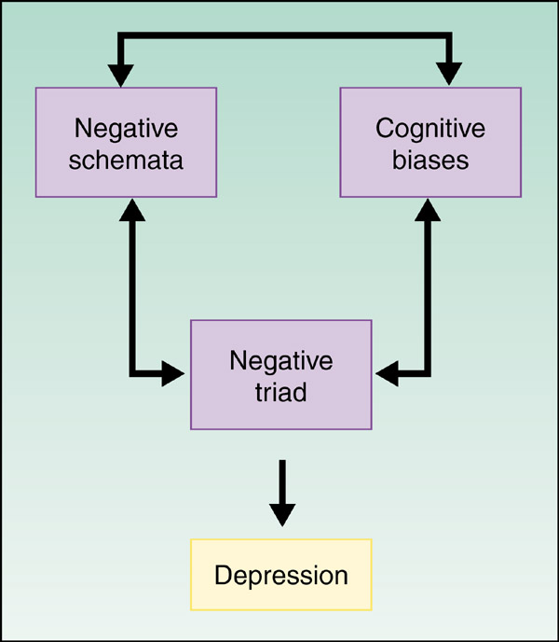
Etiology of Mood Disorders: Psychological Factors
Cognitive theories
Beck’s theory
Negative triad
Negative view of:
Self
World
Future
Negative schemata
Underlying tendency to see the world negatively
Negative schemata cause cognitive biases
Tendency to process information in negative ways

Slide 29
How depression?

Slide 30
Treatment
 | Level | Functional Impairment | Treatment strategies
Severity | Mild | Mild | Watchful waiting, supportive counseling; if no improvement after one or more months, consider use of an antidepressant or brief psychological counseling
 | Moderate | Moderate | Start with monotherapy of either antidepressants or psychotherapy, or a combination of both
 | Severe | Severe | May start with monotherapy of either antidepressants or psychotherapy, but should emphasize combinationof both or multiple drug therapy
Modifiers | Complicated | Co-occurring PTSD, mania, or social stressors | Start with combination of medications and somatic interventions
 | Chronicity | > 2 years of symptomatology despite treatment | For mild -start with monotherapy of either antidepressants or psychotherapy,, or a combination of both For Mod/Severe - combination of antidepressants and psychotherapy or multiple drug therapy

Slide 31
psychoeducation
Psychoeducation should be provided for individuals with depression at all levels of severity and in all care settings and should be provided both verbally and with written educational materials
There should be education on the nature of depression and its treatment options and should include the following
a. Depression is a medical illness, not a character defect
b. Education on the causes, symptoms, and natural history of major depression
c. Treatment is often effective and is the rule rather than the exception
d. The goal of treatment is complete remission; this may require several treatment trials
e. Treatment of depression can lead to decreased physical disability and longer life
f. Education about various treatment options, including the advantages and disadvantages of each, side effects, what to expect during treatment, and the length of treatment
Psychoeducational strategies should be incorporated into structured and organized treatment protocols, which entail structured systematic monitoring of treatment adherence and response and self-management strategies. [B]

Slide 32
Watchful Waiting
Watchful Waiting (WW) is defined as prospective monitoring (i.e., 4-8 weeks) of symptoms and disability and is a strategy to be used in mild cases of depression to differentiate a diagnosis of major depression from an adjustment disorder, uncomplicated bereavement, or minor depression.
Watchful Waiting should incorporate psychoeducation, general support, and prospective symptom monitoring over a 4 to 8 week period.

Slide 33
Psychotherapy
Interpersonal Psychotherapy (IPT)
A form of psychodynamic therapy that focuses on the relationships between a person and significant others. It is based on the idea that humans, as social beings, have their personal relationships at the center of psychological problems. Although a person’s depression may not be caused by any interpersonal event or relationship, it usually affects relationships and creates problems in interpersonal connections.
The goal of IPT is to improve communication skills so that a person with depression is better able to communicate with others.
Focus on current relationships

Slide 34
Cognitive therapy
Monitor and identify automatic thoughts
Replace negative thoughts with more neutral or positive thoughts
CT as effective as medication for severe depression
CT more effective than medication at preventing relapse

Slide 35
Mindfulness based cognitive therapy (MBCT)
Rationale
Strategies,
mindful meditation,
Yoga exercises
6 to 8 sessions (classes) for exercising yoga and meditation
Homework assignments (audiotapes)
More suitable for relapse patients

Slide 36
Biological Treatment of Mood Disorders
Electroconvulsive therapy (ECT)
Reserved for
Severe depression with high risk of suicide
Depression with psychotic features
Treatment non-responders
Induce brain seizure and momentary unconsciousness
Side effects
Memory loss
Medication
Lighttherapy
Short wavelength light on the face of patient
It decreases melatonin level among depressive patients
Initially devised for SADs (seasonal affective disorder)
Equally benificial for non-seasonal depression

