Slide 2
Vision For Future
APTA : Professional voice
Physical Therapy will be provided by PT who are DPT/board certified specialist
Consumers will have direct access to physical therapists in all environments for patient/client management , prevention, and wellness services
Physical therapists will be practitioners of choice in
clients’ health networks and will hold all privileges of
autonomous practice.
PTAs
educated and licensed to provide PT–directed and –supervised components of interventions.

Slide 3
Guided by integrity, lifelong learning, and a commitment to comprehensive and accessible health programs for all people, PTs & PTAs will render evidence-based service .
Rendering care without any discrimination …

Slide 4
Involve themselves in better care of pt using new technologies and basic clinical research
Growth of profession and so better care

Slide 5
Professional Practice in PT
DPT
Public Expectations
How to cope with increased Expectations
Influence of DPT degree.

Slide 6
THE DOCTORATE IN PHYSICAL THERAPY
1999:Creighton University :first DPT program
to determine the influences of the DPT in physical therapy education and the need for the degree program.
published their analysis in the professional journal Physical Therapy, arguing that the DPT provides PTs with a clear professional identity consistent with that of other health care professionals (e.g., podiatrists, pharmacists, psychologists, and chiropractors)

Slide 7
Public expectation ,PTs image, DPT
image of the PT should be consistent with the
public’s expectations of a professional
the doctoral degree recognizes and enhances such an image.
Need of health care
Consumers depicts ……
Social status

Slide 8
Expectations & predicted changes in clinical practice,
PTs require a enhanced & updated education,
job training
to prepare them for the future.

Slide 9
curricula for these DPT programs to prepare students for the unpredictable future of clinical practice
processes of evaluation, diagnosis, and patient management
supervising treatment
writing clinical case reports
Documenting the use of outcome data
Patients education
confronting ethical and financial dilemmas

Slide 10
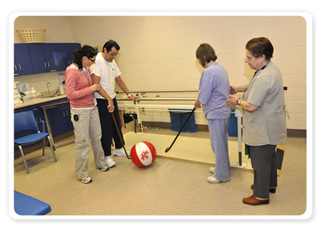
The DPT will help eliminate individuals who are not willing to “go the extra mile” for the profession.
The DPT will distinguish PTs from other allied health practitioners such as massage therapists, athletic trainers, and kinesiotherapists.

Slide 11
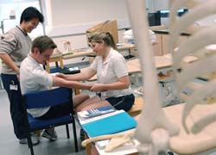
DPT and MD degrees.
Individuals attracted to other nonmedical clinical doctoral degrees ------
physical therapy
PTs ----- broader array of issues than ever before.

Slide 13
Evidence Based PT & professional Practice
DPT
tDPT degree
American Board of Physical Therapy Specialties (ABPTS)
Direct access to Physical Therapist

