Slide 1
File Processing VS DBMS

Slide 2
File System : File system is basically a way of arranging the files in a storage medium like hard disk. File system organizes the files and helps in retrieval of files when they are required. File systems consists of different files which are grouped into directories. The directories further contain other folders and files. File system performs basic operations like management, file naming, giving access rules etc.
Example:
NTFS(New Technology File System), EXT(Extended File System).
2. DBMS(Database Management System) : Database Management System is basically a software that manages the collection of related data. It is used for storing data and retrieving the data effectively when it is needed. It also provides proper security measures for protecting the data from unauthorized access. In Database Management System the data can be fetched by SQL queries and relational algebra. It also provides mechanisms for data recovery and data backup
Example:
Oracle, MySQL, MS SQL server.
A file system is a software that manages and organizes the files in a storage medium, whereas DBMS is a software application that is used for accessing, creating, and managing databases. The file system doesn't have a crash recovery mechanism on the other hand, DBMS provides a crash recovery mechanism.

Slide 3
DBMS vs. File System
There are following differences between DBMS and File system:
1. | File system is a software that manages and organizes the files in a storage medium within a computer. | DBMS is a software for managing the database.
2. | Redundant data can be present in a file system. | In DBMS there is no redundant data.
3. | It doesn’t provide backup and recovery of data if it is lost. | It provides backup and recovery of data even if it is lost.
4. | There is no efficient query processing in file system. | Efficient query processing is there in DBMS.
5. | There is less data consistency in file system. | There is more data consistency because of the process of normalization.
6. | It is less complex as compared to DBMS. | It has more complexity in handling as compared to file system.
7. | File systems provide less security in comparison to DBMS. | DBMS has more security mechanisms as compared to file system.
8. | It is less expensive than DBMS. | It has a comparatively higher cost than a file system.

Slide 4
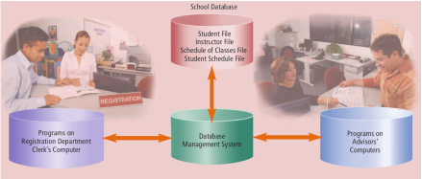
File Processing Approach :
-Each user maintains separate files—and programs to manipulate these files—because each requires some data not available from the other user's files.
-This redundancy in defining and storing data results in wasted storage space and in redundant efforts to maintain common up-to-date data
-In traditional file processing, data definition is typically part of the application programs themselves; hence, these programs are constrained to work with only one specific database, whose structure is declared in the application programs
Database Approach:
-A single repository maintains data that is defined once and then accessed by various users repeatedly through queries, transactions, and application programs
When an organization uses the database approach, many programs and users share the data in the database. The database does secure its data, however, so that only authorized users can access certain data items. While a user is working with the database, the DBMS resides in the memory of the computer.

Slide 5
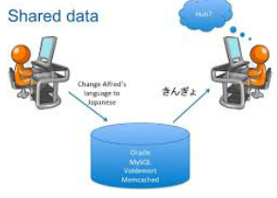
• Reduced Data Redundancy — Most data items are stored in only one file, which greatly reduces duplicate data. • Improved Data Integrity — When users modify data in the database, they make changes to one file instead of multiple files. Thus, the database approach increases the data’s integrity by reducing the possibility of introducing inconsistencies.
• Shared Data — The data in a database environment belongs to and is shared, usually over a network, by the entire organization. Organizations that use databases typically have security settings to define who can access, add, modify, and delete the data in a database.
• Easier Access — The database approach allows nontechnical users to access and maintain data, providing they have the necessary privileges. • Reduced Development Time — It often is easier and faster to develop programs that use the database approach.

Slide 6
Advantages of Database Approach over File Processing Approach:
-Self-describing nature of a database system; complete definition or description of database structure and constraints is part of the database:
-Insulation between programs and data; program-data dependence versus program-data independence
-When structure changes, business requirements change
-Accessing data is done through SQL statements, so when structure is changed, usually only have to change SQL statements (rather than multiple programs)
-When structure continually changes, business requirements change
-Support of multiple views of data
-Sharing data and multiuser transaction processing
- Database can be more complex than a file processing system. - Databases also require more memory, storage, and processing power than file processing systems. - Data in a database can be more vulnerable than data in file processing systems. - Database can store a lot of data in a single file.

