Slide 2
Objectives Overview
Define the term, database, and explain how a database interacts with data and information
Define the term, data integrity, and describe the qualities of valuable information
Discuss the terms character, field, record, and file
Describe file maintenance techniques and validation techniques
Differentiate between a file processing approach and the database approach
See Page 513
for Detailed Objectives

Slide 3
Objectives Overview
Discuss the functions common to most database management systems
Explain how to access Web databases
Identify database design guidelines and discuss the responsibilities of database analysts and administrators
Describe characteristics of relational, object-oriented, and multidimensional databases
See Page 513
for Detailed Objectives

Slide 4
Databases, Data, and Information
Database
Collection of data organized in a manner that allows access, retrieval, and use of that data
Data
Collection of unprocessed items
Text
Numbers
Images
Audio
Video
Information
Processed data
Documents
Audio
Images
Video
Page 514

Slide 5
Pages 514 – 515
Figure 10-1

Slide 6
Databases, Data, and Information
Database software, often called a database management system (DBMS), allows users to:
Create a computerized database
Add, modify, and delete data
Sort and retrieve data
Create forms and reports from the data
Page 515

Slide 7
Databases, Data, and Information
Data integrity identifies the quality of the data
Garbage in, garbage out (GIGO) points out the accuracy of a computer’s output depends on the accuracy of the input
Page 516

Slide 8
Databases, Data, and Information
Valuable information should have the following characteristics:
Accurate
Verifiable
Timely
Organized
Accessible
Useful
Cost-effective
Pages 516 - 517

Slide 9
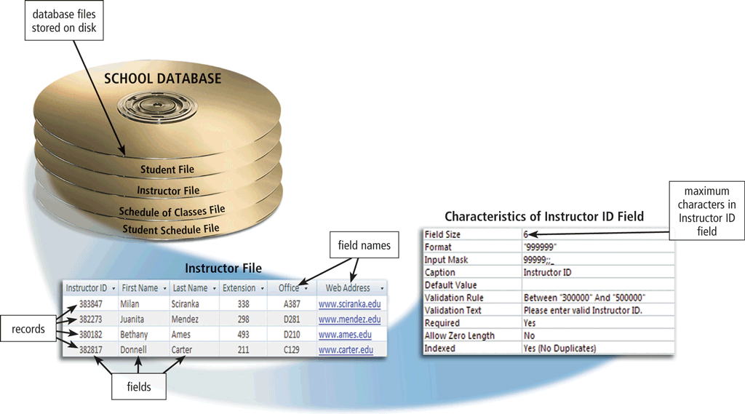
The Hierarchy of Data
Data is organized in layers
Files, records, fields, characters
Page 517
Figure 10-2

Slide 10
The Hierarchy of Data
A character is one byte
Numbers, letters, space, punctuation marks, or other symbols
A field is a combination of one or more related characters
Field name
Field size
Data type
Page 518
Figure 10-3

Slide 11
The Hierarchy of Data
Common data types include:
Text
Numeric
AutoNumber
Currency
Date
Memo
Yes/No
Hyperlink
Object
Attachment
Page 518

Slide 12
The Hierarchy of Data
A record is a group of related fields
A primary key uniquely identifies each record
A data file is a collection of related records
Page 519
Figure 10-4

Slide 13
Maintaining Data
File maintenance refers to the procedures that keep data current
Adding records
Modifying records
Deleting records
Page 520

Slide 14
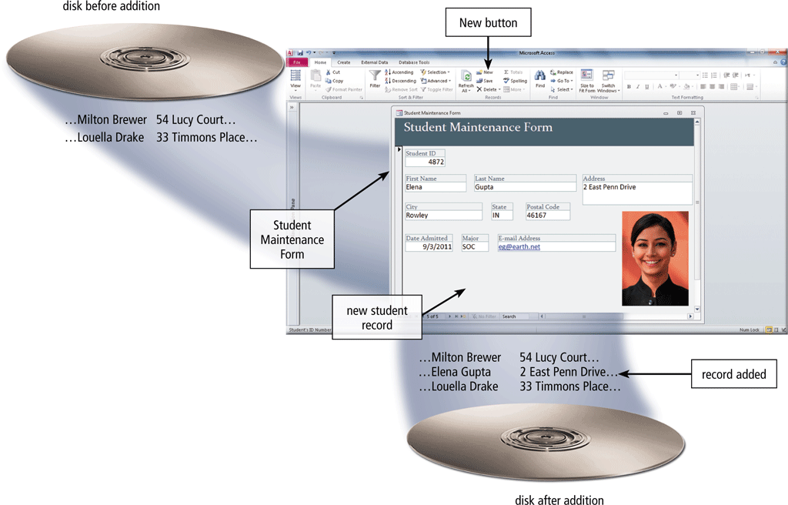
Maintaining Data
Users add new records to a file when they obtain new data
Page 520
Figure 10-5

Slide 15
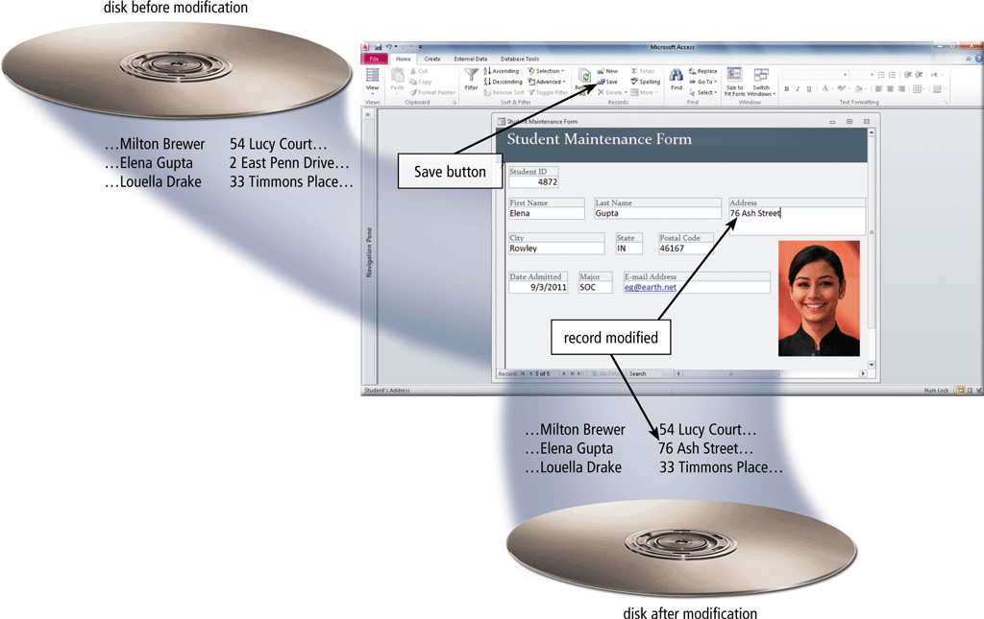
Maintaining Data
Users modify a record to correct inaccurate data or update old data
Page 521
Figure 10-6

Slide 16
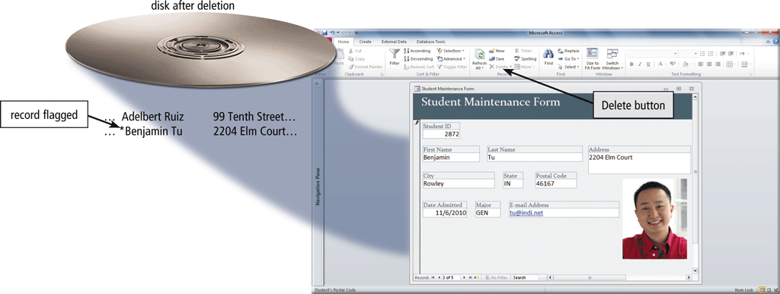
Maintaining Data
When a record no longer is needed, a user deletes it from a file
Page 522
Figure 10-7

Slide 17
Maintaining Data
Validation compares data with a set of rules or values to find out if the data is correct
Alphabetic/Numeric check
Range check
Consistency check
Completeness check
Check digit
Other checks
Pages 522 - 524

Slide 18
File Processing Versus Databases
File processing system
Database approach
Each department has its own set of files
Used for many years
Have data redundancy
Isolate data
Programs and users share data
Reduce data redundancy
Improve data integrity
Share data
Allows easier access
Reduces development time
Can be more vulnerable
Pages 524 - 526

Slide 19
Page 525
Figure 10-10

Slide 20
Page 527
Figure 10-11

Slide 21
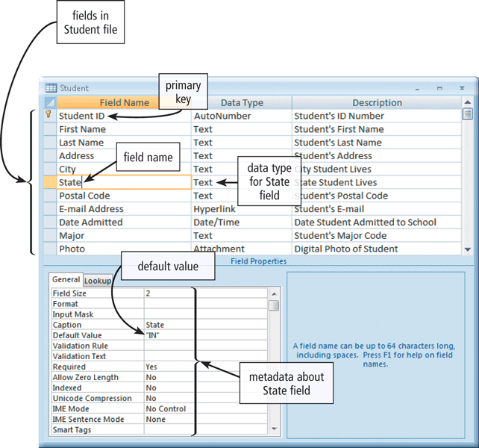
Database Management Systems
A data dictionary contains data about each file in the database and each field in those files
Pages 527 – 528
Figure 10-12

Slide 22
Database Management Systems
A DBMS provides several tools that allow users and programs to retrieve and maintain data in the database
Query language
Query by example
Form
Report generator
Page 528

Slide 23
Database Management Systems
A query language consists of simple, English-like statements that allow users to specify the data to display, print, or store
Query by example (QBE) provides a GUI to assist users with retrieving data
Page 528

Slide 24
Page 529
Figure 10-13

Slide 25
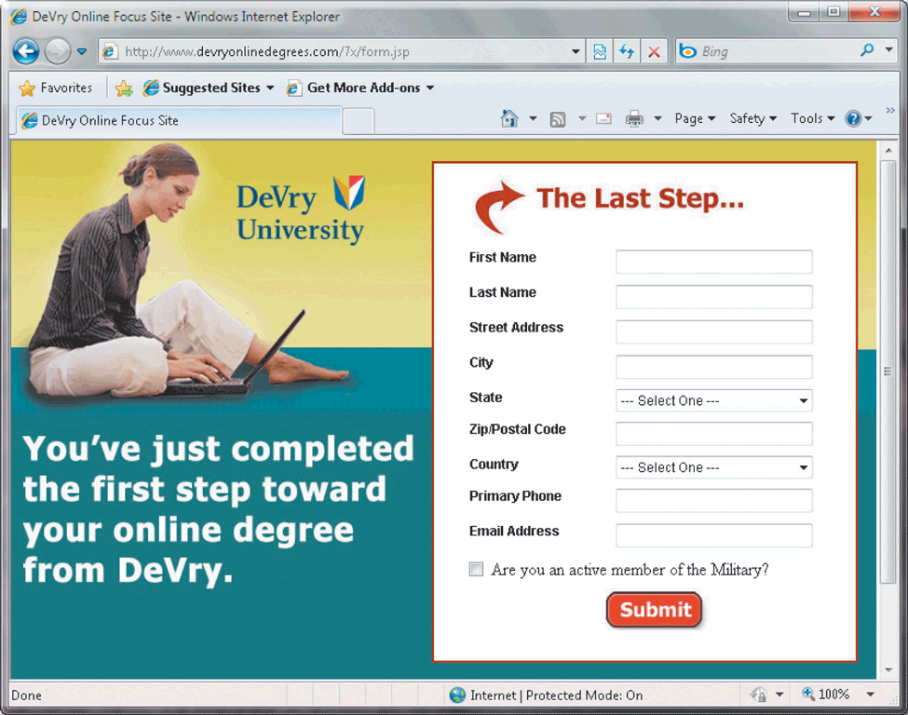
Database Management Systems
A form is a window on the screen that provides areas for entering or modifying data in a database
Page 530
Figure 10-15

Slide 26
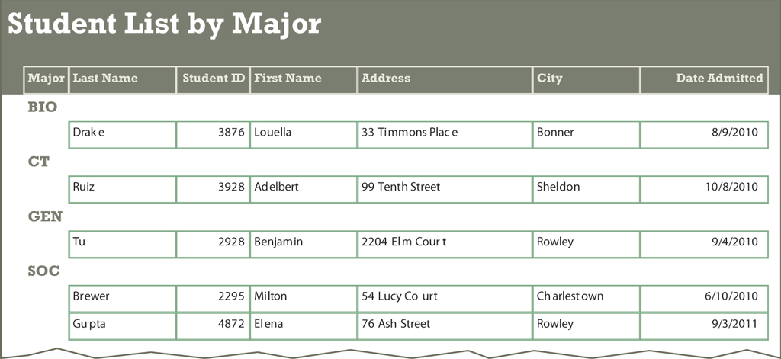
Database Management Systems
A report generator allows users to design a report on the screen, retrieve data into the report design, and then display or print the report
Page 531
Figure 10-16

Slide 27
Database Management Systems
A DBMS provides means to ensure that only authorized users access data at permitted times
Access privileges
Principle of least privilege
Page 531

Slide 28
Database Management Systems
A DMBS provides a variety of techniques to restore the database to a usable form in case it is damaged or destroyed
Backup
Log
Recovery utility
Continuous backup
Pages 531 - 532

Slide 29
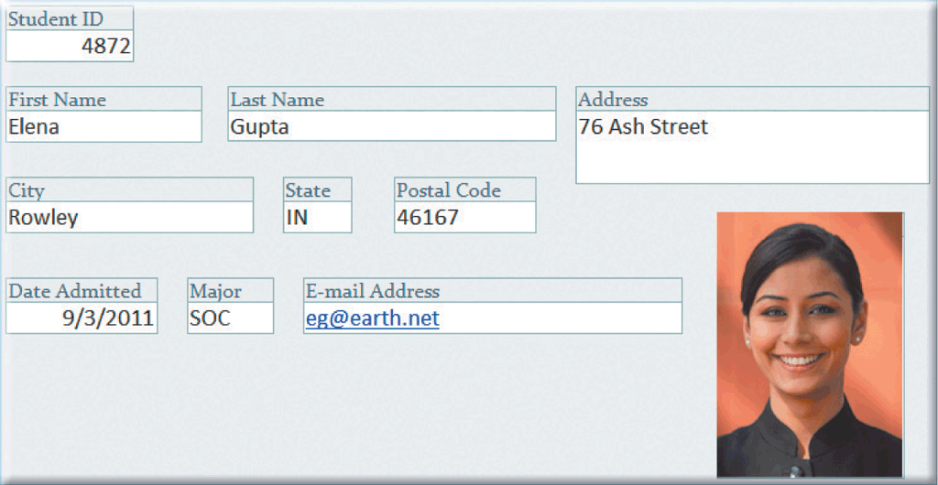
Database Management Systems
Page 532
Figure 10-17

Slide 30
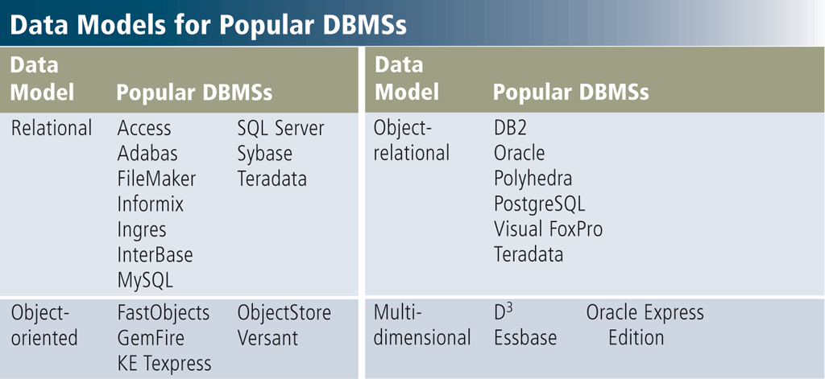
Relational, Object-Oriented, and Multidimensional Databases
A data model consists of rules and standards that define how the database organizes data
Page 533
Figure 10-18

Slide 31
Relational, Object-Oriented, and Multidimensional Databases
A relational database stores data in tables that consist of rows and columns
Each row has a primary key
Each column has a unique name
A relationship is a link within the data
Page 533
Figure 10-20

Slide 32
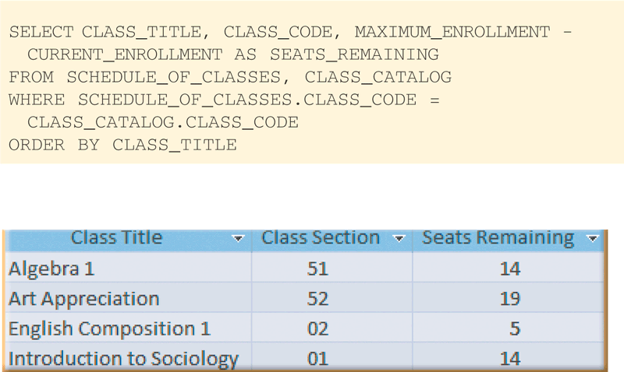
Relational, Object-Oriented, and Multidimensional Databases
Structured Query Language (SQL) is a query language that allows users to manage, update, and retrieve data
Page 534
Figure 10-21

Slide 33
Relational, Object-Oriented, and Multidimensional Databases
An object-oriented database (OODB) stores data in objects
Examples of applications appropriate for an object-oriented database include:
Multimedia database
Groupware database
Computer-aided design database
Hypertext database
Page 534

Slide 34
Relational, Object-Oriented, and Multidimensional Databases
Page 535
Figure 10-22

Slide 35
Relational, Object-Oriented, and Multidimensional Databases
A multidimensional database can store data in more than two dimensions of data
Sometimes known as a hypercube
Can consolidate data much faster than a relational database
A data warehouse is a huge database that stores and manages the data required to analyze historical and current transactions
Pages 535 - 536

Slide 36
Web Databases
Databases on the Web allow you to:
Shop for products or services
Buy or sell stocks
Search for a job
Make airline reservations
Register for college classes
Check semester grades
Page 536

Slide 37
Page 536
Figure 10-23

Slide 38
Video: How a Photo Sharing Site Keeps Its Data
CLICK TO START

Slide 39
Database Administration
It is important to have a carefully designed database
Page 537
Figure 10-24

Slide 40
Database Administration
Database analysts and administrators are responsible for managing and coordinating all database activities
Database Analyst (DA)
Decides on proper field placement, defines data relationship, and identifies users’ access privileges
Database Administrator (DBA)
Creates and maintains the data dictionary, manages security, monitors performance, and checks backup and recovery procedures
Page 538

Slide 41
Database Administration
Employees should learn how to use the data in the database effectively
Interact with database
Identify new data for the database
Maintain the database
Page 538
Figure 10-25

Slide 42
Summary
How data and information are valuable assets to an organization
Methods for maintaining high-quality data
Assessing the quality of valuable information
Advantages of organizing data in a database
Various types of databases
Roles of the database analysts and administrators
Page 539

Slide 43
Chapter 10 Complete

Slide 44
Project due Dec. 22
Use Access to input a list of three friends including name, email address, phone number, home address, birthday.
Design a Christmas card.
Use Access to send the Christmas card via email to each friend.
Use Access and mail merge to print Christmas card and envelop to each friend.

