Slide 10
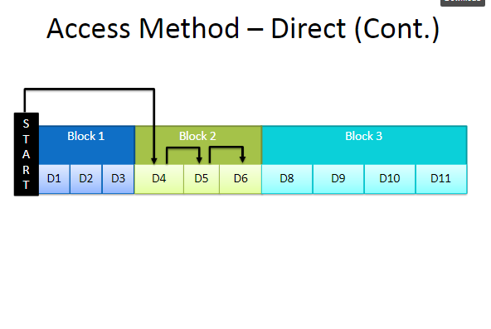

Slide 14
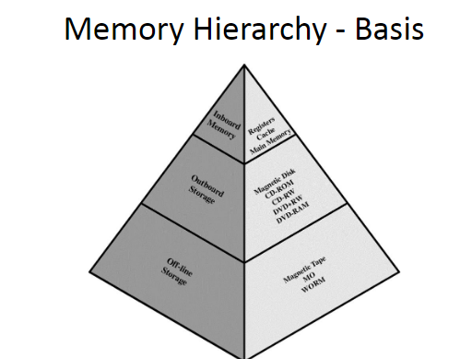

Slide 22
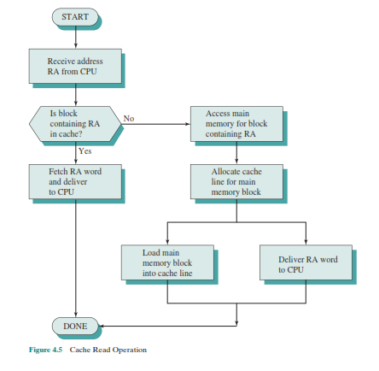

Slide 23
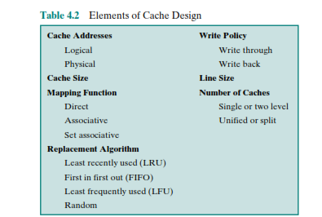

Slide 24
CACHE ADDRESSES:
virtual memory is a facility that allows programs to address memory from a logical point of view, without regard to the amount of main memory physically available. For reads to and writes from main memory, a hardware memory management unit (MMU) translates each virtual address into a physical address in main memory. When virtual addresses are used, the system designer may choose to place the cache between the processor and the MMU or between the MMU and main memory(Figure 4.7). A logical cache, also known as a virtual cache, stores data using virtual addresses. The processor accesses the cache directly, without going through the MMU. A physical cache stores data using main memory physical addresses. One obvious advantage of the logical cache is that cache access speed is faster than for a physical cache, because the cache can respond before the MMU performs an address translation.

Slide 25
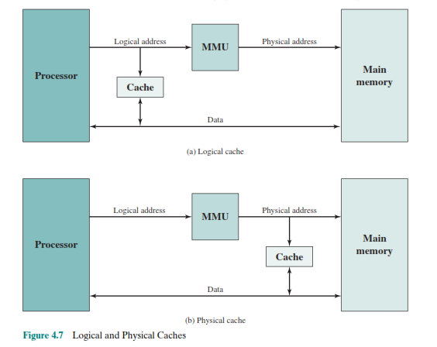

Slide 26
Cache Size
We would like the size of the cache to be small enough so that the overall average cost per bit is close to that of main memory alone and large enough so that the overall average access time is close to that of the cache alone. There are several other motivations for minimizing cache size. The larger the cache, the larger the number of gates involved in addressing the cache. The result is that large caches tend to be slightly slower than small ones—even when built with the same integrated circuit technology and put in the same place on chip and circuit board. The available chip and board area also limits cache size.
Mapping Function
Because there are fewer cache lines than main memory blocks, an algorithm is needed for mapping main memory blocks into cache lines. Further, a means is needed for determining which main memory block currently occupies a cache line. The choice of the mapping function dictates how the cache is organized. Three techniques can be used: direct, associative, and set associative.

Slide 27
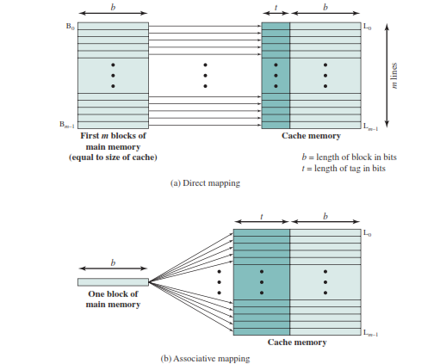

Slide 28
DIRECT MAPPING:
The simplest technique, known as direct mapping, maps each block of main memory into only one possible cache line. The mapping is expressed as
i = j modulo m
where
i = cache line number
j = main memory block number
m = number of lines in the cache
The direct mapping technique is simple and inexpensive to implement. Its
main disadvantage is that there is a fixed cache location for any given block. Thus,
if a program happens to reference words repeatedly from two different blocks that
map into the same line, then the blocks will be continually swapped in the cache,
and the hit ratio will be low (a phenomenon known as thrashing).

Slide 29
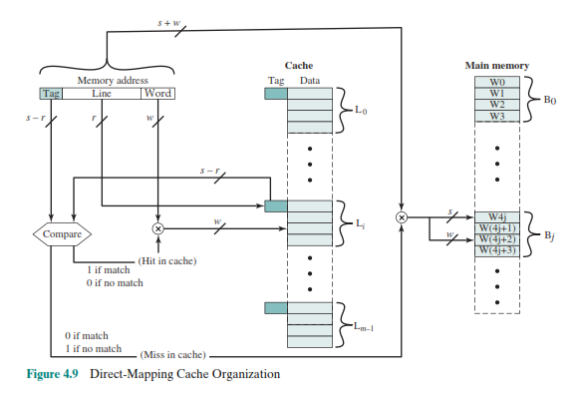

Slide 30
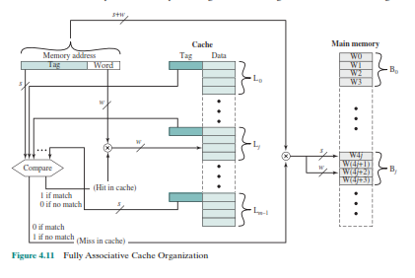
ASSOCIATIVE MAPPING:
Associative mapping overcomes the disadvantage of direct
mapping by permitting each main memory block to be loaded into any line of the
cache (Figure 4.8b). In this case, the cache control logic interprets a memory address
simply as a Tag and a Word field.

Slide 31
SET-ASSOCIATIVE MAPPING :
Set-associative mapping is a compromise that exhibits the strengths of both the direct and associative approaches while reducing their disadvantages.
In this case, the cache consists of a number sets, each of which consists of a number of lines. The relationships are
m = V * k
i = j modulo V
where
i = cache set number
j = main memory block number
m = number of lines in the cache
v = number of sets
k = number of lines in each set

Slide 32
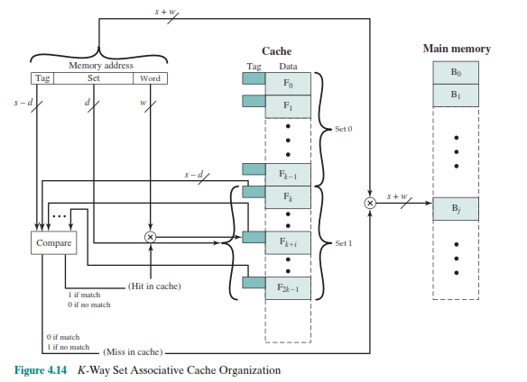

Slide 33
Number of Caches
MULTILEVEL CACHES:
As logic density has increased, it has become possible to
have a cache on the same chip as the processor: the on-chip cache. Compared with
a cache reachable via an external bus, the on-chip cache reduces the processor’s
external bus activity and therefore speeds up execution times and increases overall
system performance. When the requested instruction or data is found in the on-chip
cache, the bus access is eliminated. Because of the short data paths internal to
the processor, compared with bus lengths, on-chip cache accesses will complete
appreciably faster than would even zero-wait state bus cycles. Furthermore, during
this period the bus is free to support other transfers.
UNIFIED VERSUS SPLIT CACHES:
When the on-chip cache first made an appearance,
many of the designs consisted of a single cache used to store references to both data and instructions. More recently, it has become common to split the cache into two: one dedicated to instructions and one dedicated to data. These two caches both exist at the same level, typically as two L1 caches.

Slide 34
Line Size:
Another design element is the line size. When a block of data is retrieved and placed
in the cache, not only the desired word but also some number of adjacent words are
retrieved. As the block size increases from very small to larger sizes, the hit ratio
will at first increase because of the principle of locality, which states that data in the
vicinity of a referenced word are likely to be referenced in the near future. As the
block size increases, more useful data are brought into the cache. The hit ratio will
begin to decrease, however, as the block becomes even bigger and the probability
of using the newly fetched information becomes less than the probability of reusing
the information that has to be replaced.
Replacement algorithm and write policy must be read from book

