Slide 2
Head Injury
Dr.Waqas Ahmad

Slide 3
Cerebral concussion
Transient neurological dysfunction resulting from an applied force to the head.
A forceful blow to the resting movable head usually produces maximum brain injury beneath the point of cranial impact.

Slide 4
(Contre coup injury)
A moving head hitting against an unyielding object usually produces maximum brain injury opposite the site of cranial impact as the brain rebounds within the cranium.

Slide 5
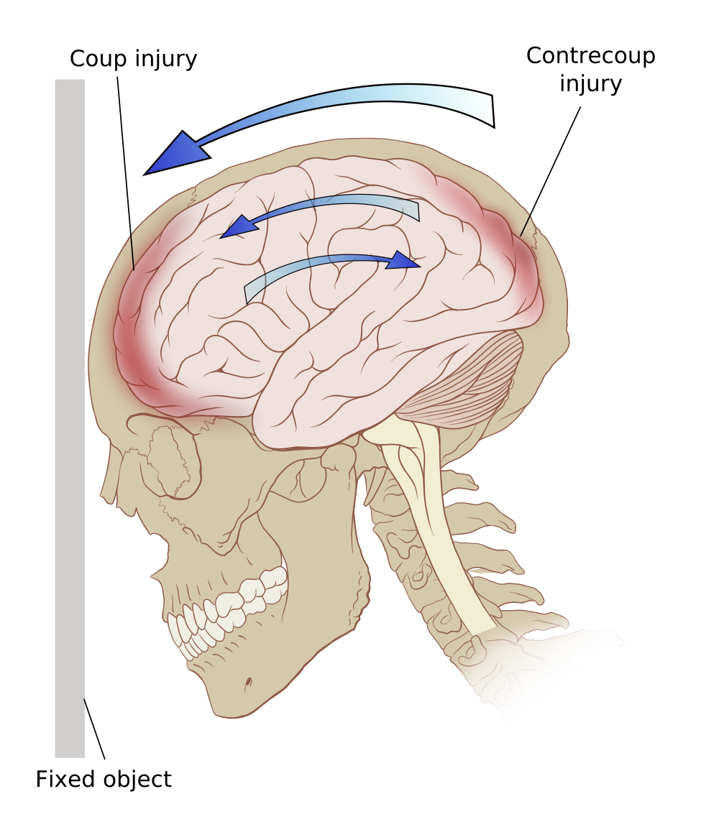

Slide 6
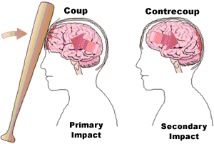

Slide 8
Moving head before impact
Head acceleration
brain lags toward
squeezing away the cerebrospinal fluid (CSF) ,thickening CSF layer
maximal shearing forces at this site
lack of coup injury in the moving head injury

Slide 9
Stationary head prior to impact
No brain lag
No change in distribution of CSF,
absence of contrecoup injury
coup injury.

Slide 10
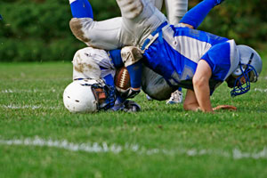
Sports related impacts
Coup / countercoup ?
Notes:
Both are common.

Slide 11
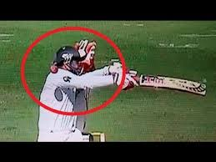

Slide 14
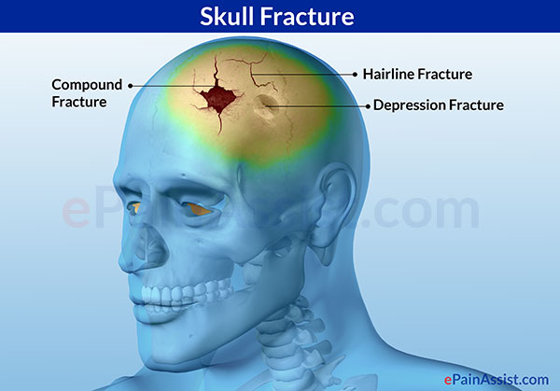
Energy transfer bone to brain .
Temporary > linear
Permanent > Depressed

Slide 15
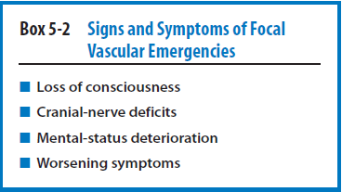
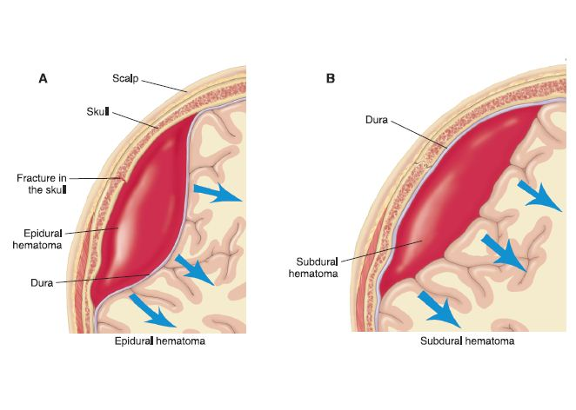

Slide 17
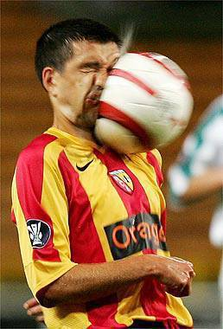
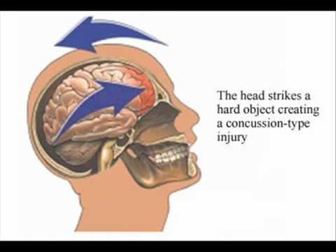
Cerebral concussion, the most common sport-related TBI, classified as a mild diffuse injury and is often referred to as mild traumatic brain injury (MTBI).
The injury involves an acceleration–deceleration mechanism in which a blow to the head or the head striking an object results in one or more of the following conditions:

Slide 18
Post-concussion symptoms include:
Headaches
Dizziness
Fatigue
Irritability
Anxiety
Insomnia
Loss of concentration and memory
Noise and light sensitivity

Slide 19
Post-concussion syndrome is a complex disorder in which various symptoms — such as headaches and dizziness — last for weeks and sometimes months after the injury that caused the concussion.
Concussion is a mild traumatic brain injury, usually occurring after a blow to the head. Loss of consciousness isn't required for a diagnosis of concussion or post-concussion syndrome.
In most people, post-concussion syndrome symptoms occur within the first seven to 10 days and go away within three months, though they can persist for a year or more.

Slide 20
Mild Concussion
Frequent(85%)
Difficult to recognize and diagnose
Transient change in electrophysiology of brain
Altered mental status
No unconsciousness
Impaired cognitive function e.g. Post Traumatic amnesia
Dizziness and Tinnitus
Rare loss of coordination that is evident on Romberg Test
Headache

Slide 21
Moderate
Transient mental confusion, tinnitus, moderate dizziness, unsteadiness
prolonged posttraumatic amnesia (30 minutes).
A momentary loss of consciousness often results, lasting from several seconds up to 1 minute.
Blurred vision, dizziness, balance disturbances, and nausea
Careful clinical observation
Skilled judgment reg. return to game

Slide 22
Severe
Longer Time frame
Post Traumatic amnesia > 24 hrs
Retrograde amnesia

Slide 23
Second Impact Syndrome
When an athlete who has sustained an initial head trauma, most often a concussion, sustains a second injury before symptoms associated with the first have totally resolved.
Often, the first injury was unreported or unrecognized. SIS usually occurs within 1 week of the initial injury and involves rapid brain swelling and herniation as a result of the brain losing autoregulation of its blood supply.

Slide 24
Brain stem failure develops in 2 to 5 minutes, causing rapidly dilating pupils, loss of eye movement, respiratory failure, and eventually coma.
On-field management of SIS should include rapid removal of any helmet or pads so the athlete can be rapidly intubated. Unfortunately, the mortality rate of SIS is 50%, and the morbidity rate is 100%.
.

Slide 25
Although the number of reported cases is relatively low, the potential for SIS to occur in athletes with mild head injuries should be a major consideration when making return-to-play decisions.

Slide 26
Immediate Management of Sport-Related Concussion
Easy to recognize concussion if athlete is unconscious.
Of all cerebral concussions, 90% to 95% involve no loss of consciousness but rather only a transient loss of alertness or the presence
of mental confusion.

Slide 27
Three primary objectives
Recognizing the injury and its severity
2. Determining if the athlete requires additional attention and/or assessment
3. Deciding when it is safe for the athlete to return to sports activity.

Slide 28
Initial On-Site Assessment
Better to perform initial evaluation after injury on the site. Your approach to the initial assessment may differ depending whether you are dealing with an athlete-down or ambulatory condition. Athlete-down conditions are signified by the athletic trainer and/or team physician responding to the athlete.
A primary survey involving basic life support should be performed first. This is easily performed and usually takes only 10 to 15 seconds as respiration and cardiac status are assessed to rule out a life-threatening condition.Once life-threatening conditions have been ruled out, the secondary survey can begin.

Slide 29
Primary survey of athlete
Secondary survey:
During the secondary survey, a seven-step protocol (history, observation, palpation, special tests, active/passive range of motion, strength tests, and functional tests) should be strictly followed to ensure that nothing has been overlooked.
Notes:
Shaking athlete with cervical spine is contraindicated.

Slide 30
If the athlete is unconscious or is regaining consciousness but is still disoriented and confused, the injury should be managed similar to that of a cervical spine injury because the clinician may not be able to rule out an associated cervical spine injury. Therefore, the unconscious athlete should be transported from the field or court on a spine board with the head and neck immobilized. Vital signs should be monitored at regular intervals (1–2 minutes), as the clinician talks to the athlete in an attempt to help bring about full consciousness.

Slide 31
If the athlete is in a state of lethargy or stupor or appears to be unconscious, do not attempt to arouse the individual by shaking. Shaking the athlete is contraindicated when a cervical spine injury is suspected.
If loss of consciousness is brief, lasting less than 1 minute, and the remainder of the examination is normal, the athlete may be observed on the sideline and referred to a physician at a later time.
Prolonged unconsciousness, lasting 1 minute or longer, requires immobilization and transfer to an emergency facility so the athlete can undergo a thorough neurological examination.

Slide 32
Amnesia testing
The clinician can perform amnesia testing by first asking the athlete simple questions directed toward recent memory and progressing to more involved questions.
Asking the athlete for the first thing he or she remembered after the injury will test for length of posttraumatic amnesia, also known as anterograde amnesia.
Asking what the play was before the injury or who the opponent was last week will test for retrograde amnesia. Retrograde amnesia is generally associated with a more serious head injury.

Slide 33
Questions of orientation (name, date, time, and place) may be asked; however, research suggests that orientation questions are not good discriminators between injured and non injured athletes.
Facing the athlete away from the field and asking the name of the team being played may be helpful. Portions of the observation and palpation plan should take place during the initial on-site evaluation.
The clinician should observe for any deformities and abnormalities in facial expressions (indicating possible compromise of cranial nerve VII) speech patterns, respirations and movement of the extremities.

Slide 34
All of this can be performed while asking the athlete questions. Additionally, gentle palpation of the skull and cervical spine should be performed to rule out an associated fracture. The athlete who is conscious or who was momentarily unconscious should be transported
to the sidelines or locker room for further evaluation after the initial on-site evaluation.
If the athlete is unconscious moving and positioning should be done carefully, assuming possible associated cervical injury. A helmet does not have to be removed at this time unless in some way it compromises maintenance of adequate ventilation. Often an adequate airway can be maintained just by removing the
face mask or strap.

Slide 35
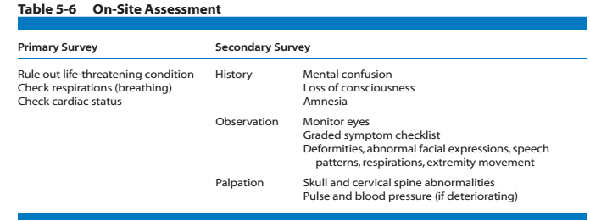

Slide 36
Sideline Assessment
Quick cranial nerve assessment
Visual acuity :(cranial nerve II: optic) read / identify selected objects (at near range and far range).
Eye movement (cranial nerves III and IV: oculomotor and trochlear) should be checked for coordination and a purposeful appearance by asking the athlete to track a moving object.

Slide 37
Pupils
The pupils also should be observed to determine if they are equal in size and equally reactive to light; the pupils should constrict when light is shined into the eyes.
Observation of the pupils also assesses the oculomotor nerve. Abnormal movement of the eyes, changes in pupil size, or reaction to light often indicate increased intracranial pressure.

Slide 38
The clinician should also look for any signs
Otorrhea
CSF draining from the ear canal.
Rhinorrhea
CSF draining from the nose.

Slide 39
Battle’s sign(posterior auricular hematoma)
Mastoid ecchymosis, is an indication of fracture of posterior cranial fossa of the skull, and may suggest underlying brain trauma.
Battle's sign consists of bruising over the mastoid process, as a result of extravasation of blood along the path of the posterior auricular artery.

Slide 40
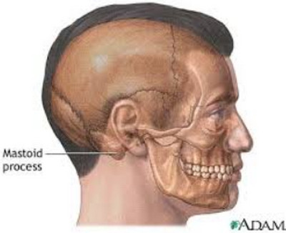

Slide 41
Raccoon eyes
Bilateral periorbital ecchymosis also known as "raccoon eyes". Bilateral = "both sides", periorbital="around the orbit (eye), eccyhmosis=bruise". Bruising around the eyes on both sides.
Periorbital ecchymosis secondary to
blood leaking from the anterior fossa of the skull.

Slide 42
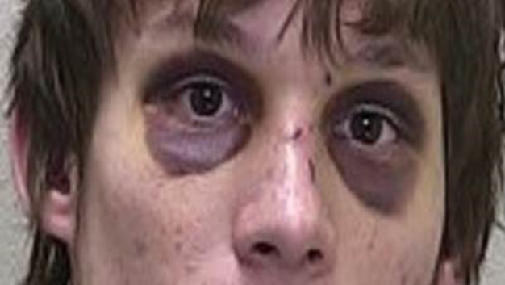

Slide 43
If the athlete’s condition appears to be worsening, the pulse and blood pressure should be taken. The development of an unusually slow heart rate or an increased pulse pressure(increased systolic and decreased diastolic) after the athlete has calmed down may be signs of increasing intracranial involvement.
The clinician must be capable of identifying deteriorating conditions that would warrant
immediate physician referral or transfer to the emergency department.

Slide 44
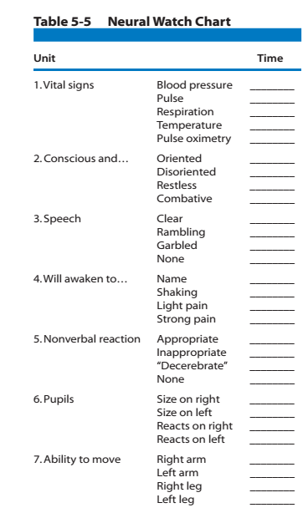

Slide 45
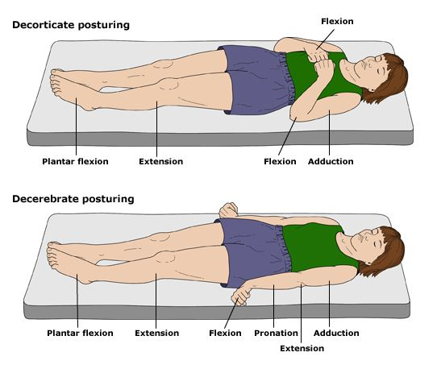

Slide 46
Special Tests for the Assessment of Coordination
The inclusion of objective balance testing in the assessment
of concussion is recommended. Balance Error Scoring System (BESS) is recommended over the standard Romberg
test, which for years has been used as a subjective tool for the assessment of balance.
The BESS was developed to provide clinicians with a more objective test that is a rapid and cost effective method of objectively assessing postural stability in athletes on the sports sideline or athletic training room after a concussion.

Slide 47
Research has found the BESS to be a reliable and valid assessment tool for the management of sport related concussion.
Three different stances (double, single, and tandem) are completed twice, once while on a firm surface and once while on a 10-cm–thick piece of medium density foam (Airex) for a total of six trials.

Slide 48
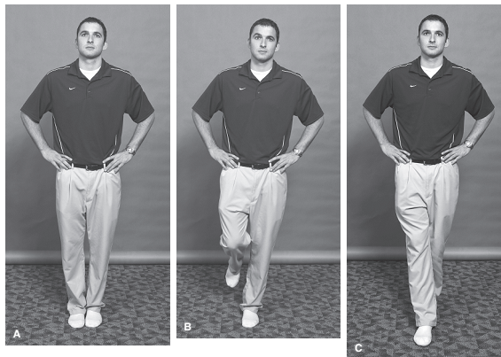

Slide 49
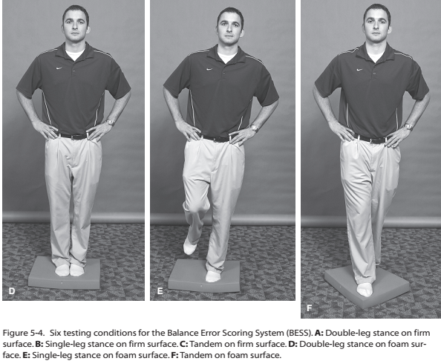

Slide 50
The total test time is approximately 6 minutes—the athlete is asked to assume the required stance by placing their hands on the iliac crests and on eye closure the 20-second test begins.
During the single-leg stances, subjects are asked to
maintain the contralateral limb in 20 to 30 degrees of hip
flexion and 40 to 50 degrees of knee flexion. Additionally, the athlete is asked to stand quietly and as motionless as possible in the stance position keeping his or her hands on the iliac crests and eyes closed.

Slide 51
The single-limb stance tests are performed on the nondominant foot. This same foot is placed toward the rear on the tandem stances. Subjects are told that, on losing their balance, they are to make any necessary adjustments and return to the testing position as quickly as possible.
Performance is scored by adding one error point for each error committed.
Trials are considered to be incomplete if the athlete is unable to sustain the stance position for longer than 5 seconds during the entire 20-second testing period. These trials are assigned a standard maximum error score of “10.”

Slide 52
Balance test results during injury recovery are best used when compared to baseline measurements, and clinicians working with athletes or patients on a regular basis should attempt to obtain baseline measurements when possible.
More sophisticated balance assessment using computerized forceplate systems and sensory organization testing (SOT) has identified balance deficits in athletes up to 3 days following a mild concussion. These tests are recommended for making return-to-play decisions, especially when preseason baseline measurements are available for comparison.

Slide 53
Assessment of coordination

Slide 54
Finger-to-Nose test
The finger-to-nose test is also considered to be a good test for combining cognitive processing and balance. The clinician asks the athlete to stand with his or her eyes closed and arms out to the side. The athlete is then asked to touch the index finger of one hand to the nose and then to touch the index finger of the other hand to the nose. The athlete is then asked to open his or her eyes and touch the index finger of the evaluator (placed at varying ranges in the peripheral view) to test acuity and depth of perception. Inability to perform any of these tasks may be an indication of physical disorientation secondary to intracranial involvement.

Slide 55
SAC (Cognition Testing) Standardized- assessment-of-concussion
The SAC requires approximately 5 minutes to administer and assesses four domains of cognition, including orientation, immediate memory, concentration and delayed recall. A composite total score of 30 possible points is summed to provide an overall index of cognitive impairment and injury severity.
The SAC also contains a brief neurological screening and documentation of injury-related signs and symptoms (e.g.LOC,post traumatic amnesia, retrograde amnesia).

Slide 56
The SAC includes measures of functions most sensitive to concussion:
Orientation ;(month, date, day of week, year, time)
Immediate memory ;(recall of 5 words in 3 separate trials)
Neurological;
Loss of consciousness; (occurrence, duration)
Amnesia; (either retrograde or anterograde) (recollection of events pre- and post-injury)
Sensation
Coordination
Strength
Concentration
Exertional maneuvers (jumping jacks, sit-ups)
Delayed recall (5 word)

Slide 58
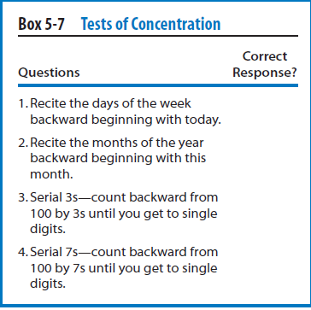

Slide 59
Medications
Aspirin or non-steroidal anti-inflammatory drugs, which decrease platelet function and potentially increase intracranial bleeding, mask the severity and duration of symptoms, and possibly lead to a more severe injury.
It is also recommended that acetaminophen (Tylenol)be used sparingly in the treatment of headache-like symptoms in the athlete with a concussion because of its pain-relieving effect, which could mask the severity and duration of these symptoms.

Slide 60
Other medications to avoid during the acute post-concussion period include those that adversely affect central nervous function—in particular, alcohol and narcotics.

Slide 61
Computerized Neuropsychological Tests
A number of computerized neuropsychological testing programs have been designed for the assessment of athletes after concussion.The Automated Neuropsychological Assessment Metrics (ANAM), CogState, Concussion Resolution Index,
Immediate Postconcussion Assessment and Cognitive Testing (ImPACT) are all currently available and have shown promise as reliable and valid concussion assessment tools .The primary advantages to computerized testing include the ability to assess reaction time,

Slide 62
the ability to baseline test a large number of athletes in a short time, and the multiple forms used within the testing paradigm to reduce the practice effects.

Slide 63
Other Tests
If the athlete successfully completes the special tests and return to participation on the same day is anticipated, sensory (dermatome) testing and range of motion (ROM) testing should be performed followed by strength testing.
These tests are performed to ensure that the athlete has
normal sensory and motor function, which could have been compromised as a result of an associated brachial plexus injury.
These tests can be performed in a systematic order,as described for upper and lower quarter screenings.

Slide 64
If the athlete has been asymptomatic for at least 20 minutes and has been cleared on all tests to this point, functional tests may be performed to assess the athlete’s readiness to return to participation.
Functional testing should include exertional tests on the sideline such as situps, pushups, short sprints, and sport-specific tasks.
The objective of these tests is to seek evidence of early post-concussive symptoms. Often these exercises will increase intracranial pressure in the athlete with a head injury and cause symptoms to reappear.

Slide 65
It is essential that the clinician document and record the initial findings and subsequent monitoring of any athlete with a head injury.
Depending on the severity of the injury, return-to-participation decisions can be considered on the same day of the injury or could perhaps take days or even weeks.
Regardless a sound clinical evaluation combining the results from the Graded Symptom Checklist (GSC), BESS, and neuropsychological testing should be conducted prior to making the decision.

Slide 66
Wake-Ups and Rest
Wake up the athlete every 3 to 4 hours during the night to evaluate changes in symptoms and rule out the possibility of an intracranial bleed, such as a subdural hematoma.
This recommendation has raised some debate about unnecessary wake-ups that disrupt the athlete’s sleep pattern and may increase symptoms the next day from the combined effects of the injury and sleep deprivation.

Slide 67
A good rule to use is if the athlete experienced LOC, had prolonged periods of amnesia, or is still experiencing significant symptoms, he or she should be awakened during the night. Both oral and written instructions should be given to both the athlete and caregiver regarding waking.
In the treatment of concussion, complete bed rest was ineffective in decreasing post-concussion signs and symptoms.

Slide 68
The athlete should avoid activities that may increase symptoms (e.g., staying up late studying, exertional activities) and should resume normal activities of daily living, such as attending class or driving, once symptoms begin to resolve or decrease in severity.
As previously discussed, a graded test of exertion should be used to determine the athlete’s ability to safely return to full activity.

Slide 70
DAY-OF-INJURY REFERRAL
1. Loss of consciousness on the field
2. Amnesia lasting longer than 15 minutes
3. Deterioration of neurological function*
4. Decreasing level of consciousness*
5. Decrease or irregularity in respirations*
6. Decrease or irregularity in pulse*
7. Increase in blood pressure
8. Unequal, dilated, or unreative pupils*
9. Cranial-nerve deficits
10. Any signs or symptoms of associated
injuries, spine or skull fracture, or bleeding*

Slide 71
11. Mental-status changes: lethargy, difficulty
maintaining arousal, confusion, agitation*
12. Seizure activity*
13. Vomiting
14. Motor deficits subsequent(after) to initial on-field
assessment
15. Sensory deficits subsequent to initial
on-field assessment
16. Balance deficits subsequent to initial on-field
assessment
17. Cranial-nerve deficits subsequent to initial
on-field assessment

Slide 72
18. Post-concussion symptoms that worsen
19. Additional post-concussion symptoms as compared with those on the field
20. Athlete is still symptomatic at the end of the game (especially at high school level)

Slide 73
DELAYED REFERRAL (AFTER THE DAY
OF INJURY)
1. Any of the findings in the day-of-injury
referral category
2. Post-concussion symptoms worsen or do not
improve over time
3. Increase in the number of post-concussion
symptoms reported
4. Post-concussion symptoms begin to interfere
with the athlete’s daily activities (e.g., sleep
disturbances, cognitive difficulties)

Slide 74
Return to Competition after Sport-Related Concussion
Cantu EB grading system
Scale is in use once athlete is symptoms free
The athlete whose confusion resolves promptly (within 20 minutes) and has no associated symptoms at rest or during or following functional testing may be considered a candidate to return to play.
Notes:
SAC: standardises assessment of concussion……
Assessment of postural stability include BESS , SOT

Slide 75
Any unconscious player will not participate on that day
Factors in making return of athlete to play
previous history of concussion
Contact Vs non contact sports
Availability of Experienced personals to observe during recovery
Early follow-up to determine when a disqualified athlete can return to participation.

Slide 76
Asymptomatic before return to game
majority of people with head trauma recover without any permanent neurologic deficit or need for surgery
Most experts agree that athletes should be held from competition for extended periods (1–3 additional weeks) following a second concussion to ensure that all post concussive symptoms have resolved and that participation in contact sports should be terminated for the season after three concussions.

Slide 77
B

Slide 78
Neurophychological ,Postural stability.

Slide 79
Which of the following are key elements of injury mechanisms for cerebral concussion?
A. Velocity of head before impact
B. Time over which force is applied
C. Magnitude of force
D. None of the above
E. All of the above

Slide 80
During the secondary survey, the clinician should
attempt to gain as much information about:
A. Mental confusion
B. Loss of consciousness
C. History (including mechanism of injury)
D. Amnesia
E. All include information the clinician should obtain.

Slide 81
Second impact syndrome:
A. Does not produce brain damage
B. Produces minimal brain damage
C. May produce brain stem failure
D. None of the above
E. All of the above

Slide 82
Two types of global brain injury include:
A. Small and large
B. Simple and complicated
C. Focal and diffuse
D. Uncomplicated and complex
E.Mild and severe

Slide 83
If an athlete loses consciousness following a sport related concussion:
A. He or she should be allowed to return to play that day
B. He or she should see the team physician
C. He or she should be allowed to return whenever ready
D. None of the above
E. All of the above

Slide 84
Headache following a concussion:
A. Is a minor detail
B. Can be an indication of whether the injury is
improving or worsening over time
C. Should not be considered when making a return to- play decision
D. It not a common symptom
E. None of the above

Slide 85
The three primary objectives for a clinician dealing with a head injured athlete are:
A. Returning the athlete to play quickly, following a coach’s guidelines, and grading the injury
B. Returning the athlete to play quickly, determining
if the athlete needs additional assessment, and following having the athlete participate in physical activity daily
C. Recognizing the injury and its severity, determining
whether the athlete requires additional attention or
assessment, and deciding when the athlete may
return to sport activity
D. All of the above are correct
E. None of the above are correct

Slide 86
Which of the following best represents an appropriate secondary survey:
A.History, active/passive range of motion, strength test,
and cognitive tests
B. History, observation, range of motion, strength test,
and cognitive test
C.History, palpation, special test, strength test, functional
tests, and range of motion
D. History, observation, palpation, special test,
active/passive range of motion, strength tests, and
functional tests
E. History, observation, palpation, special test,
active/passive range of motion, and strength tests

