Slide 1
Metamorphism
Types of Metamorphism
Contact Metamorphism
Regional Metamorphism
Cataclastic Metamorphism
Hydrothermal Metamorphism
Burial Metamorphism
Shock Metamorphism (Impact Metamorphism)
Grade of Metamorphism
Low-grade metamorphism
High-grade metamorphism
Classification of Metamorphic Rocks
Texture
Protolith
Bulk Chemical Composition
criteria are normally employed for the classification of metamorphic Rock
certain non-foliated rocks with specific chemical compositions and/or mineral assemblages are given specific names.
Metamorphic Facies
Zeolite facies.
Prehnite-pumpellyite-facies.
Greenschist facies.
Epidote-Amphibolite-facies.
Amphibolite-facies.
Granulite facies.
Ultra-High Temperature Facies.
Blueschist facies.

Slide 2
Metamorphism
The mineralogical and structural adjustment of solid rocks to physical and chemical conditions that have been imposed at depths below the near surface zones of weathering and diagenesis and which differ from conditions under which the rocks in question originated.
The word "Metamorphism" comes from the Greek: meta = after, morph = form, so metamorphism means the after form. In geology this refers to the changes in mineral assemblage and texture that result from subjecting a rock to conditions such pressures, temperatures, and chemical environments different from those under which the rock originally formed.
Note that Diagenesis is also a change in form that occurs in sedimentary rocks. In geology, however, we restrict diagenetic processes to those which occur at temperatures below 200ºC and pressures below about 300 MPa (MPa stands for Mega Pascals), this is equivalent to about 3 kilobars of pressure (1kb = 100 MPa).
Metamorphism, therefore occurs at temperatures and pressures higher than 200ºC and 300 MPa. Rocks can be subjected to these higher temperatures and pressures as they are buried deeper in the Earth. Such burial usually takes place as a result of tectonic processes such as continental collisions or subduction.
The upper limit of metamorphism occurs at the pressure and temperature where melting of the rock in question begins. Once melting begins, the process changes to an igneous process rather than a metamorphic process.

Slide 3
Types of Metamorphism
Contact metamorphism occurs adjacent to igneous intrusions and results from high temperatures associated with the igneous intrusion.
Since only a small area surrounding the intrusion is heated by the magma, metamorphism is restricted to the zone surrounding the intrusion, called a metamorphic or contact aureole. Outside of the contact aureole, the rocks are not affected by the intrusive event. The grade of metamorphism increases in all directions toward the intrusion. Because the temperature contrast between the surrounding rock and the intruded magma is larger at shallow levels in the crust where pressure is low, contact metamorphism is often referred to as high temperature, low pressure metamorphism. The rock produced is often a fine-grained rock that shows no foliation, called a hornfels

Slide 4
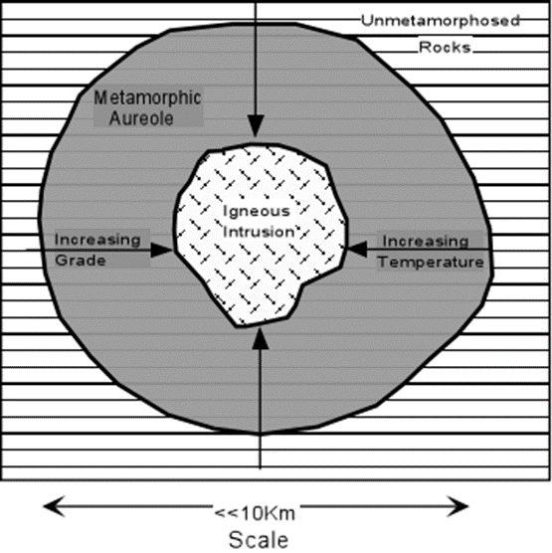

Slide 5
Regional metamorphism occurs over large areas and generally does not show any relationship to igneous bodies. Most regional metamorphism is accompanied by deformation under non-hydrostatic or differential stress conditions. Thus, regional metamorphism usually results in forming metamorphic rocks that are strongly foliated, such as slates, schists, and gniesses. The differential stress usually results from tectonic forces that produce compressional stresses in the rocks, such as when two continental masses collide. Thus, regionally metamorphosed rocks occur in the cores of fold/thrust mountain belts or in eroded mountain ranges. Compressive stresses result in folding of rock and thickening of the crust, which tends to push rocks to deeper levels where they are subjected to higher temperatures and pressures.
Cataclastic metamorphism occurs as a result of mechanical deformation, like when two bodies of rock slide past one another along a fault zone. Heat is generated by the friction of sliding along such a shear zone, and the rocks tend to be mechanically deformed, being crushed and pulverized, due to the shearing. Cataclastic metamorphism is not very common and is restricted to a narrow zone along which the shearing occurred.
Hydrothermal Metamorphism Rocks that are altered at high temperatures and moderate pressures by hydrothermal fluids are hydrothermally metamorphosed. This is common in basaltic rocks that generally lack hydrous minerals. The hydrothermal metamorphism results in alteration to such Mg-Fe rich hydrous minerals as talc, chlorite, serpentine, actinolite, tremolite, zeolites, and clay minerals. Rich ore deposits are often formed as a result of hydrothermal metamorphism.

Slide 6
Burial Metamorphism When sedimentary rocks are buried to depths of several kilometers, temperatures greater than 300ºC may develop in the absence of differential stress. New minerals grow, but the rock does not appear to be metamorphosed. The main minerals produced are often the Zeolites. Burial metamorphism overlaps, to some extent, with diagenesis, and grades into regional metamorphism as temperature and pressure increase.
Shock Metamorphism (Impact Metamorphism) When an extraterrestrial body, such as a meteorite or comet impacts with the Earth or if there is a very large volcanic explosion, ultrahigh pressures can be generated in the impacted rock. These ultrahigh pressures can produce minerals that are only stable at very high pressure, such as the SiO₂ polymorphs coesite and stishovite. In addition they can produce textures known as shock lamellae in mineral grains, and such textures as shatter cones in the impacted rock.

Slide 7
Grade of Metamorphism
As the temperature and/or pressure increases on a body of rock we say the rock undergoes prograde metamorphism or that the grade of metamorphism increases. Metamorphic grade is a general term for describing the relative temperature and pressure conditions under which metamorphic rocks form.
Low-grade metamorphism takes place at temperatures between about 200 to 320ºC, and relatively low pressure. Low grade metamorphic rocks are generally characterized by an abundance of hydrous minerals. With increasing grade of metamorphism, the hydrous minerals begin to react with other minerals and/or break down to less hydrous minerals
High-grade metamorphism takes place at temperatures greater than 320ºC and relatively high pressure. As grade of metamorphism increases, hydrous minerals become less hydrous, by losing H₂O, and non-hydrous minerals become more common.

Slide 8
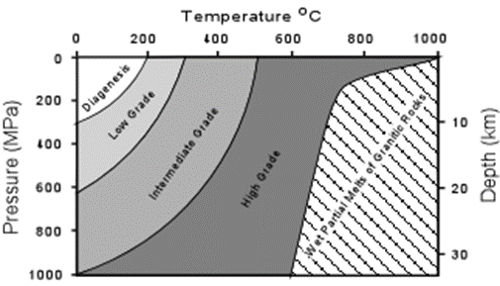

Slide 9
Classification of Metamorphic Rocks
Classification of metamorphic rocks is based on mineral assemblage, texture, protolith, and bulk chemical composition of the rock. Each of these will be discussed in turn, then we will summarize how metamorphic rocks are classified.
Texture In metamorphic rocks individual minerals may or may not be bounded by crystal faces. Those that are bounded by their own crystal faces are termed idioblastic. Those that show none of their own crystal faces are termed xenoblastic. From examination of metamorphic rocks, it has been found that metamorphic minerals can be listed in a generalized sequence, known as the crystalloblastic series, listing minerals in order of their tendency to be idioblastic. In the series, each mineral tends to develop idioblastic surfaces against any mineral that occurs lower in the series. This series is listed below:
rutile, sphene, magnetite
tourmaline kyanite, staurolite, garnet, andalusite
epidote, zoisite, lawsonite, forsterite
pyroxenes, amphiboles, wollastonite
micas, chlorites, talc, stilpnomelane, prehnite
dolomite, calcite
scapolite, cordierite, feldspars
quartz

