Slide 1
Pinacol Pinacolone Rearrangement
Ayesha Shamim
Pharm. D
M.phil

Slide 2
Contents
Definition
General Reaction
Introduction
Mechanism
Application

Slide 3
Carbocation Rearrangement
Pinacol-pinacolone rearrangement
Wagner-Merrwein Rearrangement
Wolf Rearrangement
Hoffman Rearrangement
Beckmann Rearrangement

Slide 4
Pinacol Pinacolone rearrangement
The pinacol rearrangement is the acid-catalyzed dehydration of glycols, which converts the glycol into an aldehyde or a ketone.

Slide 5
Pinacol Pinacolone rearrangement
Pinacol Pinacolone rearrangement is a very important process in organic chemistry for the conversion of 1,2 diols into carbonyl compounds containing a carbon oxygen double bond. This is done via a 1,2-migration which takes place under acyl conditions.

Slide 6
General Reaction

Slide 7
Pinacol Pinacolone Rearrangement Process
The pinacol pinacolone rearrangement process takes place via a 1,2-rearrangement. This rearrangement involves the shift of two adjacent atoms. This reaction is a result of the work of the German chemist William Rudolph Fittig who first described it in the year 1860.

Slide 8
Pinacol and Pinacolone
Pinacol is a compound which has two hydroxyl groups, each attached to a vicinal carbon atom. It is a solid organic compound which is white in colour.
The IUPAC name of Pinacolone is 3,3-dimethyl-2-butanone. Pinacolone is a very important ketone. It has a peppermint like or camphor like odour and appears to be a colorless liquid.

Slide 9
Pinacol Pinacolone Reaction
The pinacol pinacolone rearrangement proceeds through the formation of an intermediate which is positively charged. The methyl group in this intermediate proceeds to migrate from one carbon to another. This reaction can be given by

Slide 11
Mechanism
The Pinacol Pinacolone rearrangement mechanism proceeds via four steps. Each of these steps are explained below.
Step 1 Protonation of a hydroxyl group
Step 2 Loss of water
Step 3 Methyl migration
Step 4 Deprotonation

Slide 12
Step 1:
Since the reaction is carried out in an acidic medium, the hydroxide group of the pinacol is protonated by the acid.
Step 2:
Water is now removed from the compound, leaving behind a carbocation. This carbocation is tertiary and therefore stable.

Slide 13
Step 3:
The methyl group shifts to the positively charged carbon in a rearrangement of the compound.
Step 4:
The oxygen atom which is doubly bonded to the carbon is now deprotonated, giving rise to the required pinacolone.

Slide 14
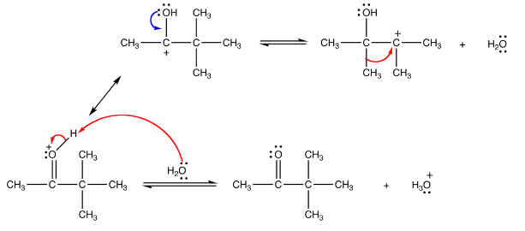
Notes:
1, 2 shift takes place in carbonium ion which is already a tertiary carbonium ion♦ It is probably due to stabilization of rearranged ion that can be affected by delocalization involving the electron pair on the oxygen atom, and ready loss of proton from the oxygen to produce a stable end product

Slide 15
Thus, the required Pinacolone product is generated. It is important to note that this rearrangement is regioselective in nature. The rearrangement of the more stable carbocation yields the major product.
Notes:
Regioselective: Any process that favors bond formation at a particular atom over other possible atoms. The description of a reaction's regioselectivity (or the absence of regioselectivity) is called the reaction's regiochemistry.

Slide 16
Uses of Pinacolone
The uses of the pinacolone product produced from the pinacol pinacolone rearrangement include:
Used in Pesticides, Fungicides, and Herbicides.
Used to prepare the cyanoguanidine drug – pinacidil.
Used in Stiripentol, which is used to treat epilepsy.
Used to produce triadimefon which is used to control fungal diseases in agriculture.
The primary applications pinacolone are in the drug industry.
Notes:
Pinacidil is a cyanoguanidine drug that acts by opening ATP-sensitive potassium channels, leading to peripheral vasodilatation of arterioles and decreasing peripheral vascular resistance. The above processes result in reduced blood pressure. This drug has been discontinued by the FDA.

