Slide 1
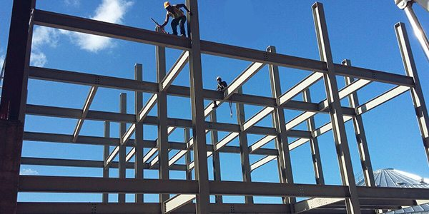
COLLEGE OF ENGINEERING AND TECHNOLOGY UNIVERSITY OF SARGODHA STEEL STRUCTURES (CT-313) (B.S TECHNOLOGY)
LECTURE-10, 11 & 12
TENSION MEMBERS
Engineer Aqeel Ahmed
Lecturer, CET, UOS, Sargodha
06-Nov-2020

Slide 2
TENSION MEMBERS
Tension members are structural elements that are subjected to axial tensile forces. They are used in various types of structures and include truss members, bracing for buildings and bridges, cables in suspended roof systems and cables in suspension and cable-stayed bridges.
Any cross-sectional configuration may be used because of any given material, the only determinant of the strength of tension member is the cross-sectional area. Circular rods and rolled angle shapes are frequently used.
The most common built-up configuration is probably the double-angle section as shown in figure 3.1, along with other typical cross-sections.
Tables of properties of various combinations of angles are included in the AISC Steel Construction Manual because of widespread use of the section.

Slide 3
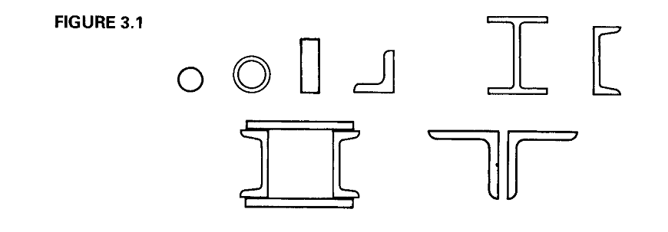

Slide 4
TENSION MEMBERS………..
The stress in an axially loaded member is given by
P = Magnitude of load
A= Cross-sectional area (area normal to the load)
The Stress as given by this equation is exact provided that the cross-section under consideration is not adjacent to the point of application of the load, where the distribution of stress is not uniform.
if the cross-sectional area of a tension member varies along its length, the stress is a function of the particular section under consideration.

Slide 5
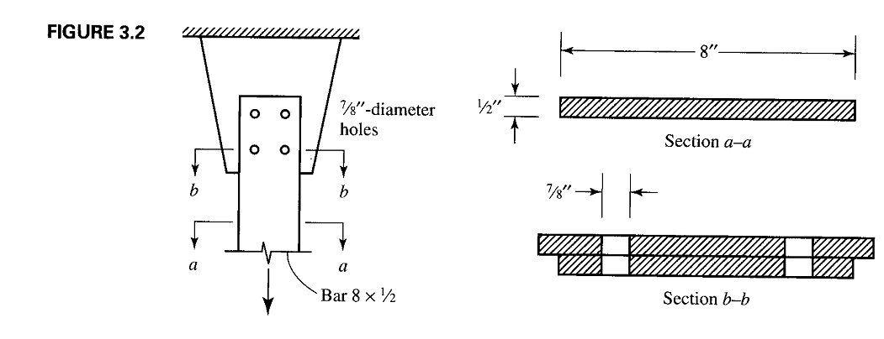

Slide 6
The presence of holes in a member will influence the stress at a cross section through the hole or holes. At these locations, cross-sectional area will be reduced by an amount equal to the area removed by the holes.
Tension members are frequently connected at their ends with bolts as illustrated in Figure-3.2.
The tension member shown, a ½ X 8 plate is connected to a gusset plate, which is a connection element whose purpose is to transfer the load from the member to a support or to another member.
The area of the bar at section a-a is (1/2) X (8) = 4 in² , but the area at the section b-b is only 4 - 2 X (1/2) X (7/8) = 3.13 in² and will be more highly stressed.
This reduced area is referred to as net area or net section and the unreduced area is known as gross area. The typical design problem is to select a member with sufficient cross-sectional area to resist the loads.
In general analysis is a direct procedure, but design is an iterative process and may require some trial and error.

Slide 7
TENSILE STRENGTH
A Tension member can fail by reaching one of two limit states: excessive deformation or fracture.
To prevent excessive deformation, initiated by yielding, the load on the gross section must be small enough that the stress on the gross section is less than the yield stress Fy.
To prevent fracture, the stress on the net section must be less than the tensile strength Fu.
In each case, the stress P/A must be less than a limiting stress F or
$\frac{ P}{A}<F$
Thus the load must be less than FA, or
P < F A

Slide 8
TENSILE STRENGTH……….
The nominal strength in yielding is
The nominal strength in fracture is
Where A_{e} is the effective net area, which may be equal to either net area or in some cases, a smaller area. We will discuss the effective net area later on stage.
Although yielding will first occur on the net cross section, the deformation within the length of the connection will generally be smaller than the deformation in the remainder of the tension member.

Slide 9
TENSILE STRENGTH……….
The reason is that net section exists over a relatively small length of the member and the total elongation is a product of the length and the strain (a function of stress).
Most of member will have an unreduced cross section, so attainment of the yield stress on the gross area will result in larger total elongation. It is this larger deformation, not the first yield, that is the limit state.
Two design philosophies will be used to analyze and design the structural components.
(I) LRFD
(II) ASD

Slide 11
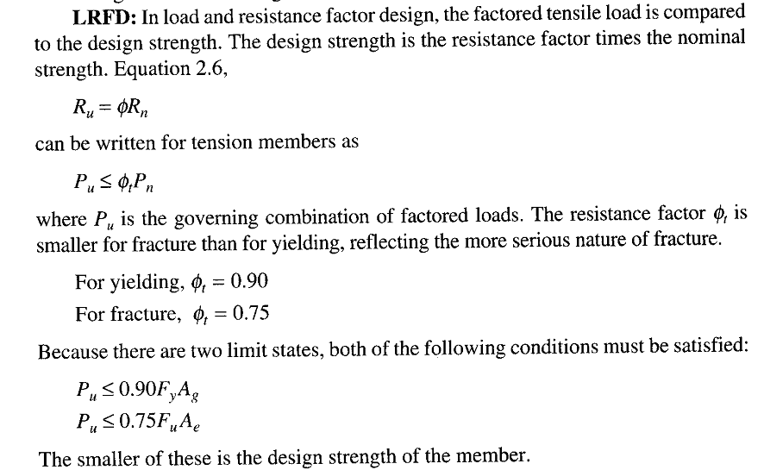
LRFD

Slide 13
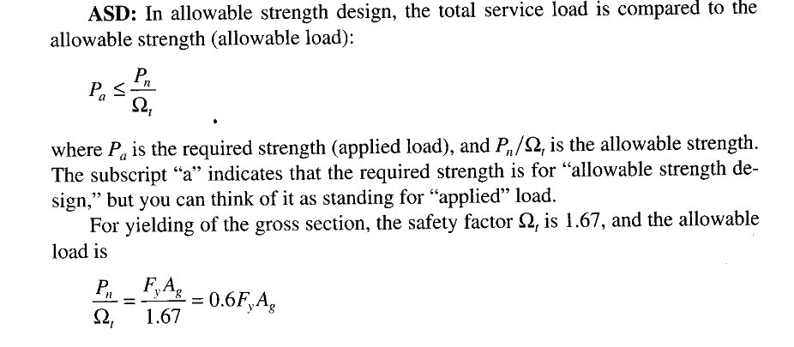
ASD

Slide 14
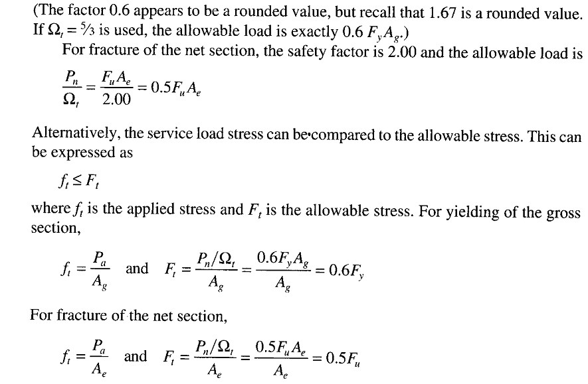
ASD……..

Slide 15
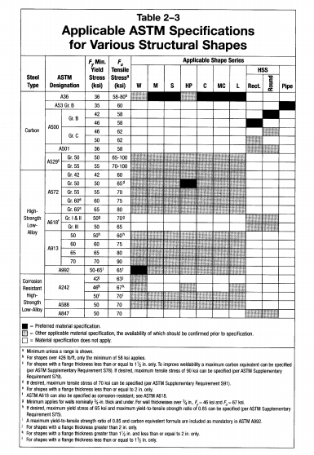

Slide 16
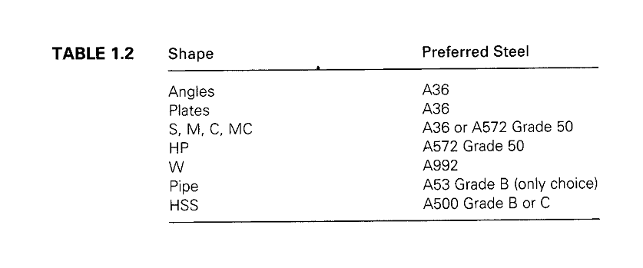

Slide 17
HOW TO FIND VALUES OF Fy AND Fu FOR DIFEERENT GRADES
You can find values Fy and Fu for various structural steels in Table 2-3 in the manual. All of the steels that are available for various hot-rolled shapes are indicated by shaded areas.
The black areas correspond to preferred materials and the gray areas represent other steels that are available.
Under the W heading we see that A992 is the preferred material for W shapes, but other materials are available usually at a higher cost.
For some steels, there is more than one grade with each grade having different values of Fy and Fu.
In these cases, the grade must be specified along with the ASTM designation- for example, A572 grade 50.
For A242, steel, Fy and Fu depend on the thickness of the flange of the cross-sectional shape.

Slide 18
This relationship is given in the footnotes in the table.
For example to determine the properties of a W33 X 221 of ASTM A242 steel, first refer to the dimensions and properties table in part 1 of the manual and determine that the flange thickness tf is equal to 1.28 inches.
This matches the thickness range indicated in footnote 1; therefore Fy = 50 Ksi and Fu = 70 Ksi.
Values of Fy and Fu for plates and bars are given Table 2-4.
Information on structural fasteners including bolts and rods can be found in Table 2-5.

Slide 19
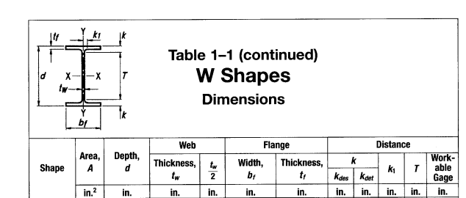

Slide 20
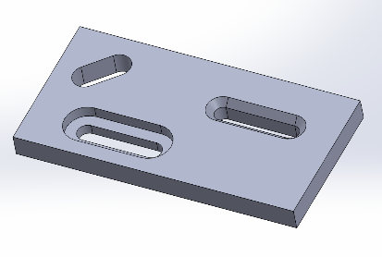
AREA TO BE DEDUCTED FOR OPENINGS
All three, slot, groove and hole, refer to the opening of an object. The difference among the three is:
1. Slot : rectangular shaped but edges are circular in nature
2. Groove : is also rectangular in nature and the edges are also straight
3. Hole: is circular in nature

Slide 21
AREA TO BE DEDUCTED FOR OPENINGS
The exact amount of area to be deducted from gross area to account for the presence of bolts holes depends on the fabrication procedure.
The usual practice is to drill or punch standard holes (i.e. not oversized) with a diameter 1/16 inch larger than the fastener diameter.
To account for possible roughness around the edges of the hole, Section D3 of the AISC specification requires the addition of 1/16 inch to the actual hole diameter.
This amounts to using an effective hole diameter 1/8 inch larger than the fastener diameter.
In the case of slotted holes, 1/16 should be added to the actual width of the hole.
One can find details related to standard, oversized and slotted holes in AISC J3.2, “Size and Use of Holes” (Chapter J, “Design of Connections”)

Slide 22
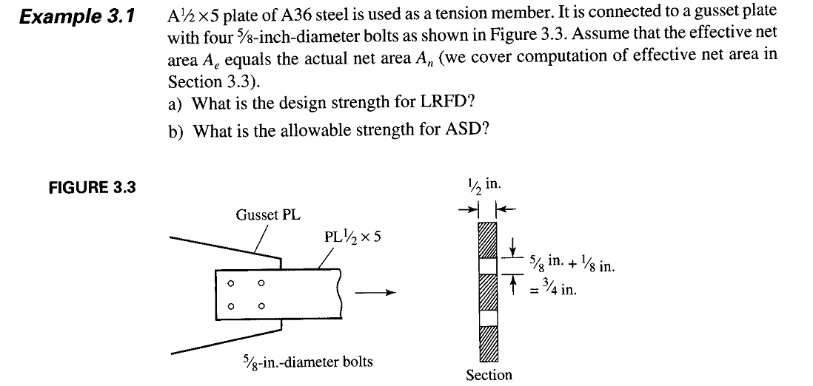

Slide 23
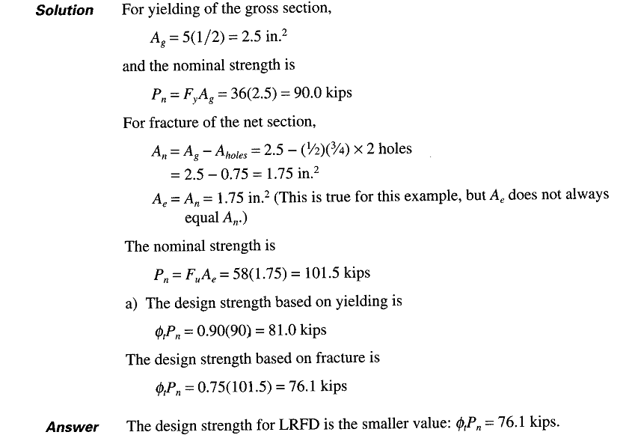

Slide 24
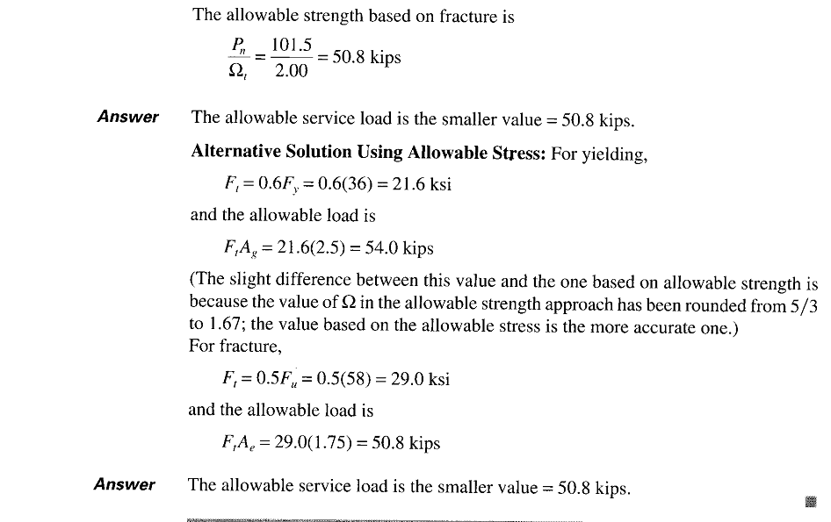

Slide 25
The effect of stress concentration at holes appears to have been overlooked.
In reality, stresses at holes can be high as three times the average stress on the net section and at fillets of rolled shapes, they can be more than twice the average (McGuire, 1968).
Because of the ductile nature of Structural Steel, the usual design practice is to neglect such localized stresses.
After yielding begins at a point of stress concentration, additional stress is transferred to adjacent areas of the cross section.
This stress redistribution is responsible for the “forgiving” nature of structural steel.
Its ductility permits the initially yielded zone to deform without fracture as the stress on the remainder of the cross section continues to increase.
Under certain conditions, however steel may loose its ductility and stress concentration can precipitate brittle fracture, these situations include Fatigue loading and extremely low temperature.

Slide 27
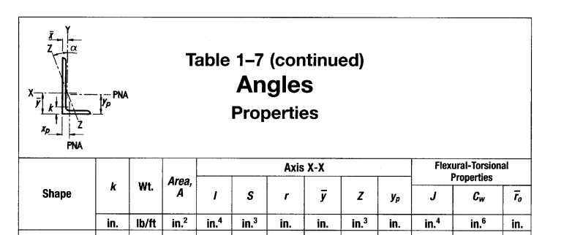

Slide 28
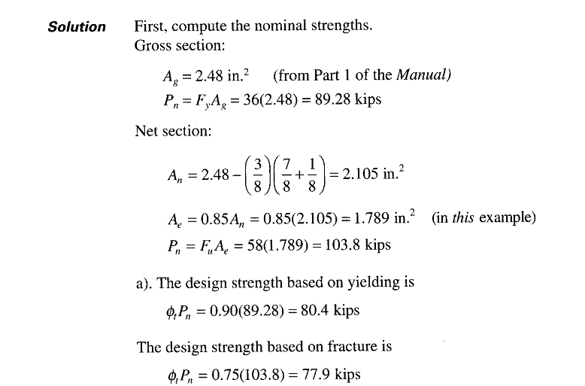

Slide 29
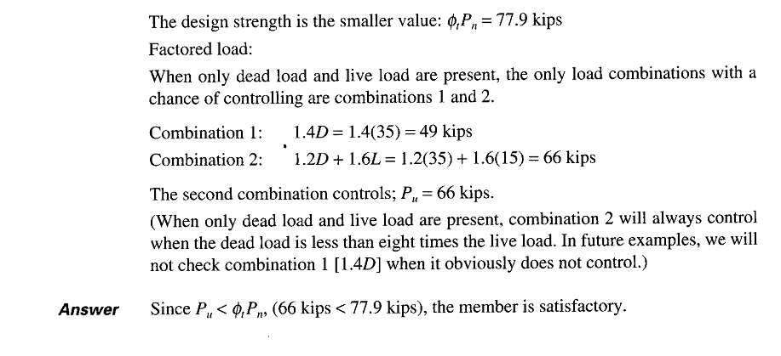

Slide 30
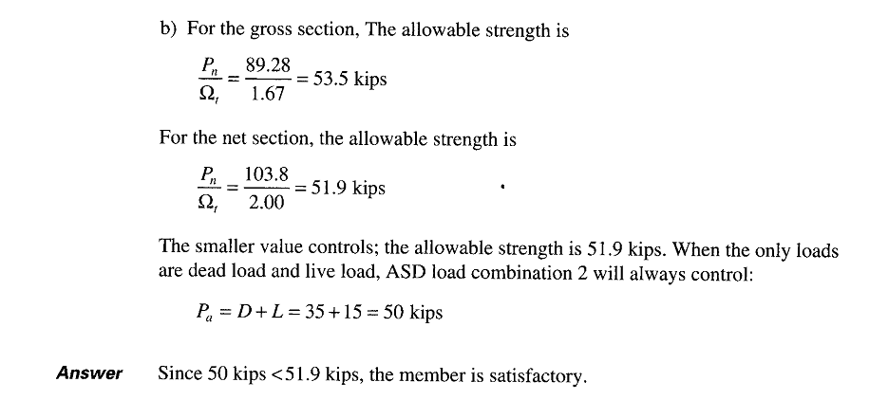

Slide 31
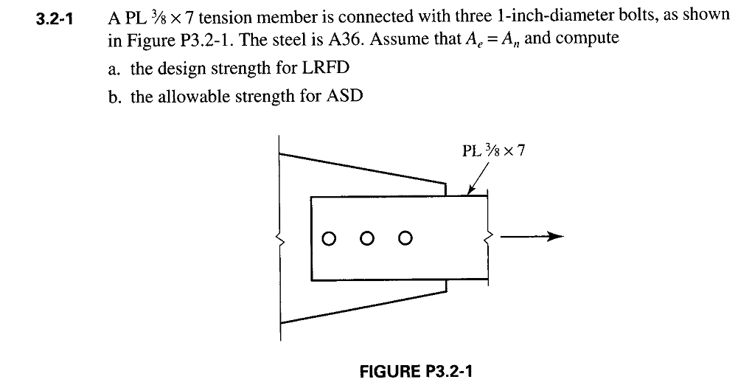

Slide 32
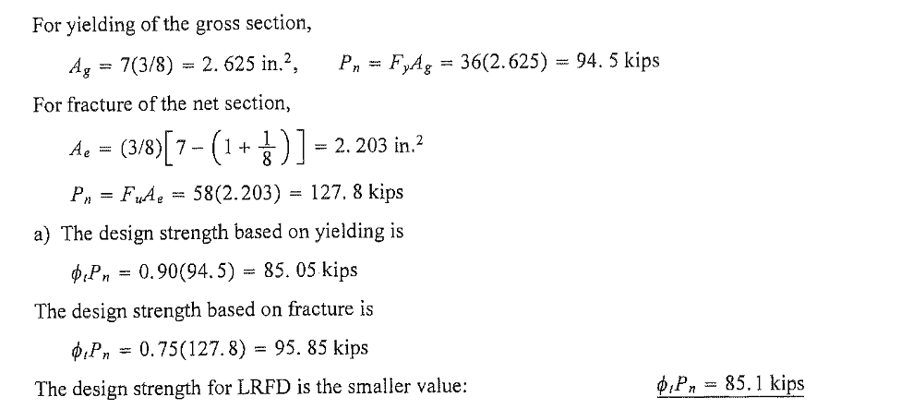

Slide 33
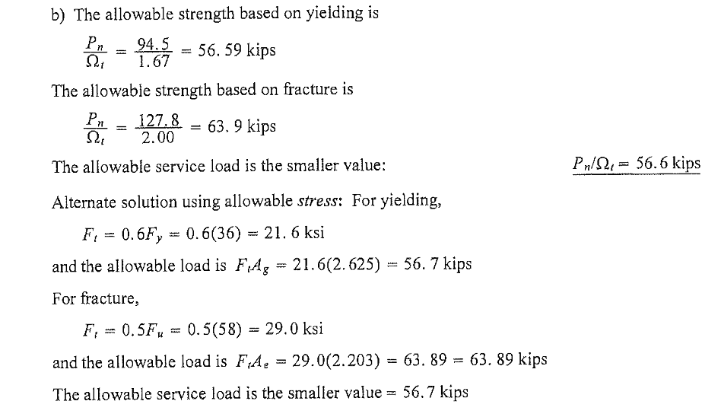

Slide 34
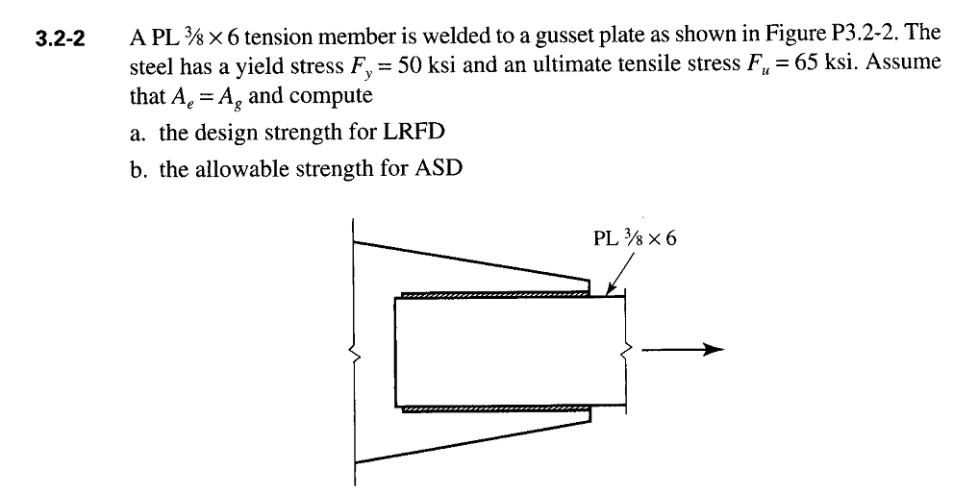

Slide 35
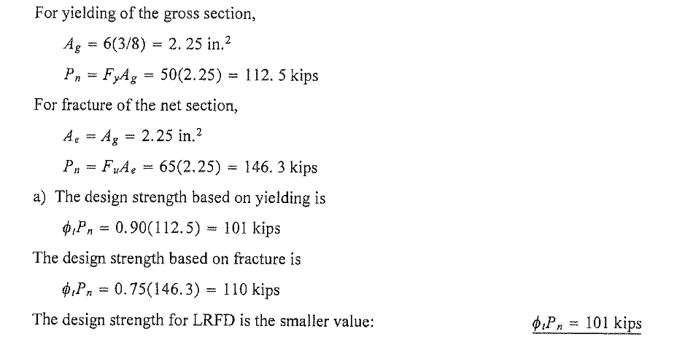

Slide 36
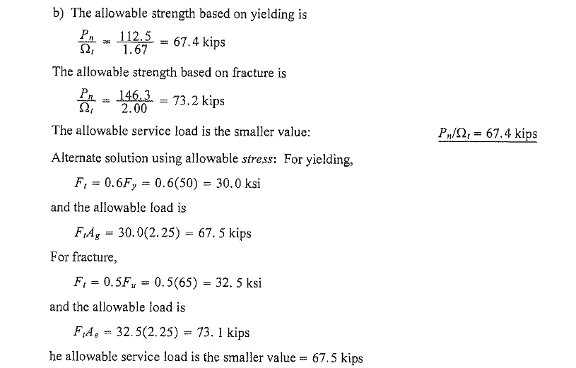

Slide 37
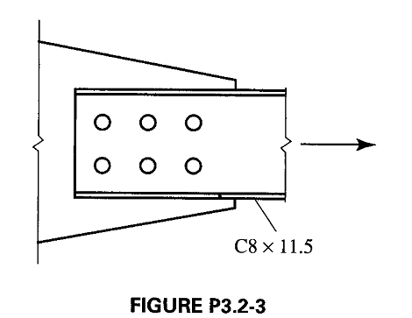

Slide 38
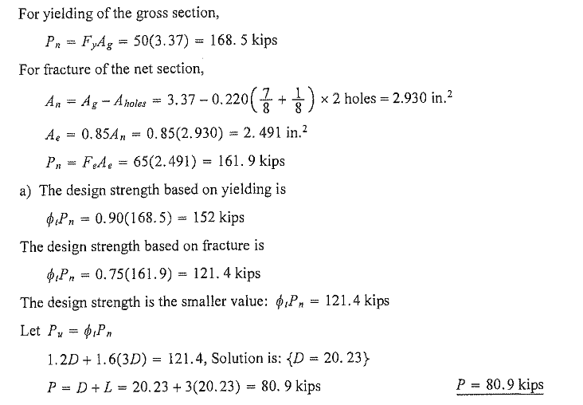

Slide 39
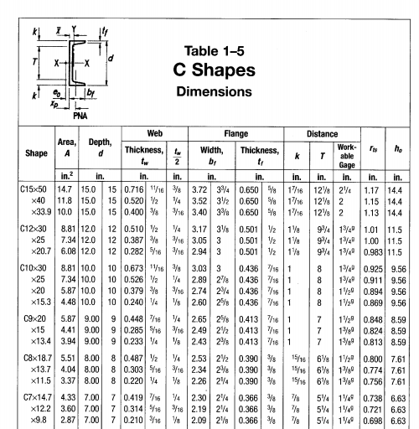

Slide 40
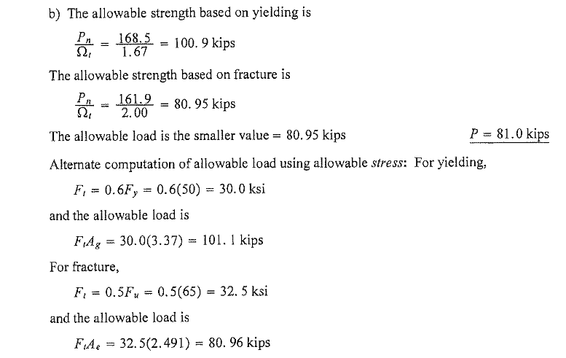

Slide 41
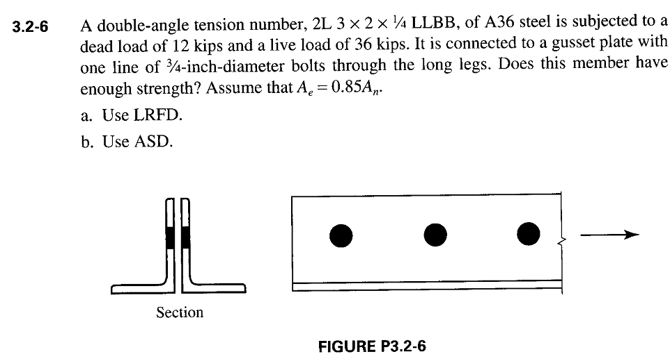

Slide 42
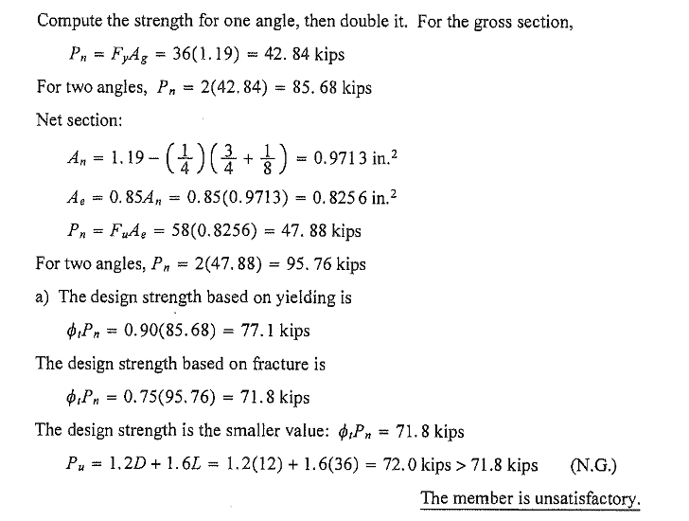

Slide 43
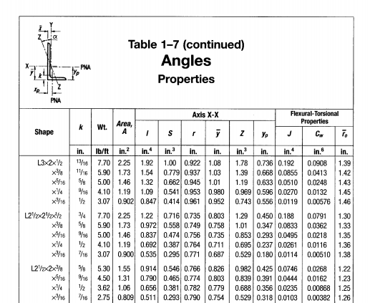

Slide 44
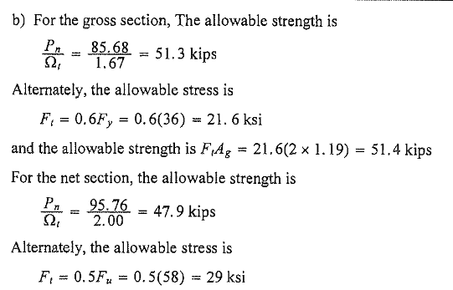

Slide 45
WHAT IS THE DIFFERENCE IN COMPUTATIONAL EFFORT FOR THE TWO DIFFERENT APPROACHES?
Regardless of the method used, the two nominal strengths must be computed (If a stress approach is used with ASD, an equivalent computation must be made).
With LRFD, the nominal strengths are multiplied by resistance factors.
With ASD, the nominal strengths are divided by load factors. Up to this, the number of steps is the same.
The difference in effort between the two methods involves the load side of the relationships.
In LRFD, the loads are factored before adding.
In ASD, in most cases the loads are simply added.
Therefore, for tension members LRFD requires slightly more computation.

