Slide 1
Uncle Mushtaq kee story!!

Slide 2
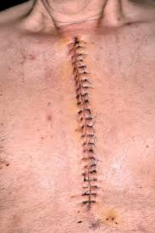

Slide 3
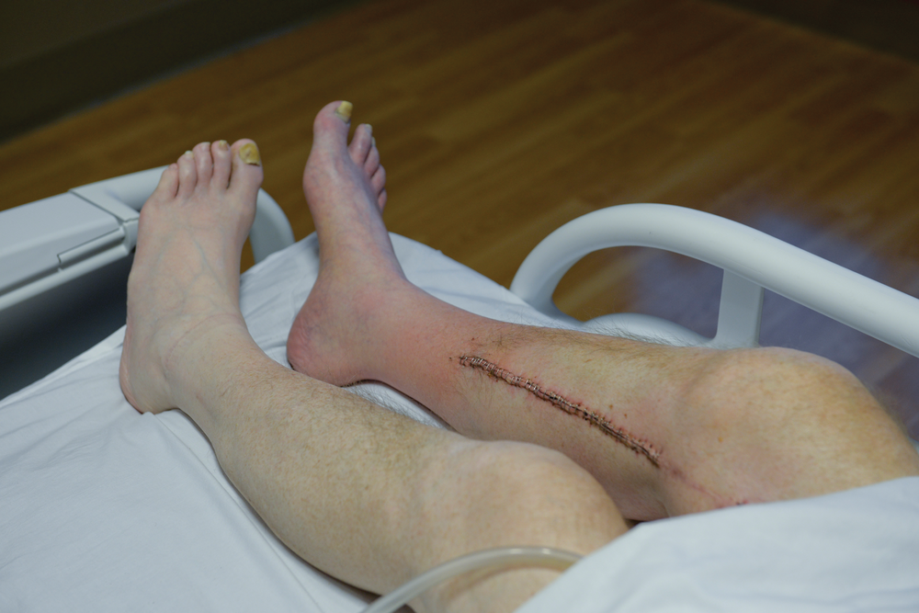

Slide 4
Acute Limb Ischemia
Dr Ahmad Hassan Khan

Slide 5
Introduction
Acute disruption of blood supply to an organ or extremity.
There is sudden decrease in limb perfusion which cause a potential threat to limb viability.
The effect of sudden arterial occlusion depends on state of collateral blood supply

Slide 6
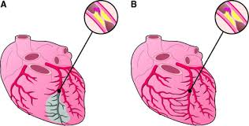

Slide 24
Investigations
A surgical emergency, usually diagnosis is clear from history and examination

Slide 40
Acute thrombotic occlusion
Doppler scan
Angiography

Slide 41
Treatment options
Intra-arterial thrombolysis(TPA)
Angioplasty
Bypass

Slide 42
Traumatic occlusion
Operate in emergency and manage accordingly
Repair the divided vessel
Put some kind of graft

Slide 43
Complication
Myoglobin, potassium and lactic acid will be absorbed in blood.
Can go in ARF
Compartment syndrome
Ischemia causes increase in interstitial fluid increase

Slide 44
Thank you

