Slide 1
Lesson 4 (Firearm Injuries)
By Dr Nadir Ali

Slide 2
Types of Firearm Entry wound
1. Contact wound
a) Tight contact
b) Loose contact
2. Close range/Near Distant wound
Upto 2 yards
3. Distant Firearm wound
Beyond 2 yards

Slide 3
Near contact or contact range
Mechanism
Gases with huge pressure pass from the muzzle end into the tissues, greatly distending them.
If no hard structure like bone under the skin, gases easily get dispersed into the tissues.
If there is a hard structure under the skin e.g. skull, it resists the entry of gases which return with extreme force of blowback phenomenon.

Slide 4
Gases Effects.
When the accumulated gases return back (blowback phenomenon), they cause
Gross splitting/Tearing of skin. Wound may be of stellate shape
Everson of wound edges.
Muzzle end imprint abrasion
Pressure extrusion. Tissues, blood, fat etc can extrude out of the wound along with gases

Slide 7
Close Range Firearm Entry wound
Examination of clothes is important
Burning, blackening, tattooing present
Collar of abrasion present
Grease collar / Dirt collar may be present
Margins may be inverted
Wad maybe present in the track in case of smooth bored firearm

Slide 10
Firearm Exit Wound
There may or may not be an exit wound
May be multiple exit wounds of one entry wound due to Secondary missiles
Exit wound is larger with everted margins.
No close range characteristics (gunpowder effects)
Shored exit wound:
In routine no collar of abrasion on exit wound, but when exit site is tightly pressed by any belt or wall etc. collar of abrasion is formed and this is called shored exit wound.

Slide 11
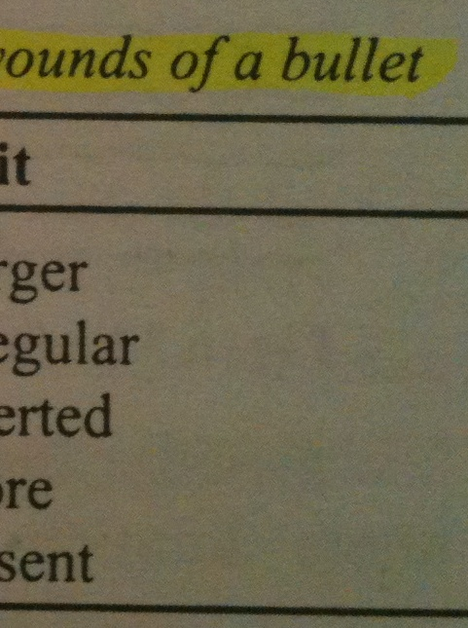

Slide 12
Beveling Phenomenon
It is found in in the bones with double tables.
As bone of skull is diploic (has 2 layers).
Table which is struck first by projectile is supported from below so has comparatively small circular hole & clean margins.
Table which is 2nd to be struck has no support so has a bigger irregular hole & beveled margins.
M/L importance
Gives direction of fire

Slide 14
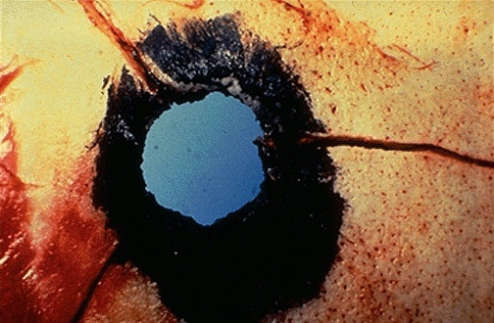
Beveled margins
Blackening in the track

Slide 15
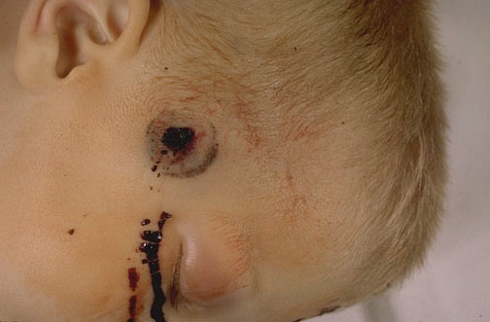
Muzzle end imprint Abrasion

Slide 16
Questions
1- What is cavitation?
2- Difference between temporary & permanent cavitation?
3- What is M/L importance of terminal ballistics?
4- What are the components of shot charge responsible for damage?
5- How much distance flame, smoke & unburnt gunpowder particles can travel?
6- Differentiate between tattooing & stippling??
7- What is M/L importance of tail wag phenomenon?

Slide 17
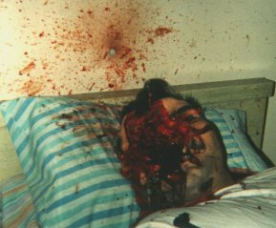
Plastic WAD struck with the wall

Slide 18
Questions
1- Classify firearm entry wounds?
2- Describe contact wound of a rifled firearm?
3- What is a stellate firearm wound?
4- Describe a close range rifled firearm wound?
5- What is significance of examination of clothes in a firearm wound?
6-Write down the differences between a firearm entry wound and exit wounds in a tabulated form.
7-What is beveling phenomenon.?
8-How you can find out the direction of a fire.

Slide 19
Shotgun Entrance Wound:
It depends upon
Degree of choke
Size & no. of pallets
Distance of fire. Mainly depends on distance.
Contact wound:
Enemas entry–size approximately to the bore of the gun.
Ragged tear of skin
Burning, blackening and tattooing in wound track
Wad present in wound also.

Slide 20
Shot gun wounds (contd…)
Contact shotgun wound are most destructive
Bursting rupture of head is rule rather than exception
Skull may be largely fragmented leading to Egg-shell fractures
Scalp is extensively lacerated

Slide 21
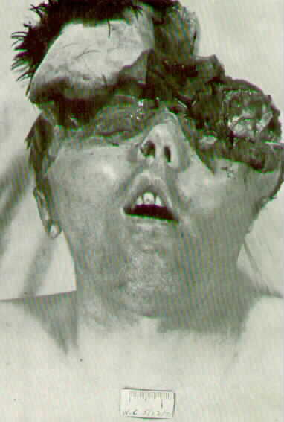
Contact Shotgun wound (Egg-Shell Fracture)

Slide 22
02) Short/close Range:
At one yard--Single hole
At 2 to 3 yards
A pattern showing one or central enmass entry with a few peripheral pallet holes around it.
Wad present up to 2 yards.
Burning/blackening may or may not be.
Tattooing may present.

Slide 23
03). Distant Range:
a. Central enmass entry absent.
b. Dispersion of pallets has the following relation to the distance.
“Diameter of the spread in inches will be equal to distance of fire in yards. (Roughly)”
c. Each hole is of the size of pallet.

Slide 25
Important:
“Billiard ball ricochet effect”
Normally the pallets exit from the muzzle end in a sequence (Fanning phenomenon)
But sometimes they strike together before or after the exit and they don’t follow the routine rules of travelling of a shot gun fire and scatter irregularly (Ricocheting Phenomenon).
It may misguide about the distance of fire.

Slide 26
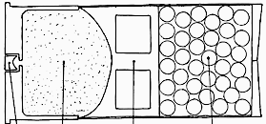
Shotgun Entry wound complex
Fanning
phenomenon

Slide 27
Billiards Ball Ricocheting Phenomenon
Misguides
distance of fire

