Slide 1
Abnormal gait

Slide 2
Abnormal Gait Syndromes
In general gait deviations fall under four headings:
Those caused by weakness
Those caused by abnormal joint position or range of motion
Those caused by muscle contracture
Those caused by pain

Slide 3
Abnormal Gait Types
Pain
Antalgic gait
Gonalgic gait
Podalgic gait
Leg length discrepancy
Short leg
Musculoskeletal
Trunk bending
Anterior trunk bending
Posterior trunk bending
Lateral trunk bending
Hyperlordosis

Slide 4
Abnormal Gait
Hip region Hip hiking Hip flexion contracture Psoatic weakness Vaulting Hip joint stiffness Toe in gait Toe out gait | Knee region Knee Flexion contracture Quadriceps weakness Knee joint stiffness Ankle region Toe walking Equinaus walking Flat foot Planterflexiors weakness

Slide 5
Abnormal Gait
Neurological abnormal gait
Cerebellar Ataxic
Sensory ataxic
Vestibular ataxic
Parkinson gait
Propulsive gait
Steppage gait
Scissors gait
Myopathic gait
Hemiplegic gait
Hysterical gait

Slide 6
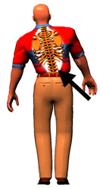
Abnormal Gait: Pain
Antalgic Gait: Painful hip
Gonalgic Gait: painful knee
Podalgic Gait: painful foot
Decrease single limb support period
(less time on bad leg)
Limp adopted
To avoid pain
Avoid weight-bearing
Very short stance phase

Slide 7
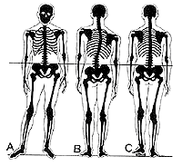
Short Leg Gait/ leg length discrepancy
True short leg
False Short leg
Pelvis raised
Foot supinated
Scoliosis
Below 1 inch no modification
Shoe modification

Slide 8
Trunk bending
Lateral trunk bending
Anterior trunk bending
Posterior trunk bending
Hyper lordosis gait

Slide 9
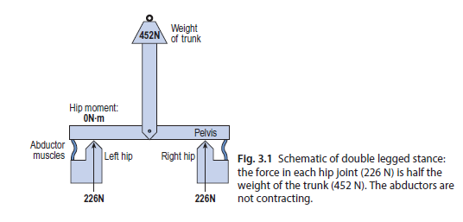
Lateral trunk bending

Slide 10
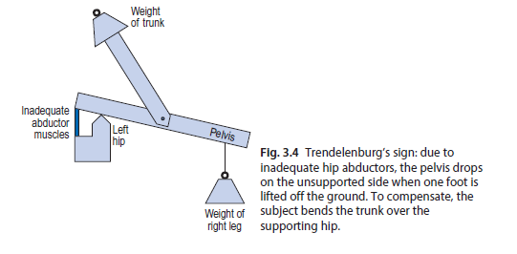
Trenlenberg’s sign

Slide 11
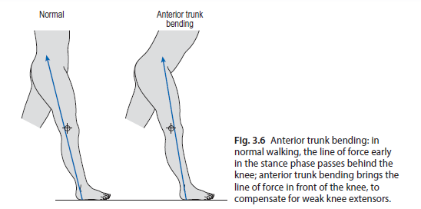
Anterior trunk bending

Slide 12
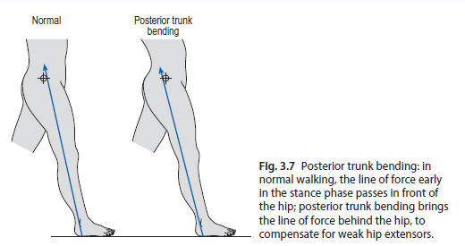
Posterior trunk bending

Slide 13
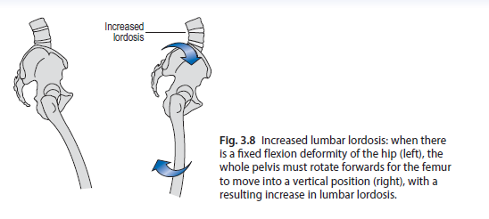
Increase lumbar lordosis

Slide 14
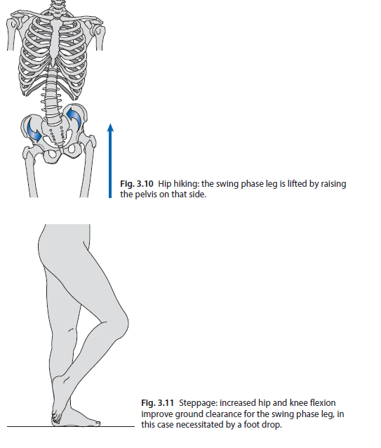
Hip Hiking

Slide 15
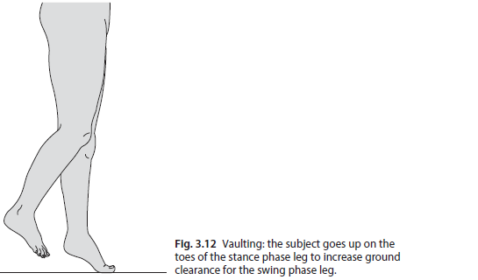
Vaulting

Slide 16
Hip region
Hip flexion contracture…….Increase lumbar lordosis
Psoatic weakness ….Pelvis raised
Hip joint stiffness

Slide 17
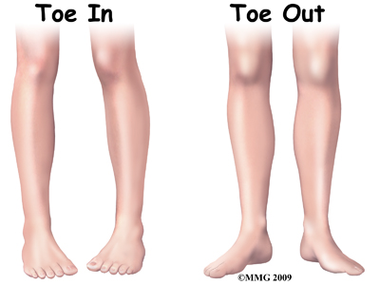
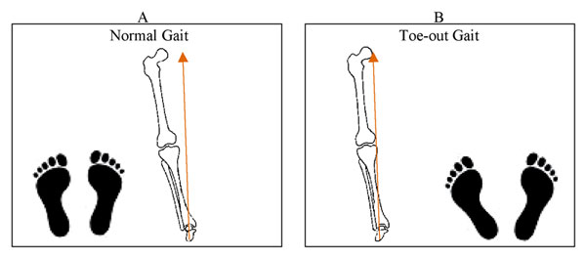
Toe in gait …..Internal Rotators
Toe out gait……External Rotators

Slide 18
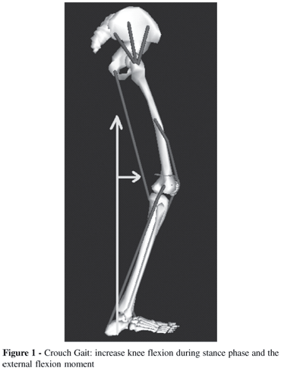
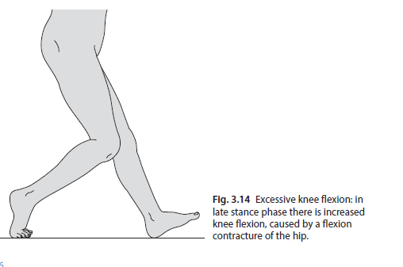
Excessive knee flexion or Crouched Gait
Hamstring spasticity
Excessive knee flexion
Knee buckles

Slide 19
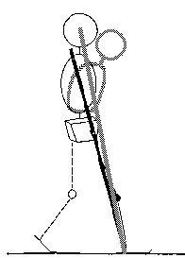
Knee region
Quadriceps weakness ……anterior trunk bending
Knee joint stiffness

Slide 20
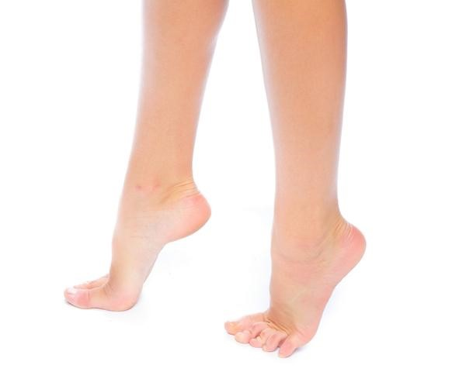
Ankle region
Toe walking…….Tight TA
Equinaus walking……Tight DF
Flat foot
Planterflexiors weakness …..lack of push

Slide 21
Abnormal Gait
Neurological abnormal gait
Sensory ataxic
Vestibular ataxic
Cerebellar Ataxic
Parkinson gait
Propulsive gait
Steppage gait
Scissors gait
Myopathic gait
Hemiplegic gait
Hysterical gait

Slide 22
Proprioceptive Loss: Sensory Ataxia
Wide, irregular, uneven steps
Unsteady, wide based gait
Throw feet forward and out and bring them down first on heels and then toes (double tapping sound)
Watch ground
Positive Romberg (cannot stand with feet together and eyes closed)
Friedrich ataxia

Slide 23
Vestibular system
Gait unsteadiness
Inability to walk down stairs independently
Decreased ocular fixation during motion leading to sense that world is “jiggling”
May be unable to drive, or need to stop walking to read a sign
“Vestibular Ataxia”
Vertigo or nystagmus with standing/walking

Slide 24
Balance Loss due to Cerebellar problems
Wide based
Unsteadiness
Irregularity of steps
Lateral veering
Motor ataxia
Eye open Romberg sign

Slide 25
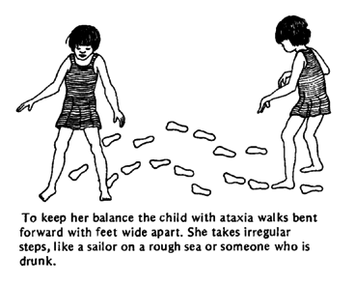
ATAXIC GAIT
An unsteady
Uncoordinated
Wide base
Feet thrown out

Slide 26
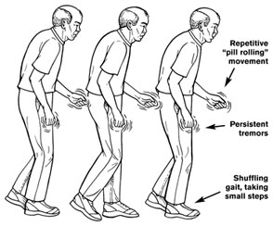
FESTINATING/PARKINSONIAN GAIT
Involuntarily moves
Short steps
Accelerating steps
Difficult to start
Difficult to stop

Slide 27
Parkinson Gait
Shuffling: small stepped gait without arm swing with high speed.
Festinating: short quick stepped gait with stooped posture due to displaced centre of gravity.
Freezing: sudden brief inability to move during mid stance.
Flat foot strike instead of heel strike

Slide 28
Propulsive Gait
Stiff neck and head
Excessive force to propel body
Upper trunk stiffness

Slide 29
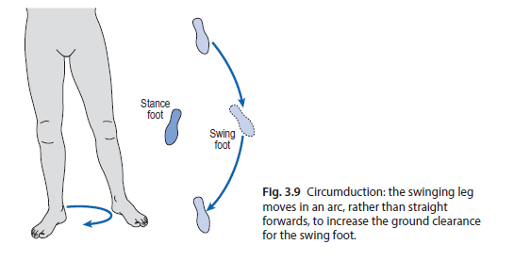
Steppage or foot drop

Slide 30
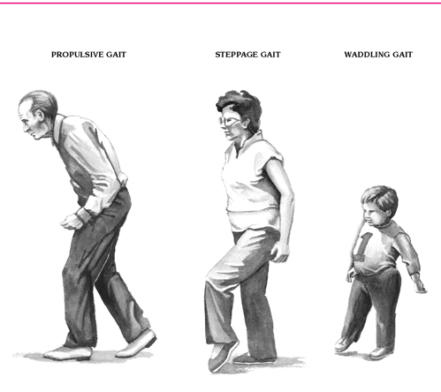
Steppage Gait
Foot drop
Leg is lifted high so
Toes can clear the ground
Foot slap at initial contact

Slide 31
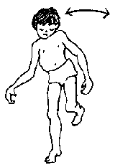
Abductor weakness Trenlenberg sign positive Pelvis drop opposite Trunk sway same Lurching Gait Wadding gait
Waddling gait or Myopathic Gait

Slide 32
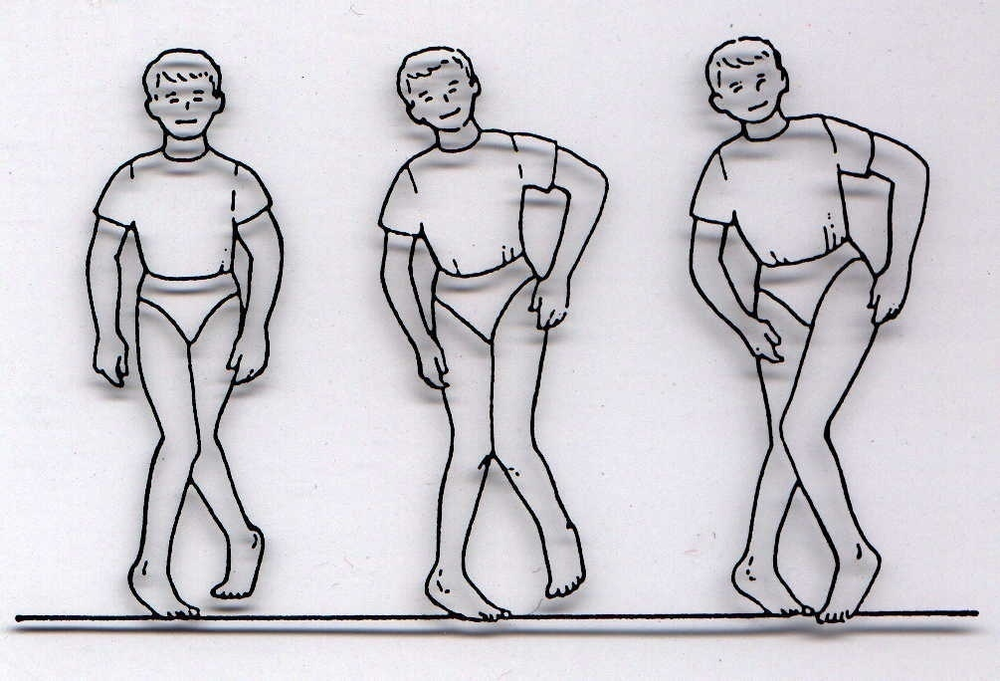
Scissor Gait
Legs cross midline
Adductors Spasticity
Toe walk
Planter flexor spastic
Spastic Cerebral palsy

Slide 33
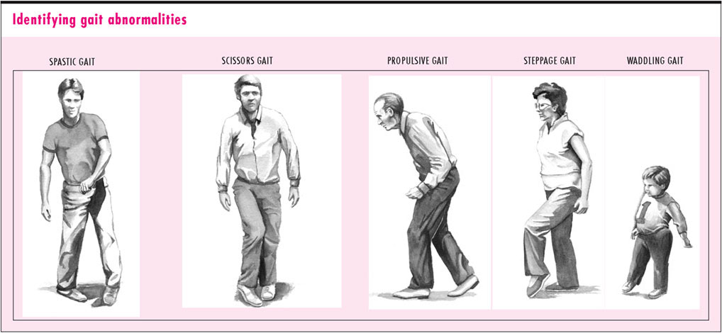

Slide 34
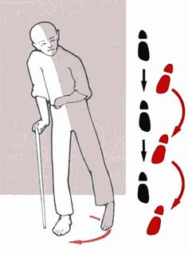
Hemiplegic Gait
Foot clearance
Hip flexor weakness
Pelvis retracted

Slide 35
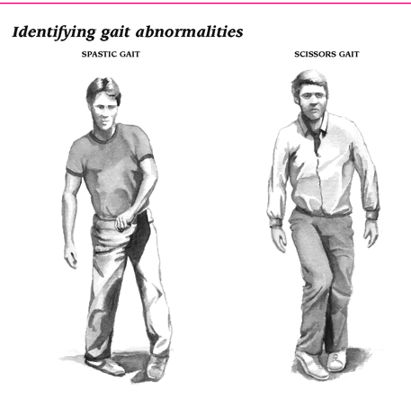

Slide 36
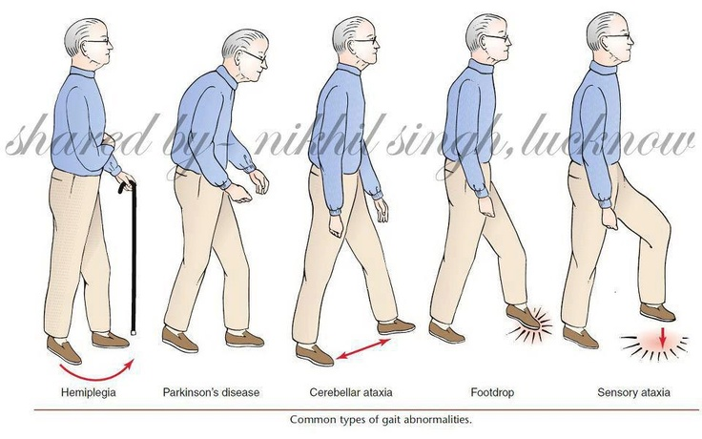

Slide 37
Hysterical Gait

Slide 38
HIP
Hip flexion excessive……Contracture
Limited HF……weakness …..Tight HE
HE limited…..HF contracture
External rotation…..Pelvis retracted
Hip hiking……Weak DF, Spastic extensor
Circumduction….weak HF

Slide 39
Deviations at Hip
Position | Deviation | Description | Possible cause
Heel strike to FF | Excessive flexion | More than 30 | Contracture
 | Limited HF | Less than 30 | Weakness of flexors
FF to MS | Limited HE | Not neutral | HF contracture
 | Internal rotation |  | Spastic
 | External rotation |  | Pelvis rotation
 | Abduction |  | Spastic
 | Adduction |  | Spastic
Swing | Circumduction | Semicircle | Weak HF
 | Hip hiking Excessive hip flexion | Quadus lamborum More than 30 | Extensor spastic Foot drop

Slide 40
Deviations at Knee
Position | Deviation | Description | Possible cause
Heel strike | Excessive KF | Buckles | Spastic flexors
Foot flat | Knee hyperextend | Hyperextend | Weak Quads, Spastic Quads
Mid stance | Knee hyperextend | Hyperextend | As above
Push off | Excessive KF | More than 40 | Flexor contracture (CVA)
 | Limited KF | Less than 40 | Spastic Quads
Swing
 | Excessive KF | More than 65 | Flexor withdrawl , Dysmetria
 | Limited KF | Less than 65 | Extensor spasticity , Circumduction

Slide 41
Deviation at Ankle
Position | Deviation | Description | Possible cause
Initial contact | Foot slap | Foot slap | Weak DF
 | Toes first | Tip toe | Spastic PF , Length
 | Foot flat | Entire foot | Weak DF, Neonatal
Mid stance | Excessive positional PF | Tibia does not advance move | Ecc.Weak PF or tight
 | Heel lift | Not with ground | Spastic PF
 | Excessive DF | Tibia more advance | Weak PF,KF or HF contracture
 | Toe clawing | Grab floor | Spastic flexor, grasp reflex
Push off | No roll off | Insufficient weight shift | Weakness of PF
Swing | Toe drag Varus | Insufficient DF Inverted | Weak DF Spastic invertors

Slide 42
Deviation of Trunk
Position | Deviation | Description | Possible cause
Stance | Trunk lateral lean | Trenlenberg gait | Weak Abd
 | Backward trunk lean | Hyperextension at hip | Weak GM
 | Forward trunk lean | Forward | Weak Quad

