Slide 12
Extraction process of Zinc
The important ore of Zinc is Zinc blende (ZnS). So it is extracted from zinc blende by carbon reduction process. The following are the steps involved for the extraction process of zinc.
a. Crushing and Pulverization:
The big lumps of ore is first crushed by a jaw crusher and powered in ball mills.

Slide 13
Concentration
The crushed and pulverized ore is concentrated by froth flotation process. This process is used for the concentration of sulphide ore. The powered ore is suspended in water and after adding pine one, it is stirred by passing the compressed air. The particles of the sulphide ore which are wetted by the oil comes to the surface along the froth (fizzy substance) which is taken out and the gangue particles remains at the bottom which are then removed.

Slide 14
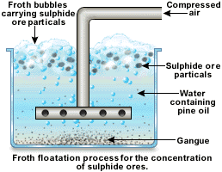

Slide 15
c. Roasting:
The concentrated ore is roasted in the excess of air at a temperature of 900 degree celsius in the reverbatory furnace. So the ore reacts with oxygen to form Zinc Sulphide (ZnS) and Sulphur dioxide (SO₂) which is given by the reaction below.
2ZnS+3O2−→−heat2ZnO+SO2

Slide 16
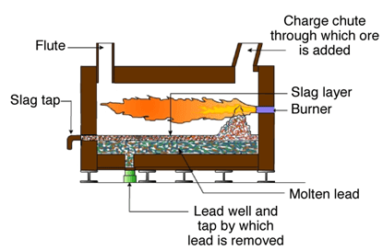

Slide 17
During this process, some ore of the ZnS is also converted into zinc sulphate.
ZnS+2O2⟶ZnSO4ZnS+2O2⟶ZnSO4
Above 900 degree celsius, this zinc sulphate decomposes to give Zinc Oxide.
ZnSO4−→−−−>900∘C2ZnO+SO2+O2ZnSO4→>900∘C2ZnO+SO2+O2
In this roasting process, the volatile impurities are also removed as their oxides.
C+O2⟶CO2C+O2⟶CO2
S+O2⟶SO2S+O2⟶SO2
S+O2⟶SO2S+O2⟶SO2
P4+5O2⟶2P2O5P4+5O2⟶2P2O5
2As+3O2⟶2As2O3

Slide 18
Reduction:
The roasted ore is mixed with coke and heated strongly so that the zinc and oxides get converted into Zinc. For reduction, either Belgian process or vertical retort process is used. But vertical retort is the modern and continuous method. Vertical retort Process

Slide 19
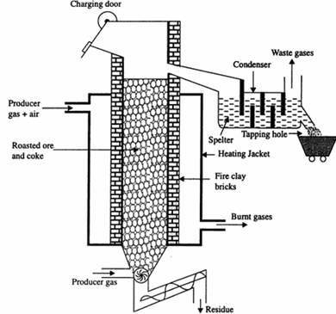

Slide 20
It is one of the most important, continuous and commercial technique for the reduction of zinc. Here, zinc ore is mixed with the coke in the ratio of 2:1. It is passed through the charging door. The retort is heated by the producer gas (CO + N2 ). Zinc vapour along with the carbon monoxide is led to the condenser by applying a suction and forcing producer gas from below. Following reaction takes place during reduction.
ZnO+C⟶Zn+CO
Molten Zinc is taken out from the condenser time to time. The crude metal obtained is called zinc spelter which contains about 3% of other impurities.

Slide 21
. Purification
The spelter zinc contains Fe, Pb, As, Sb, Cd as impurities. It is further purified by electrolysis process.
Electrolysis Process: Pure zinc is made anode and pure aluminium as cathode. Zinc sulphate solution is acidified by sulphuric acid is taken as electrolyte. When electricity is passed through the electrolytic solution, pure zinc gets deposited at cathode whereas impurities remain as anode mud. Following electrolytic reaction occurs here:
At anode: Zn–2e⟶Zn++Zn–2e⟶Zn++
At cathode: Zn+2e⟶Zn

Slide 22
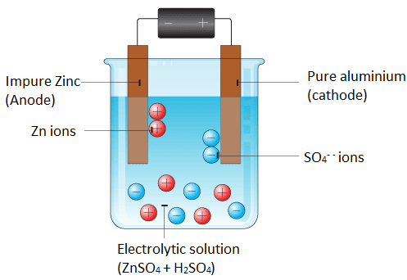

Slide 23
Copper Alloys
Copper and copper alloys offer a suite of infinitely recyclable materials providing many property combinations suited to a wide range of applications that facilitate and enhance our daily lives.
Copper’s performance can be expanded to suit many industrial applications by alloying: making a solid material out of two or more different metals. Good electrical and thermal conductivity, strength, ductility and excellent corrosion resistance are just some of the properties that copper and its alloys offer. Copper alloys are grouped into families, based on their composition.

Slide 24
Copper Alloys
There are more than 400 copper alloys, each with a unique combination of properties, to suit many applications, manufacturing processes and environments.
Pure copper has the best electrical and thermal conductivity of any commercial metal. Today, over half of the copper produced is used in electrical and electronic applications and this leads to a convenient classification of the types of copper into electrical (high conductivity) and non-electrical (engineering). Go to the Coppers section.
Copper forms alloys more freely than most metals and with a wide range of alloying elements to produce the following alloys:
Brass is the generic term for a range of copper-zinc alloys with differing combinations of properties, including strength, machinability, ductility, wear-resistance, hardness, colour, hygienic, electrical and thermal conductivity, and corrosion-resistance. Go to the Brasses section.
Bronze alloys are made from copper and tin, and were the first to be developed, about four thousand years ago. They were so important that they led to a period in time being named the Bronze Age. Go to the Bronzes section.

Slide 25
Copper Alloys
Gunmetals are alloys of copper with tin, zinc and lead and have been used for at least 2000 years due to their ease of casting and good strength and corrosion resistance. Go to the Gunmetals section.
Copper-nickel alloys have excellent resistance to marine corrosion, high thermal conductivity and low susceptibility to attachment of marine macro-oragnisms. The addition of nickel to copper improves strength and corrosion resistance, but good ductility is retained. Go to the Copper-nickels section.
Nickel silver alloys are made from copper, nickel and zinc, and can be regarded as special brasses. They have an attractive silvery appearance rather than the typical brassy colour. Go to the Nickel silvers section.
Beryllium-copper is the hardest and strongest of any copper alloy, in the fully heat treated and cold worked condition. It is similar in mechanical properties to many high strength alloy steels but, compared to steels, it has better corrosion resistance.

