Slide 2
Olives (Olea Europaea)

Slide 4
Contents
Botany of Olives
Origin of olives
Production of olives
Floral description
Nutritive value of Olive
Olive Projects in Pakistan
Breeding objectives
Quality Control
Processing of Olives
Olives in Pakistan
Uses

Slide 5
Olives:-
Olive trees can live for hundreds of years. This is the oldest and also religious tree in the world.
It is estimated that the tree was planted in the period 1350-1100BC!

Slide 6
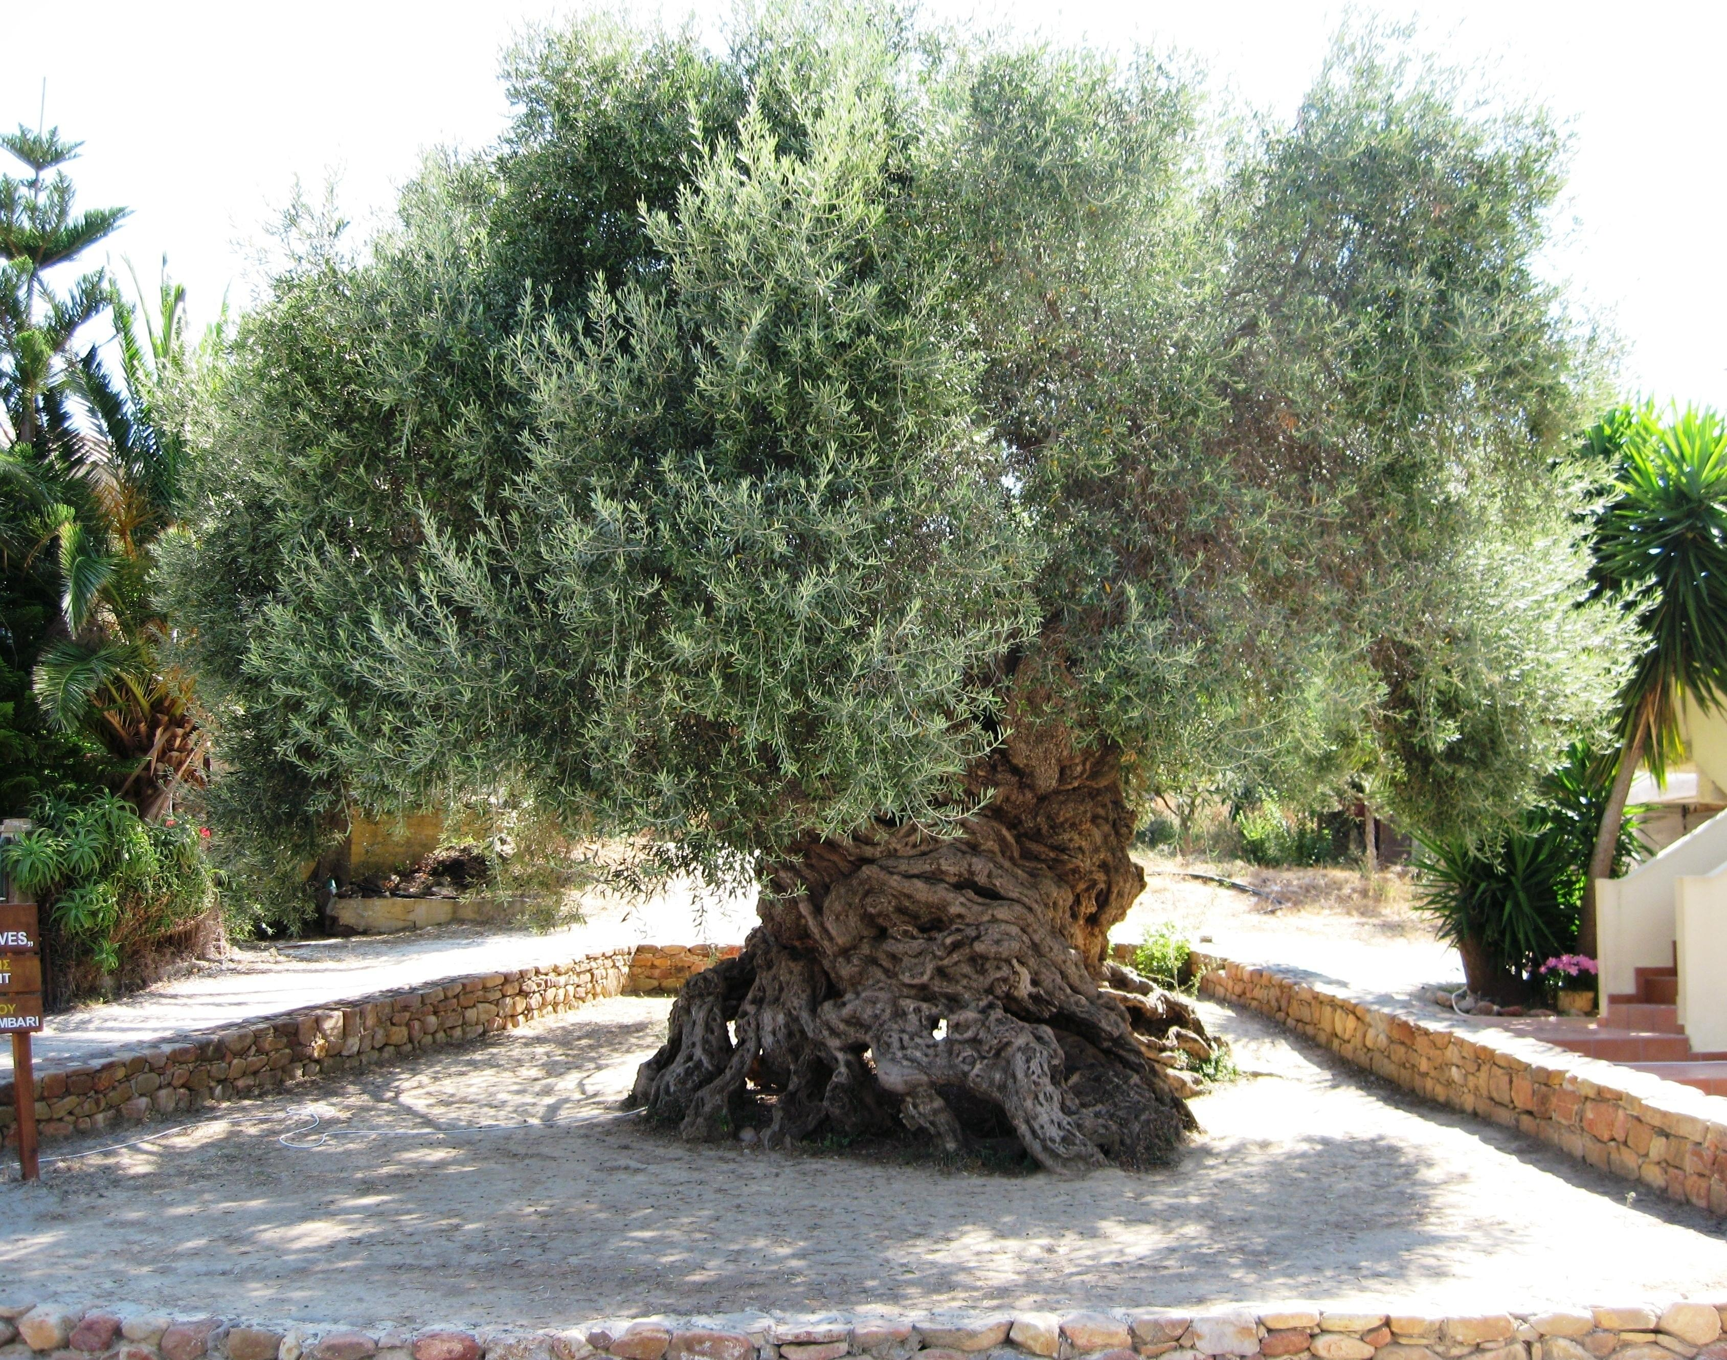

Slide 7
Olives:-
Family Oleaceae
Botanical name Olea Europaea
Common name Olive, Zaiton
Diploid species 2n = 46
Its age is ranging from 35 to 100 years but it can grow hundred to thousands of the years and also give good yield.

Slide 8
Origin:-
Found mainly in the mediterranean Basin like Spain, France, Italy, Greece, Turkey, Syria, Lebanon, Israel, Egypt, Morocco. It is one of the most oldest plant cultivated by man. Olive oil was considered a valuable product as early as in ancient time. But good quality olive oil is made in al over the world like Argentina, Australia, USA, Pakistan etc.

Slide 9
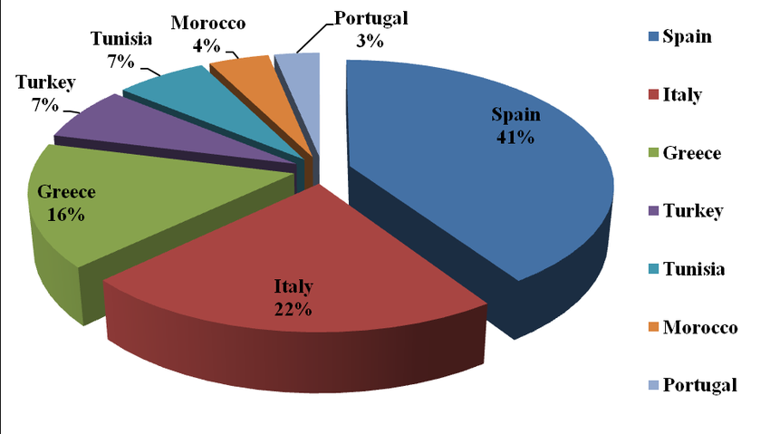
Olive oil production ranking

Slide 10
Cultivation of olives
Olives trees grow in groves, in mild or temperate climate like In Mediterranean region.
It can be grown via seed and also through propagation which is adaptable in which cuttings and air layering is included.
It can be grown in any type of soil but sandy soil with PH 5.6-8.5 is considered best
Plant to plant distance should be maintained it depends on condition of soil but optimum distance should be 6×6 or 7×7
It can tolerate harsh environment and can survive in low water so irrigation should be done when required

Slide 11
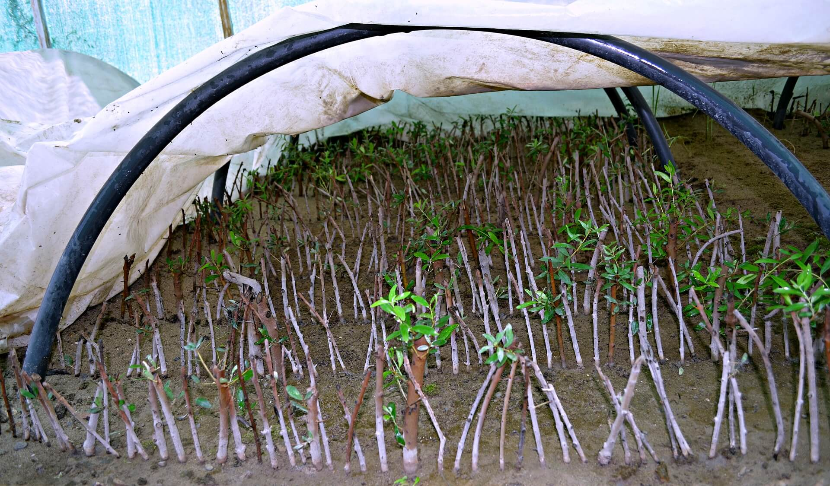

Slide 12
Contd…
Pruning should e done every year after harvesting because it can not bear flowers again
Insects like Fruit fly, Twig cutter, bark beetle and aphid and Diseases like Bacterial blight, Sooty mold) should e managed via insecticides and pesticides (karaty, Azwordren, CuOH₂)
It flowers in spring which change from green to black in end of autumn and it is finally harvested in beginning of winter

Slide 13
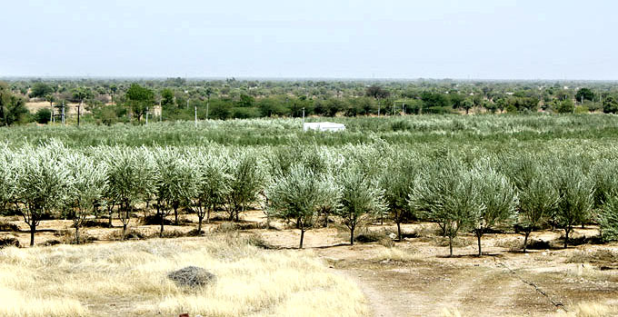

Slide 14
Flower of Olives:-
Flower buds are born in the axil of each leaf. Usually the bud is formed on the current season’s growth and begins visible growth the next season. Buds may remain dormant for more than a year and then begin growth, forming viable inflorescences with flowers a season later than expected. there are hundreds of flowers per twig. Each inflorescence contains 15-30 flowers.

Slide 15
Cont..
Olives are monoecious.
Perfect flowers, those with both pistillate and staminate parts, normally consist of a small calyx, 4 petals, 2 stamens with a filament supporting a large pollen-bearing anther.
Perfect flowers are born apically in an inflorescence, and within the typical triple-flower inflorescence. The flowers are small, yellow-white.
The pistil is green when immature and deep green when open at full bloom.

Slide 17
Seed of olives

Slide 18
Nutritive value of Olives:-
Extra virgin olive oil is fairly nutritious
It contains Vit. A, D, E & K and other beneficial fatty acids like Saturated, Monounsaturated(Oleic acid), Omega 3, Omega 6.
Extra virgin olive oil also have antioxidants.
It does not contain cholesterol. But have Poly unsaturated fatty acids. Which help prevent atherosclerosis.

Slide 19
Contd…
Vitamins of olives decrease the risk of atherosclerosis, Cancer, and helps to fight against cholelithiasis, gastritis, Stomach ulcer, Constipation and also help in preventing the formation of free radicals.
It has great cleansing effect and enhances digestive processes.
It slows the aging process and also prevent blood clots.

Slide 20
Contd…
Olives oil contains Vit. D, which promotes the absorption of calcium and prevent osteoporosis.
Having polyphenols which fight free radicals, lower the risk of heart diseases.
It balances blood sugar levels, so it should be used by diabetic patients.
It’s a gluten free product and salt also.

Slide 21
Olives in Pakistan:-
Olives was introduced first time in Pakistan in 1986 under Italian project ‘Fruit, Vegetable and olive project’
One wild specie “Olea Cuspidata” which is most widely grown in Pakistan(Hill station of Murree, Chakwal) not only in Pakistan but in sub-continent also but unfortunately it is not grown on commercial scale anywhere.
Other spp. Is most likely cultivated in Swat, Dir, Malakand, KPK, balochistan (Loralai, Khizdar)

Slide 22
Projects working on Olives:
Now there many projects which are working on economic production of olives in Punjab, KPK, Baluchistan mainly
Olive valley in Chakwal by Italy
Promotion of olive Cultivation for Economic Development and Poverty Allevation
Promotion of olive cultivation on commercial scale

Slide 23
Breeding objectives
High Yield
High oil contants
Oil bodies diameter
Embryo testa ratio
Testa color
Seed size

Slide 24
Quality enhanment:-
the use of different enzymes viz. pectinase, cellulase and pectinase CCM in combinations to enhance olive oil recovery and quality. The enzymatic treatment significantly increased the oil yield and clarity of oil without adversely affecting the quality parameters.

Slide 25
Varieties of Olives:
Cornicabra
Frantoio
Manzania
Picual
Ponetine
Lugano

Slide 26
Processing:-
First of all olive fruits are harvested by hand or by Manual/mechanical harvesting using different tools and machines.
After transporting into the mills fruits are washing and cleaning from dust or other undesirable things for this purpose it is deposited on conveyer belt
in Crushing and then grinding ground break the structure of fruit without scrapping, to release the liquid then shifted into the blender for homogenization.
Churning gives us Solid phase and liquid phase it is the final quality

Slide 27
Contd…
5. Solid phase-liquid consist in introducing the resulting mass this cold working process kept intact all the organoleptic and nutritional properties of olive juice temperature should be maintained in 27-29 ͦC for 90 minutes.
6. Then by pressing centrifugation and decantation we get oil.
7. Then storage after extracting virgin olive oil and also making the categories of olives oil and it should e stored in 15 to 18 ͦC

Slide 28
Processing steps:

Slide 30
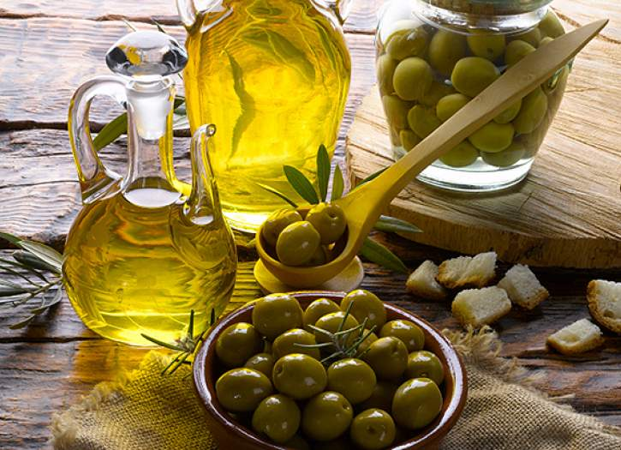

Slide 31
Varieties of Olive oil:
Extra Virgin olive oil
Virgin olive oil
Pure olive oil
Olive pomace oil (Kitchen)
Extra light olive oil

Slide 32
Products of olive oil:-

Slide 33
Uses of Olive oil
Olive oil is used for medicine, cosmetic, recipes
It is used in soap and lotions hair oil and other beauty products.
Religious value in Christian, jews, and Muslims
Used as a flame in lamps
Used in pickle
Its an edible oil so used for cooking
Used is medicines

Slide 34
We should make Olive oil as a staple:
Extra- virgin olive oil is the highest quality oil which is obtained by using first-cold pressed process. it is a great ingredient in salad dressing, it can be used with boiled or stewed vegetables and dishes pasta or rice etc. so this is very healthy oil so it should be used as a staple in our healthy diet. also its taste is good.

