Slide 1
Subject: Engineering Probability and Statistics
Class: BS 4th
Lecture: 6th week
Topic: Normal Distribution

Slide 2
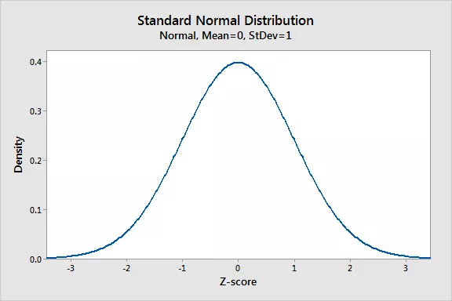
Standard Normal Distribution
As discussed in the introductory section, normal distributions do not necessarily have the same means and standard deviations. Therefore the normal distribution has many different shapes depending on the parameter values.
However, the standard normal distribution is a special case of the normal distribution where the mean is zero and the standard deviation is 1. This distribution is also known as the Z-distribution.

Slide 3
Standard z-score
A value on the standard normal distribution is known as a standard score or a Z-score. A standard score represents the number of standard deviations above or below the mean that a specific observation falls. For example, a standard score of 1.5 indicates that the observation is 1.5 standard deviations above the mean. On the other hand, a negative score represents a value below the average. The mean has a Z-score of 0.
Every normal random variable X can be transformed into a z score via the following equation:
z = (X - μ) / σ
where Z is the value on the standard normal distribution, X is the value on the original distribution, μ is the mean of the original distribution, and σ is the standard deviation of the original distribution.

Slide 4
Why we use Standard Normal Distribution?
The standard normal distribution and scale may be thought of as a tool to scale up or down another normal distribution. The standard normal distribution is a tool to translate a normal distribution into numbers which may be used to learn more information about the set of data than was originally known.
For example in order to find $P\left(X<a\right),$ where X is $N(μ,σ^{2})$, we standardized by setting $Z=\frac{X−μ}{σ}$. So that we can employ the standard normal distribution. The inequality $X<a$ becomes $Z<\frac{a−μ}{σ}$. This statement is equivalent to saying that $P\left(X<a\right)=P(Z<\frac{a−μ}{σ})$
Similarly, in order to find $P\left(a<X<b\right),$ where X is $N(μ,σ^{2})$, we standardized by setting $Z=\frac{X−μ}{σ}$. So that we can employ the standard normal distribution. This statement is equivalent to saying that $P\left(a<X<b\right)=P(\frac{a−u}{σ}<Z<\frac{b−μ}{σ})$

Slide 5
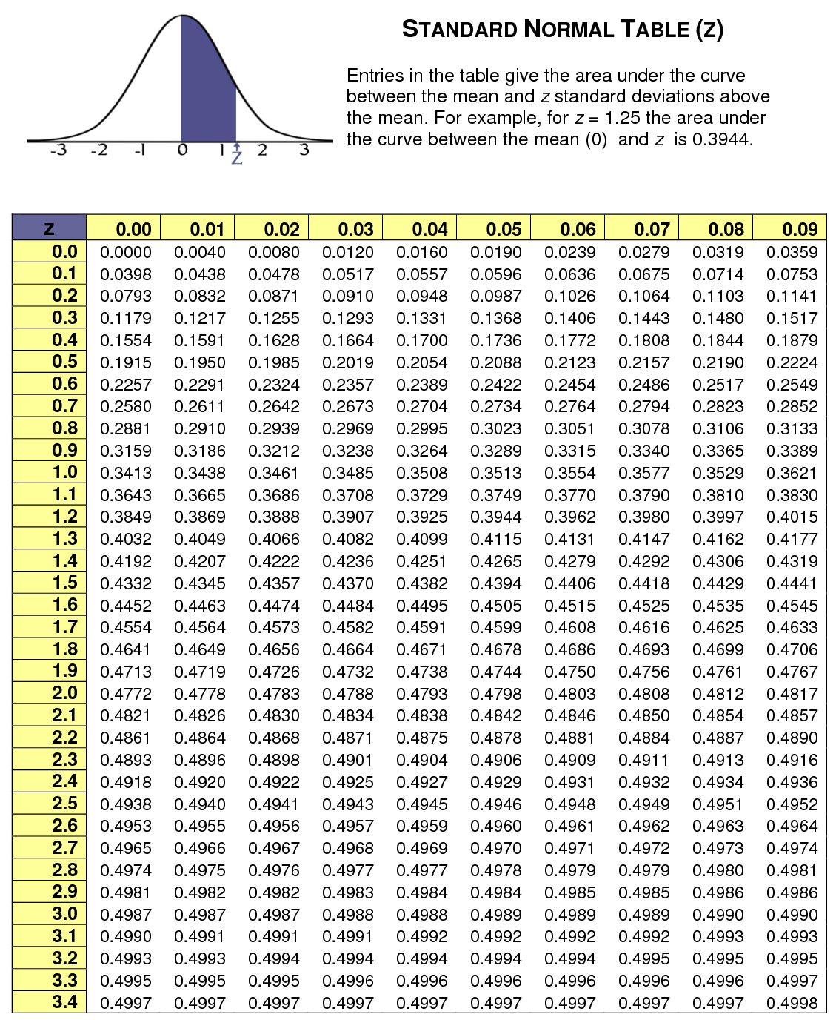
Area Under the Standard Normal Curve

Slide 6
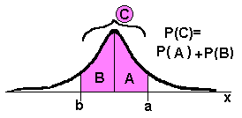
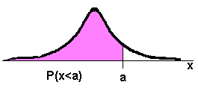
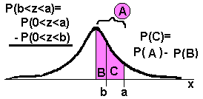
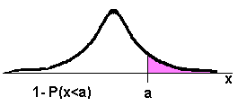
Different kind of probability problem under SND
There are 4 basic types of probability problems dealing with distributions, including normal and standard normal distributions. They are summarized by the words between, below, and above. Figure out which kind of problem you have and the computation becomes easy.

Slide 7
Questions
Suppose that the lengths of 200 aluminum coated sheets are normally distributed with a mean of µ = 30.5 inches and a standard deviation of σ = 0.2 inch. What is the probability that a sheet selected at random from the population of sheets is between 30.25 and 30.75. Also find the number of sheets between 30.25 and 30.75. inches.
Solution
We transform each value of X to the corresponding value of z
$$P\left(30.25≤X≤30.75\right)=P(\frac{30.25−30.5}{0.2}≤\frac{X−μ}{σ}≤\frac{30.75−30.5}{0.2})$$
$$P\left(30.25≤X≤30.75\right)=P\left(\frac{30.25−30.5}{0.2}≤Z≤\frac{30.75−30.5}{0.2}\right)$$
$$=P\left(−1.25≤z≤1.25\right)$$

Slide 8
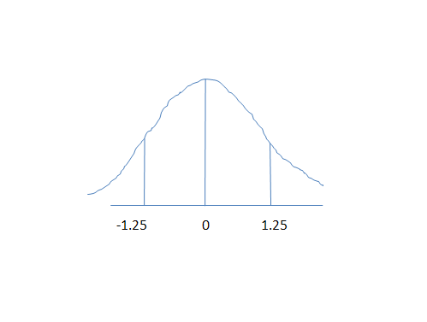
$$P\left(30.25≤X≤30.75\right)=P\left(−1.25≤z≤1.25\right)=P\left(−1.25<z<0\right)+P\left(0<z<1.25\right)=0.3944+0.3944=0.7888$$
The number of sheets between 30.25 and 30.75 inches is = 200(0.7888) = 157.76 or 158

Slide 9
Practice Question
Q 2: Let the random variable Z have the standard normal distribution. Find
$P\left(0≤Z≤1.20\right).$
$P\left(−1.65≤Z≤0\right).$
$P\left(0.6≤Z≤1.67\right).$
$P\left(−1.30≤Z≤2.18\right).$
$P\left(−1.96≤Z≤−0.84\right).$
$P\left(Z≥1.96\right).$
$P(Z≤−2.15)$

Slide 10
Quiz Assignment
What is hyper geometric distribution?
Assumptions
Mean and Variance
MGF if possible

