Slide 2
Role of Planking in Soil & Water Conservation.

Slide 3
Introduction
There are several tillage practices which are managed by different types of tillage implements. We use them according to our purpose. These all practices are mostly related to soil operations.

Slide 4
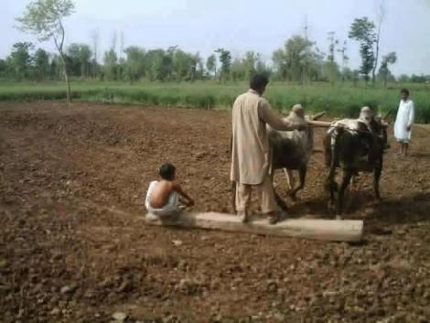
Planking
It is the process of leveling/pressing the soil with the help of wooden or iron block.

Slide 5
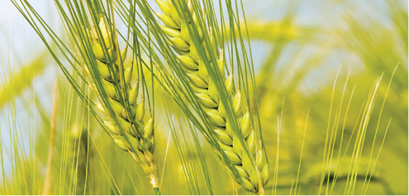
How planking works
By effective planking it reduce the work in crop establishment and crop management.
We can reduce our expenses on heavy water application.
Planking is done by the most useful agronomic tool Planker.

Slide 6
Plank and roller
Plank is a very simple implement and consist of a heavy wooden beam of 2 m in length.
In addition, shafts and handle are fixed to the beams.
When it is worked, most of the clods are crushed due to its weight.
It also helps in micro-leveling and slight compaction necessary after sowing.
Rollers are used mainly to crush the hard clods and to compact the soil in seed rows.

Slide 7
Continue …….
These secondary tillage implements have been used from the earlier times for the purpose of crushing the clods and smoothening the fields. If clods are not crushed, it pulls the clods inside the soil surface. Different types of Pulverizers or Rollers are available like corrugates type or spiked teeth type.

Slide 8
Purpose of Planker
Soil Preparation.
Soil Smoothening.
Soil Packing.

Slide 9
Work Done by Planker
Planker is a secondary tillage implement.
The basic work done by secondary tillage implement is given below:
This tillage tool remove the weeds by cutting. They are covered, dragged out from the surface of soil and are finally killed.
Tillage tool loosen the soil and facilitate the moisture entry into the soil.
Tillage tool perform the smoothening and levelling process of the field.
Leveling process to make soil surface in level for sowing seeds.

Slide 10
Work Done by Planker
Leveling is done by using a leveler, mode of wood or iron. Planker is also used for whole this Process.
Planker break the clods and later pulverize them for efficient seed bed preparation.
This tool cut the crop residue like straw etc. and further mix them with soil for faster decomposition.
When the Planker move on the soil surface it make the furrow on soil surface, to remove these furrow for the purpose of soil leveling the planker agianly move the soil surface.

Slide 11
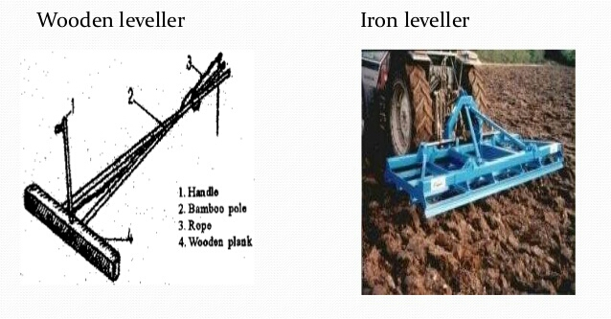

Slide 12
Benefits of Planking
Conservation of soil water for long time.(Increase soil water retention)
Reduce soil erosion.
Reduce surface run off.
Better control on perennial weeds.
Uniform distribution of water.
Helps in incorporating dry fertilizer.
Destroy the insects at larval stage.
Ultimately increase crop yield.

Slide 13
Maintenance Tips
Keep the secondary implements clean with regular checks.
All nut bolts should be fully tight.
Storage Tips:
After the season ends, keep following things in mind:
The implement should be cleaned.
The implement should be stored under a shelter.

Slide 14
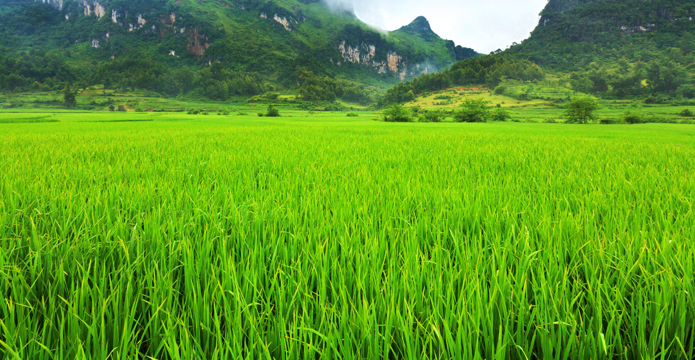
Thanks

