Slide 1
Methods in Molecular Biology

Slide 2
Molecular Biology
Molecular Biology is the branch of biology that deals with the molecular basis of biological activity.
This field also overlaps with other areas of biology and chemistry, particularly genetics and biochemistry.

Slide 3
Molecular biology concerns itself with the understanding of the interactions between the various systems of a cell, including the interactions between the different types of DNA, RNA and protein biosynthesis as well as learning how these interactions are regulated.

Slide 4
Relationship to other biological sciences
Researchers in molecular biology use specific techniques native to molecular biology but increasingly combine these with techniques and ideas from genetics and biochemistry.
There is not a defined line between these disciplines.

Slide 5
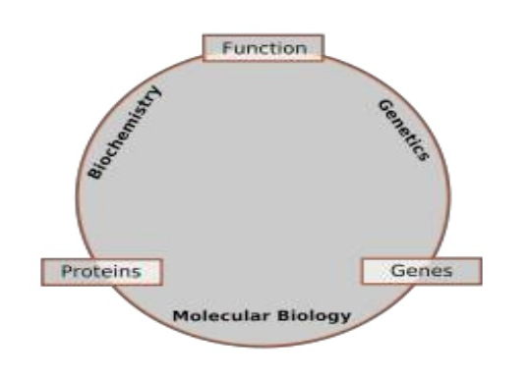
Relationship to other biological sciences:

Slide 6
Biochemistry:
It is the study of the chemical substances and vital processes occuring in the living organisms.
Biochemists focus heavly on the role, function, and structure of biomolecules.

Slide 7
Genetics:
It is the study of effect of genetic differences on organisms.
The study of “mutants” organisms which lack one or more functional components with respect to the so called “wild type” or normal phenotype.

Slide 8
Molecular Biology:
It is the study of molecular process of replication, transcription, translation and cell function.
The central dogma of molecular biology where genetic material is transcribed into RNA and then translated into proteins despite being an oversimplified picture of molecular biology, still provides a good starting point for understanding the field.

Slide 9
Molecular Biology Methods:
Molecular Biology techniques or methods utilize DNA, RNA and enzymes that interact with nucleic acids to understand biology at a molecular level.

Slide 10
Techniques of Molecular Biology:
Expression Cloning.
Polymerase Chain Reaction (PCR).
Gel Electrophoresis.
Macromolecule blotting and probing techniques.
Southern Blotting.
Northern Blotting.
Western Blotting.
Eastern Blotting.
Arrays.
Allele specific oligonucleotide.
Antiquated technologies.

Slide 11
Expression Cloning:
One of the most basic techniques of molecular biology to study protein function is expression cloning.
In this technique , DNA coding for a protein of interest is cloned into a plasmid.

Slide 13
Polymerase Chain Reaction (PCR):
The Polymerase Chain Reaction is an extremely versatile technique for copying DNA.
In brief, PCR allows a specific DNA sequence to be copied or modified in predetermined ways.

Slide 15
Gel Electrophoresis:
Gel Electrophoresis is one of the principal tops of molecular biology.
The basic principle is that DNA, RNA, and proteins can all be separated by means of an electric field and size.

Slide 17
Macromolecule blotting and probing:
Southern Blotting:
Named after it's inventor, biologist Edwin Southern.
The southern blot is a method for probing for the presence of a specific DNA sequence within a DNA sample.

Slide 18
Northern Blotting:
The northern blot is used to study the expression patterns of a specific type of RNA molecule as relative comparison among a set of different samples of RNA.

Slide 19
Western Blotting:
In western blotting, proteins are first separated by size, in a thin gel sandwiched between two glass plates in a technique known as SDS- PAGE (sodium dodecyl sulfate polyacrylamide gel electrophoresis).
The proteins in the gel are then transferred to a polyvinyl dene fluoride (PVDF) , nitrocellulose, nylon, or other support membrane.

Slide 21
Eastern Blotting:
Eastern blotting techniques is to detect post-translational modification of proteins.
Proteins blotted on to the PVDF or nitrocellulose membrane are probed for modifications using specific substrates.

Slide 23
Arrays:
A DNA array is a collection of spots attached to a solid support where each spot contains one or more single stranded DNA oligonucleotide fragment.
In this technique, RNA Ina tissue is isolated and converted to labeled cDNA. This cDNA is then hybridized to the fragment on the array and visualization of the hybridization can be done.
This is particularly useful for comparing gene expression of two different tissues.
Arrays can be made with molecules other than DNA.

Slide 24
Allele Specific Oligonucleotide:
It is a technique that allows detection of single base mutations without the need for PCR or gel electrophoresis.
Short, labeled probes are exposed to the non-fragmented target DNA.
Hybridization occurs with high specificity. The target DNA is then washed and the labeled probes are then removed. The target DNA is then analyzed for the presence of the probe.
In this technique, a control must be used to ensure successful experimentation.

Slide 25
Antiquated Technologies:
In molecular biology, procedures and technologies are continually being developed and other technologies abandoned.
Aside from their historical interest, it is often worth knowing about older technology, as it is occasionally useful to solve another new problem for which the newer technique is inappropriate.

Slide 26
The End

