Slide 2
SEED BANK

Slide 3
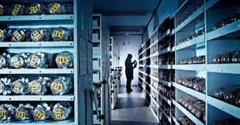
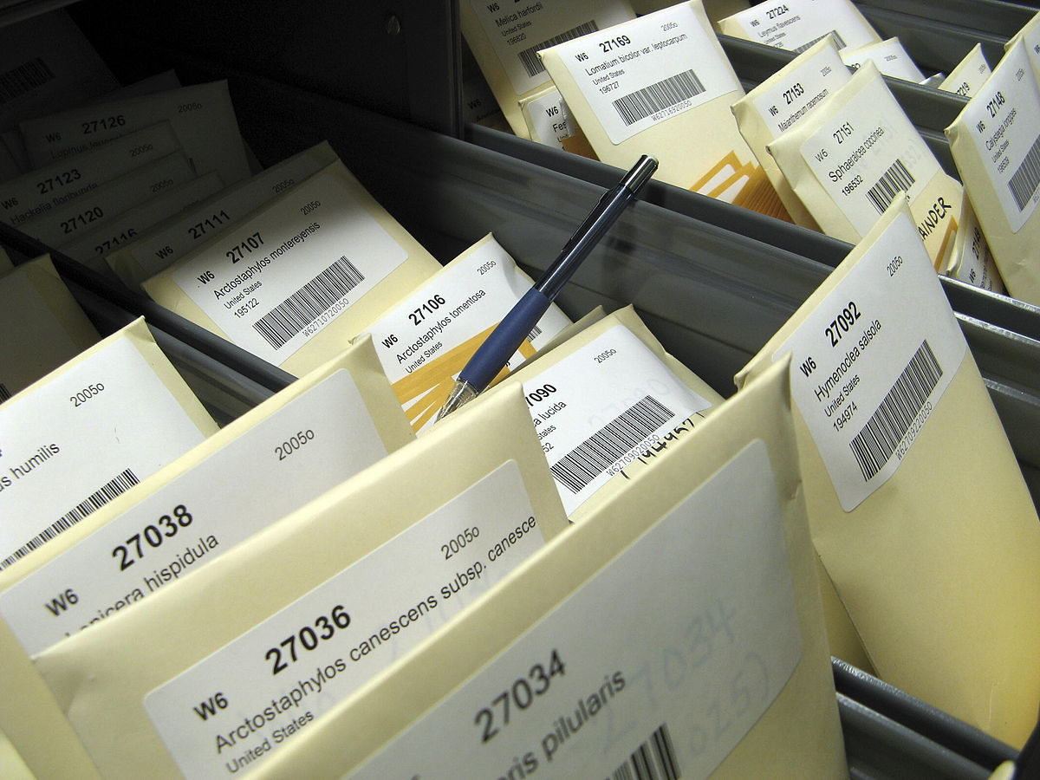
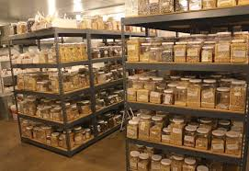

Slide 4
introduction
Seed bank stored seeds as a source for planting incaseseed reserve or else where destroy
It’s a type of seed bank.
The seeds may store may be fruit crops or those of rare special to protect biodiversity.
There are different reasons for storing seeds.

Slide 5
Many usefusl plants that were develop over centuries no longer use of commercial agricultural reproduction and are becoming rare storing seed also protect against castrophic events like nature diasaters out break of diseses.

Slide 6
Unlike seeds libraries that encourages frequant of reuse and sharing of seeds.
Seed banks are not typically to the open for public.

Slide 7
Types of seeds according to the storage conditions:
ORTHODOR SEEDS
INTERMEDIATE SEEDS
RECALCITRANT SEEDS

Slide 8
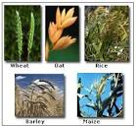

Slide 9
ORTHODOR SEEDS
It can be maintain in a dormant stage for decades in a cool and dry environment with little damage to the DNA.
They remain viable and are easily store in seed bank when suitably prepare.
EXAMPLE
Include many species in familes fabaceae and poaceae

Slide 10
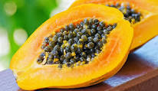

Slide 11
INTERMEDIATE SEEDS
Which exhibit the dryness tolerance characteristics of the orthodox seeds, but are sensitive to low temperature storage like the recalcitrant seeds
EXAMPLE:
PAPAYA etc.

Slide 12
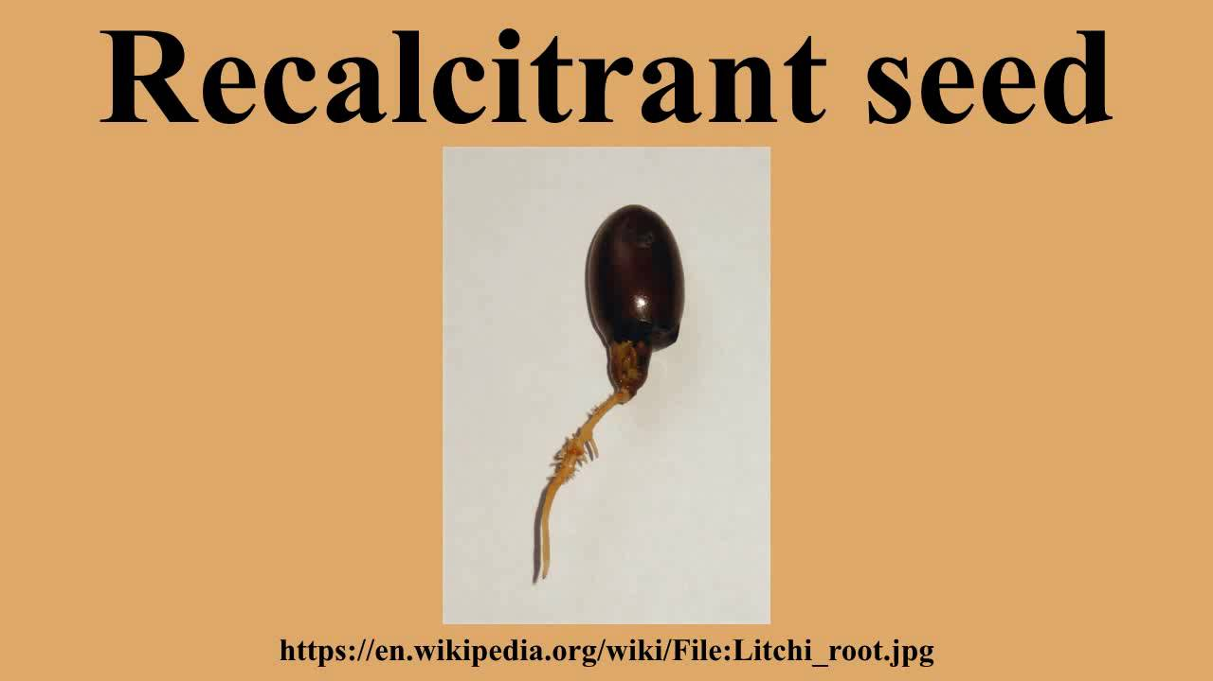

Slide 13
RECALCITRANT SEEDS
They are damage by dryness and sub zero temperature and most be continuously replant to replenish seeds stocks
EXAMPLE
Seeds of coca and rubber.

Slide 14
Optimal storage conditios:
Depending on the species seeds are dryed to the suitable moisture contents according to an appropriate protocol
This will be less than 5%
the seed are then stored at 180 temp or below because seed DNA degrades with time.
The seeds need to be predicatly replantes and fresh seed collected for another round of long term storange.

Slide 15
alternative
In site conservation of seeds producing olants species is another conservation involves the creation of national park and national forest
A way of preserving natural habitat of the turgeted seed producing organisms and insitue conservation of agriculture.

Slide 16
longerity
Seeds may be viable for 100 and even 1000 of years .
The oldest carbon 14 dated seeds that has grown in to a a viable plant was date palm seed about a 2000 years old.
Recover from great pelis in Israel in febrary 2012 Rusian scientists announced that they have regenerated a narrow leaf plant from a 32000 years old

Slide 17
The seeds was found in a burrows 124 feet hundred suberian perma frost along with 8000 other seeds.
Seed tissues was grown in test tubes until it could be transplanted to the soil

