Slide 1
Karyotype
Three terms, namely, karyotype, karyogram, and
idiogram, are often referred to in the identification of chromosomes. Karyotype is the number, size,
and morphology of a chromosome set of a cell in an individual or species (Battaglia, 1994).

Slide 2
Karyogram is the physical measurement of the chromosomes from a photomicrograph, where
chromosomes are arranged in descending order (longest to shortest). An idiogram represents a
diagrammatic sketch (interpretive drawing) of the karyogram (Figure 6.1).

Slide 3
The classification of chromosomes is based on physical characteristics, such as size of chromosomes, features of
telomere, position of kinetochore, secondary constriction, size and position of heterochromatic
knobs, and relative length of chromosomes

Slide 4
NOMENCLATURE OF CHROMOSOMES
The kinetochore (centromere) position is a useful landmark for the morphological identification and nomenclature of chromosomes disagreed with using
the term kinetochore for the centromeric region of the chromosome body. A monocentric chromosome

Slide 5
contains one centromere and nomenclatured chromosomes based on the position of the centromere in the chromosomes:

Slide 6
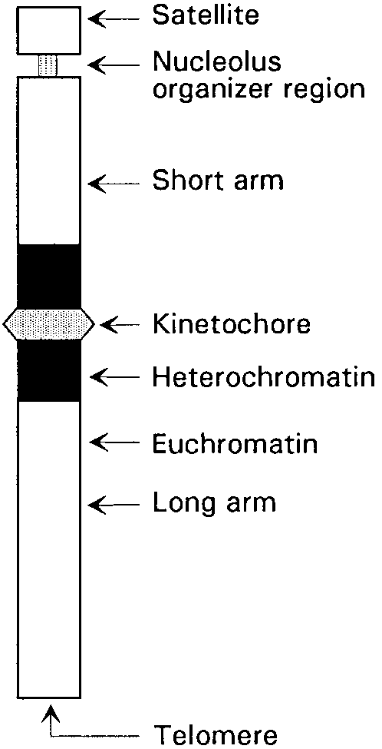

Slide 7
Chromosome types
1. Median centromere (isobrachial chromosomes): Centromere is situated in the middle of the chromosome, resulting in an arm ratio of 1:1.
2.Submedian centromere
(heterobrachial chromosome): Centromere is located near the middle of the chromosome, resulting in an arm ratio of more than 1:1 but less than 1:3 (from 1:1 to 1:2.9).
3. Subterminal centromere
(hyperbrachial chromosome): Centromere is near one extremity of the
chromosome, resulting in a ratio of 1:3 or more.
4. Terminal centromere
(monobrachial chromosome): Centromere is situated at one extremity of the chromosome, resulting in an arm ratio of 0:1.

Slide 9
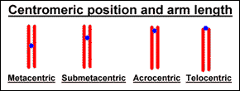
Identifying specific chromosomes
Centromere position and arm ratios assist in identifying specific chromosomes
Many chromosomes appear identical by these criteria.
Identifcation revolutionised by dyes producing reproducible patterns of bands

Slide 10
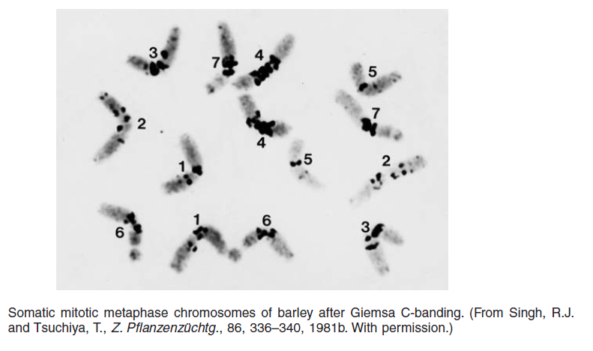

Slide 11
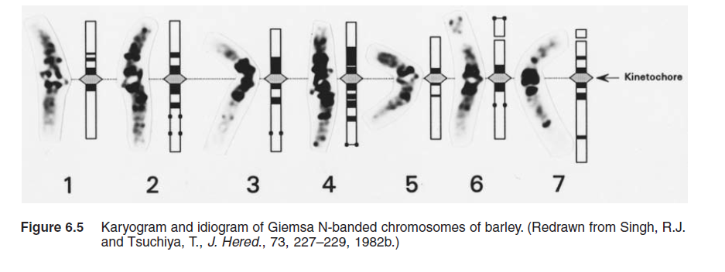

Slide 12
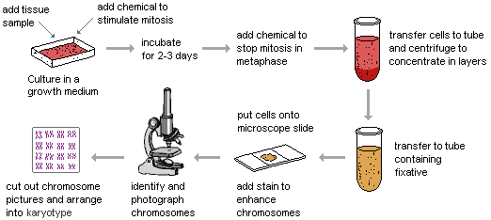
PREPARATION OF CHROMOSOMES

Slide 13
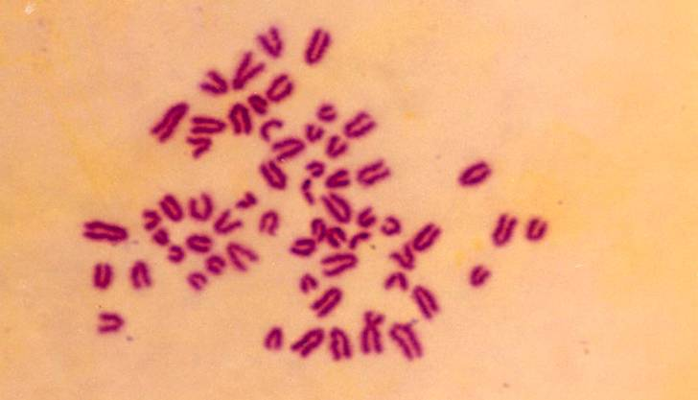
MITOTIC CHROMOSOMAL SPREAD OF CATTLE

Slide 14
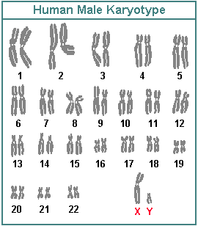

Slide 15
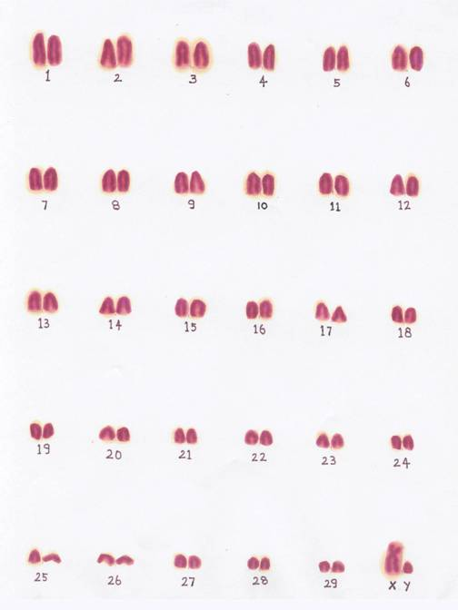
NORMAL KARYOTYPE OF CATTLE

Slide 16
BANDING OF CHROMOSOMES
G - Banding
Q - Banding
C - Banding
R - Banding
T - Banding
NOR - Banding
High Resolution Banding
Restriction Endonuclease Banding

Slide 17
Q-banding
1. Dehydrate the slides by dipping in alcohol with decreasing concentration 90%, 70% and 50% one min each.
2. Rinse in distilled water. .
3. Wash the slide in phosphate buffer at pH 6.8.
4. Stain the slide in quinacrine mustard (5 mg in 100 mI) or in quinacrine dihydrochloride 5% for 20 min.
5. Rinse in phosphate buffer and mount in the same buffer.
6. Examine under fluorescent microscope.

Slide 18
C-banding
1. Treat the slides in 0.2 N HCI for one hr at room temperature.
2. Rinse in de-ionized water.
3. Immerse in 1% barium hydroxide at 50°C for 5-15 min.
4. Rinse in deionized water.
5. Incubate at 60°C in 2XSSC buffer for one hr.
6. Rinse in de-ionized water and stain in 4% Giemsa stain for 90 min.
7. Rinse in de-ionized water, dry and examine under oil immersion.

Slide 19
R-banding
1. Age the slides for 7 -10 days .
2. Place the slides in a Coplinjar containing phosphate buffer ofpH 6.5 at 85°C and incubate for 20-25 min.
3. Stain the slides in 0.01% acridine orange in the phosphate buffer pH 6.5 for 4-6 min. Rinse in phosphate buffer and mount in the same buffer.
4. Examine under fluorescent microscope.

Slide 20
T -banding
1. Age the slide for 7 days.
2. Place.the slides in PBS pH 5.0 for 20-60 min at 87°C.
3. Rinse in PBS.
4. Stain in 3% Giemsa in phosphate buffer pH 6.8 at 87°C, leave for 5-30 min and rinse.
5. Slides are stained in Hoechst 33258 stain for 10 min (Hoechst stain 0.5 pg/m1 of phosphate buffer).Rinse in phosphate buffer and examine in fluorescent microscope.
6. Alternatively, the stained slides are covered with a cover slip and placed in a wet chamber under UV lamp for 2 to 3 hrs or under direct sunlight for 2 hrs.
7. Remove the cover slip and stain in Giemsa stain for 10 min.
8. Rinse in buffer, dry and mount in DPX.

Slide 21
METHODOLOGY
G- Banding technique
Ageing of good slides for 10 days
Normal saline
Treated with trypsin 0.25% solution 10-15 sec
Immersed in 70% ethanol for few minutes
Stained with 10% Giemsa for 6-10min
Microphotograph good spreads
Construction of G-banded karyotype

Slide 22
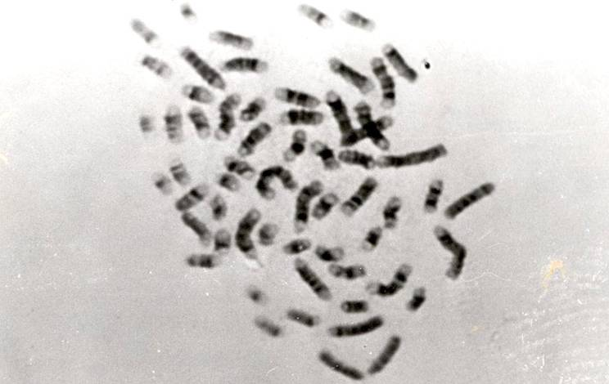
G-BANDED MITOTIC CHROMOSOMAL SPREAD OF CATTLE

Slide 23
Chromosome banding
Q banding: chromosomes stained with a fluorescent dye such as quinacrine
G banding: produced by staining with Giemsa after digesting the chromosomes with trypsin
C banding: chromosomes are treated with acid and base, then stained with Giesma stain

Slide 24
Making a karyotype
Karyotypes are presented in a standard form.
First, the total number of chromsomes is given, followed by a comma and the sex chromosome constitution.

Slide 25
Karyotype protocol
blood + heparin to prevent coagulation
centrifugation through dense medium: red cells and granulocytes pellet, no mononuclear cells (lymphocytes and monocytes).
cultured for 3-4 days in (mitogen) phytohemagglutinin, which stimulates proliferation.
add colcemid- disrupts mitotic spindles and prevents completion of mitosis.
harvested and treated with hypotonic solution: nuclei swell osmotically, aids good spreads
cells are fixed, put onto a slide and dried.
stained to induce a banding pattern

Slide 26
FISH technique
DNA probes are specific to regions of individual chrs.
Probe attaches to the spread of chrs
a fluorescein stain is applied.
visible with the aid of a fluorescent microscope.
The chr 21 pair have been painted.

Slide 27
Fluorescent in situ hybridisation
The tyramide signal amplification technology uses a fluorescent tyramide and HRP
Probe is labeled with biotin and detected by streptavidin-HRP or an antibody.
HRP reacts with a fluorescent tyramide in the presence of hydrogen peroxide to produce a reactive tyramide that attaches to proteins in the area.
The turnover of multiple dye-labeled tyramide substrates per peroxidase label results in strong signal amplification.

Slide 28
Metaphase FISH
Detect microdeletions beyond resolution of routine cytogenetics
Identify extra material of unknown origin.
Determine a simple deletion or a subtle or complex rearrangement.
Detect specific rearrangements in certain cancers.
Number of microdeletion syndromes diagnosed by FISH is expanding rapidly.
Probe may be specific for the gene as in Williams Syndrome
a deletion has been shown in the elastin gene in 96% of individuals with a firm diagnosis.

Slide 29
Interphase FISH
Determine the chr number
Specific rearrangements in certain cancers.
Advantage is that it is rapid
Aneuploid Screen on amniotic fluid cells
Nuclei denatured and hybridized with probes for chromosomes 13, 18, 21, X, and Y and results usually obtained within 24 hours.
Routine cytogenetics is included to confirm the results or detect any abnormalities not detected by interphase FISH.

Slide 30
Metaphase cell
probed for DiGeorge/Velo-Cardio-Facial/CATCH 22/Shprintzen Syndrome
caused bymicrodeletion on chr 22.
dual-color mixture of two probes
Green- an internal control at 22q13.
red -at the DiGeorge region 22q11.2.
this individual would not have DiGeorge Syndrome.

Slide 31
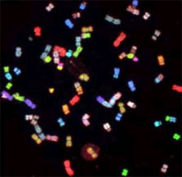
Multicolour FISH
Can use probes of different colours to identify different all chromosomes at once
Chromosome rearrangement in an oral cancer cell shown with multi-colored painting probes.

