Slide 1
Commitment and Leadership
Lecture 2

Slide 2
Commitment and Policy
Lecture 2
What is Commitment ?
The state of being bound emotionally or mentally to a course of action or to another person or persons
“ It is an act or a statement a oath or promise which create an obligation/ compulsion.

Slide 5
Commitment & Policies

Slide 6
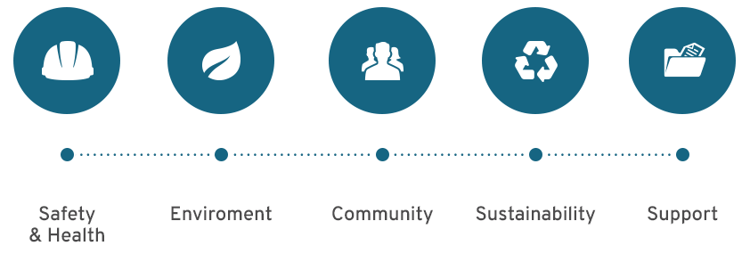
Commitment & Policies

Slide 7
Changing the Culture

Slide 8
Changing the Culture

Slide 9
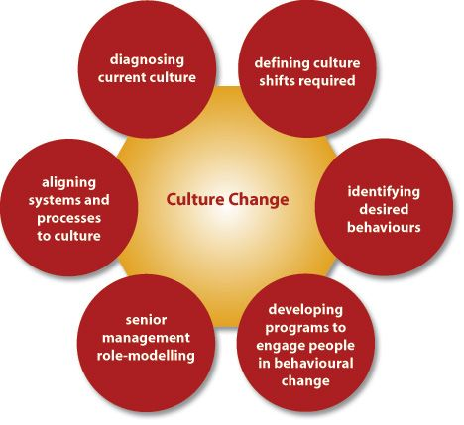

Slide 19
A Clear Vision or Visionary
As a Leader, you need to have a clear vision of what you want to achieve and why.
This Vision needs to be impressive sufficient to cover the vision of the people or group you wish to lead.
Good leaders are always thinking “What next”, It is a common question asked by a good leaders. They encourage growth and strategic thinking so the organization remain healthy.

Slide 20
Communication Skill
Leaders need to be able to communicate their vision powerfully and persuasively.
Competent
Leader have to be competent in the task

Slide 21
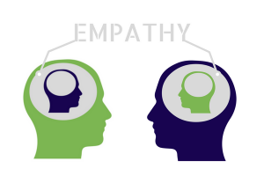
Empathy OR Empathetic
A leader should understand the feeling of other. When your team knows that you are kindhearted to their concerned. They will be more likely to work with you and share in your vision .
Leaders are able to sympathetic with people, so that feel and know that their feelings and thoughts.

Slide 22
Consistency
Being a consistent leader , will gain you respect and credibility by setting an example of fairness and credibility. The team will want to act the same way

Slide 23
Self Confidence
A Leader should have confidence in himself as well as a sense of responsibility to carry out any work.

Slide 24
Fairness
Fairness means dealing with others consistently and honestly.
A leader must check all the facts and hear everyone before passing judgment.

Slide 25
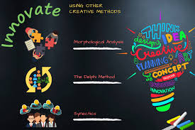
Creativity
Creativity is the ability to think differently. Creating gives, leaders the ability to see thing that others have not seen and leaders follows in new direction.

Slide 26
Decisive or Strong minded
A leader will usually make a decision quickly once having accessed the situation and then attach with that decision.

