Slide 1
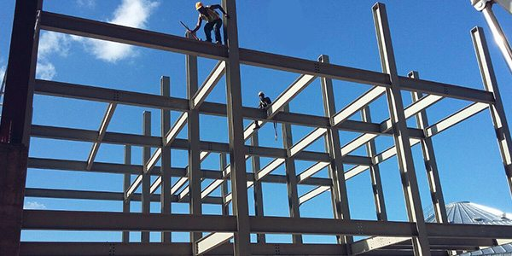
COLLEGE OF ENGINEERING AND TECHNOLOGY UNIVERSITY OF SARGODHA DESIGN OF STRUCTURES (CE-409) 01-Credit Hour
LECTURE-4
DESIGN OF RETAINING WALL STRUCTURES

Slide 2
RETAINING WALLS
Retaining walls are structural members used to provide for soil other materials and to prevent them from assuming their natural slope.
In this sense, the retaining wall maintains unequal levels of earth on its two faces.
The retained material on the higher level exerts a force on the retaining wall that may cause its overturning or failure.
Retaining walls are used in bridges as abutments, in buildings as basement walls and in embankments.
They are also used to retain liquids, as in water tanks and sewage-treatment plants

Slide 3
RETAINING WALLS
Retaining walls may be classified as follows:
GRAVITY WALLS:
These usually consists of plain concrete or masonry and depend entirely on their own weight to provide stability against the thrust of the retained material.
These walls are proportioned so that tensile stresses do not develop in the concrete or masonry due to the exerted forces on wall.
The practical height of a gravity wall does not exceed 10 ft.

Slide 4
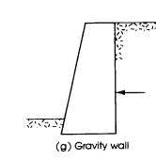

Slide 5
RETAINING WALLS
2. SEMI-GRAVITY WALLS:
These are gravity walls that have a wider base to improve the stability of the wall and to prevent the development of tensile stresses in the base.
Light reinforcement is sometimes used in the base or stem to reduce large section of the wall.

Slide 6
RETAINING WALLS
3. CANTILEVER RETAINING WALL:
It is a reinforced concrete wall that is generally used for heights from 8 to 20 ft.
It is the most common type retaining structure because of economy and simplicity of construction.
Various types of cantilever retaining walls are shown in figures in next slide.

Slide 7
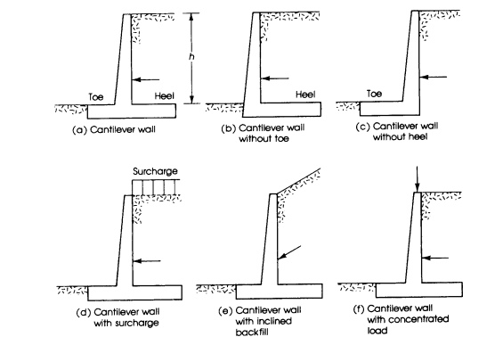

Slide 8
RETAINING WALLS
4. COUNTERFORT RETAINING WALLS:
These walls higher than 20 ft develop a relatively large bending moment at the base of stem, which makes the design of such walls uneconomical.
One solution in this case is to introduce transverse walls (or counterforts) that tie the stem and base together at intervals.
The counterfort act as a tension ties supporting the vertical walls.
Economy is achieved because the stem is designed as a continuous slab spanning horizontally between counterforts, whereas, the heel is designed as slab spanning horizontally between counterforts.
Whereas the heel is designed as a slab supported on three sides.

Slide 9
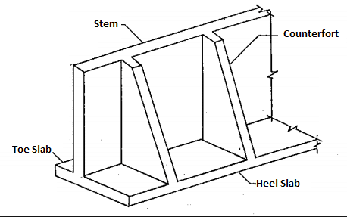

Slide 10
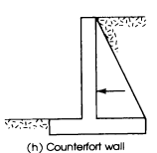

Slide 11
RETAINING WALLS
5. BUTTRESSED RETAINING WALLS:
It is similar to the counterfort wall, but in this case transvers walls are located on the opposite visible side of the stem and act in compression.
The design of such walls becomes economical for heights greater than 20 ft.
They are not popular because of exposed buttresses.

Slide 12
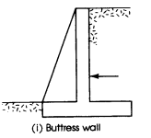

Slide 13
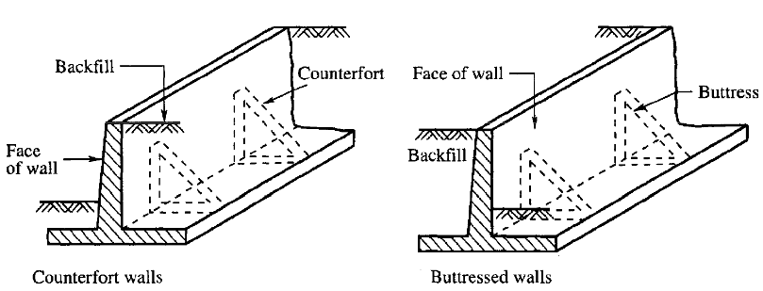

Slide 14
RETAINING WALLS
6. BRIDGE ABUTMENTS:
These are the retaining walls that are supported at the top by the bridge deck.
The wall may be assumed fixed at the base and simply supported at the top.

Slide 16
RETAINING WALLS
6. BASEMENT WALLS:
These walls resists earth pressure from one side of the wall and span vertically from the basement-floor slab to the first-floor slab.
The wall may be assumed fixed at the base and simply supported or partially restrained at the top.

Slide 17
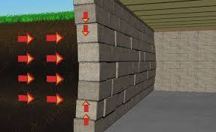

Slide 18
RETAINING WALLS
Forces on Retaining Walls:
Retaining walls are generally to gravity loads and to earth pressures due to the retained material on the wall.
Gravity loads due to the weights of the materials are well defined and can be calculated.
The magnitude and direction of earth pressure on a retaining wall depends on the type and condition of soil retained and on other factors and cannot be determined as accurately as gravity loads.
Granular materials, such as sand, behave differently from cohesive materials such as clay or from any combination of both types of soils.

Slide 19
RETAINING WALLS
Forces on Retaining Walls:
Although the pressure intensity of soil on a retaining wall is complex, it is common to assume a linear pressure distribution on a wall.
The pressure intensity increase with depth linearly and its value is a function of the height of the wall and type of soil.
The pressure intensity, p, at a depth h below the earths surface may be calculated as follows:

Slide 20
RETAINING WALLS
Forces on Retaining Walls:
Where w is the weight of soil and C is a coefficient that depends on the physical properties of soil.
The value of the coefficient C varies from 0.3 for loose granular soil, such as sand, to about 1.0 for cohesive soil, such as wet clay.
If the retaining wall is assumed absolutely rigid, a case of earth pressure at rest develops.
Under soil pressure, the wall may deflect or move a small amount from earth and active soil pressure develops as shown in figure 14.2.
If the wall moves toward the soil, a passive soil pressure develops.
Both the active and passive soil pressures are assumed to vary linearly with the depth of wall.

Slide 21
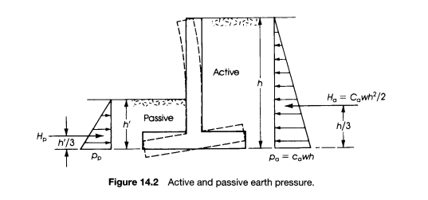

Slide 22
RETAINING WALLS
Forces on Retaining Walls:
For dry, granular, non-cohesive materials, the assumed linear pressure diagram is fairly satisfactory;
Cohesive soils or saturated sands behave in a different nonlinear behavior.
Therefore, it is very common to use granular materials as backfill to provide an approximately linear pressure diagram and also to provide for the release or drainage of water from behind the wall.
For a linear pressure, the active and passive pressure intensities are determined as follows:

Slide 23
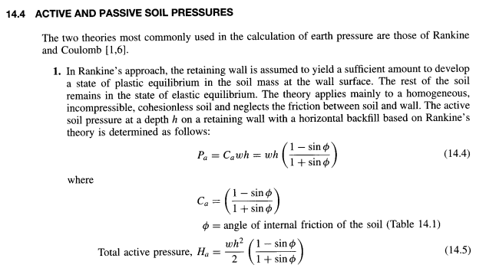

Slide 24
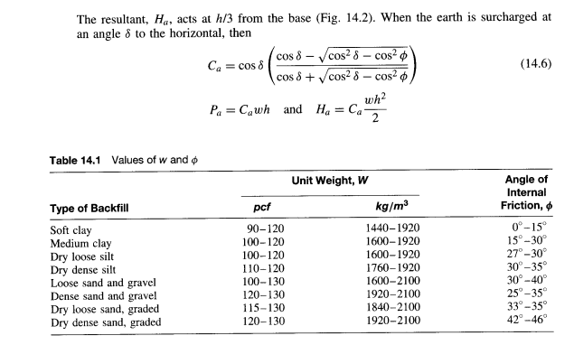

Slide 26
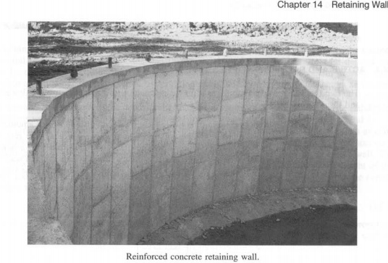

Slide 27
