Slide 1
THE BIOLOGICAL APPROACH Theory, Application, and Assessment CHAPTER: 9
C.I: DR. SUMAYA BATOOL
DEPARTMENT OF PSYCHOLOGY
UNIVERSITY OF SARGODHA

Slide 2
Hans J. Eysenck: Definition of Personality
Personality is “the sum-total of the actual or potential behavior-patterns of the organism, as determined by heredity and environment it originates and develops through the functional interaction of the four main sectors into which these behavior-patterns are organized. For Eysenck, personality consists of acts and dispositions organized in a hierarchical fashion in terms of their level of generality. The cognitive sector (intelligence), the conative sector (character), the affective sector (temperament), and the somatic sector (constitution).

Slide 3
Three Dimensions of Personality
Extraversion.
Neuroticism.
Psychoticism.
Introversion versus Extroversion.
Emotionally Stable versus Unstable (neurotic)
Impulse Control versus Psychotic.

Slide 4
Extraversion - Introversion
Extraversion:
Tough mindedness; impulsiveness; tendency to be outgoing; desire for novelty; performance enhanced by excitement; preference for vocations involving contact with other people; tolerance for pain.
Introversion:
Tender mindedness; introspectiveness; seriousness; performance interfered with by excitement; easily aroused but restrained, inhibited; preference for solitary vocations; sensitivity to pain.

Slide 5
Neuroticism- Psychoticism
Neuroticism:
Below-average emotional control, will-power, and capacity to exert self; slowness in thought and action; suggestibility; lack of persistence; tendency to repress unpleasant facts; lack of sociability; below-average sensory acuity but high level of activation.
Psychoticism:
Poor concentration, poor memory; insensitivity; lack of caring for others; cruelty; disregard for danger and convention; occasionally originality and/or creativity; liking for unusual things; considered peculiar by others.

Slide 6
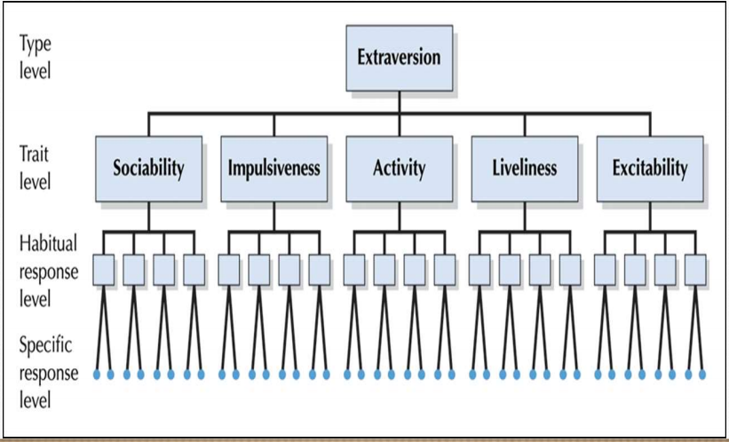
Eysenck’s Hierarchical Model of Personality
Eysenck conceptualized each of these three traits (E, N & P) as sitting on the top of their own hierarchy.
At the top level, there is a super trait. Eg: Extraversion
In the second level there are narrow traits or trait levels to each super traits. Eg: Sociability
In the third level, there are habitual acts. Eg: entertaining strangers
In the base level there are Specific response or acts. Eg: Telling jokes

Slide 7
Eysenck’s Hierarchical Model of EXTROVERSION

Slide 8
EYSENCK’S HIERARCHICAL MODELOF NEUROTICISM

Slide 9
EYSENCK’S HIERARCHICAL SYSTEM OF PSYCHOTICISM

Slide 10
Physiological Differences: Stimulation Sensitivity and Behavioral Systems
He originally maintained that extraverts and introverts have different levels of cerebral cortex arousal when in a non stimulating, resting state.
Extraverts generally have a lower level of cortical arousal than do introverts. Extraverts seek out highly arousing social behavior because their cortical arousal is well below their desired level when doing nothing.
Introverts have the opposite problem. They typically operate at an above-optimal cortical arousal level. These people select solitude and non stimulating environments in an effort to keep their already high arousal level from becoming too aversive.
Unfortunately, a great deal of research has failed to uncover the different levels of base-rate cortical arousal proposed by Eysenck.

Slide 11
Reinforcement sensitivity theory:
According to this theory each human brain has a behavioral approach system (BAS) and a behavioral inhibition system (BIS).
People with a highly active BAS are intensely motivated to seek out and achieve pleasurable goals. Compared to people low on this dimension, they get more pleasure out of rewards and more enjoyment out of simply anticipating that rewards are coming.

Slide 12
People with a highly active BIS tend to be more apprehensive than others. They approach new situations warily, are on the constant lookout for signs of danger, and are quick to retreat from a situation that they sense might lead to problems.
most researchers see a connection between the BAS and extraversion and between the BIS and neuroticism. That is, people with a highly active BAS are similar to those scoring high in extraversion, and those with a highly active BIS are similar to people scoring high in neuroticism.

Slide 13
TEMPRAMENT AND PERSONALITY
Temperaments are general patterns of behavior and mood that can be expressed in many different ways and that, depending on one’s experiences, develop into different personality traits.
Three temperament dimensions:
emotionality
activity
sociability

Slide 14
EMOTIONALITY
Emotionality refers to the intensity
ACTIVITY
Activity refers to a
SOCIABILITY
Sociability relates
of emotional reactions. Children who cry frequently, are easily frightened,
and often express anger are high in this temperament. As adults, these individuals
are easily upset and may have a “quick temper.”
person’s general level of energy. Children high in this temperament move
around a lot, prefer games that require running and jumping, and tend to
fidget and squirm when forced to sit still for an extended period of time.
to a general tendency to affiliate and interact with others. Sociable children
seek out other children to play with. Adults high in this temperament
have a lot of friends and enjoy social gatherings.

Slide 15
Gender differences in temperament:
Girls are more likely than boys to exhibit an effortful control temperament, which includes the ability to focus attention and exercise control over impulsive urges.
On the other hand, boys are more likely than girls to be identified with a surgency temperament. This temperament pattern includes high levels of activity and sociability. These gender differences can be seen in children as young as 3 months of age.

Slide 16
INHIBITED AND UNHIBITED CHILDERN
Inhibited children are controlled and gentle. When they throw a ball or knock over a tower of blocks, they do so in a manner that is “monitored, restrained, almost soft.”
Inhibited children are the ones who cling to their mothers or fathers when entering a new playroom or when meeting new children. They are slow to explore new toys or equipment and may go for several minutes without saying a word.
Uninhibited children show the opposite pattern. Approximately 25% of the children in the researchers’ samples fall into this category.
These children jump right in to play with a new toy or to climb on a new piece of playground equipment. They usually start talking soon after they enter a new play area, even if they don’t already know the other children playing there.

Slide 17
INHIBITED CHILDERN
Inhibited children are not simply more afraid of everything. Rather, they are vulnerable to a specific form of anxiety psychologists refer to as anxiety to novelty.
These children are cautious about and at times fearful of new people and new situations.
Inhibited toddlers often turn away from strangers and bury their face in mother’s or father’s leg.
As adults, they may express their discomfort in a new situation by withdrawing socially and waiting for others to speak first.

Slide 18
According to researches inhibited and uninhibited styles represent inherited biological temperaments. Inhibited and uninhibited children show a number of physical differences almost from the moment of birth.
They differ in terms of body build, susceptibility to allergies, and even eye color.
Inhibited children are more likely than uninhibited children to show signs of irritability, sleep disturbances, and chronic constipation during the first few months of life.
Newborns later identified as inhibited children respond to unfamiliar stimuli with increased heart rate and pupil dilation.

Slide 19
UNHIBITED CHILDERN
Researchers also find that uninhibited children are susceptible to their own set of potential problems.
In particular, uninhibited children are more likely than most to exhibit disruptive behavior disorders, including aggressiveness and attention problems. But once again, parents and others have a hand in determining how this inherited temperament expresses itself by the time these uninhibited children become adolescents and adults.

Slide 20
EVOLUTIONARY PERSONALITY PSYCHOLOGY
Natural Selection and Psychological Mechanisms:
Evolutionary personality psychology is based on the theory of evolution, as developed in the field of biology for more than a century.
According to evolution theory, physical features evolve because they help the species survive the challenges of the environment and reproduce new members of the species. The key to this process is natural selection.
According to evolutionary personality theory, just as the natural selection process has led to the evolution of certain physical characteristics in humans, this process is also responsible for what are called psychological mechanisms.

Slide 21
Anxiety and Social Exclusion:
Anxiety is an unpleasant emotional state, something a normally functioning person would prefer to avoid. It interferes with our ability to learn new tasks, remember information, perform sexually, and so on.
Social exclusion explanation of anxiety fits nicely with evolutionary personality theory.
Anything that motivates people to avoid behaviors that might lead to their exclusion from the group would help the species survive.
Anxiety serves this purpose, and evolutionary personality psychologists argue that anxiety evolved to meet the needs of the species.

Slide 22
APPLICATION: CHILDREN’S TEMPERAMENTS AND SCHOOL
EASY CHILD (40%):
Easy children, are adaptable, positive in mood, and interested in new experiences; they get along well with others and are outgoing and friendly.
DIFFICULT CHILD(10%):
Difficult children, like Andrew, tend to be intense, low in adaptability, and negative in mood, as well as negative in their response to newness.
SLOW-TO-WARM-UP CHILD (15%):
Slow-to-warm-up children, like Kevin, are characteristically withdrawn and negative when faced with new situations and new people; they are initially slow to adapt to change but, given time they adapt well

Slide 23
Temperament and Academic Performance
Children with an easy temperament get higher grades and better evaluations from their teachers.
In most classes, children who are attentive, adaptable, and persistent are likely to do better than those who are low on these temperament dimensions.
Difficult child or children with short attention spans and children who are easily distracted may have difficulty completing assignments or paying enough attention to learn their lessons the first time.
Slow-to-warm-up children may be seen as unmotivated when they fail to eagerly attack an assignment or as unintelligent when they require several tries to master a new task.

Slide 24
The “Goodness of Fit” Model
Goodness Of Fit: Psychological development isn’t only influenced by the individual’s temperament, but also by how much it fits the culture and practices of the society the person is part of.
According to the model, how well a child does in school is partly a function of how well the learning environment matches the child’s “capabilities, characteristics, and style of behaving”

Slide 25
ASSESSMENT: BRAIN ELECTRICAL ACTIVITY AND CEREBRAL ASYMMETRY
MEASURING BRAIN ACTIVITY:
One relatively simple and inexpensive procedure uses an instrument called an electroencephalograph (EEG) to measure electrical activity in different parts of the human brain.
Typically, small electrodes are attached to the person’s head with hair clips and elastic straps.
In addition, the EEG enables researchers to record brain activity in very quick intervals.
This sensitivity is particularly important when looking at emotions, which often change very rapidly.

Slide 26
Cerebral Asymmetry
EEG data can be used to assess activity level in many different regions of the brain, cerebral hemisphere has proven particularly useful in understanding individual differences in emotion.
This region has considerable connections with the parts of the brain that regulate emotions.
Researchers find the anterior region of a person’s right cerebral hemisphere often shows a different activity level than the anterior region of that same person’s left cerebral hemisphere. Researchers refer to this difference in right and left hemisphere activity as cerebral asymmetry.
When participants experienced happiness, as determined by their facial expressions, the activity in their left cerebral hemisphere increased.
When participants experienced disgust, there was more activity in the right hemisphere.

Slide 27
Individual Differences in Cerebral Asymmetry
Most people typically have higher activation in one hemisphere than in the other, even when in a relatively none motional resting state.
However, which hemisphere displays the higher activity level is not the same for everyone.
Some people tend to have higher activity in the left hemisphere when resting, whereas others tend to have more right hemisphere activity. Moreover, like other individual differences, differences in cerebral asymmetry tend to be fairly stable over time.

Slide 28
people with higher right hemisphere activity require a less intense negative event to experience fear or sadness. A minor disappointment or a rude remark might be enough to push them over the threshold into a negative emotional state.
On the other hand, people who generally have a higher level of left hemisphere activity may require a less intense positive event before they experience happiness. An enjoyable conversation or a favorite song on the radio might be enough to trigger pleasant emotions.

Slide 29
STRENGTHS AND CRITICISMS OF THE BIOLOGICAL APPROACH
Strengths:
One strength of the biological approach is that it ties personality psychology to the discipline of biology.
In addition, research in this area has identified realistic limitations for the blank slate model of personality development.
Another strength of the biological approach is its strong emphasis on research.
Criticisms:
Criticisms of the approach include the difficulty researchers have when testing some of their ideas.
Other criticisms are that researchers have not agreed upon a single model for temperament and that the biological approach provides little information about behavior change.

