Slide 1
Electrical Power Transmission
Cables for Underground Power Transmission
By:
Engr. Muhammad Imran Hashmi

Slide 2
Electrical Power Transmission
Introduction
Advantages and Disadvantages
Usage
Requirements
Construction
Insulation
Classification
Insulation resistance of dielectric
Capacitance of cables (core and inter-sheath)

Slide 3
Introduction
Electric power can be transmitted or distributed either by overhead system or by underground cables.
Underground cables have its own advantages and disadvantages.

Slide 4
Advantages and Disadvantages
Advantages
Protection against storms and lightning
Low frequency of fault occurrence
Smaller voltage drop as the inductive reactance of overhead transmission lines is greater
Public safety
Better general appearance
Disadvantages
Have greater installation cost
Insulation problems at high voltage compared to overhead transmission lines
High maintenance cost
Capacitance and charging current is high so that for long distance power transmission the charging current is very high results in over voltage problems.

Slide 5
Use of Underground Cables
Cables are employed where it is not feasible to use overhead lines such as:
Populated Areas (Metropolitan Cities): where municipal authority prohibit overhead lines for reasons of safety around plants and substations and maintenance conditions do not permit the use of overhead construction.
Submarine Crossing:
Airports:

Slide 6
Requirements of Underground Cables
Following are the main parts of underground cables
Conductors: Mostly stranded aluminum conductors
Insulation: To avoid contact within different phase conductors and direct contact with earth
Protective Cover: To protect overall cable
The type of cable used will depend on the working voltage, composition of soil and service requirement,

Slide 7
Requirements of Underground Cables
The conductors used should be tinned stranded copper or aluminum of high conductivity
The size of conductor must be able to carry the desired load current and voltage drop within acceptable limits
The insulation must be reliable and enough for the level of voltage
Overall protection must be suitable to withstand rough handling during laying process.

Slide 8
Requirements of Underground Cables
Materials used for manufacturing the cables must have a thorough chemical and physical stability throughout its length and life.

Slide 9
Construction of Cables
Core of cable
Insulation of cable
Metallic sheath
Bedding
Armouring
Serving

Slide 10
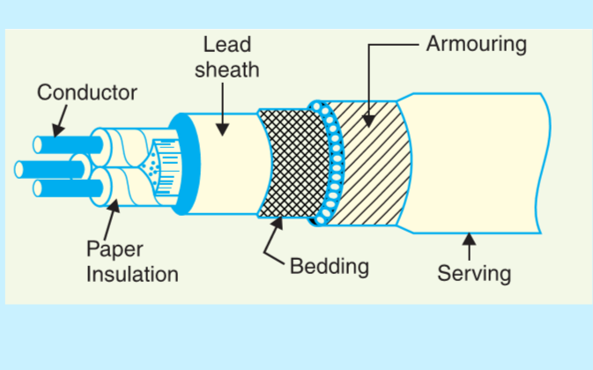
Parts of Cable

Slide 11
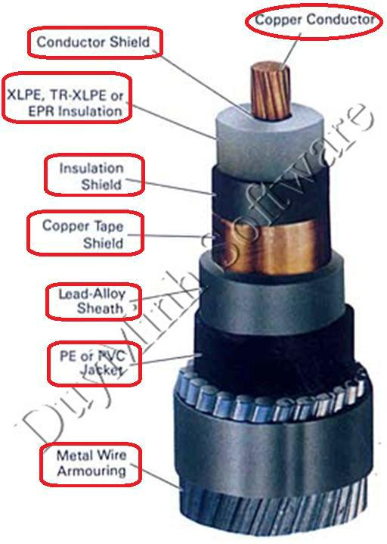
Parts of Cable

Slide 12
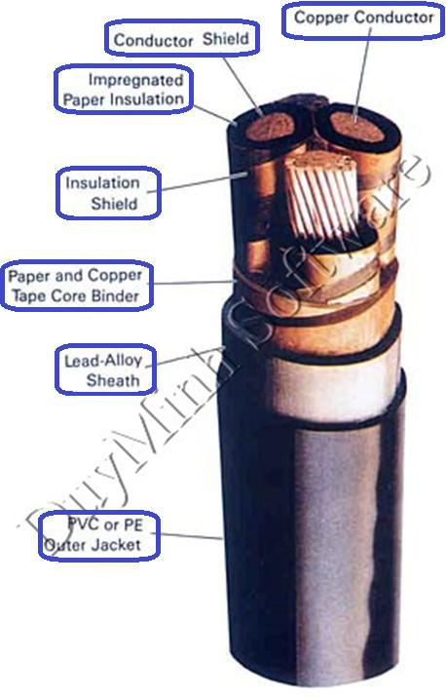

Slide 13
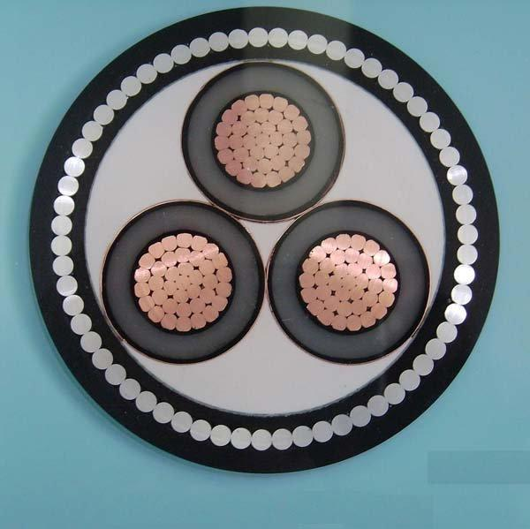
Filling Material
22kv Medium
Voltage Underground
XLPE Power Cable

Slide 14
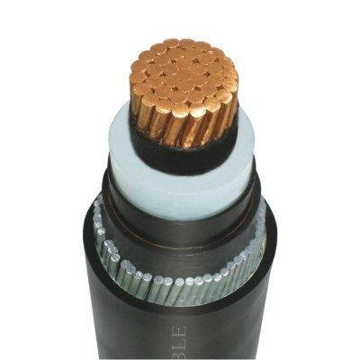
11kV Copper Core and
shield power cable 25mm

Slide 15
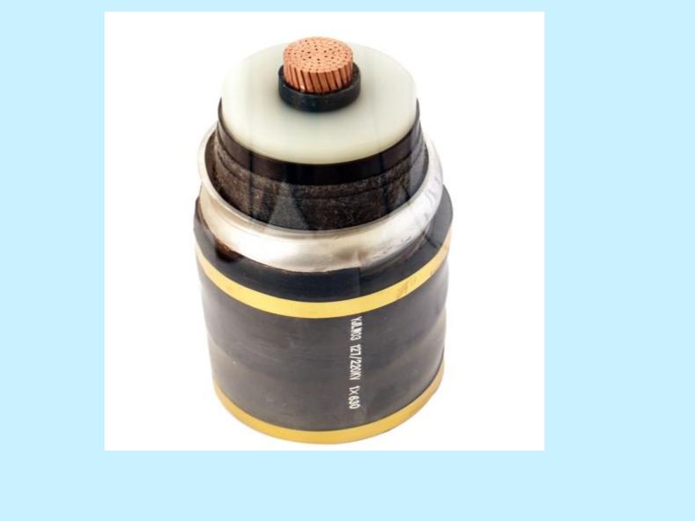
500 kV high voltage XLPE Cable

Slide 16
Construction of Cables
Cores of cables: A cable may have one or more cores depending upon the service for which it is being used. The conductor made of tinned copper or aluminum are usually stranded in order to provide flexible cable.
Insulation: Materials used for cable insulations are impregnated paper, varnish cambric or rubber mineral compound. The thickness of insulation must be able to withstand the level of voltage of cable.

Slide 17
Construction of Cables
Metallic Sheath: Protection of cable against moisture, gases and other chemical reactions i.e. alkalies present in soil is provided by metallic sheath. It is usually of lead or aluminum.
Bedding: A sheet of fibrous material (jute or hessian tape) is used over the metallic sheath to protect it from rough handling as well as corrosion and mechanical injury.

Slide 18
Construction of Cables
Armouring: It is optional which is used over bedding in some type of cables. It is one or two layers of galvanized steel wire or steel tape.
Serving: An overall protection is provided to whole cable made of some fibrous material like that of bedding. It provides protection against atmospheric conditions.

Slide 19
Insulating materials for cables
The proper choice of insulating material for cables is of considerable importance. The insulating materials used in cables should have the following properties:
High insulation resistance to avoid leakage current
High dielectric strength to avoid electrical breakdown
High mechanical strength to withstand mechanical handling

Slide 20
Insulating materials for cables
Unaffected by acids and Alkalies to avoid chemical reactions
Non-hygroscopic i.e. it should not absorb moisture from air or soil. The moisture decreases the insulation resistance and hasten the breakdown of the cable. In case of hygroscopic it must be covered with water proof sheet
Non-inflammable
Low cost

Slide 21
Types of Insulation Materials
Rubber: Rubber may be obtained from milky sap of tropical trees or it may be produced from oil products. It has relative permittivity varying between 2 and 3, dielectric strength is about 30kV/mm and resistivity of insulation is 10¹⁷ Ω-cm. Major drawbacks viz., readily absorbs moisture, maximum safe temperature is low (about 38ºC), soft and liable to damage due to rough handling and ages when exposed to light.

Slide 22
Types of Insulation Materials
Vulcanized Rubber: It is prepared by mixing pure rubber with mineral matter such as zine oxide, red lead etc., and 3 to 5% of Sulphur. The V R insulation is generally used for low and moderate voltage cables.

Slide 23
Types of Insulation Materials
Impregnated Paper: It consists of chemically pulped paper and impregnated with some compound such as paraffinic. It has the advantages of low cost, low capacitance, high dielectric strength and high insulation resistance. The only disadvantage is that paper is hygroscopic

Slide 24
Types of Insulation Materials
Varnished Cambric: It is a cotton cloth impregnated and coated with varnish. As the varnished cambric is hygroscopic, therefore, such cables are always provided with metallic sheath. Its dielectric strength is about 4 kV/mm and permittivity is 2.5 to 3.8.

Slide 25
Types of Insulation Materials
Polyvinyl chloride (PVC): This insulating material is a synthetic compound. It has high insulation resistance, good dielectric strength and mechanical toughness over a wide range of temperatures. As the mechanical properties (i.e., elasticity etc.) of PVC are not as good as those of rubber, therefore, PVC insulated cables are generally used for low and medium domestic lights and power installations.

Slide 26
Classification of Cables
Cables for underground service may be classified in two ways according to:
Type of insulating material
Voltage Level
Number of Cores

Slide 27
Classification of Cables
Classification of cables according to voltage level are as follow:
Low Tension (L.T) Cables- Up to 1 kV
High Tension (H.T) Cables- Up to 11 kV
Super Tension (S.T) Cables- Up to 22kV to 33kV
Extra High Tension (E.H.T) Cables- from 33kV up to 66kV
Extra Super Voltage Cables- Beyond 132 kV

Slide 28
Classification of Cables
Classification of cables according to core type are as follow:
Single core
Two core
Three core
Four core
For a 3-phase, either 3 single core or one three core cable can be used depending upon the operating voltage and load demand.

Slide 29
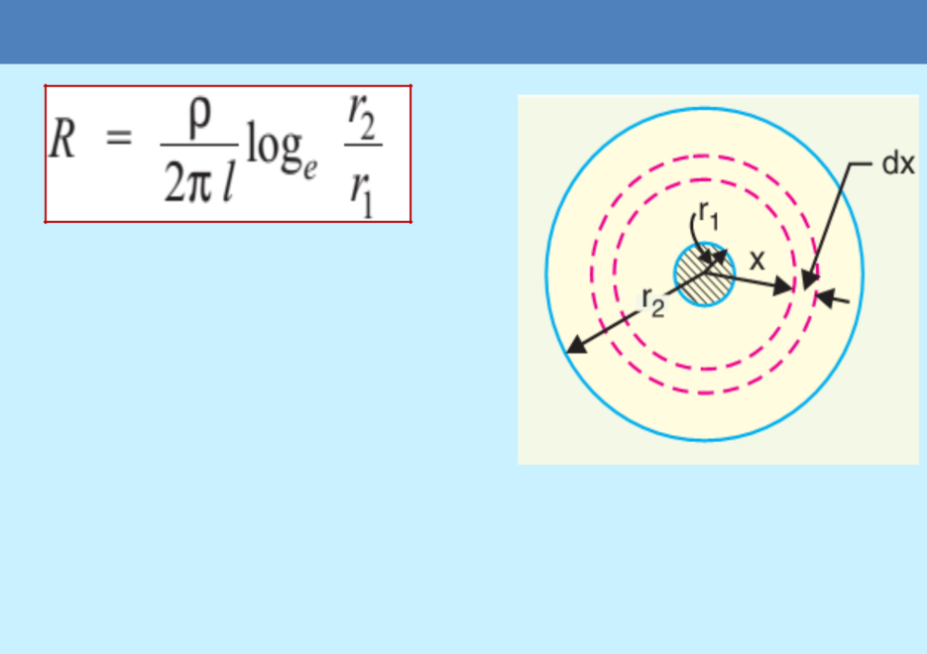
Insulation resistance of a single core cable
This shows that insulation resistance of a cable is inversely proportional to its length. In other words, if the cable length increases the insulation resistance decreases and vice-versa.
Leakage resistance is inversely proportional to the length of cable.
The resistance of the core of cable is proportional to the length of cable.

Slide 30
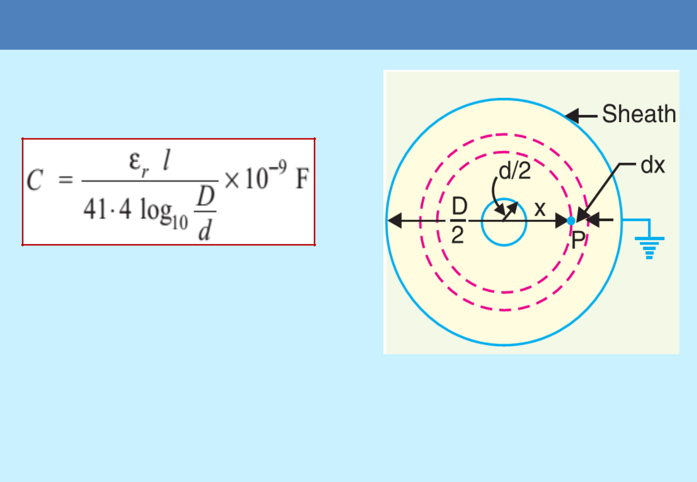
Capacitance of single core cable

Slide 31
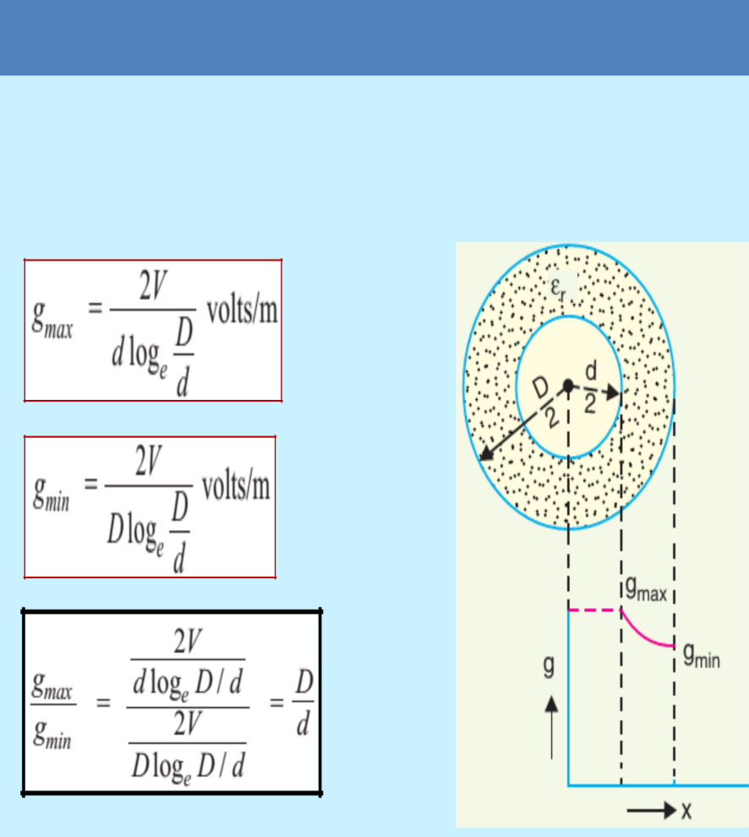
Dielectric Stress in a Single Core Cable
The insulation of cable is subjected to electrostatic forces known as dielectric stress.
Dielectric stress is in fact the potential gradient (or electric field intensity) at that point.

Slide 32
Grading of Cable
The process of achieving uniform electrostatic stress in the dielectric of cables is knows as the grading of cables.
(g-max) at the conductor surface and decreases as we move towards the sheath.
To overcome these disadvantages it is necessary to have a uniform stress distribution in cable.
The following are the two main methods of grading of cables: (i) Capacitance grading (ii) Inter-sheath grading.

Slide 33
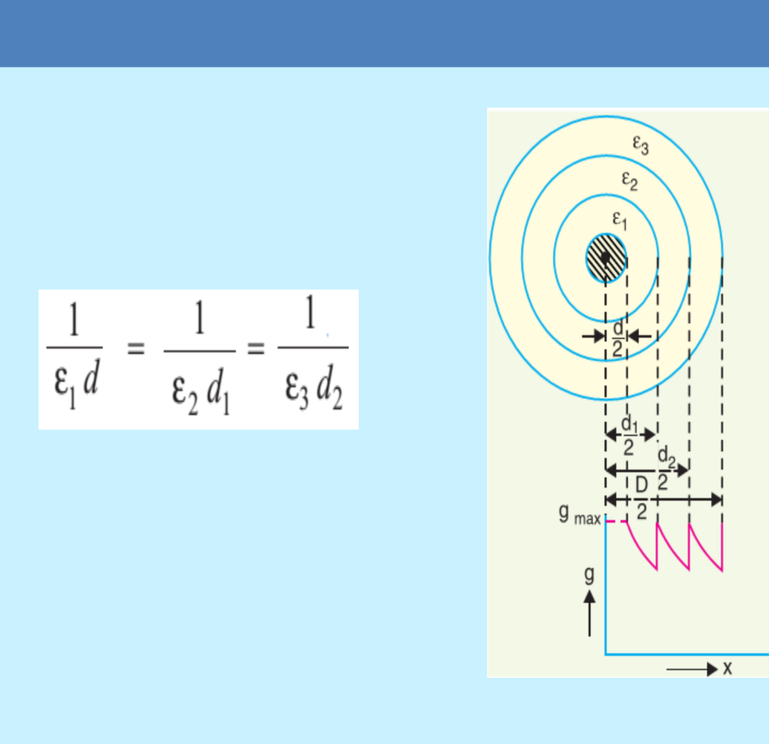
Capacitance Grading
The process of achieving uniformity in the dielectric stress by using layers of different dielectric is known as capacitance grading.
Its main disadvantage is that there are few high grade dielectric of reasonable cost whose permittivity vary over the required range.

Slide 34
Inter-sheath Grading

Slide 35
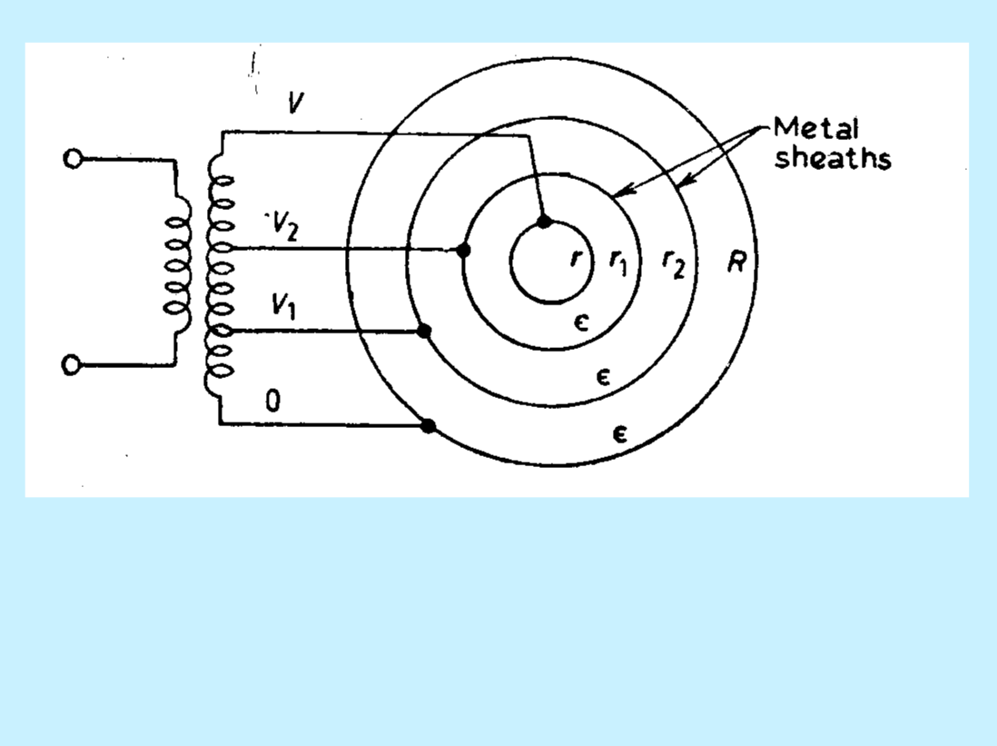
Inter-sheath Grading
In this method of cable grading, a homogeneous dielectric is used, but it is divided into various layers by placing metallic inter-sheaths between the core and lead sheath.

Slide 36
Inter-sheath Grading
Intersheath Grading is a method of creating uniform voltage gradient across the insulation by means of separating the insulation into two or more layers by thin conductive strips.
These strips are kept at different voltage levels through the secondary of a transformer.

Slide 37
Capacitance of 3-core Cables
The capacitance of a cable system is much more important than that of overhead line because in cables (i) conductors are nearer to each other and to the earthed sheath (ii) they are separated by a dielectric of permittivity much greater than that of air.

Slide 38
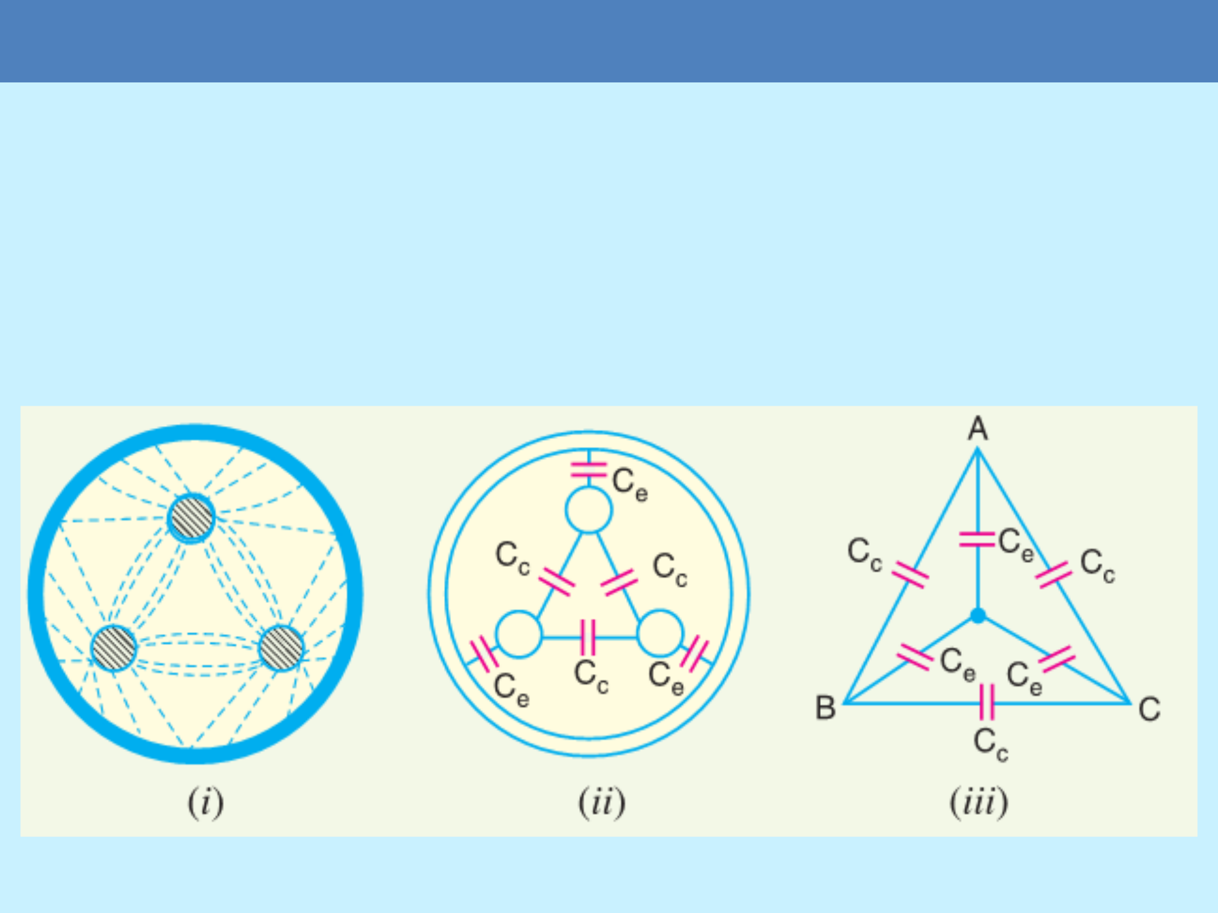
Capacitance of 3-core Cables

Slide 39
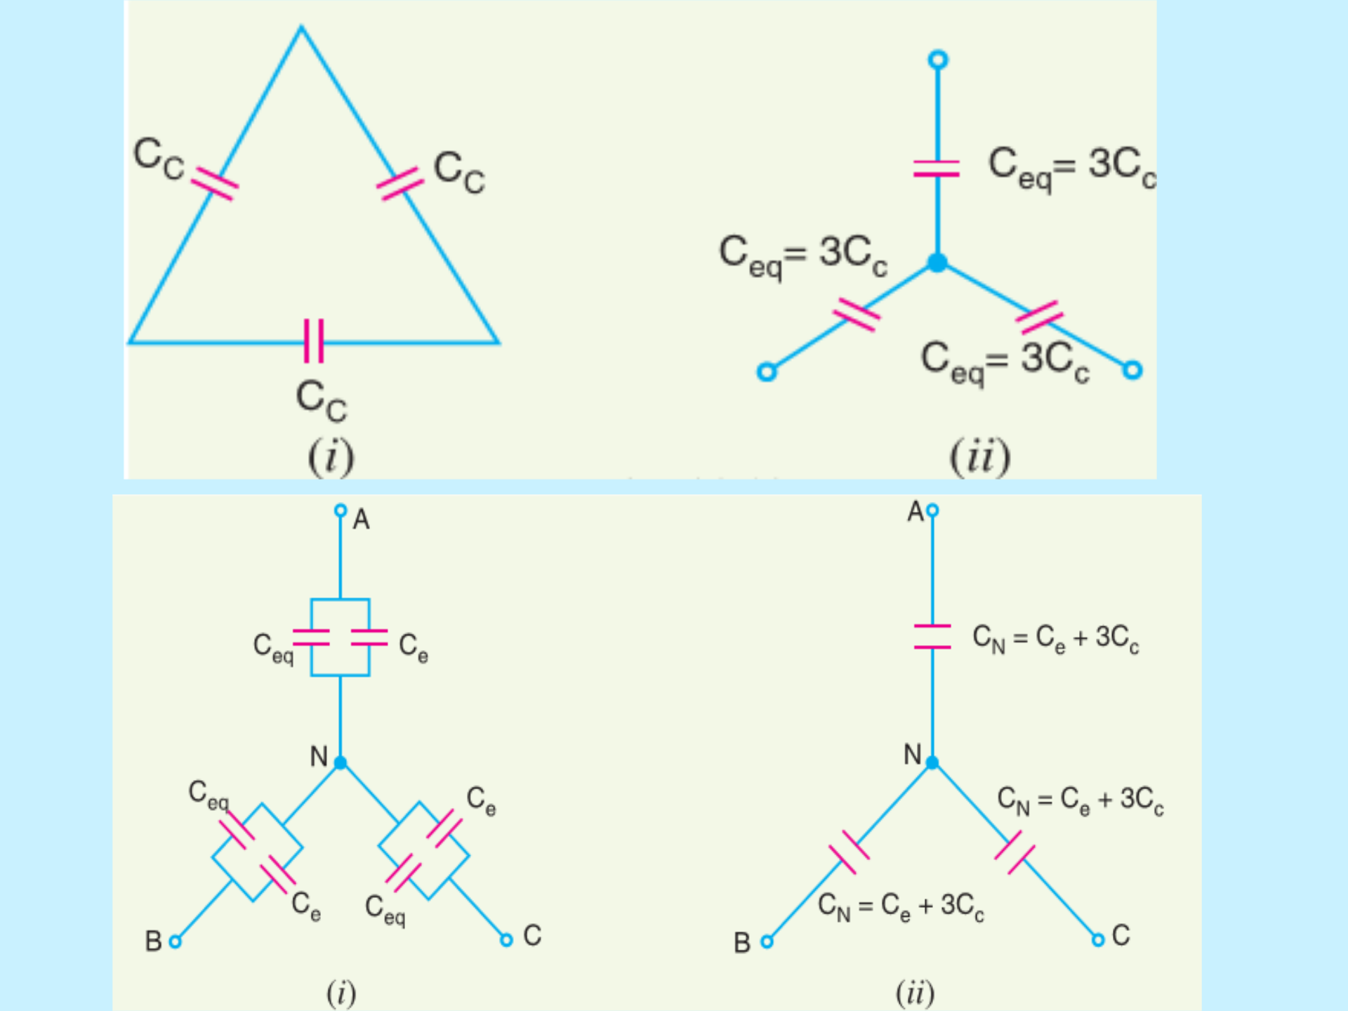
Capacitance of 3-core Cables

Slide 40
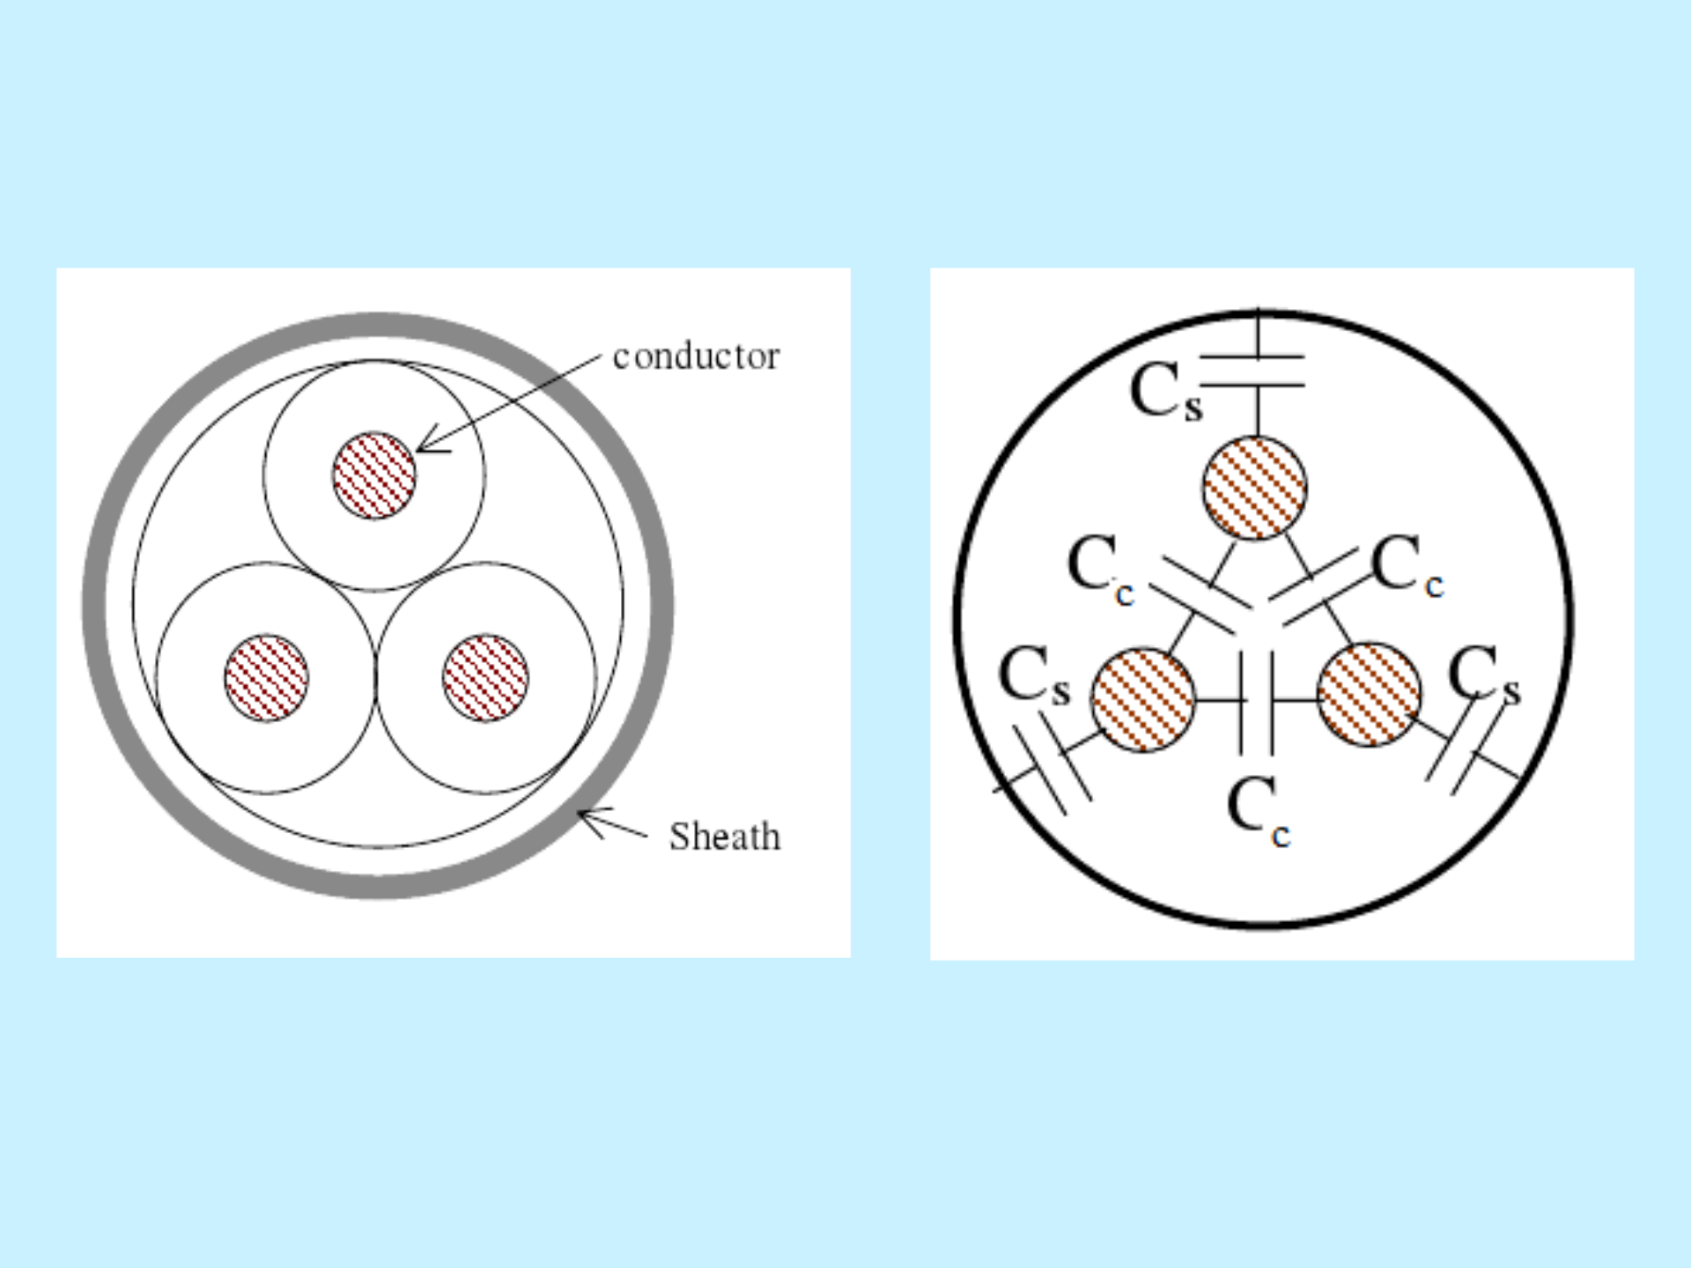
Capacitance of 3-core Cables

Slide 41
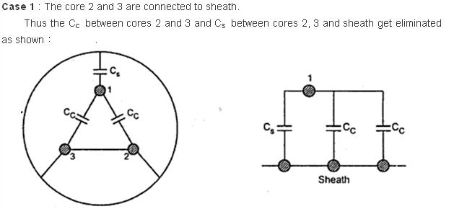
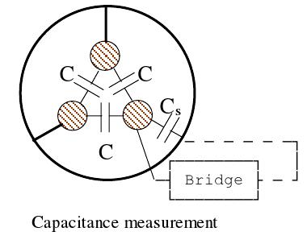
Capacitance of 3-core Cables
Cy=Cs+2Cc

Slide 42
Capacitance of 3-core Cables
Cx = 3xCs

Slide 43
Thank you !
Feel free to ask your queries 24/7 through whatsapp voice messages.
Stay Home-Stay Safe.

