Slide 1
PRESENTATION
by
1. Hamid jawad.
2. Ehsan Ali.
3. Hafiz Sajid Ur Rehman.
4. Umair Ashiq
Topic:
Fecal sampling
Present To:
Dr Imtiaz Hussain
University college of agriculture, University of sargodha.

Slide 2
Why do we take Fecal sample?
We take fecal sample for performing different tests in laboratory.
We mainly focus in tests to checking the eggs of different parasites in different animals.
To diagnose a certain disease we test the parasites or microbes of that disease.

Slide 3
FECAL SAMPLING
It is a practice that performs to collect a sample of fecal material or animal dung from suspected animals.
Due to no access on providing pure germless feed to animals, we collect the fecal sample to examine the parasites.
Because which feed that animal intakes that feed residues excrete from the excretory system in the form of excretory product or faeces.

Slide 4
EQUIPEMENTS
Pre labelled sample bottles/bags/trays: laboratories usually prefer the containers to be numbered from 1, rather than with sheep ear tag numbers or names of goats.
Recording sheet with sample container numbers,date and a space to record the animal's ear tag number, name or group .
Smooth close-fitting gloves.
Bucket of soapy water.
A rope & place to restrain animals, such as a narrow race tree or pole etc.

Slide 5
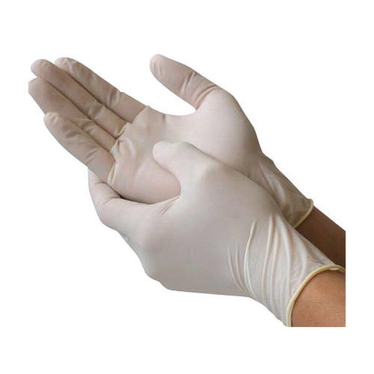
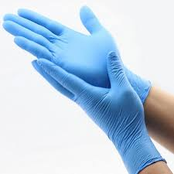

Slide 6
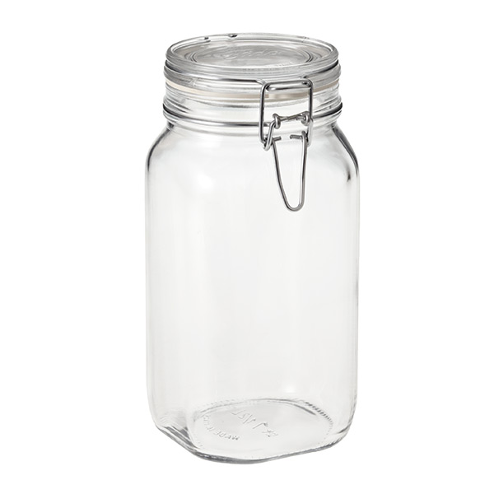
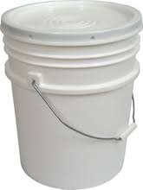

Slide 7
Tow method of sampling
Generally there are two types of collecting the sample.
1st method of collecting the sample, when animal normally excrete the feces, simply wear gloves and collect sample by hand.
Other way to collect the sample is by entering the fingers into rectum of the animal to avoid foreign contamination.
In first method there is a chance of foreign contamination or foreign object in the fecal material

Slide 8
Precautions and tips
Sample collected directly from rectum.
Sample collection is very difficult when the feces are very runny. So prior to a week of sample collection, give more roughages to animal so that feces become firm and normal activity of excretion is resulted.
During sample collection there is a risk of infectious organisms may harmful even for sampler.
Sample must be collected in clean container which traps the moisture.
Sufficient amount of sample should be collected, proper examination of sample should feasible.

Slide 9
Precautions and tips
It is essential to label the container with number, name and date of collection.
Sample should directly preserve in cold container after collection.
Sample should transport carefully till the laboratory for testing.
For prolonged storage of sample farmalin 3-10% is added.
In each step wash the hands properly with soapy water.

Slide 10
OTHER USEFUL TIPs
Lubricant: paraffin or vegetable oil can be used.
Table to hold the bucket and lubricant (or a trolley that can be moved along the race).
Large ice bricks for samples (if collecting for more than an hour in hot weather).
An assistant (to record and pass containers).
Remove rings on your collection hand and ensure your fingernails are short and smooth.

Slide 11
Handling & Restraining
Haltare
Rope Tied Both Legs

Slide 12
WORKING PROCEDURE
Wearing gloves insert the fingertips of your collection hand into the lubricant.
(this is optional but can make the process easier).
Insert the pointer or middle finger into the rectum carefully.
Keep the finger parallel to the wall of rectum.
This is why to avoid pushing dung further back or tearing the rectum.
Some people insert a spoon or a tube into the rectum, however these are not feasible.

Slide 13
WORKING PROCEDURE
Feel for dung: firm or hard pellets will be easy to feel if present, but very soft or watery dung may be difficult to feel.
Carefully hook a fingertip—not the whole finger, so as to avoid pushing through the wall of the rectum.
Repeat this, applying more lubricant as needed, until sufficient dung is collected.
For people with thin fingers, and if the animals are not small, using both fingers together may yield more dung.

Slide 14
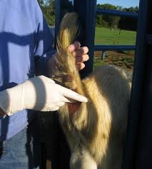
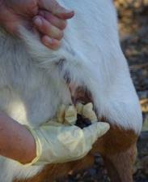

Slide 15
WORKING PROCEDURE
If no dung can be felt, set that animal aside for 15 minutes or more before trying to collect again.
rinse the gloved hand in the soapy water, replacing the water as it becomes too dirty.
If a large number of samples are to be collected on a hot day, place them into ice bricks or refrigerator.

Slide 16
Effect of amount 0f water
Normal amount of feces varies according to animal species, amount of feed intake, and amount of water intake.
Abnormal values of water.
Increase…………………….Diarrhea
Decrease……………………Constipation
Absence …………………….Intestinal obstruction

Slide 17
Consistency of feces
Depends upon:
Water content
Type of feed
Rate of passage of ingesta via digestive tract.
Watery feces observed in cases of diarrhea.
Milk fed animals excrete feces with medium consistency.
Dehydration causes the formation of firm balls of feces.
the presence of undigested food material indicates the improper mastication and digestion.

Slide 18
Microscopic animal fecal analysis
Coccidia is a protozoan parasite. Coccidiosis, the malady caused by this protozoan, can be one of the most economically devastating diseases in many ...animals.

Slide 19
Common Parasites in animals
1) Hookworms.
Hookworms are small, thin worms that attach to the wall of the small intestine and suck animal blood.Sign of hookworms infection include anemia,diarhea,weight loss,weakness and blood in the feces.

Slide 20
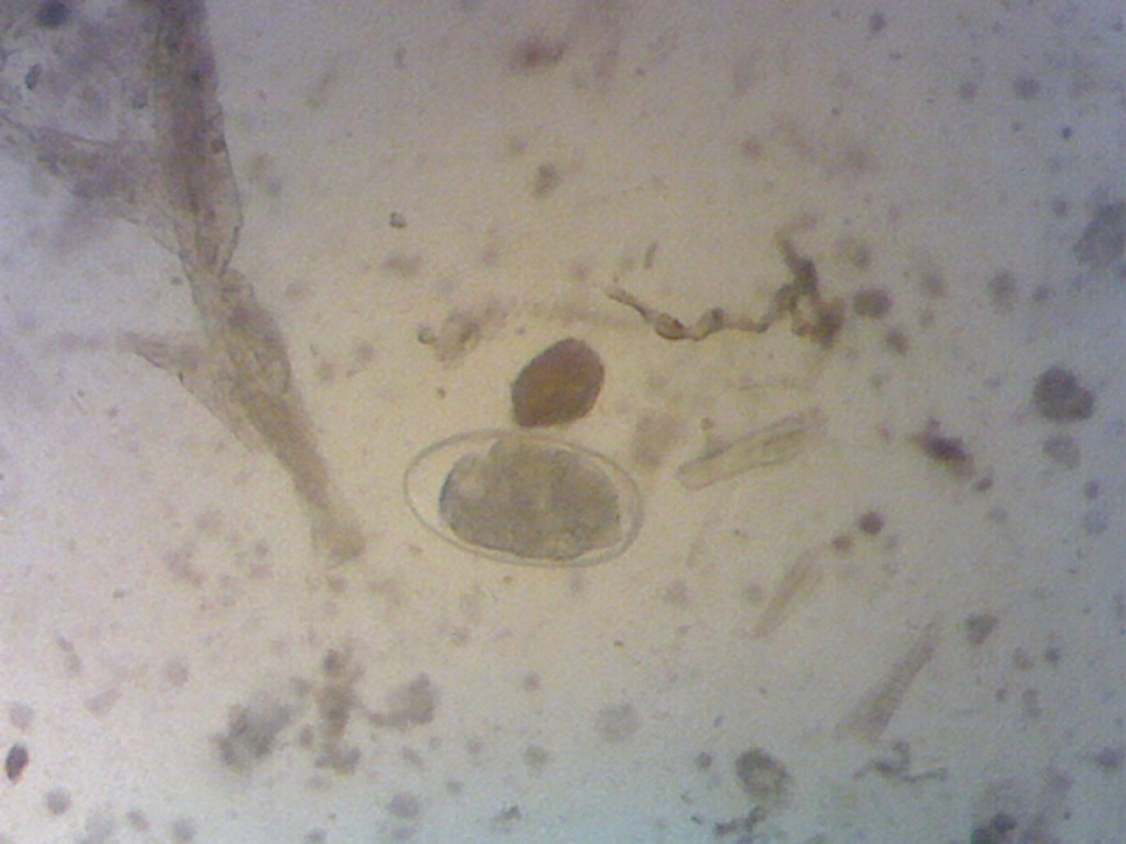
Nematodes – Sheep/Goats

Slide 21
2)Roundworms.
Roundworms infect the intestinal track,most pupies and kittens are born with roundworm larvae already in their system.Roundworms can often be seen by nacked eye in pets.These can passed to human throgh skin contact it infected feces and soil causing damage to the liver, eyes and central nervous system.

Slide 22
3)Whipworms.
they live in animal large intestine and shed fewer eggs then other types of intestinal parasite and can be harder to detect by stool sample. Animal with with severe infestation suffer from chronic weight loss,diarrhea,and mucous-coated stool.

Slide 23
Trichuris (Whipworm)- Sheep

Slide 24
4)Tapeworms.
Tapeworms are transferred via the fecal-oral route,ingested fleas infested with tapeworms eggs .Tapeworms can grow to up to 6 inches in the animal intestine.symptoms general itchiness around the anal area,butt scooting,distended abdomen.

Slide 25
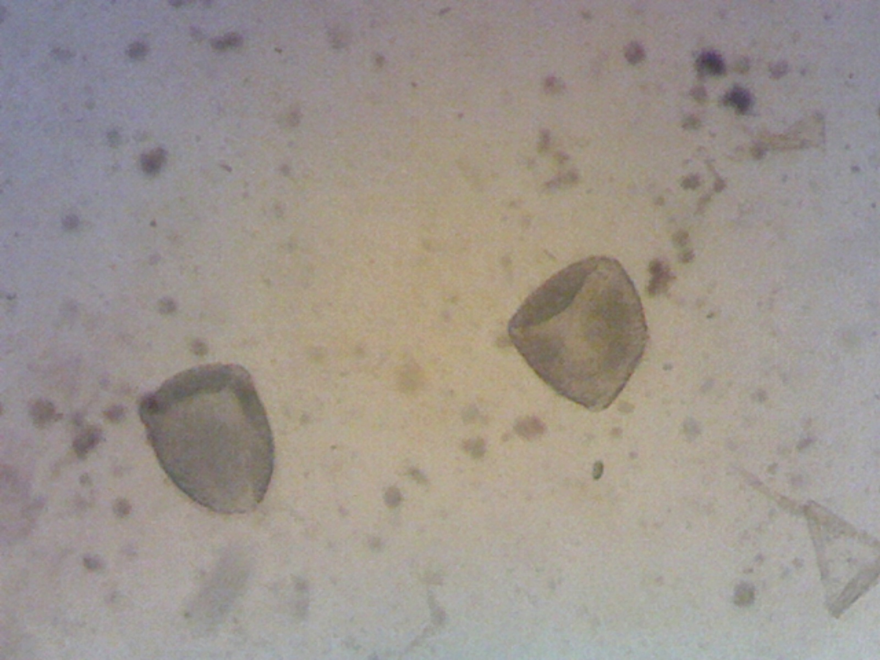
Tapeworms: Sheep/Goats

Slide 26
5)Giardia
Giardia is different from the rest of the parasites.it is not a worm it’s a single celled protozoan.The active form of the parasite lives in the intestine,the inactive form is encased in a hard shall(cysts)and can live outside of a host.Animal contract giardia by ingesting these cysts.Symptoms include vomting,greasy or foul-smelling feces and diarrhea.

Slide 27
Parasite Identification: Camelids

Slide 28
Parasite Life Cycle

Slide 29
Impact on Livestock
Large financial impact on the livestock industry
Responsible for death, disease and reduced productivity
Results in increased costs for veterinary support and feed
Rescue treatment can result in loss of organic status of the animal

Slide 30
General sample preparation:
Weigh sample (2 or 4 grams)
Mix with flotation solution
Strain into second cup
Stir well and load first chamber
Stir well and load second chamber
Place on microscope and set timer (minimum 2 minutes)
Count both chambers – count nematodes, tapes, coccidia separately
Take total count and multiply by appropriate multiplier

Slide 31
Capital equipment for FEC:
McMaster slide
Weigh scale
Microscope
Tea strainers
Hand counter
Timer
Measuring device such as a syringe, graduated cylinder or cup

Slide 32
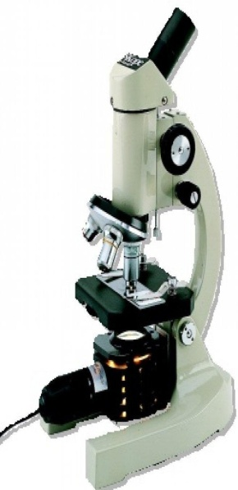
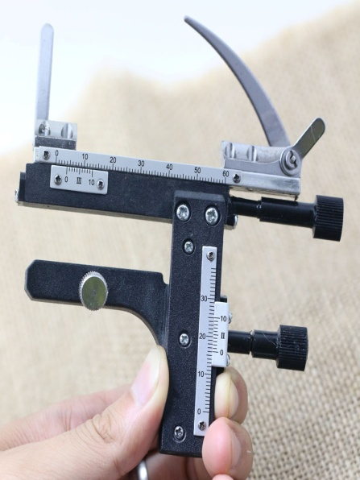
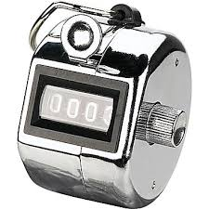
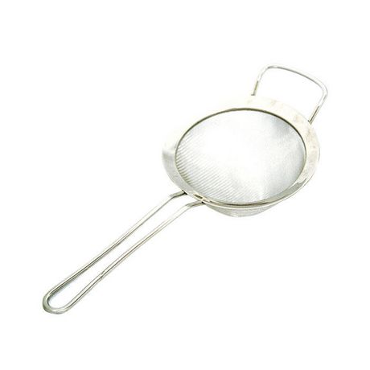
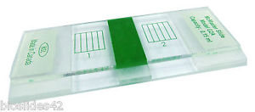
Capital Equipment

Slide 33
FECAL TESTING

Slide 34
McMaster Slide

Slide 35
Method:
There are 3 main methods to analysis fecal sample
1)Direct fecal sampling
2)Floatation solution
3)Sadimentation

Slide 36
Procedure
1)1gm sample,1-2 drops of water,mix it, use coverslap on slide ,Focus 10x,and see the sample on 40x
2)On the basis of specific gravity,3gm Nacl in 100ml of water solution is prepared,take 1gm of sample use 15ml solution in test tube,wait for 30 minutes,on top side coverslip and see on 40x
3)3gm sugar plus 100 ml of water(wt by volume)mix it specimen set at bottom,use pipet to take sample and see under microscope.

Slide 37
Parasite Identification: Ruminants

Slide 38
Parasite Eggs: Ruminants

Slide 39
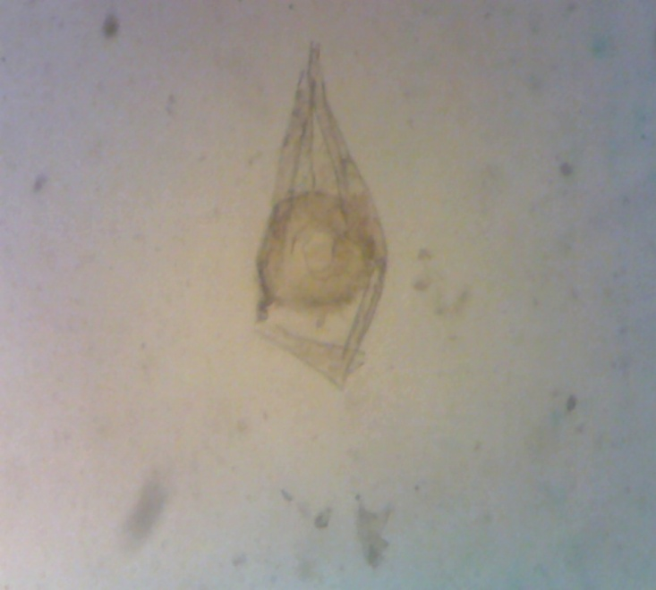
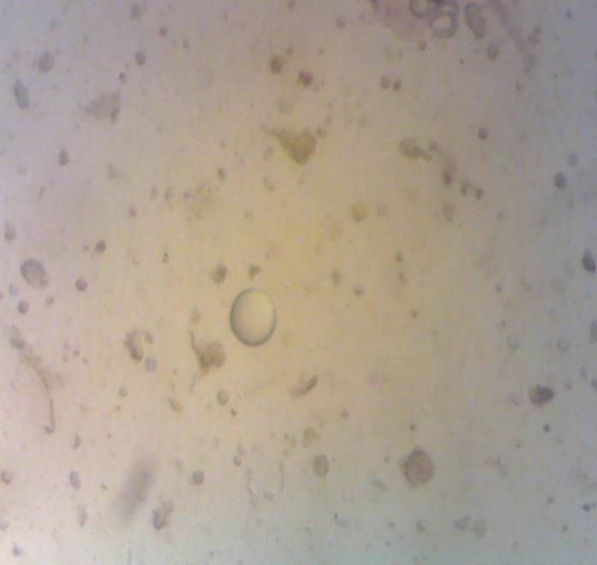
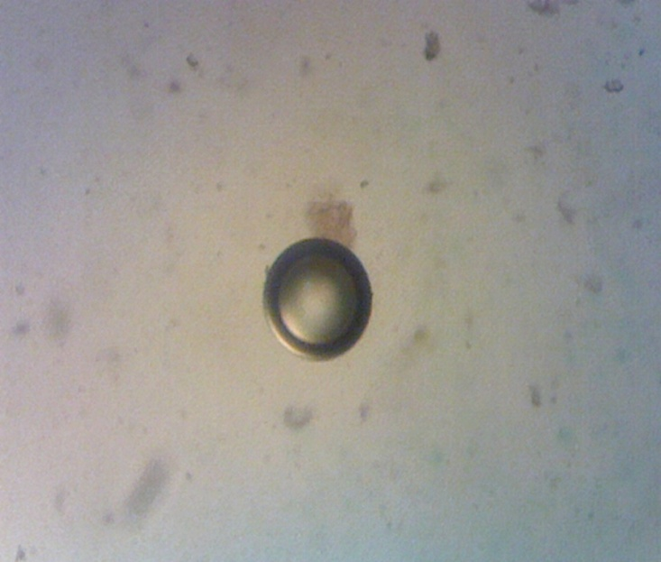
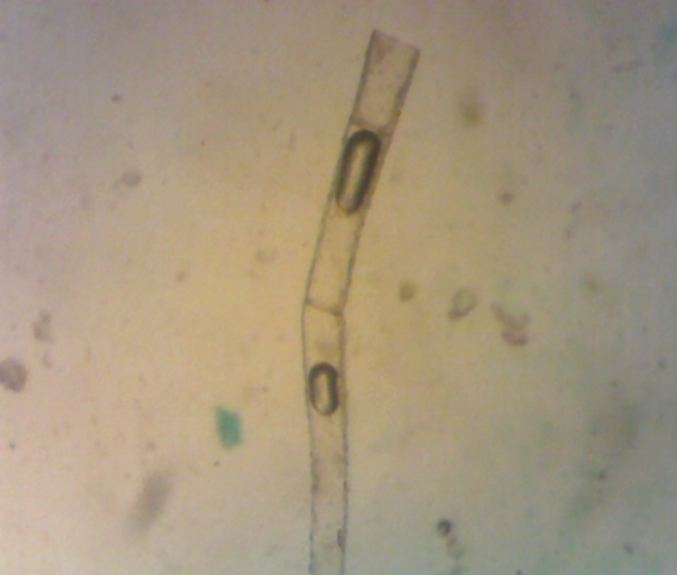
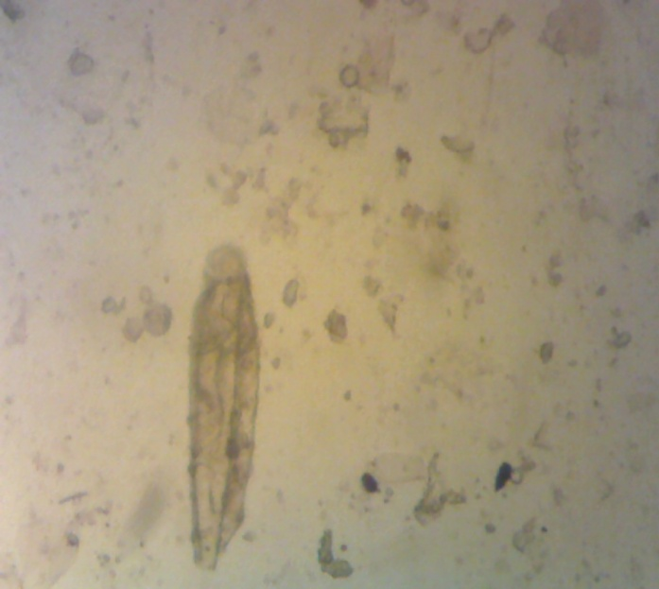
When you first look down the scope:

Slide 40
Parasite management includes:
pasture management
targeted treatment
maintenance of refugia
stock selection
proper nutrition
proper drenching technique
quarantine new and returning stock
stock management

