Slide 1
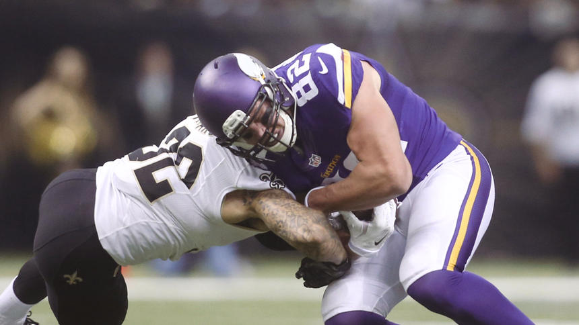

Slide 2
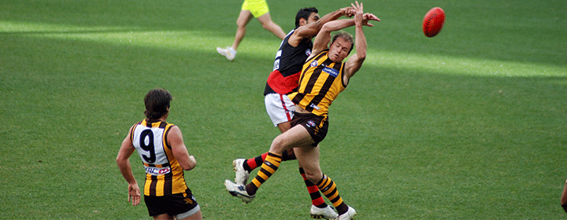

Slide 3
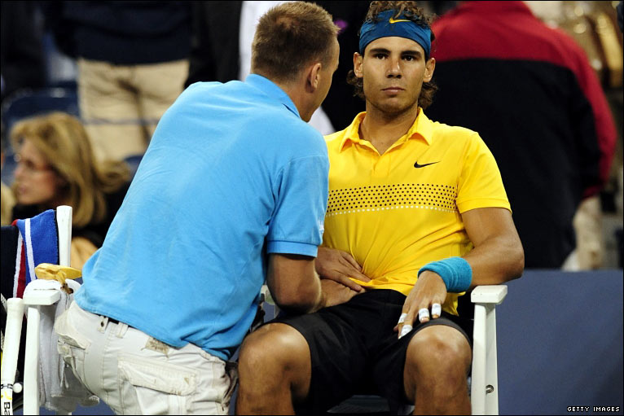

Slide 4
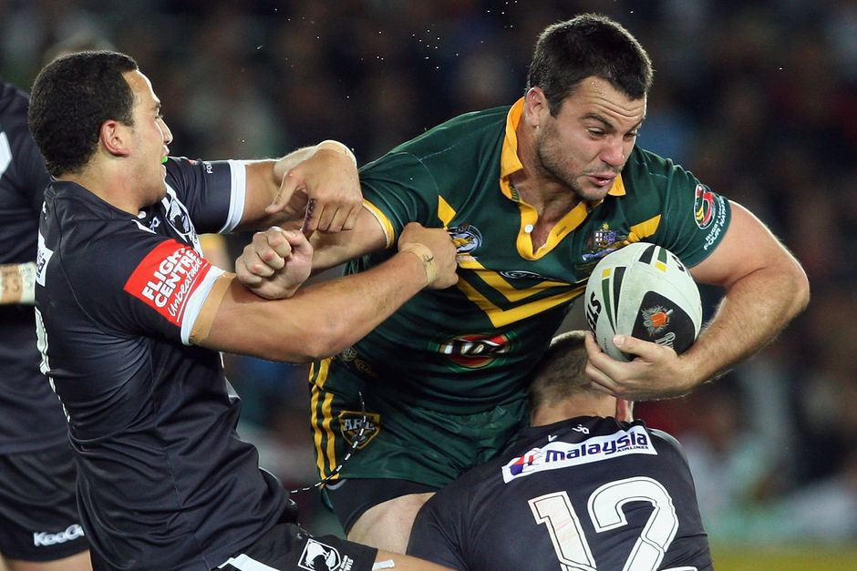

Slide 5
Abdominal Trauma Care

Slide 6
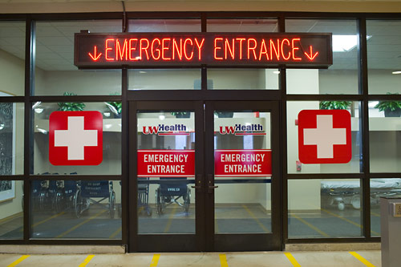
“Golden Hour”
ACS concept that deaths & complications are reduced when trauma victims receive definitive treatment within the 1st hour after injury
Notes:
American college of surgeons

Slide 7
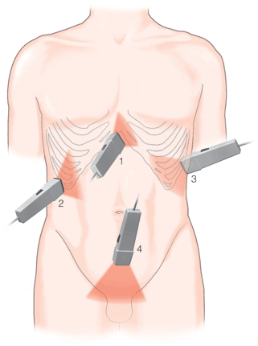
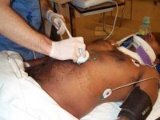
Definitions
Cullen’s Sign – Irregular hemorrhagic patches around the umbilicus
Grey Turner Sign – Bilateral flank bruising or ecchymosis. A classic finding of bleeding into the retroperitoneum around the kidneys and pancreas. (hemorrhagic pancreatitis)
Kehr’s Sign – Referred pain in the L shoulder d/t irritation of the adjacent diaphragm
(Splenic injury,free air, int abd Bleeding)
FAST – Focused Assessment with Sonography in Trauma - Identify free fluid (usually blood) in the peritoneal, pericardial, or pleural spaces

Slide 8
Rebound Tenderness

Slide 9
A example of Kehr’s sign would include right shoulder tip pain associated with right upper quadrant abdominal pain in a person with cholycystitis.
Another example of Kehr’s sign includes violent left shoulder tip pain post abdominal trauma, which often indicates damage to or a ruptured spleen.

Slide 10
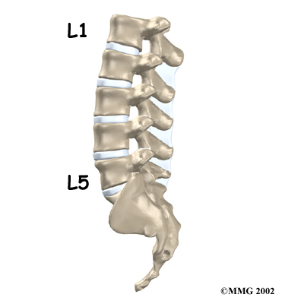

Slide 11
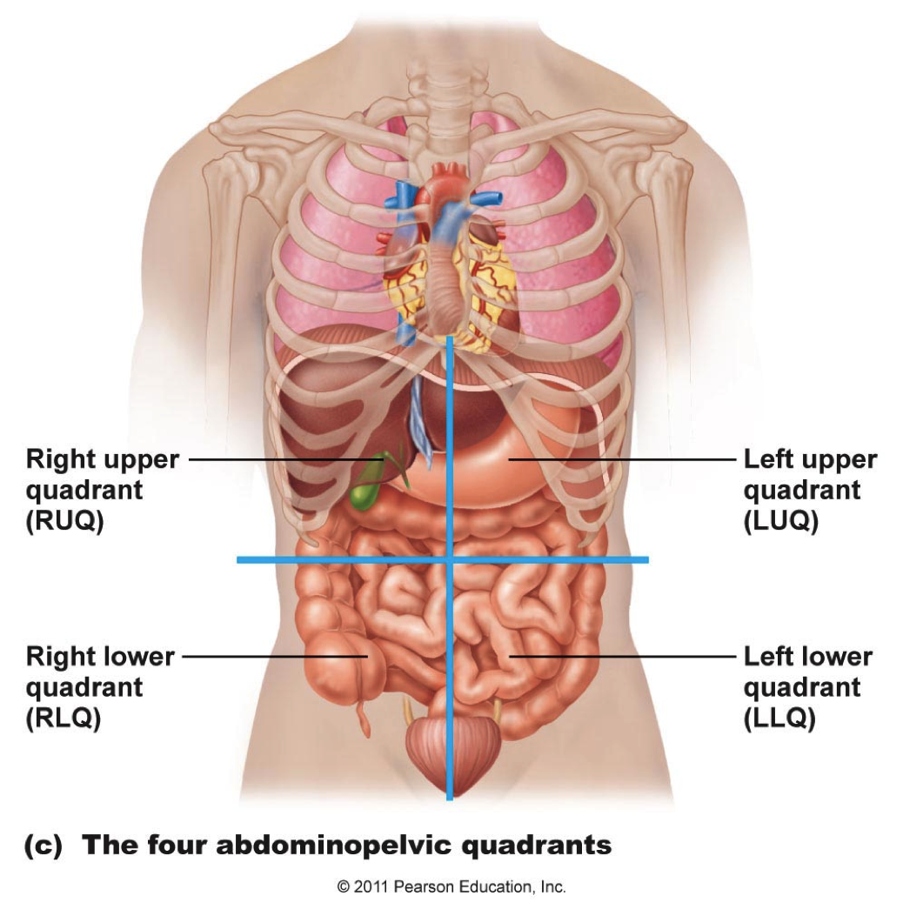
Abdominal Quadrants & Organs

Slide 12
Mechanisms of Injury
Blunt Trauma
Compression from crush between solid objects such as the steering wheel/seat belt & the vertebrae
Shearing causing a tear or rupture from stretching @ points of attachment
Penetrating Trauma
Stab Wounds
Gunshot Wounds
Blast
Impalement - Missiles

Slide 13
Abdominal Injuries
Subtle sometimes diffuse signs & symptoms
Organ injuries associated with location & mechanism of injury
Most frequent cause of potentially preventable death!!!

Slide 14
Abdominal Wall Contusion
The most common traumatic injury in sports is an abdominal wall contusion. Contusions in the region of the epigastrium may result in transient dyspnea (“getting the wind knocked out”).
This injury can usually be treated with a period of rest.
A blow to the abdomen can also cause a hematoma
in the rectus abdominus, which can mimic an acute abdominal internal injury.

Slide 15
Abdominal Wall Contusion
Complain of sudden abdominal pain with rapid swelling but will improve by being placed in postures that relax the abdominal wall.
Forward flexed position.
Active contraction of the abdominal muscles will worsen symptoms. Initial icing to reduce bleeding.

Slide 16
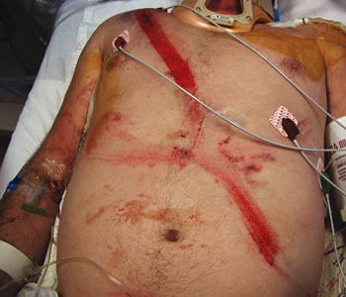
Signs of Abdominal Trauma
MOI – Rapid deceleration, compression forces
Bent steering wheel
Soft tissue injuries to the abd, flank, or back
Shock w/o obvious cause
Seat belt signs
Peritoneal signs

Slide 17
Treatment of Abdominal Trauma
Secure airway with spinal precautions
Provide ventilatory support
Wound management
Manage shock
Fluids
Rapid transport

Slide 18
Solid Organ Injuries
Spleen
Liver
Kidneys
Pancreas

Slide 19
Splenic Injuries
Associated with left rib 10-12 fxs, falls, contact sports, assaults
Most commonly injured organ from blunt trauma – Injured ~ 25% of blunt abdominal trauma & 7 % penetrating abdominal trauma
40% have no symptoms
Kehr’s Sign from hemoperitoneium
Bleeding may be contained by capsule

Slide 20
Ballone sign—Fixed dullness in the left flank and shifting position dullness in the right flank—has been described as an infrequent finding.
The capsule of the spleen can contain bleeding and physical examination findings are occasionally delayed in their presentation.
Plain x-rays may demonstrate an enlarged spleen if a
subcapsular hematoma with an intact capsule is present. An
enlarged spleen may also displace the stomach anteromedially and the left kidney, left transverse colon, and splenic
flexure inferiorly.

Slide 21
On x-ray, haziness of the abdomen,
bulging flanks, and displacement of small bowel loops are associated with signs of free peritoneal fluid, such as blood
Ultrasound
The “gold standard” test to evaluate an injury to the spleen is a CT scan. The majority of injuries to the spleen can be treated nonoperatively, with more than half of the higher-grade injuries managed nonoperatively

Slide 22
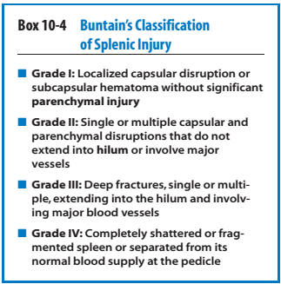

Slide 23
Splenic Injuries
Signs & Symptoms
Kehr’s sign
Signs of hemorrhage or shock
Tender LUQ
Abdominal wall muscle rigidity, spasm or involuntary guarding

Slide 24
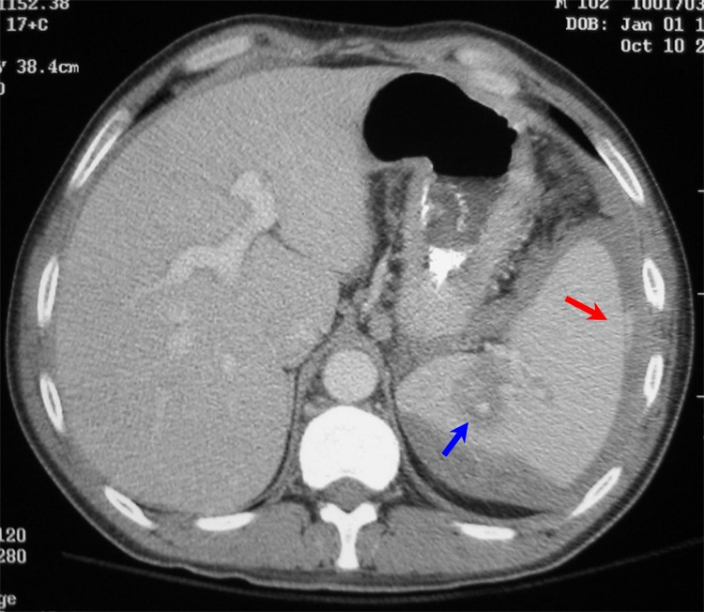
Splenic CT with Laceration & Blush

Slide 25
Splenic Injuries
Treatment
Avoid splenectomy if possible
Post splenectomy sepsis syndrome
Rebleeding risk highest in first 7 days
Embolization
Operative repair or splenectomy
Hospital Course & Concerns
Re-bleeding – Monitor Hct, base deficit, abdomin
Post spenectomy infection prevention
Pneumococcal Vaccine

Slide 26
Hepatic Injuries
Largest organ in the abdominal cavity
2nd most commonly injured intraabdominal organ
Blood or bile escape into peritoneal cavity
Associated with R 8-12 rib fractures
Blunt trauma (15-20%) from steering wheel or lapbelt
Penetrating trauma ~37% w/I 10% mortality
Subcapsular hematomas
Lacerations
Vascular injuries

Slide 27
Hepatic Injuries
Signs & Symptoms
RUQ penetrating or blunt trauma
RUQ pain
Abdominal wall muscle rigidity, spasm, or involuntary guarding
Rebound tenderness
Signs of hemorrhage or
shock

Slide 28
Hepatic Injuries
Treatment
Operative repair
Damage Control - Pack the liver to control bleeding & close at a later time
Hospital Course
Monitor for bleeding & bile leak
Open abdominal dressings
Conservative management

Slide 29
CT scan is regarded as the best test to evaluate
liver injuries and for the presence of blood in the abdomen.
Use of alanine aminotransferase (ALT) and aspartate aminotransferase (AST) has been shown to correlate with the presence of abdominal injury in both adults and children.

Slide 30
Retroperitoneal Injuries
Blunt (9%) or penetrating (11%) trauma to the abdomen or posterior abdomen
Kidney’s, uterus, pancreas, or duodenal injuries
Hemorrhage usually from pelvic or lumbar fractures
Grey Turner’s Sign ~ 12 hours or later
Cullen’s Sign ~ 12 hours or later

Slide 31
Renal Injuries
Pathophysiology
Solid organ
Most common injury is a contusion, then lacerations or fractures
Hemorrhage
Urine extravasation
Combination
Associated with posterior rib fractures & lumbar vertebral injuries
Deceleration forces may injure the renal artery

Slide 32
Renal Injuries
Classificaton
Minor –
Renal contusion with or w/o subcapsular hematoma from a
Minor Lac - Not including the collecting system
Major Lac -
Deep medullary laceration
Laceration into the collecting system with urinary extravasation
Shattered - Renal artery/ vein injury

Slide 33
Renal Injuries
Signs & Symptoms
Flank ecchymosis
Flank and abdominal tenderness
Gross or microscopic hematuria
Renal vein thrombosis following martial arts trauma is a rare entity and presents with flank pain and microscopic hematuria.
CT scan is diagnostic.

Slide 34
Renal Injuries
Treatment
Non-operative
Operative repair or Nephrectomy
Hospital Course
Monitor urine output for volume & bleeding
Monitor for & treat shock

Slide 35
Pancreatic Injuries
MOI
Blunt trauma – Compression
Steering wheel
Handlebar
Penetrating injury in the LUQ, flank, back
Stab wound

Slide 36
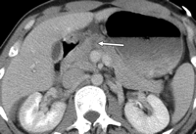
Pancreatic Injuries
Signs & Symptoms
Seatbelt Sign or flank brusing
Hemorrhagic shock d/t location near great vessels
Peritoneal Signs
Not immediately recognized
Tender LUQ
Abdominal wall muscle rigidity, spasm or involuntary guarding

Slide 37
Serum amylase levels can be diagnostic, but the levels are often slow to rise.
CT scan is the initial imaging study of choice
and can show lacerations of the pancreas but may not diagnose injuries to the pancreatic duct, which often require endoscopic retrograde cholangeography (ERCP).

Slide 38
Pancreatic Injuries
Treatment
Non-operative
Operative repair, drains subtotal pancreatectomy
Hospital Course
Monitor for fistulas, abscesses, sepsis
Monitor pancreatitis

Slide 39
Intestinal Injuries
Injury to the duodenum and jejunum rarely is reported with abdominal trauma in sports.
Duodenal injury is most commonly associated with a direct blow to the epigastric area and often is found in conjunction with an injury to the pancreas. CT scan with contrast is considered the best test to evaluate
for this injury.
Jejunal injuries are also extremely rare and have variable
presentations. In some cases athletes have returned to
play, only to have symptoms after play and ultimately require surgery.

Slide 40
Appendicitis
Right lower quadrant tenderness, abdominal rigidity, guarding, rebound tenderness, pain aggravated by coughing or movement, and duration of pain are the classic findings on examination and are the most common findings predicting appendicitis.
Symptoms of loss of appetite, nausea, and a low-grade fever are often present at the onset, although they are passed over until progression of the clinical picture occurs.
Pain that begins in the periumbilical area and then shifts to the right lower quadrant of the abdomen is also highly predictive

Slide 41
Appendicitis
A complete blood count, urinalysis, amylase, liver function studies, erythrocyte sedimentation rate, C-reactive protein, and potentially a CT scan.
The most crucial issue in the management of appendicitis concerns transfer to a hospital and, ultimately, whether the patient needs surgery

Slide 42
Ectopic Pregnancy
Ectopic pregnancy is the implantation of a fertilized ovum outside of the endometrial cavity .
The normal site of ovum implantation is in the uterus.
An ectopic pregnancy almost always involves implantation of the ovum in a fallopian tube, although other sites are possible.
If the pregnancy continues and the fallopian tube ruptures, there may be life-threatening intraabdominal bleeding.

Slide 43
Nontraumatic Abdominal Injuries
Marathon pancreatitis is a rare condition that presents with abdominal pain during a race and becomes progressively more painful on completion of the race. The etiology is unknown, although some authors postulate dehydration and others suggest ischemia.
It appears to be more common in females and mostly in younger runners. CT scan demonstrates edema of the pancreas, and blood tests document injury to the pancreas.

Slide 44
Omental infarction, or omental torsion, is an acute vascular disorder which compromises tissue of the greater omentum—the largest peritoneal fold in the abdomen.
in massive intraabdominal bleeding requiring laparoscopy.
Pubic symphysis staphylococcal infection after marathon running has also been described with patients presenting with pelvic, abdominal, and hip pain accompanied by fever and pubic symphysis pain.

Slide 45
Ultrasound and CT scan were normal, but magnetic resonance imaging (MRI) of the pubic symphysis clearly demonstrated the infection.
Must be distinguished from mechanical pubic symphysitis, and a history of infectious symptoms such as chills, sweats, and fever should be a required part of the history of all patients with pubic symphysitis.

Slide 46
Ectopic Pregnancy
It is a major cause of morbidity and mortality in women and, if undiagnosed, can result in rupture of the fallopian tube, massive hemorrhage, and death.
Cigratte smoking
Increasing age

Slide 47
Ectopic Pregnancy
Vital signs looking for evidence of hypotension, elevated pulse rate, and abdominal rigidity and guarding; physical examination findings are often subtle and the athletic trainer should arrange
a pelvic examination by an experienced clinician
Arrange for screening using transvaginal ultrasound

Slide 48
Ectopic Pregnancy
The diagnosis of ectopic pregnancy can be enhanced by the use of “discriminatory cutoff.” Determining the age of a pregnancy by history can be difficult, and beta-human chorionic gonadatropin (-hCG) is often used as a marker of gestational age.
When -hCG reaches a specific level, usually 1500 to 2500, an intrauterine pregnancy should be visualized.
.

Slide 49
The absence of an intrauterine pregnancy implies an abnormal location and increases concern for an ectopic pregnancy.
When levels are below the discriminatory cutoff, serial measurements can be made and the athlete can be observed, but when levels are above the cutoff and no intrauterine pregnancy is seen on ultrasound, surgery is recommended

Slide 50
Hollow Organ Injuries
Small or large bowel, gastric, ureter, urinary bladder, urethral injuries
Perforation with spillage of contents into peritoneal cavity
Perforation with spillage of contents into the retroperitoneal space
Signs & symptoms of peritonitis
Complications
Sepsis
Wound infection
Abscess formation

Slide 51
Abdominal Hollow Organ Injuries
Pathophysiology
Small bowel is the most frequently injured
Blunt trauma - Seatbelt injuries from misuse or deceleration injuries
Crush, burst, penetration – Early
Ischemia or perforation – Late
High risk of infection
Penetrating trauma – GSW, stab wounds, explosions with shrapnel

Slide 52
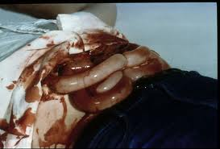
Abdominal Hollow Organ Injuries
Gastric & Small Bowel Signs & Symptoms
Peritoneal signs
Pain, tenderness, guarding, rigidity, fever, distension
Evisceration protrusion of an internal organ i.e. small bowel or stomach

Slide 53
Evisceration Treatment
Cover with moist sterile gauze or trauma dressing with outer occlusive cover
Do not attempt to replace eviscerated organs into the peritoneal cavity
Rapid transport

Slide 54
Abdominal Hollow Organ Injuries
Gastric & Small Bowel Treatment
Surgical repair
Diversion of the injured bowel with re-anastamosis at a later time
Hospital Course
Monitor abdomen for peritonitis
Monitor & treat wound infections
Monitor nutritional status

Slide 55
Pelvic Organ Injuries
Classification
Pelvis fractures
Penetrating trauma
Straddle-like injuries from falls
Pedestrian injuries

Slide 56
Pelvic Hollow Organ Injuries
Bladder & Urethral Injuries
Majority are caused by blunt trauma
Bladder ruptures associated with pelvic trauma
Urethral trauma is more common in males, straddle injuries

Slide 57
Pelvic Hollow Organ Injuries
Bladder & Urethral Injuries S & S
Suprapubic pain
Urge but inability to urinate
Blood at the meatus & in scrotum
Rebound tenderness
Abdominal wall guarding
Displaced prostate gland

Slide 58
Pelvic Hollow Organ Injuries
Bladder & Urethral Injuries Treatment
Diagnosis with CT cystogram
Intraperitoneal – Rupture at dome. Assoc. with a full bladder (Badger game). Requires surgery
Extraperitoneal – Ruptures at neck. Non-operative treatment
Non-operative treatment with foley decompression of bladder
Operative repair
Hospital Course
Monitor urinary output, for urinary obstruction, blood in urine or infection

Slide 59
Vascular Structure Injuries
Deceleration injuries – to aorta, IVC, renal, messentaric, or iliac ateries and veins
Palpable mass
Pulsatile mass
Hypovolemia or hypovolemic shock
Sacroiliac

Slide 60
Abdominal or Pelvic Solid & Hollow Organ Injuries
Diagnostic Tests
FAST - Ultrasound
DPL – Diagnostic Peritoneal Lavage
Abdominal, Pelvic CT scan
Retrograde urethrogram
Physical exam

Slide 61
General Assessment
Bleeding
Pain & abdominal tenderness or guarding
Abdominal rigidity & distension
Evisceration

Slide 62
General Management of Abdominal Trauma
Scene survey for MOI
Rapid evaluation of the patient
High concentration O2
Stabilize – Direct pressure, compression mattress external, sheet or pelvic binder for hemorrhage
Cardiac monitor
Rapid Transport

