Slide 1
E commerce
An overview of e-Commerce & Models

Slide 2
Commerce
Commerce is a division of trade or production which deals with the exchange of goods and services from producer to final consumer.
It comprises the trading of something of economic value such as goods, services, information, or money between two or more entities.

Slide 3
E Commerce
Commonly known as Electronic Marketing
“It consist of buying and selling goods and services over an electronic systems Such as the internet and other computer networks.”
“E-commerce is the purchasing, selling and exchanging goods and services over computer networks (internet) through which transaction or terms of sale are performed Electronically

Slide 4
Traditional Business VS Ecommerce

Slide 5
Models/Classification of Ecommerce
Business-to-business (B2B)
Business-to-Consumer (B2C)
Business-to-government (B2G)
Consumer-to-consumer (C2C)
Government to consumer (G2C)
Government-to-business (G2B)

Slide 6
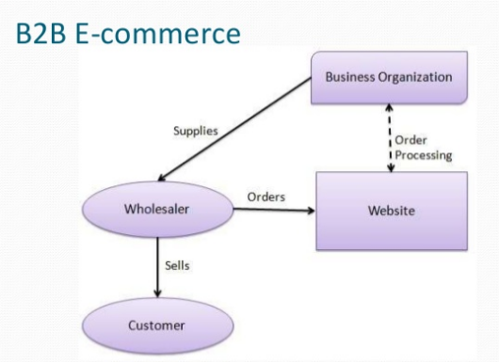
What is B2B e-commerce?
B2B e-commerce is simply defined as ecommerce between companies. About 80% of e-commerce is of this type.
Examples:
Intel selling microprocessor to Dell
Heinz selling ketchup to Mc Donalds

Slide 7
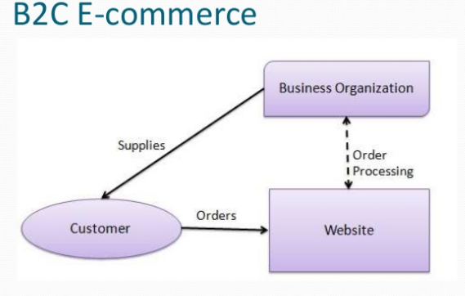
What is B2C ecommerce?
Business-to-consumer e-commerce, or commerce between companies and consumers, involves customers gathering information; purchasing physical goods or receiving products over an electronic network.
Example:
Dell selling me a laptop

Slide 8
What is B2G ecommerce?
Business-to-government e-commerce or B2G is generally defined as commerce between companies and the public sector. It refers to the use of the Internet for public procurement, licensing procedures, and other government related operations
Example:
Business pay taxes, file reports, or sell goods and services to Govt. agencies.

Slide 9
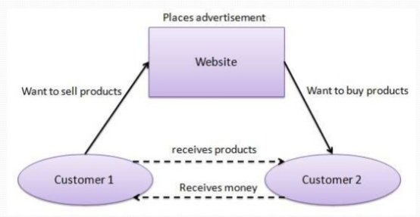
What is C2C ecommerce?
Consumer-to-consumer e-commerce or C2C is simply commerce between private individuals or consumers.
Example:
Mary buying an iPod from Tom on eBay
Me selling a car to my neighbour

Slide 10
G2C E-commerce
This Model is also a part of e-governance.
The objective of this model is to provide good and effective services to each citizen. The Government provides the following facilities to the citizens through website. Information of all government departments, Different welfare schemes, Different application forms to be used by the citizens.

Slide 11
G2B E-commerce
Government-to-business (G2B) is a business model that refers to government providing services or information to business organisation. Government uses B2G model website to approach business organizations. Such websites support auctions, tenders and application submission functionalities.

Slide 12
Process of ecommerce
A consumer uses Web browser to connect to the home page of a merchant's Web site on the Internet.
The consumer browses the catalog of products featured on the site and selects items to purchase. The selected items are placed in the electronic equivalent of a shopping cart.
When the consumer is ready to complete the purchase of selected items, she provides a bill-to and ship-to address for purchase and delivery

Slide 13
When the credit card number is validated and the order is completed at the Commerce Server site, the merchant's site displays a receipt confirming the customer's purchase.
The Commerce Server site then forwards the order to a Processing Network for payment processing and fulfilment.

Slide 14
Advantages of Ecommerce
Faster buying/selling procedure, as well as easy to find       products.
Buying/selling 24/7.
More reach to customers, there is no theoretical geographic limitations.
Low operational costs and better quality of services.
No need of physical company set-ups.
Easy to start and manage a business.
Customers can easily select products from different providers without moving around physically.

Slide 15
DISADVANTAGES OF E-COMMERCE
Unable to examine products personally
Not everyone is connected to the Internet
There is the possibility of credit card number theft
Mechanical failures can cause unpredictable effects on the total processes.

