Slide 1
POLYNEUROPATHIES
FAIZA AMJAD

Slide 2
Introduction
More common than general neuropathies

Slide 3
Compressive Neuropathy of the Upper Extremity ::::

Slide 4
Upper Extremity Nerves

Slide 5
Carpal Tunnel Syndrome: Median Neuropathy at the wrist. Cubital Tunnel Syndrome: Ulnar neuropathy at the elbow. Radial Nerve Palsy at the spiral groove of the humerus.

Slide 6
Median Nerve

Slide 7
Carpal Tunnel Syndrome : Etiology
Disproportion between available space and its contents = increased pressure within CT
Median nerve most delicate: mostly affected: functional disturbance
Disproportion between Space vs. Contents
Actual narrowing of the walls of the canal
vs.
Increase in the volume of its contents
But usually multifactorial.

Slide 9
Idiopathic CTS
Largest number of cases
Thickening of para-tendinous tissue- specially of the FDP tendons
Chronic edema, fibrinoid swelling, hyaline and mucoid degeneration followed by fibrotic thickening, increased collagen formation.
Influenced by hormonal factors and repetitive occupational overuse.

Slide 10
Hormonal factors
Chronic/Acute Specific Inflammation
Edematous thickening of paratenons: third trimester of pregnancy or shortly after delivery
45 % of all pregnant women complain of some tingling, numbness of the fingers- resolves in most cases after delivery.
Pre-menopausal
Contraceptive drugs
Rheumatoid Tenosynovitis
JRA
Tuberculous tenosynovitis
Acute pyogenic Infection
Acute thrombophlebitis
Erroneous I.V. infusion

Slide 11
Post-traumatic CTS
Systemic disease
Blunt trauma- edema, bleeding
Carpal bone dislocation- lunate
Distal radial fracture
Compartment syndrome
Abnormal wrist position
Malunited distal radial fracture
Osteophytes from chronic arthritis
Gout
Myxedema (severe form of hypothyroidism)
Amyloidosis (when an abnormal protein buildup in body and leads to organ failure)
Diabetes
Myeloma (cancer WBCs)
Acromegaly
Chronic Renal failure

Slide 12
Diagnosis-History
Nocturnal paresthesia
Numbness/tingling/burning or cramplike sensations-median nerve distribution
Pain of the resting hand-pathognomonic
May subside with manual activity
Weaknes/clumsiness
Postural aggravation
Proximal pain: may radiate upto shoulder
Pain may subside in advanced cases
Feeling of cold, and swollen fingers: disturbance of autonomous function of median nerve.
Flattenning of thenar eminence

Slide 15
Sensory Distribution

Slide 16
Median Nerve testing

Slide 17
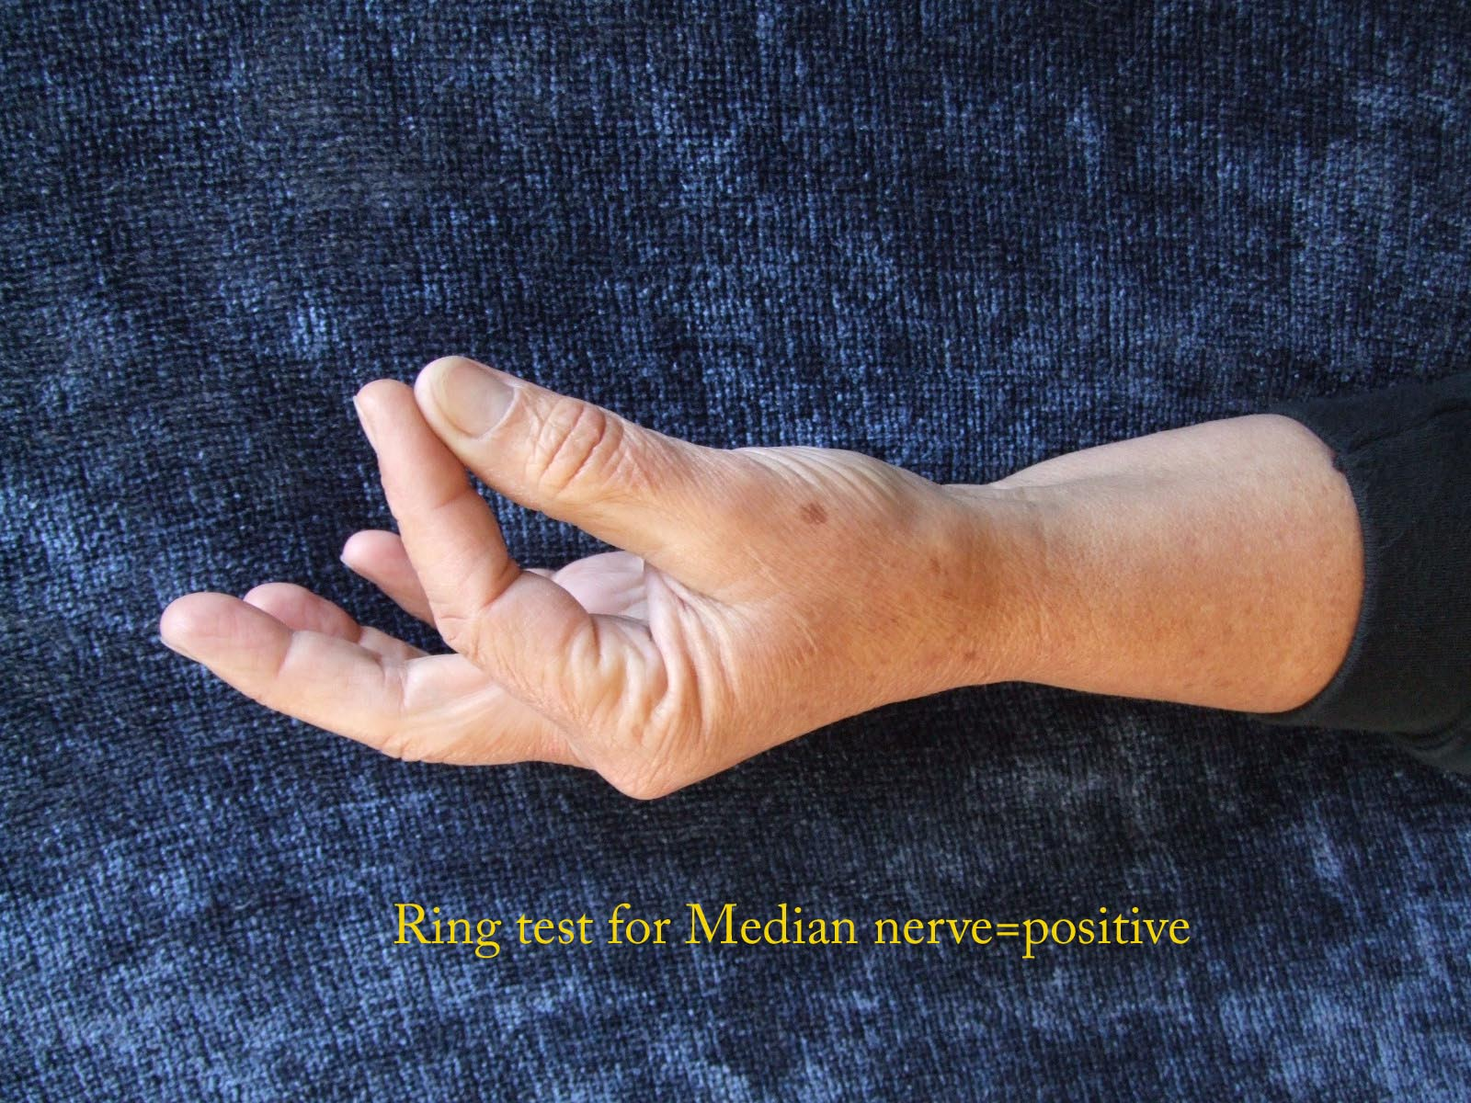
Median nerve

Slide 18
Median nerve:findings
Imaging studies:
Plain radiographs: cervical,chest,wrist,hand
Magnetic resonance imaging: unclear diagnosis,anatomic causes, failure of CTR
Ultrasound: space occupying lesion

Slide 19
Electrodiagnostic testing
Nerve Conduction study
Segmental demyelination-> slowed nerve conduction:conduction block
Electromyography
Rule out proximal compression,double crush, polyneuropathy

Slide 20
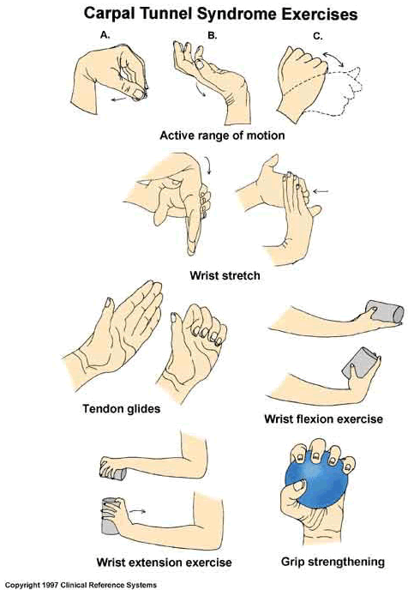
Treatment: conservative
Wrist splint
Activity modification
Steroid injection
NSAID
?Vit B6
Stretching exercises / ergonomic equipments ( prevention)

Slide 21
Carpal Tunnel Release (CTR)
Open
Endoscopic
Limited incision

Slide 22
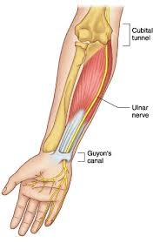
Ulnar Nerve

Slide 23
Cubital Tunnel Syndrome
Paresthesia in ulnar digits
Weakness
Intrinsic wasting
Elbow pain

Slide 24
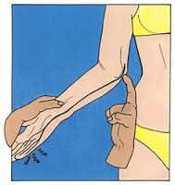
Cubital Tunnel Syndrome:findings
Ulnar nerve subluxation
Tinel’s sign
Elbow flexion test
Intrinsic muscles
Sensation

Slide 26
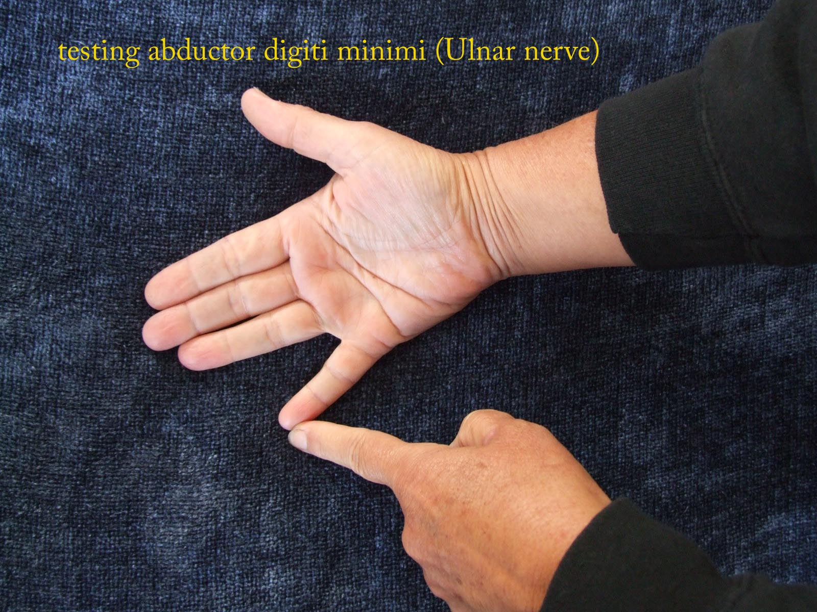
Ulnar Nerve Testing

Slide 27
Sensory Distribution

Slide 28
Radial Nerve

Slide 29
Radial Nerve Palsy
Wrist drop: weak wrist/ finger extension
Sensation changes
Findings dependant on etiology:
Saturday night palsy
Fracture humerus: post reduction
Gunshot wound
Post operative
compression

Slide 30
Sensory Distribution

Slide 31
Radial Nerve Test

Slide 32
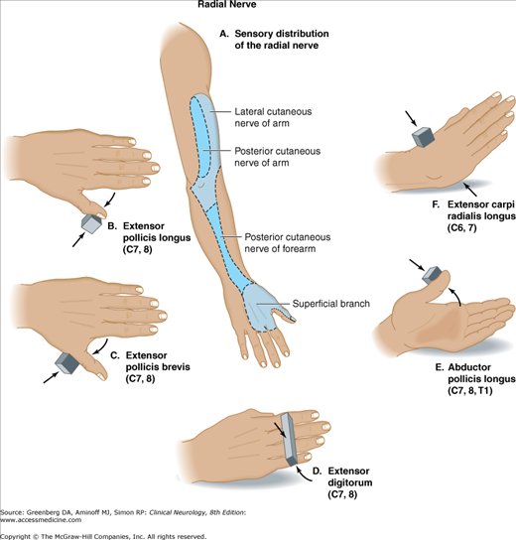

Slide 33
Brachial Plexus Injuries

Slide 34
Grades of Injury
Grade 1 – Neuropraxia
Disruption in nerve function that produces numbness and tingling
Most common grade within athletics
Symptoms usually resolve within several minutes
Grade 2 – Axonotmesis
Damage to the nerve’s axon
Symptoms = numbness, tingling, and affected function (may last several days)
Long nerves have a greater healing time than short nerves
Grade 3 – Neurotmesis
Permanent nerve damage occurs
“Occurs with high-energy trauma, fractures, and penetrating injuries”

Slide 35
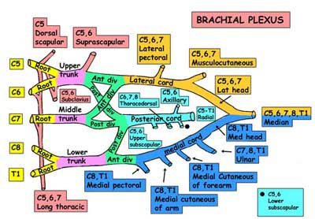

Slide 37
Brachial Plexus Injury: Adults
High-energy trauma to the upper extremity and neck causes a variety of lesions to the brachial plexus.
The common mechanism is violent distraction of the entire forequarter from the rest of the body in a motorcycle accident or a high-speed motor vehicle accident. A fall from a significant height may also result in brachial plexus injury.
Sports most commonly associated with brachial plexus injuries include: football, baseball, basketball, volleyball, fencing, wrestling, and gymnastics
Nerve injuries can result from blunt force trauma, poor posture, or chronic repetitive stress
Patients generally present with pain and/or muscle weakness
Over time, some patients may experience muscle atrophy
Loss of useful function of the upper extremity is common

Slide 38
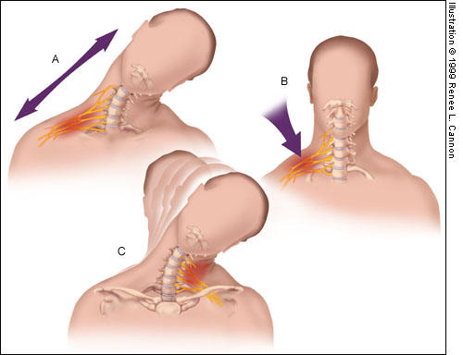
Mechanisms of Injury to the Brachial Plexus
Traction: direct blow to the shoulder with the neck laterally flexed toward the unaffected shoulder (gymnast falls on beam)
Direct trauma: direct blow to the supraclavicular fossa over Erb’s point
C. Cervical Nerve Compression: Occurs when the neck is flexed laterally toward the patient’s affected shoulder, compressing / irritating the nerves, resulting in point tenderness over involved vertebrae of affected nerve(s) (Troub, 2001)

Slide 39
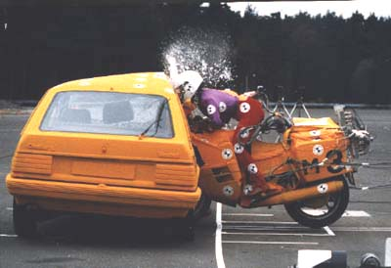
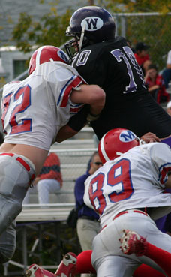
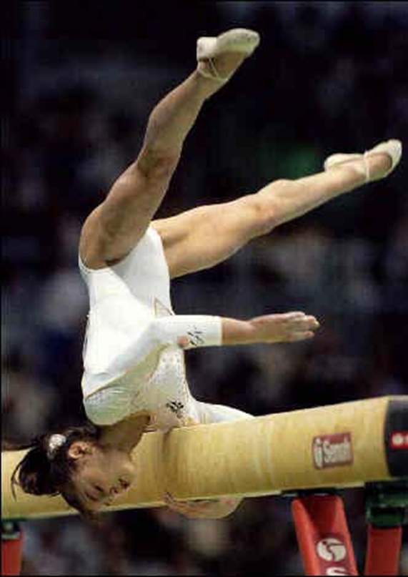
Mechanisms of Injury to the Brachial Plexus

Slide 44
Adult Brachial Plexus Injury
Examination (use pre-printed brachial plexus diagrams): determine level
Look at face: does he have Horner’s? (=lower root lesion C8 T1)
Undress upper torso
Look from front at posture of arm, scars, muscle wasting, asymmetry/swelling
Look at back again for scars, muscle wasting, asymmetry
shrug shoulders
Supraspinatus responsible for 1st 20° of shoulder abduction (resisted arm abduction)
Rhomboids (touch back of head)
Look at vascularity of arm
Check sensation both upper limbs (root levels)
Check movement both upper limbs from shoulder to fingers (AROM + PROM)
Reflexes
Function of phrenic nerve

Slide 45
Neurological Examination

Slide 46
Neurological Examination

Slide 47
Examination
LOOK, FEEL, MOVE (Talk as you are doing)
Look at the face: Ptosis and anhydrosis (Horner syndrome) suggest a complete lower plexus lesion

Slide 48
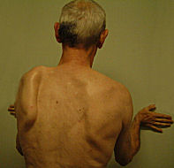
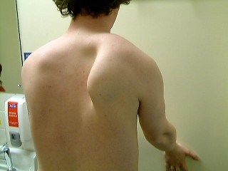
Examine the Back
Wall test for serratus ant (winging scapula)
Note weak trapezius (asymmetric shrug)

Slide 49
Examine the Back
Swelling about the shoulder can be dramatic. Diminished or absent pulses suggest vascular injury, and special consideration should be given to rupture of the subclavian vessels. Clavicle fractures are often palpable. Careful inspection and palpation of the axial skeleton may reveal concomitant injuries. Examine each cervical root individually for motor and sensory function as soon as circumstances allow.

Slide 50
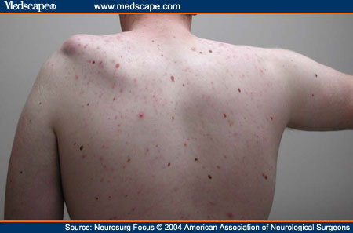
Examine the Back
Photograph showing patient with left shoulder subluxation resulting from a flail arm caused by C5–T1 lesions. Note the left deltoid, supra-, and infraspinatus muscle atrophy

Slide 51
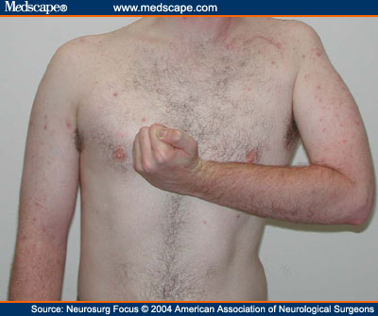
Examine Front
Notice clavicular scar, posture, wasting of Deltoid and biceps

Slide 52
Examine the Neck

Slide 53
Related Special Tests
Brachial Plexus
Cervical Compression Test
Cervical Distraction Test
Spurling’s Test
Brachial Plexus Traction Test
Thoracic Outlet Syndrome
Adson’s Test
Allen’s Test
Military Brace Position

Slide 54
Peripheral Nerve Tests
Axillary N.
Sensory – Lateral arm
Motor – Shoulder abduction
Musculocutaneous N.
Sensory – Anterior arm
Motor – Elbow flexion
Radial N.
Sensory – 1st Dorsal web space
Motor – Wrist extension and thumb extension
Median N.
Sensory – Pad of Index finger
Motor – Thumb pinch and abduction
Ulnar N.
Sensory – Pad of little finger
Motor – Finger abduction

Slide 55
Reflex Tests
C5 – Biceps brachii reflex (anterior arm near antecubital fossa)
C6 – Brachioradialis reflex (lateral aspect of forearm)
C7 – Triceps brachii reflex (at insertion of tricep brachii)
C8 and T1 do not have reflex tests

Slide 56
Investigations
Nerve conduction studies
EMG studies

Slide 57
Management
Medical:
physio: maintain supple joints with FROM
Orthoptists / splinting
Pain control
Surgical options:
nerve transfers
nerve grafting
muscle transfers
free muscle transfers
neurolysis of scar in incomplete lesions
Arthrodesis to stabilise joints

Slide 58
CERVICAL REDICULOPATHY
Hand numbness in older patients
Acute herniation at the level of C6
Degenerative changes at C6 & C7
Signs on lateral aspect of fore arm and 1st and 2nd digits
Weakness in humeral rotators and elbow flexors
In C7 radiculopathy weakness in elbow extensors and shoulder depressors and signs at third digit.
In lower cervical radiculopathies(C8-T1) signs are more at 4th and 5th digits where as weakness in hand intrinsic muscles.
Atrophy, weakness and decreased reflexes
Spurling’s sign positive
Take cervical extension motion cautiously when there is vascular or degenerative compromise is there

Slide 59
LOWER EXTREMITY NEUROPATHIES

Slide 61
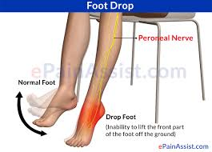
FOOT DROP
Dorsiflexors weakness common in older people.
But responsible is an upper motor neuron lesion posturing equinovarus and lower motor neuron lesion.

Slide 62
COMMON PERONEAL NEUROPATHY
Very common cause of foot drop
Risk factors are: prolong hospitalization, weight loss, knee replacement surgery, plaster casts and fracture of fibular head and neck.
Weakness in the dorsiflexors and evertors.
For the sake of treatment increase weight of individual and avoid knee hyperflexion.
Ankle foot orthosis recomended

Slide 63
Sensory distribution

Slide 64
Tinel’s sign for common peroneal nerve

Slide 65
DEEP PERONEAL NEUROPATHY
Foot drop
Comon peroneal divided in to two parts deep and superfacial peroneal nerves.
Weakness in the ant. Compartment of lower leg muscles

Slide 66
L5 REDICULOPATHY
Another cause of foot drop
Reason is degenerative changes, may be disc herniation and tumor
Show signs of LBP with or without leg pain
Night pain is common in malignant cause in comparison of benign cause
S/S: Weakness of hip abductors and knee flexors, loss of an internal hamstring reflexes on effected side, positive SLR sign( pain and dysesthesia on the anterolateral aspect of leg and dorsum of foot)
Provide ambulatory devices and orthotic devices to help in the swing phase of gait cycle.

Slide 67
SCIATIC NEUROPATHY
Another cause of foot drop
S/S: Avoiding pressure over the posterior thigh and buttock, such as that caused by sitting on a ledge.(a narrow horizontal surface projecting from a wall)
Nerve root:L4-S3

Slide 69
Sensory distribution

Slide 70
LUMBOSACRAL PLEXOPATHY
Lumbosacral plexus neuropathies are rare syndromes, which are caused by damage to the nerve bundles in the lumbosacral plexuses.
Most frequently, the lumbosacral plexus is damaged: in diabetics, by direct or indirect pelvic trauma, by compression, or obstetric complications. Tumors, aneurysms and idiopathic or hereditary neuropathies are more infrequent causes of a lumbosacral plexopathy.
Treatment, course and prognosis largely depend on the underlying disorder.

Slide 71
THIGH NMBNESS OR WEAKNESS

Slide 72
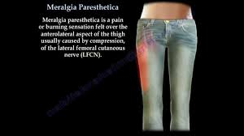
MERALGIA PARESTHETICA
Meralgia paresthetica is a condition characterized by tingling, numbness and burning pain in your outer thigh. The cause of meralgia paresthetica is compression of the nerve that supplies sensation to the skin surface of your thigh.
Tight clothing, obesity or weight gain, and pregnancy are common causes of meralgia paresthetica. However, meralgia paresthetica can also be due to local trauma or a disease, such as diabetes.
In most cases, meralgia paresthetica can be relieved with conservative measures, such as wearing looser clothing. In severe cases, treatment may include medications to relieve discomfort or, rarely, surgery.

Slide 73
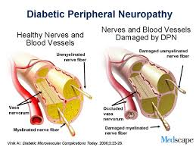
DIABETIC NEUROPATHY
Diabetes can harm your nerves. That damage, called neuropathy, may be painful.
Four types of diabetes-related neuropathy: peripheral, autonomic, proximal, and focal.

Slide 74
Peripheral Neuropathy
This type usually affects the feet and legs. Rare cases affect the arms, abdomen, and back.
Symptoms include:
Tingling
Numbness (which may become permanent)
Burning (especially in the evening)
Pain
Early symptoms usually get better when your blood sugar is under control. There are medications to help manage the discomfort.
What you should do:
Check your feet and legs daily.
Use lotion on your feet if they're dry.
Take care of your toenails. Ask your doctor if you should go to a podiatrist.
Wear shoes that fit well. Wear them all the time, so your feet don't get injured.

