Slide 2
CONTENTS
Introduction
Composition
Factors affecting quality
Poultry processing
Packaging
Poultry inspection

Slide 3
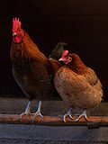
POULTRY INDUSTRY IN PAKISTAN
Poultry are domesticated birds kept by humans for their eggs, their meat or their feathers
Examples of it includes
Hens/Chicken
Duck
Geese
Turkeys

Slide 4
POULTRY INDUSTRY IN PAKISTAN
Presently turnover of Pakistan Poultry Industry is about 1,168 Billion rupees
Poultry sector generates employment and income for about 1.5 million people
Poultry sector growth rate is 10-12% per annum.
At present over 190 billion rupees worth of agriculture produce and by products of agriculture are being used in poultry feeds
There are over 15000 poultry farms spread deep into the rural areas across the country from Karachi to Peshawar
40-45% of the total meat consumption is being procured from poultry products

Slide 5
POULTRY
Meat derived from dressed carcass of poultry birds according to Meat Inspection Acts and Regulation
Composition of chicken meat
Moisture 71%
Lipids 1-3%
Proteins 25-35%
Calories 151cal/100g

Slide 6
POULTRY
Factors affecting poultry quality
Breed
Color, pH and tenderness of meat is affected by breed type
Age
Young birds have less fat content than old aged birds and their meat is relatively softer
Sex
Female birds have more fatty tissues than male
Rearing conditions and practices
Rearing and genotype have effect on muscle glycogen level of the meat

Slide 7
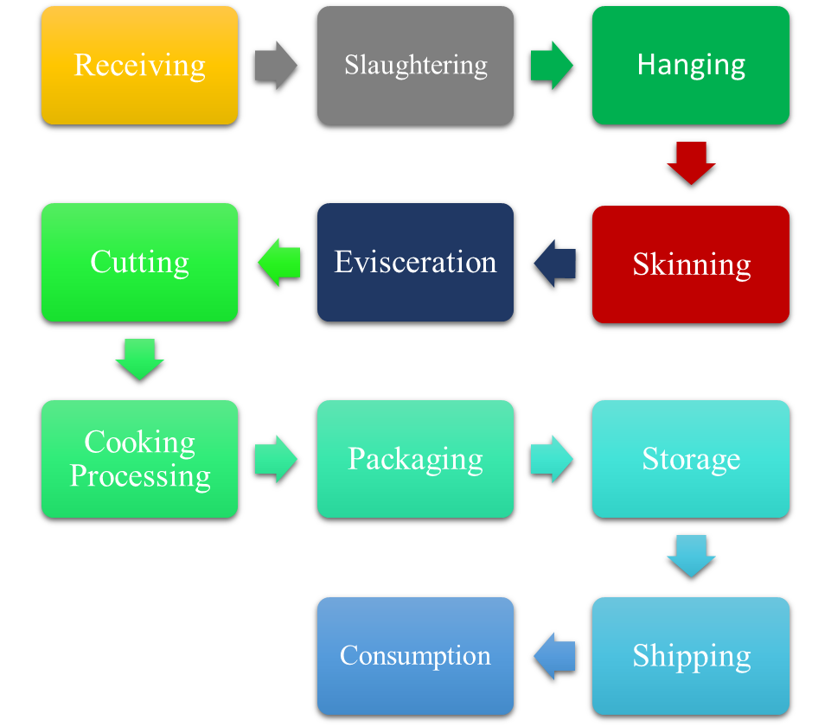
PRIMARY POULTRY PROCESSING

Slide 8
PRIMARY POULTRY PROCESSING
SLAUGHTERING
Butchering the birds or livestock for the meat purposes and the place where it is held is called slaughterhouse. Following steps are included in slaughtering
1.RECEPTION OF ANIMAL
After the bird selection, feed is withheld before 8 hours of slaughtering in order to prevent the presence of feed in the gut
This prevent the chances of contamination
Clean and safe environment during transportation must be ensure to prevent microbial exposure

Slide 9
PRIMARY POULTRY PROCESSING
2.STUNNING
Making the bird unconscious or immobilize before slaughtering
It helps in uniform bleeding
And easy plucking of feathers
Jewish and Islamic methods don’t permit stunning
Islamic method is called Halal
Jewish method is called Kosher

Slide 10
PRIMARY POULTRY PROCESSING
There are following methods of stunning
Electrical stunning
In this method, heads of bird are dipped in saline water bath at an electric current of 20Volts which make birds unconscious for 1-2 minutes and this time is enough for slaughtering the bird and bleeding to death
Gaseous Stunning
It is carried out by increasing oxygen concentration in the system which is known as hypercapric hypoxia or by depleting oxygen which is called anoxia or by changing both carbon dioxide and oxygen concentration which is called hypercapric anoxia

Slide 11
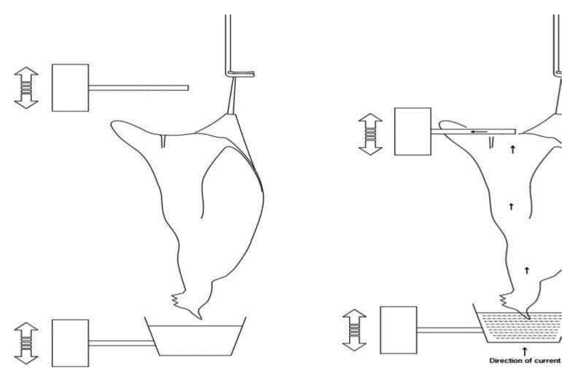
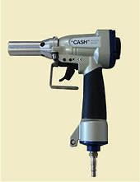
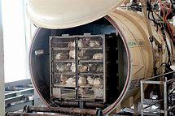
PRIMARY POULTRY PROCESSING
Mechanical stunning
It is carried by hitting the bird head with mechanical bolt piston to make it immobilize

Slide 12
PRIMARY POULTRY PROCESSING
3.SLAUGHTERING
A cut is made to the blood vessels
Jugular vein
Carotid artery
Trachea
Esophagus
While spinal cord and central nervous system remains intact

Slide 13
PRIMARY POULTRY PROCESSING
4. BLEEDING
Bleeding is to kill the animal with maximum damage to microbial growth
About 35-50% blood is removed from the animal. It takes 1/5 to 3 minutes
It also prevents the dark spots on meat

Slide 14
PRIMARY POULTRY PROCESSING
5. SCALDING
Immersion of bird in hot water to loosen its feather. Feather follicles are protein in nature and proteins breakdown upon heat
6. PLUCKING
Removal of feathers is called plucking. It can be done either manually or mechanically. Bird is rotated over cylindrical drum to remove the feathers
Pin feathers are the small feathers which are removed through waxing or singeing off

Slide 15
PRIMARY POULTRY PROCESSING
7.REMOVAL OF HEAD OR FEET
Head and feet are removed of the bird
8.EVISCERATION
Removal of inedible organs of the bird by making a cut in the abdomen
9.WASHING
The carcass is washed with the water at a temperature of 10-16C
10.CHILLING
After washing birds are chilled for 30-40min and the objective is to prevent microbial growth

Slide 16
PRIMARY POULTRY PROCESSING
11.AGEING
Meat is placed at the racks to improve the tenderness of the meat and It is done for 2-4 hours
12.CUT-UPS OR WHOLE CARCASS PACKAGING
After ageing the body of bird is cut into 4, 8 or 16 cuts or whole carcass is packed and boneless is further processed

Slide 17
MEAT PACKAGING
Packaging is the science, art and technology of enclosing food in a packaging material for the purpose of distribution, storage , sale and use
Main functions of packaging are
Containment
Protection
Preservation
Apportionment
Convenient

Slide 18
MEAT PACKAGING
Three types of materials are used for meat products packaging
Rigid including cans
Semi rigid like plastic tray boxes
Flexible including plastic bags and trays
Packaging can be either non-preservative or preservative
In preservative packaging, shelf life is extended either by vacuum, modified or controlled atmosphere packaging

Slide 19
MEAT INSPECTION
Purpose of meat inspection is to provide wholesome food to the consumer
Elements of meat inspection includes
Sanitation inspection
Pre slaughtering inspection
Post mortem inspection
Control and restriction
Product inspection

