Slide 1
Portrait Photography

Slide 2
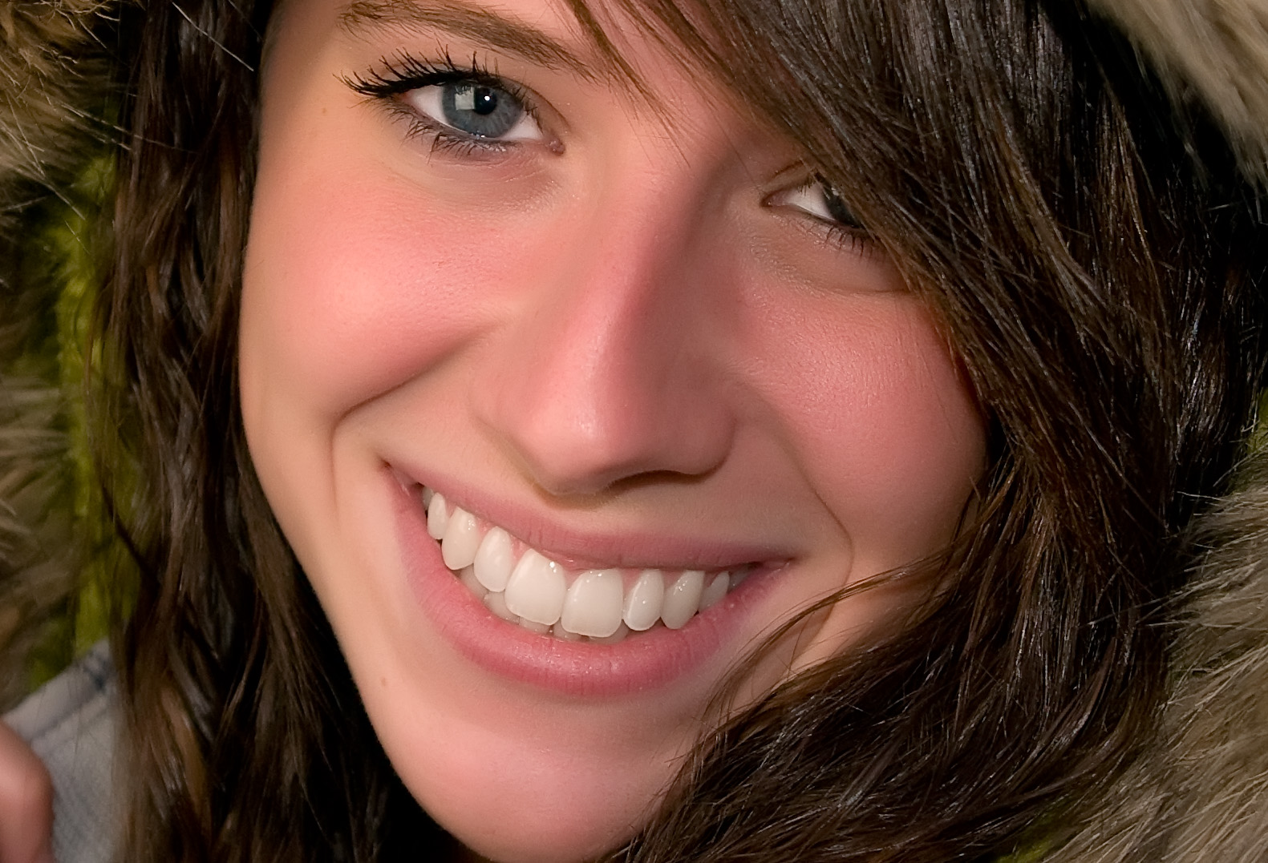

Slide 3
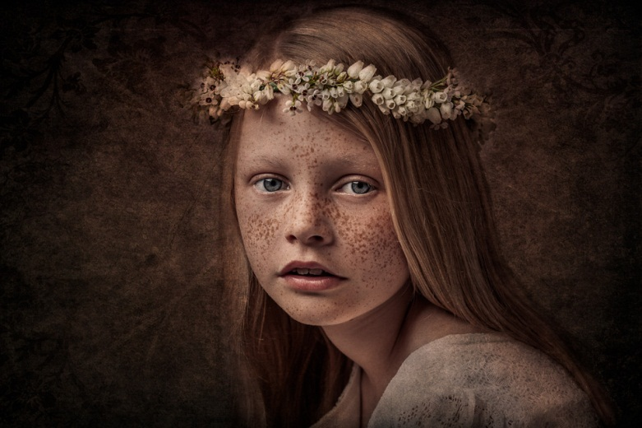
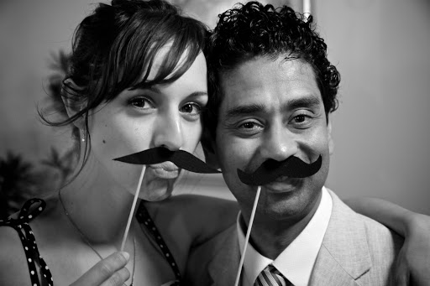
What is Portrait Photography?
Portrait Photography is one of most common forms of photography.
Portraiture, is the art of capturing a subject’s expressions
The best portrait photographers are able to really capture someone’s true character

Slide 4
8 Fundamental Styles of
Portrait Photography
TRADITIONAL
ENVIRONMENTAL
CANDID
GLAMOR PORTRAIT
LIFESTYLE PORTRAIT
SURREAL PORTRAIT
CONCEPTUAL PORTRAIT
ABSTRACT PORTRAIT

Slide 5
TRADITIONAL
Traditional or Classical portraiture - face is the predominant element. The purpose of the photograph - visual representation of that person. Subject is expected to be looking directly at the camera.

Slide 6
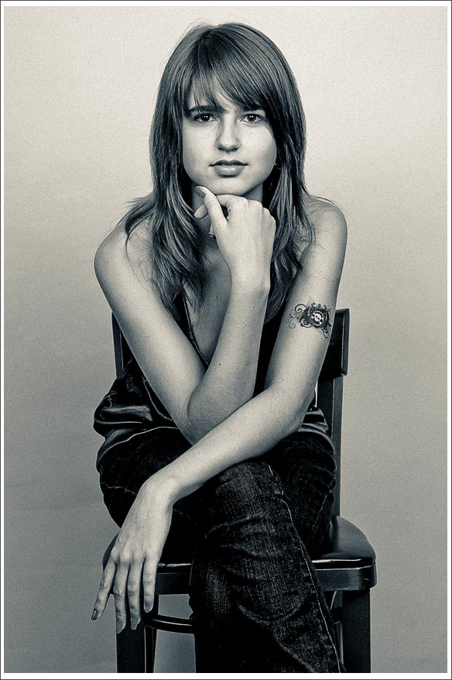
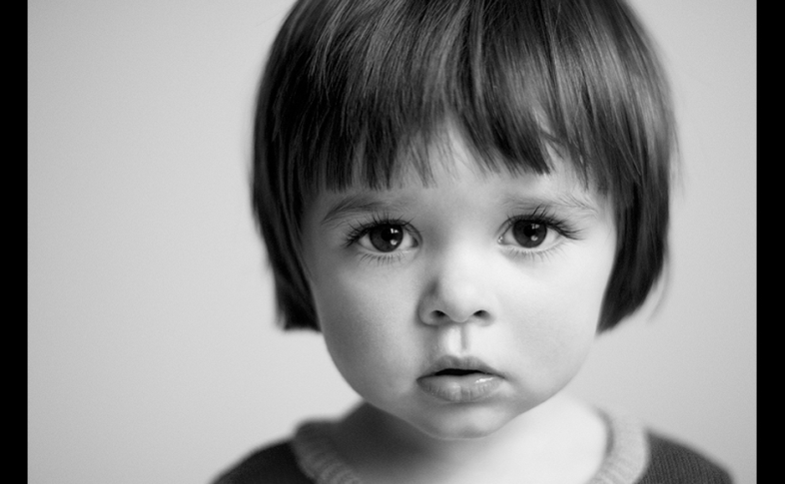
TRADITIONAL
Two-Thirds
Head Shot
Full Body

Slide 8
Environmental Portraiture
The term Environmental Portrait - subject is photographed in person’s natural environment.
For example, a worker photographed at the construction zone, teacher in the classroom, sculptor in a sculpture studio and so on. Surroundings are used to compliment the subject and to emphasize his character. Subject and setting are chosen by the photographer.

Slide 9
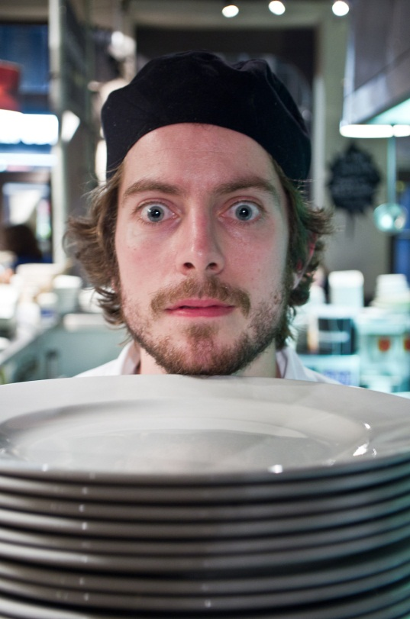
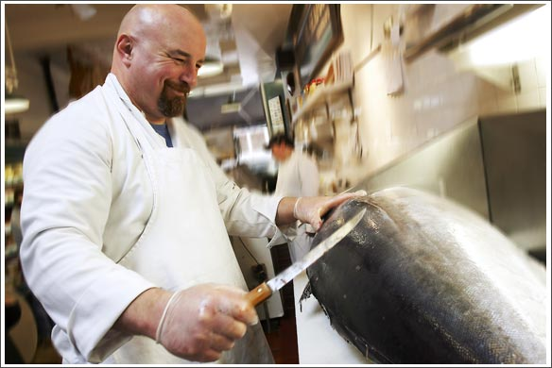
Environmental Portraiture

Slide 10
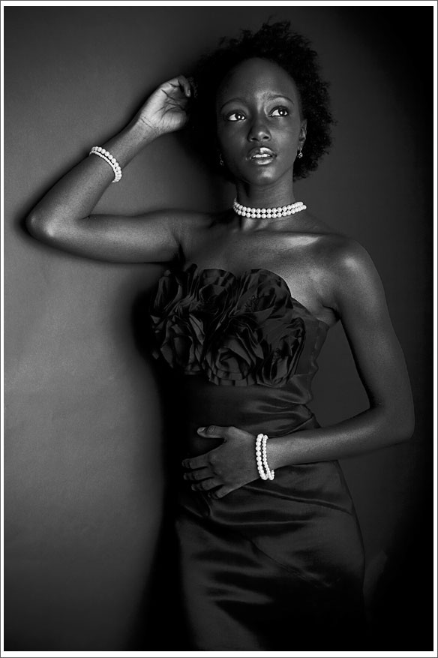
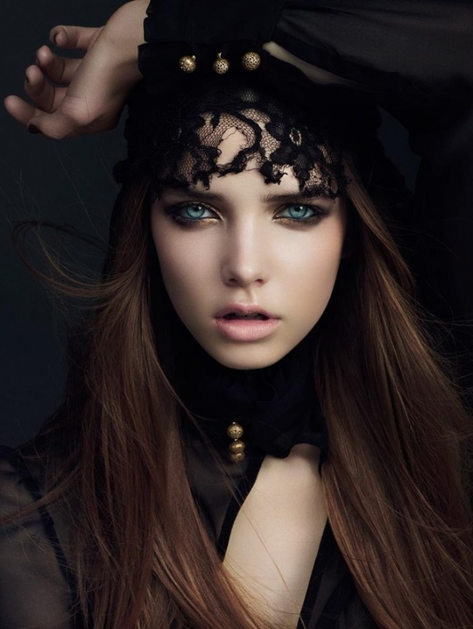
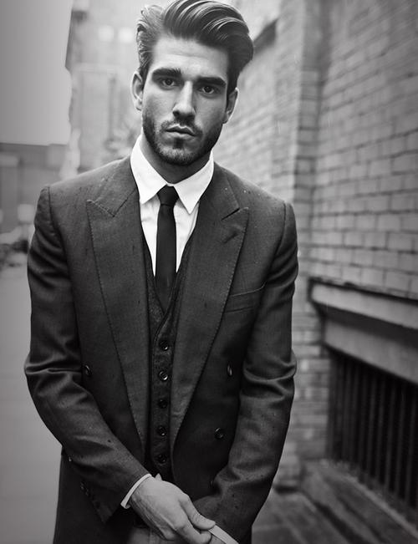
Glamor Portraiture
The term Glamor Portrait refers to portraits where emphasis is given to highlight the appeal of the subject.

Slide 11
Lifestyle Portraiture
The term Lifestyle Portrait - emphasis is given to suggest the “style of living” of the individuals depicted.
Technically it is a combination of environmental portrait and candid portrait.
More weight is given to communicate the feeling of life experience of the subject.
Often use lifestyle images to evoke emotions in viewers by depiction of desired life styles.
It is common to see this style used in wedding and family portrait photography as well.

Slide 12
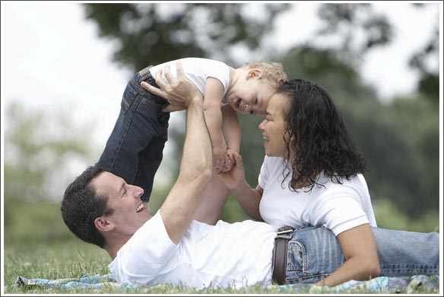
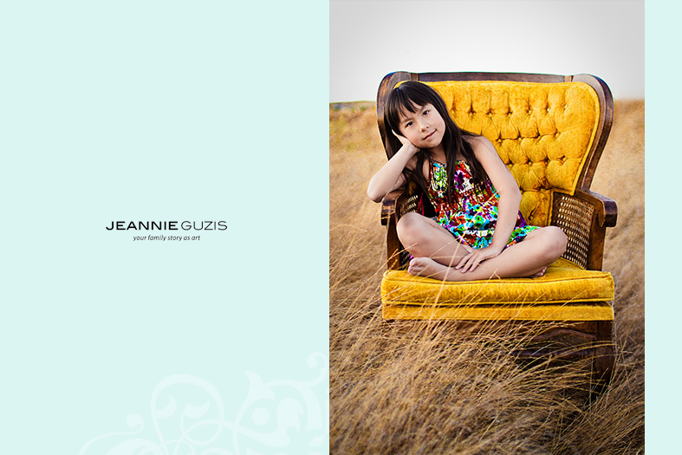

Slide 13
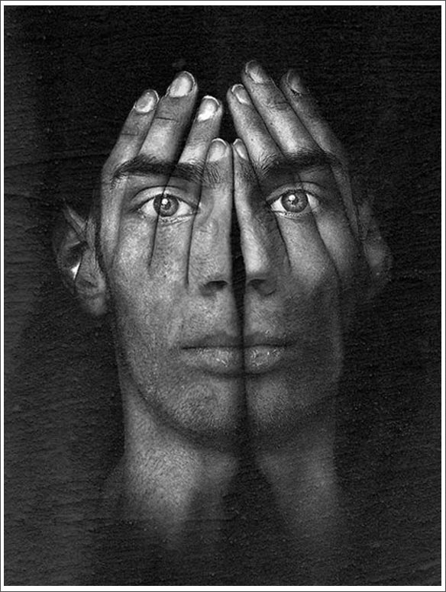
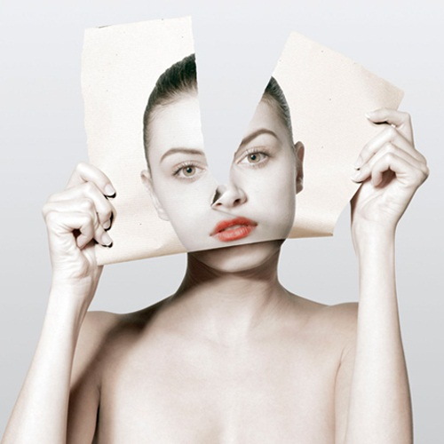
Surreal Portraiture
Surreal Portraits are created to emphasize the other reality.
A depiction of a person’s interpreted subconscious mind.
Surrealism is an art movement

Slide 14
Conceptual Portraiture
Conceptual Portrait - The hidden meaning of the concept will leave the viewer guessing as it is often open for interpretation.
Conceptual artists generally get offended when asked what did they mean in their photograph. It is the job of the viewer to decide.
Conceptual Portraits are often used in advertising photography but concepts are much easier to understand.

Slide 15
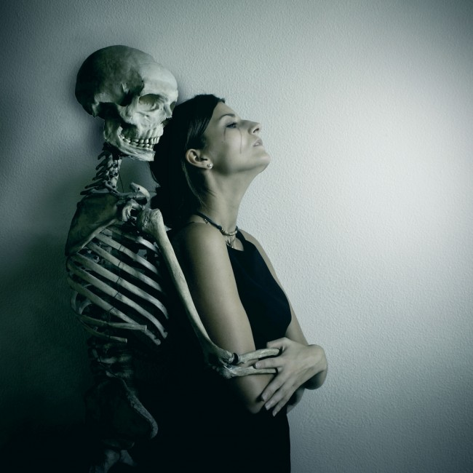
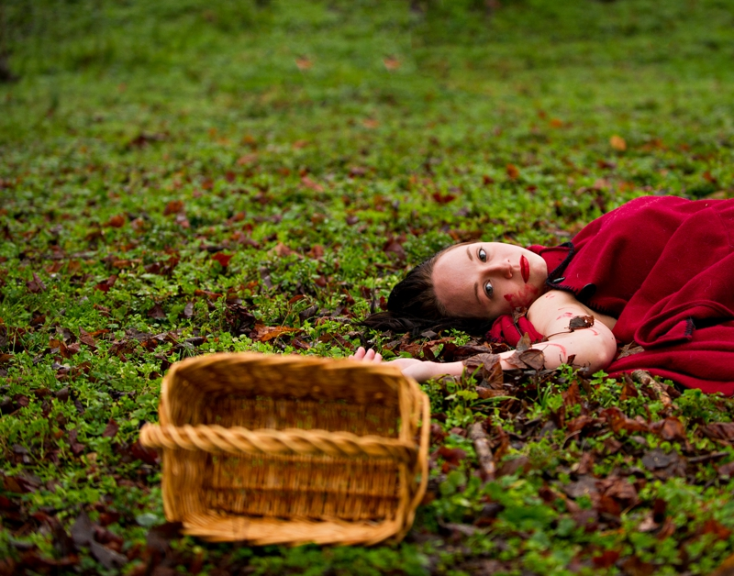
Conceptual Portraiture

Slide 16
Abstract Portraiture
Abstract portraits are created with a purpose of creating art and not based on realistic representation of a person. Collage or digital manipulation is often used.

Slide 17
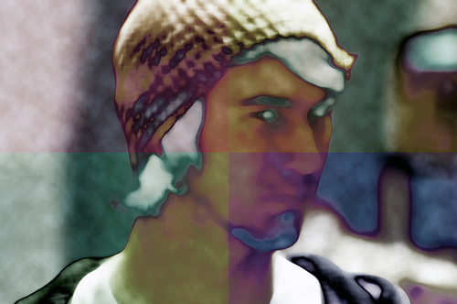
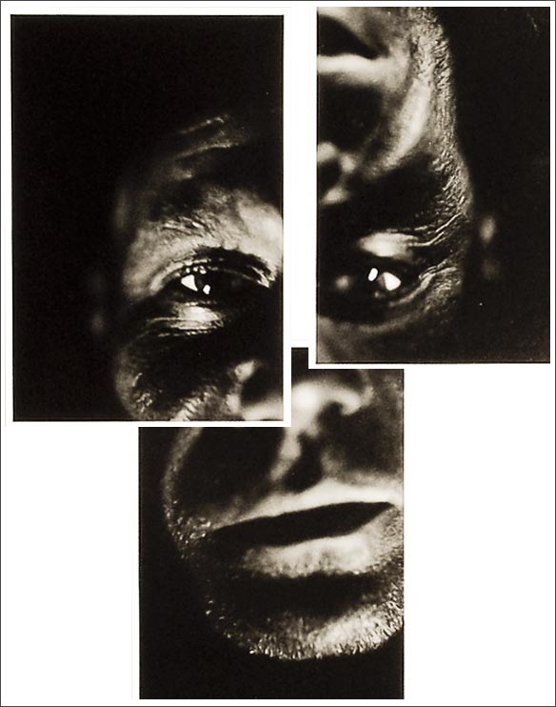
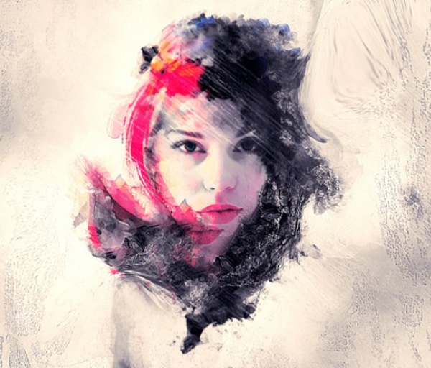

Slide 18
Candid Portraiture
A candid portrait is taken without a subject expecting or acknowledging the photographer.
This style used in photo journalism, travel photography, street photography and event photography.
As opposed to an environmental portrait this image is captured at the moment rather than set up.

Slide 19
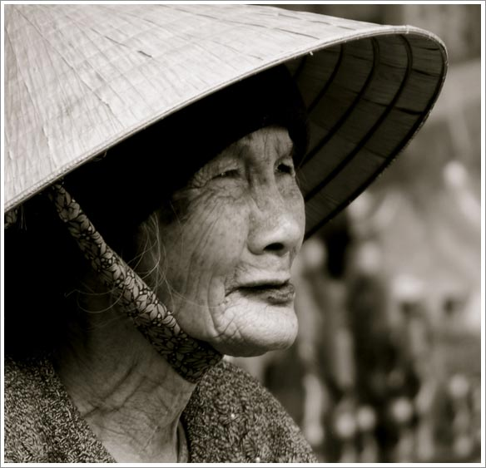
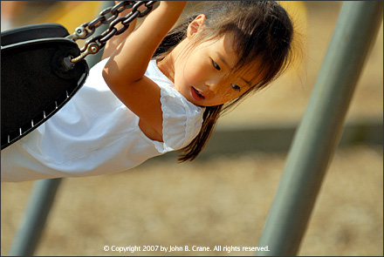
Candid Portraiture

