Slide 1
Pharmacokinetics
Dr. TASEER AHMAD

Slide 2
“One of the features which is thought to distinguish man from other animals is his desire to take medicines”
(Sir William Osler, 1849-1919)

Slide 3
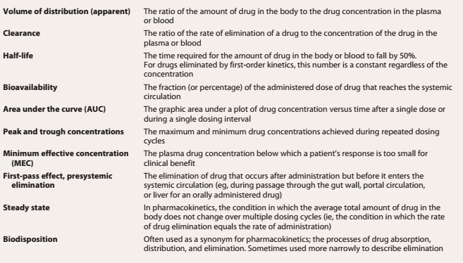

Slide 4
Pharmacokinetics
Drug molecules interact with target sites to effect the system
The drug must be absorbed into the bloodstream and then carried to the target site(s)
Pharmacokinetics is the study of drug absorption, distribution within body, and drug elimination over time. ADME
Absorption depends on the route of administration.
entry of the drug (either directly or indirectly) into plasma
Drug distribution depends on how soluble the drug molecule is in fat (to pass through membranes) and on the extent to which the drug binds to blood proteins (albumin)
Metabolism: liver or other tissues.
Drug elimination is accomplished by excretion into urine and/or by inactivation by enzymes in the liver.
Urine, bile, or feces

Slide 5
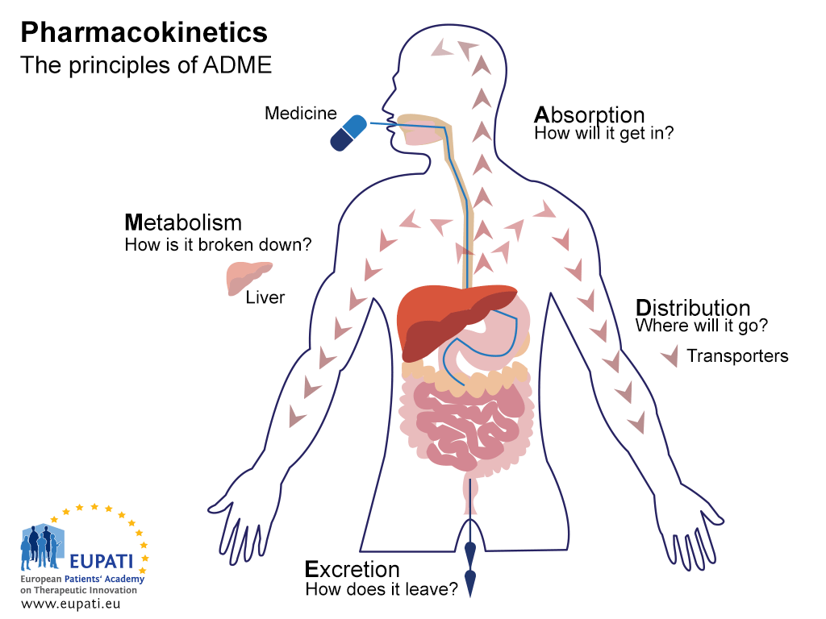
Plz watch
https://www.youtube.com/watch?v=IOf-z0D1mHk
https://www.youtube.com/watch?v=Jiml3iGBs88

