Slide 1
Brakes

Slide 2
Brakes

Slide 3
Factors depend upon capacity of brakes

Slide 4
Highest permissible temperatures recommended for different brake lining materials
1. For leather, fibre and wood facing = 65-70°C
2. For asbestos and metal surfaces that are slightly lubricated = 90 – 105°C
3. For automobile brakes with asbestos block lining = 180 – 225°C

Slide 5
The energy absorbed or the heat generated is given by
The energy absorbed (or heat generated) and the rate of wear of the brake lining at a particular speed are dependent on the normal pressure between the braking surfaces, therefore it is an important factor in the design of brakes. The permissible normal pressure between the braking surfaces depends upon the material of the brake lining, the coefficient of friction and the maximum rate at which the energy is to be absorbed.

Slide 6
Energy equation
The first step in designing the mechanical brake is to determine the braking torque or capacity for the given application. The braking torque depends upon the amount of energy absorbed by the brakes.

Slide 8
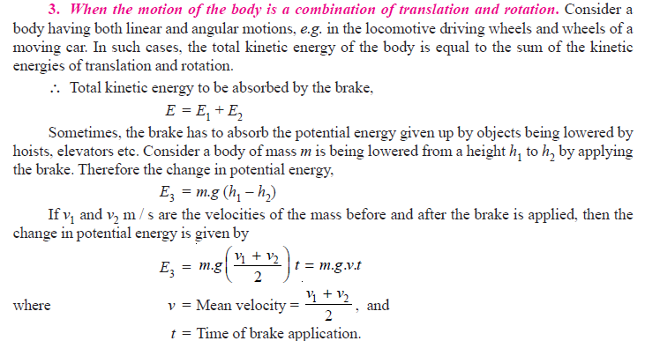

Slide 9
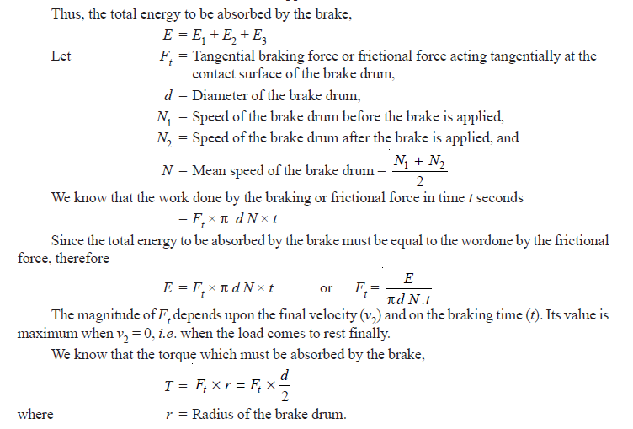

Slide 10
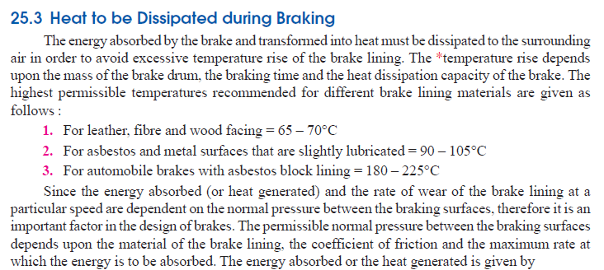

Slide 11
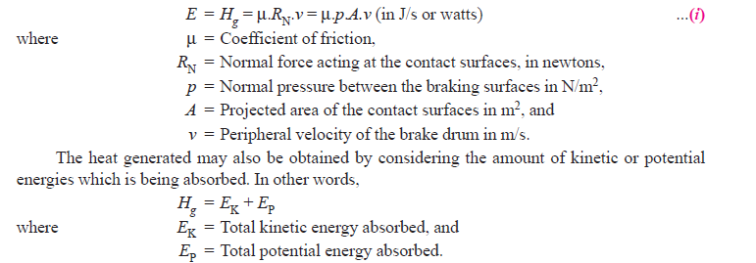

Slide 12
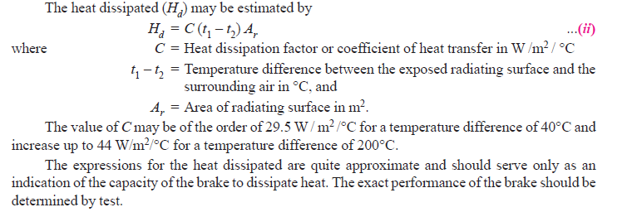

Slide 14
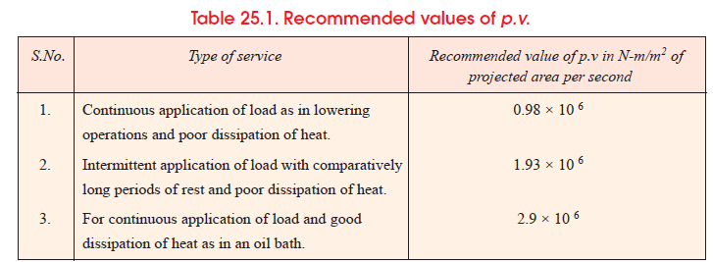

Slide 15
Types of Brakes
The brakes, according to the means used for transforming the energy by the braking element are classified as :
1. Hydraulic brakes
Operated by help of fluid pressure.(pascal)g. pumps or hydrodynamic brake and fluid agitator,
2. Electric brakes
e.g. generators and eddy current brakes, and
3. Mechanical brakes
operated by mechanically by means of levers,linkages,cams & pedals

Slide 16
The mechanical brakes, according to the direction of acting force
(a) Radial brakes.
In these brakes, the force acting on the brake drum is in radial direction. The radial brakes may be sub-divided into external brakes and internal brakes. According to the shape of the friction element, these brakes may be block or shoe brakes and band brakes.
(b) Axial brakes. In these brakes, the force acting on the brake drum is in axial direction. The axial brakes may be disc brakes and cone brakes. The analysis of these brakes is similar to
clutches

Slide 20
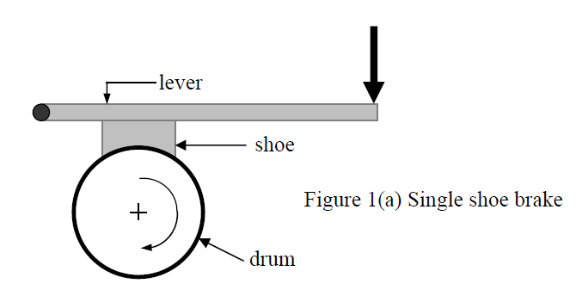
Single Block or Shoe Brake

Slide 24
Single block or shoe brake

Slide 28
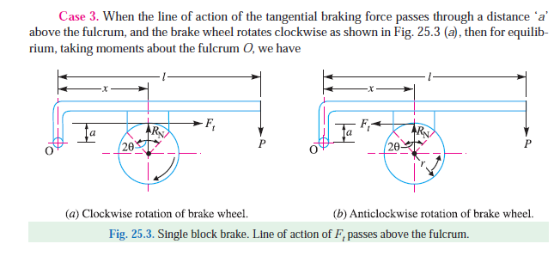

Slide 35
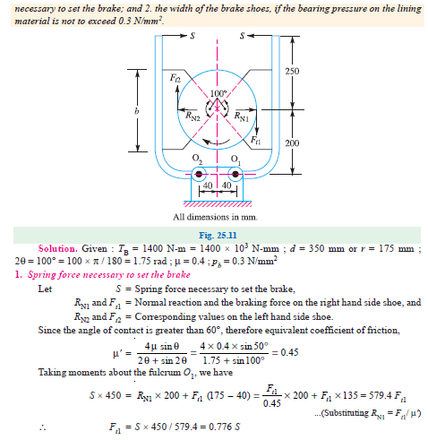

Slide 37
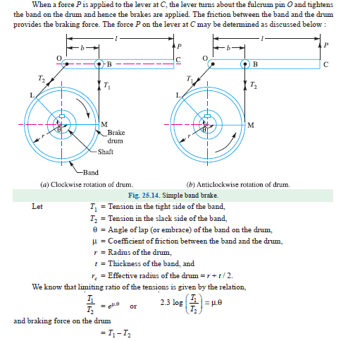

Slide 44
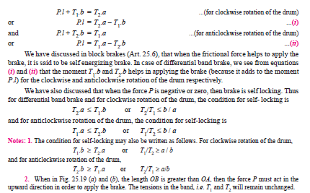

Slide 45
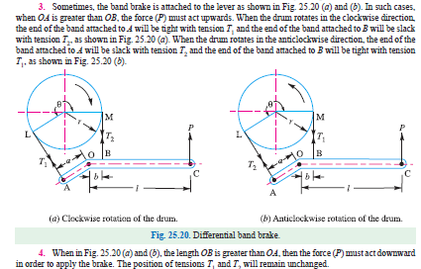

Slide 46
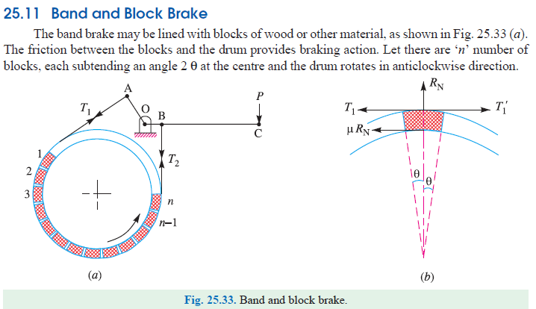

Slide 47
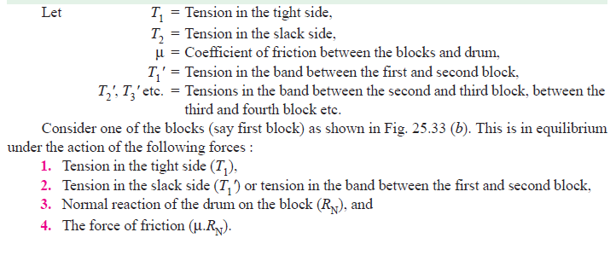

Slide 48
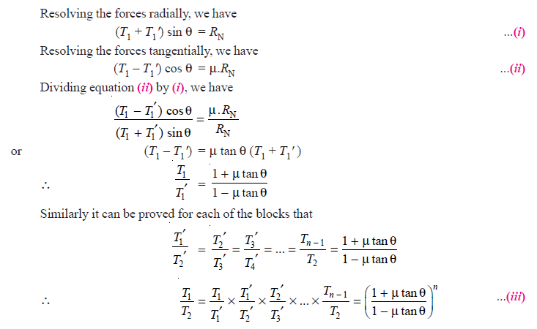

Slide 50
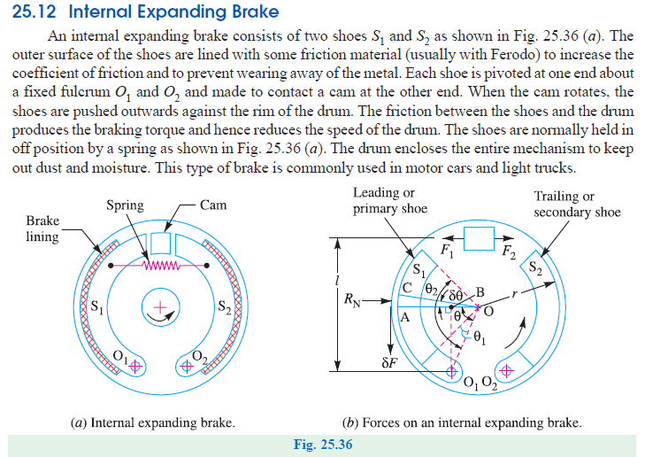

Slide 51
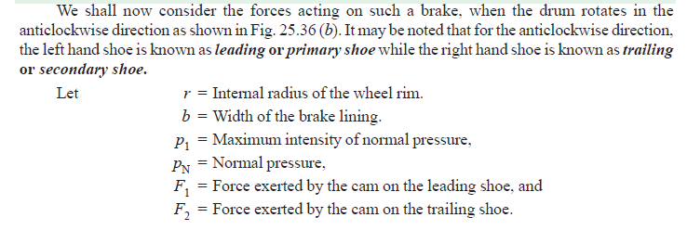

Slide 52
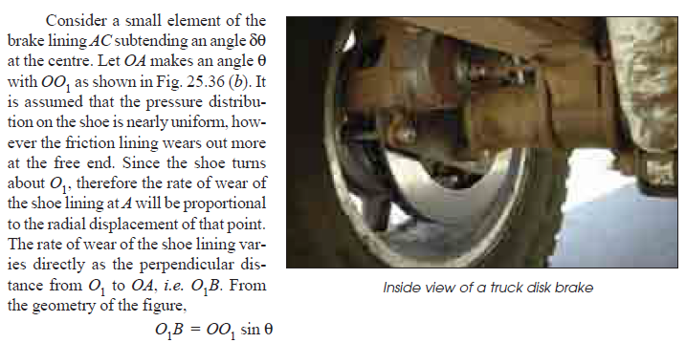

Slide 53
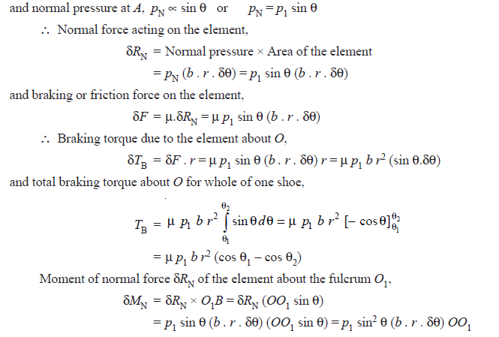

Slide 54
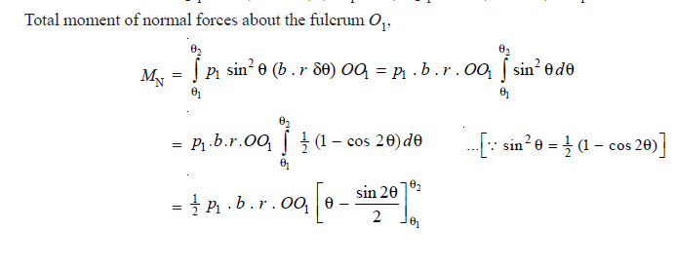
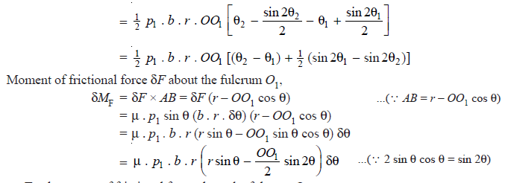

Slide 55
